Slide 1

NORTHSTAR LABS
SaaS product portfolio sample
A product story becomes stronger when the operating system is visible.
Sample case-study deck for a fictional B2B SaaS company.
42%
18 days
3.4x
activation lift
shorter handoff
expansion signal
prototype cohort
ops benchmark
pilot accounts
Northstar Labs / SaaS product portfolio sample
Fictional client sample | Replace placeholder data with sourced client metrics
01 / 08

Slide 2
CLIENT BRIEF
02
Northstar had strong features, but buyers could not see the system.
Core diagnosis
Placeholder brief: sales teams needed a simpler way to explain how planning, usage, and renewal signals connect.
The core issue was not missing capability. It was the absence of a memorable product model.
Feature recall
pre-workshop
Workflow clarity
buyer interviews
Expansion confidence
sales pulse
A scattered workflow became one product operating system, making expansion easier to understand and easier to sell.
Implementation trust
CS notes
Northstar Labs / SaaS product portfolio sample
Fictional client sample | Replace placeholder data with sourced client metrics
02 / 08

Slide 3
AUDIENCE
03
Three buying groups needed one story, not three separate decks.
Each audience kept a distinct proof need, while the case study preserved one product spine.
Audience
Need
Proof
Business result
Economic buyer
Risk reduction
Forecast bridge
Renewal confidence
Operator
Workflow control
Time-to-resolution
Less manual routing
Champion
Team adoption
Before/after path
Internal narrative
Northstar Labs / SaaS product portfolio sample
Fictional client sample | Replace placeholder data with sourced client metrics
03 / 08

Slide 4
SYSTEM MAP
04
The redesign reframed five features as one renewal workflow.
Editable diagram: replace labels with your actual project modules, screens, or service phases.
Capture
Diagnose
Act
Measure
Usage events
Risk clusters
Playbooks
Renewal score
front-line signal
triage logic
team workflow
exec proof
Proof object 01
Proof object 02
Proof object 03
Proof object 04
Adoption link
Adoption link
Adoption link
Adoption link
Northstar Labs / SaaS product portfolio sample
Fictional client sample | Replace placeholder data with sourced client metrics
04 / 08

Slide 5
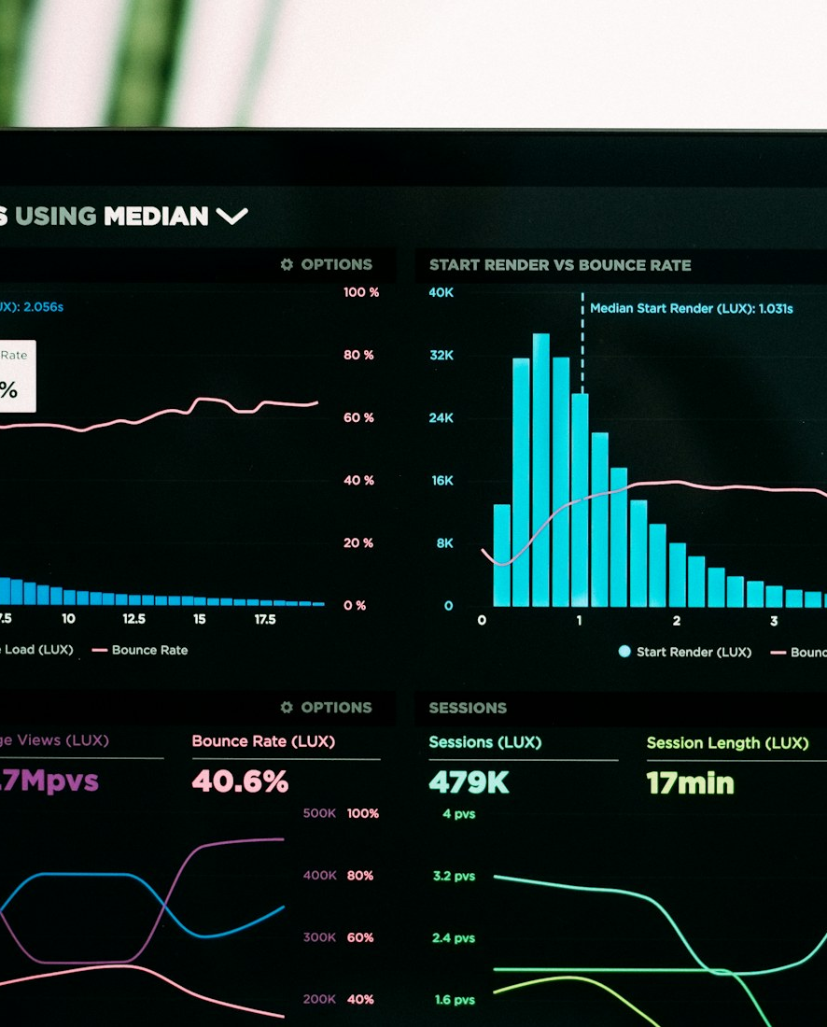
DESIGN WORK
05
The sample visual system made analytics feel like a guided path.
Use this slide to show interface direction, audit frames, workshop artifacts, or production screenshots.
messaging hierarchy
Placeholder frame for project evidence, artifact notes, or image-led proof.
dashboard proof
Placeholder frame for project evidence, artifact notes, or image-led proof.
handoff rules
Placeholder frame for project evidence, artifact notes, or image-led proof.
Northstar Labs / SaaS product portfolio sample
Fictional client sample | Replace placeholder data with sourced client metrics
05 / 08

Slide 6
RESULTS
06
The clearest wins came from faster activation and better handoffs.
Placeholder results for portfolio demonstration. Swap with measured data or label as concept work.
Portfolio proof language
Replace the placeholders with signed-off metrics. If data cannot be shared, frame the outcome as process evidence.
Activation
+42%
01
Narrative workshop
Qualified expansions
+28%
Support deflection
+24%
02
Proof-object system
Renewal readiness
+36%
03
Reusable sales slides
Northstar Labs / SaaS product portfolio sample
Fictional client sample | Replace placeholder data with sourced client metrics
06 / 08

Slide 7
ROADMAP
07
The next phase turns the story into a reusable sales operating kit.
Use as a forward-looking recommendation slide in your portfolio sample.
Week 1
Week 2
Week 3
Week 4
Metric source audit
Case-study interviews
Slide system build
Sales enablement pack
lock claims
extract proof
editable library
handoff
Northstar Labs / SaaS product portfolio sample
Fictional client sample | Replace placeholder data with sourced client metrics
07 / 08

Slide 8
WORK WITH ME
08
I turn messy product information into client-ready presentation systems.
YOUR NAME
Freelance presentation designer
Replace the contact placeholders with your name, role, email, website, and Behance link.
hello@yourname.com
yourportfolio.com
behance.net/yourname
+1 (555) 000-0000
case-study decks
pitch narratives
data visualization
presentation redesign
Northstar Labs / SaaS product portfolio sample
Fictional client sample | Replace placeholder data with sourced client metrics
08 / 08

