Slide 2
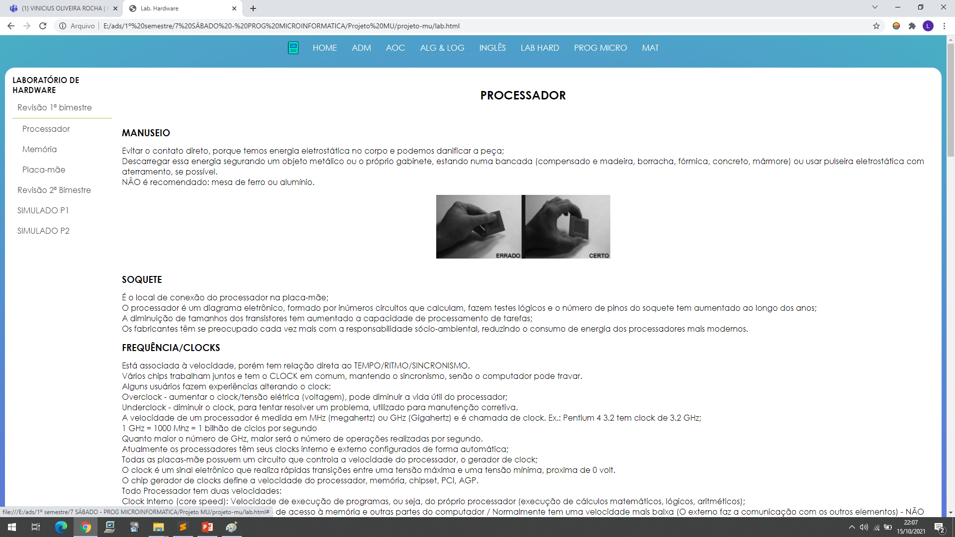



Slide 3

MUral

