Slide 1
National Football League Analysis
By:
Vinisha (D18042)
Praxis Business School, Bangalore

Slide 2
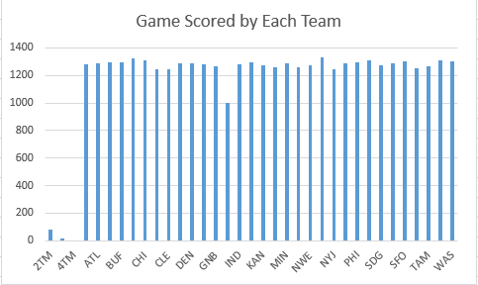
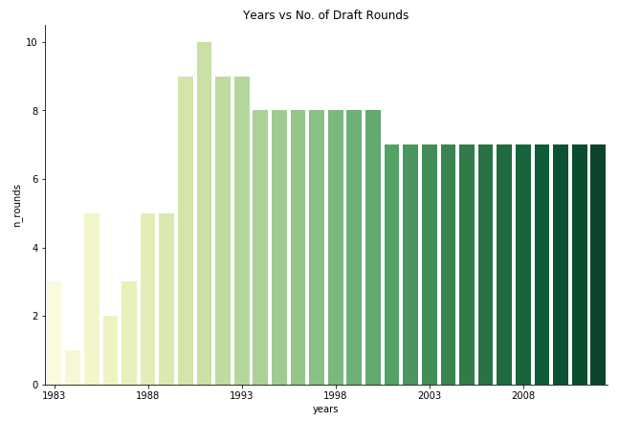
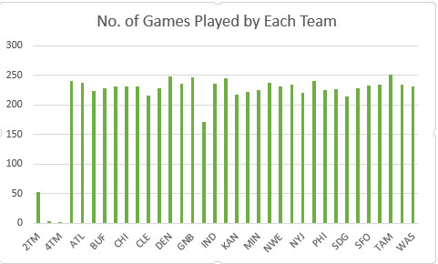
Understanding the Data
EDA:
Dropped irrelevant missing values.
Imputed missing values in some variables with its median value.
Y/A variable has been removed as missing values accounts to 48% of the data.
New variable ‘Month_of_Birth’ has been extracted from ‘DOB’.

Slide 3
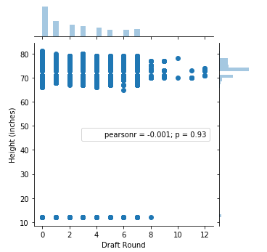
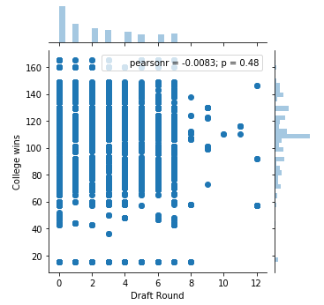
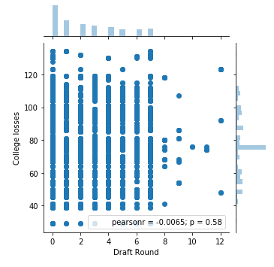
Making the Selection
Feature Selected: College Wins, College Losses, Height, Month of the Player's Birth, HomeTown, Home State
Target Variable : Draft Round
Model: Random Forest
Accuracy: 84.3 %
Insight:
Selected features are predicting Draft Round well.
Draft Round shows high dependency on selected variables.
Pearson’s correlation (p) shown in graphs is high.

Slide 4
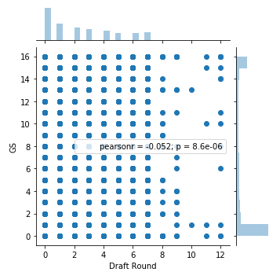
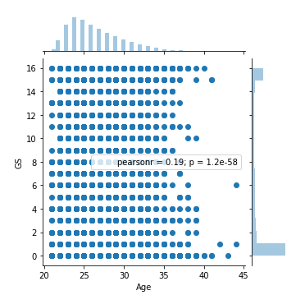
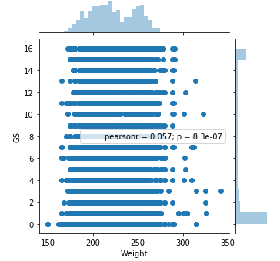
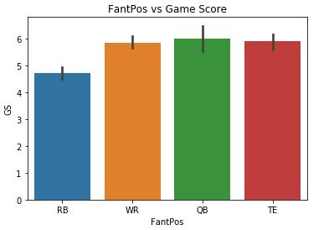
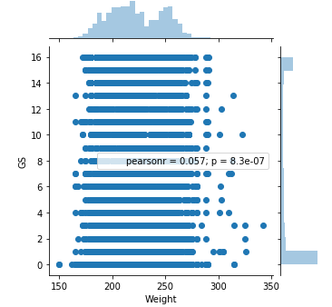
Performance At Work
Feature Selected: Height, Weight, College, Draft round, FantPos,Team (Tm), Home Town, Home State and Age
Target Variable : Game Scrored
Model: Random Forest
Accuracy: 31.8 %
Insight:
Selected features are not predicting game scored well.
Game scored shows very less dependency on selected variables.
Pearson’s correlation (p) shown in graphs is also very small.

Slide 5
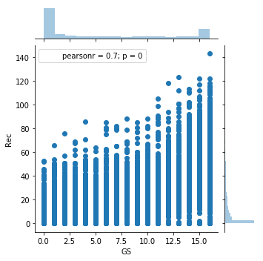
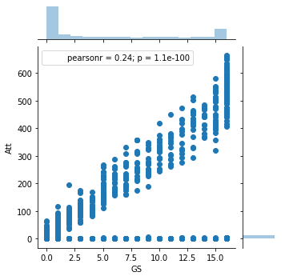
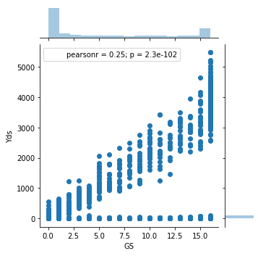
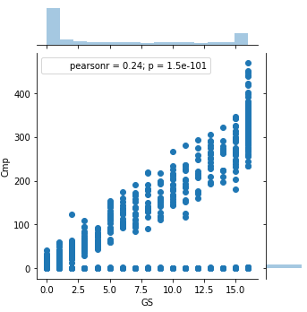
Performance At Work
Feature Selected: Cmp, Att, Yds, TD, Int, Att, Yds, TD, Rec, Yds, Y/R
Target Variable : Game Scrored
Model: Random Forest
Accuracy: 35.6 %
Insight:
Selected features are not predicting game scored well.
Game scored shows very less dependency on selected variables.
Pearson’s correlation (p) shown in graphs is also very small.

Slide 6
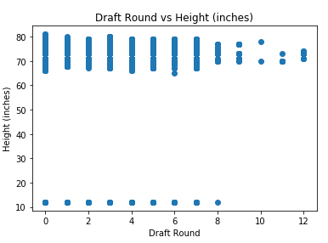
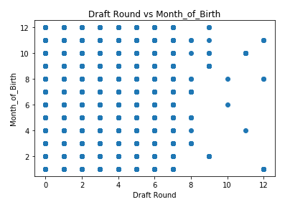
How correlated are these two vaariables:
 | Draft Round | Month_of_Birth | Height (inches)
Draft Round | 1
Month_of_Birth | 0.003011809 | 1
Height (inches) | -0.003603511 | -0.005268148 | 1
Draft Round and Month of the Player's Birth
It can be seen clearly that there is almost no correlation between them.
Very little correlation in there in positive direction.
Draft Round and Player Height
It can be seen clearly that there is almost no correlation between them.
Very little correlation in negative direction.

