Slide 1
Logistic Regression
Causal Inference
Shrestha 2026
Modeling Binary Outcomes with the Logistic Function

Slide 2
Modeling a binary outcome

Slide 3
Question
Predict the probability of good vs. bad health (binary) for older population given:
• College education (yes/no)
• Income level (high/low)
• Insurance status (insured/uninsured)
• Stress level (continuous)
Note: We did this using a LPM in the previous lecture.

Slide 4
Simulation using a known DGP and
True parameters

Slide 5
Data Gen. Process
college
High income
stress
insurance
health
We’ll be using a logistic regression to model health.

Slide 6
Data Generating Process (DGP)
θ₀ = 0.3
Intercept (baseline)
θ₁ = 0.1
College effect
θ₂ = 0.2
High income effect
θ₃ = 0.05
Insurance effect
θ₄ = -1.0
Stress effect
Note: These are logit coefficients, not probability changes as in LPM

Slide 7
Simulation Steps
Start with income and categorize high vs. low income
  Use median value
Generate college (binary) from a binomial dist.
  Probability higher for high income (say, 0.4)
Generate stress index (continuous variable)
  Stress level low for high income
Generate insurance (binary)
H = f(high income, college, stress index, insurance)

Slide 8
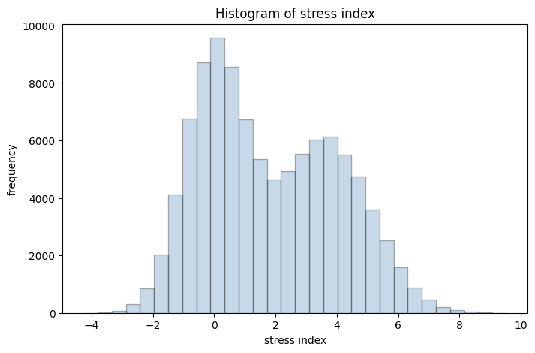
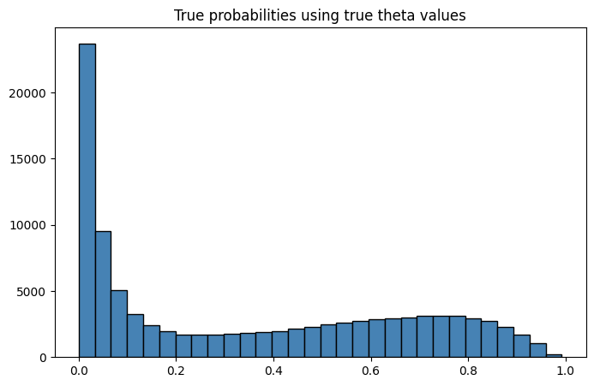
Moving from X and θ to H
1. compute z = Xθ
2. compute p = σ(z)
3. use p in a binomial dist.
to generate H.
- z is the logit
- σ(.) is the logistic function

Slide 9
LPM vs Logistic Regression

Slide 10
Why Not Linear Probability Model?
Linear Probability Model
Logistic Regression
✓ Simple to interpret
✓ Coefficients = marginal effects
✗ No guarantee probabilities
are between 0 and 1
✗ Can produce negative
Probabilities or those > 1
✓ Probabilities always
between 0 and 1
✓ Uses logistic (sigmoid)
function
Note: Coefficients ≠ marginal
effects (must be calculated)

Slide 11
Modeling objective and the logistic function

Slide 12
Primary goal
$p=σ\left(θX\right)$
p → true probabilities (of being in good health)
σ(.) is the logistic function
θ is a vector of true coefficients [0.3, 0.1, 0.2, 0.05, -1]
X → inputs (college, high income, insurance, stress)
We will simulate p using the true coefficients and the DGP.
Probabilities are the building blocks of a binary outcome. We want a model to estimate them.

Slide 13
The Sigmoid (Logistic) Function
$p = sigma\left(z\right) = \frac{1}{1+exp\left(−z\right)}$
• Input (logit):
z = Xθ (linear combination)
• Output:
Probability between 0 and 1
• S-shaped curve:
- Negative z → probabilities < 0.5
- Positive z → probabilities > 0.5

Slide 14
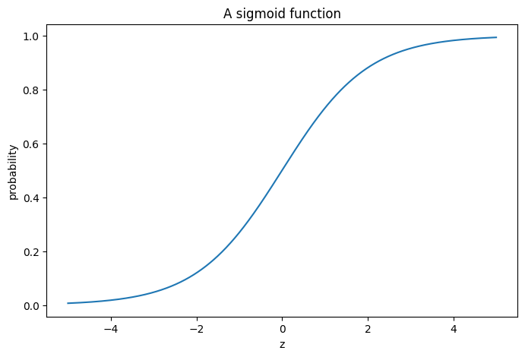

Slide 15
Objectives and the loss function

Slide 16
Objectives
1) Estimate θ using X and y
        logistic and LPM
2) Use θ hats (estimates) to predict probabilities
  Compare logistic vs LPM predictions
3) Calculate marginal effects

Slide 17
From Logits to Probabilities
1
Calculate Logit
z = Xθ (linear combination)
2
Apply Sigmoid
p = σ(z) = 1/(1 + exp(-z))
3
Generate Outcome
y ~ Binomial(1, p)
Key: Probabilities come from the logistic function!

Slide 18
The Loss Function
Cross-Entropy Loss:
$C = −\frac{1}{n}\sum_{i=1}^{n}{\left[y_{i}log\left(\hat{p_{i}}\right)+\left(1−y_{i}\right)log\left(1−\hat{p_{i}}\right)\right]}$
Intuition:
• When y = 1:
High p̂ → low loss | Low p̂ → high loss
• When y = 0:
Low p̂ → low loss | High p̂ → high loss
We don’t have an analytical solution for θ. Need gradient descent.

Slide 19
Gradient and gradient descent algorithm

Slide 20
The Gradient
Gradient = vector of partial derivatives:
$\frac{∂C}{∂θ} = \frac{1}{n}X^{T}\left\{σ\left(Xθ\right)−Y\right\}$
where:
• Xᵀ is (5 × n) matrix
• σ(Xθ) - Y is (n × 1) vector
θₙ = θₒ - η × gradient
Move in opposite direction of gradient to minimize loss

Slide 21
Gradient Descent Algorithm
No closed-form solution → use iterative optimization
1
Initialize θ randomly
2
Set learning rate η and epochs (number of iterations)
3
Calculate gradient: ∂C/∂θ = (1/n)Xᵀ(σ(Xθ) - y)
4
Update: θ ← θ - η × gradient
5
Repeat steps 3-4 until convergence

Slide 22
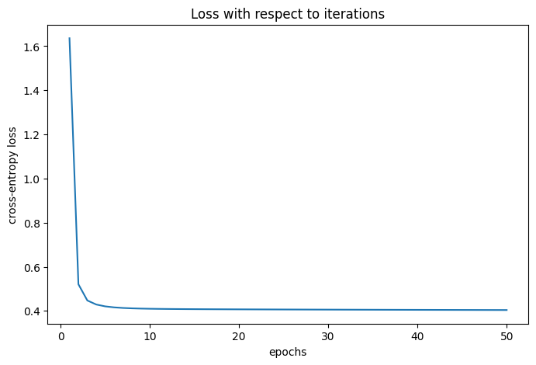

Slide 23
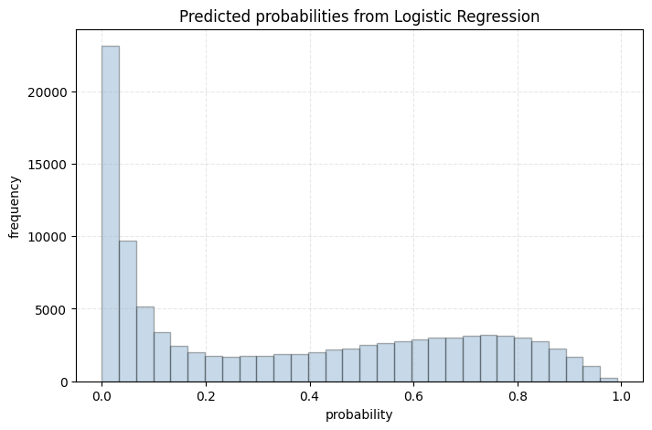
Predicted versus true probabilities

Slide 24
Implementation Results
Parameter | True | Gradient Descent | sklearn
θ₀ (intercept) | 0.3000 | 0.2998 | 0.2997
θ₁ (college) | 0.1000 | 0.1001 | 0.1001
θ₂ (income) | 0.2000 | 0.1999 | 0.1999
θ₃ (insurance) | 0.0500 | 0.0501 | 0.0501
θ₄ (stress) | -1.0000 | -0.9998 | -0.9998
Gradient descent matches sklearn's optimized implementation!

Slide 25
Marginal Effects

Slide 26
Logistic Coefficients ≠ Marginal Effects
LPM:
θ = 0.1 means 10 percentage point increase
Logistic:
θ = 0.1 increases logit by 0.1
Must calculate marginal effect at specific values
Use a benchmark person: effects are going to be w.r.t this person

Slide 27
Example (baseline: no college, low income, uninsured, mean stress):
Variable | Marginal Effect
College | ~2.5 pp
High Income | ~4.8 pp
Insurance | ~1.2 pp
Stress (+1 unit) | ~-2.3 pp

Slide 28
Predicted Probabilities: LPM vs Logistic
LPM Problem
Logistic Solution
• Produces negative
probabilities
• Some predictions > 1
• Violates probability
constraints
✓ All probabilities
between 0 and 1
✓ Matches true DGP
probabilities
✓ Theoretically sound
Logistic regression ensures valid probabilities
and better represents binary outcome processes

Slide 29
Key Takeaways
Logistic regression models binary outcomes using sigmoid function
Probabilities generated via σ(Xθ), then used in binomial process
Loss function: binary cross-entropy (no closed form)
Gradient descent effectively estimates parameters
Coefficients are on logit scale, not probability scale
Must calculate marginal effects for interpretation

Slide 30
Questions?
Logistic Regression | Causal Inference

