Slide 1



YUVA YODHA
Energy Tech Hackathon 2026
SCHNEIDER ELECTRIC
CHALLENGE 04 · SMART MANUFACTURING
MachineSense
Affordable real-time machine health and energy monitoring
for SME manufacturers.
<10%
Live
Explainable
of commercial monitoring cost
machine health + energy data
AI, not a black-box alert
Vinit Shinde (Team Lead)
Harsh Vyavahare
Dipak Mane
Shivam Sapkal
01 / 12

Slide 2



YUVA YODHA
Energy Tech Hackathon 2026
SCHNEIDER ELECTRIC
The Problem -
SME factories run blind on energy and machine health
35–40%
₹15–25k+
~900
of India's total energy is used by industry
cost of a commercial monitoring system
large factories covered by India's PAT energy scheme — SMEs are not
The daily reality for SME manufacturers :
Machines fail without warning — the first sign of trouble is often a breakdown.
Energy waste goes unnoticed until the monthly electricity bill arrives.
No affordable way to know which machine, or which fault, is costing the most.
The "Industry 4.0" barrier: Smart manufacturing requires massive capital and IT infrastructure that SMEs don't have.
Skilled labor shortage: Relying on human intuition to "hear or feel" faults is subjective and unscalable.
Unplanned downtime: A single unexpected breakdown ruins production schedules and delivery deadlines.
Paper-based logging: Data is outdated by the time it reaches the manager's desk.
02 / 12

Slide 3




YUVA YODHA
Energy Tech Hackathon 2026
SCHNEIDER ELECTRIC
Why Existing Approaches Fall Short
Commercial SCADA / monitoring
Government energy schemes (PAT)
Priced for large industry (₹15,000–25,000+ per point). Out of reach for SMEs.
Only covers ~900 large "Designated Consumers." The entire MSME segment sits outside it.
Manual inspection
Basic IoT dashboards
Reactive, not predictive — a technician finds out after something has already gone wrong.
Show raw numbers, but don't explain why an alert fired or what to actually do about it.
03 / 12

Slide 4




YUVA YODHA
Energy Tech Hackathon 2026
SCHNEIDER ELECTRIC
Our Solution — MachineSense
A low-cost sensor node plus an explainable AI engine that tells a factory owner exactly what's wrong, what it's costing, and what to do next.
How it solves the problem
Key differentiator
Retrofits any existing machine — no replacement, no PLC needed.
Costs under ₹2,500 per machine, versus ₹15,000–25,000+ commercially.
Now integrated with Schneider Electric PowerLogic™ meters for enterprise-grade reliability.
Now integrated with Schneider Electric PowerLogic™ meters for enterprise-grade reliability.
Catches mechanical wear and energy waste before the monthly bill or a breakdown reveals it.
Every alert explains itself (which signal, how much) instead of an unexplained warning light — and the system is allowed to act on its own only for safe, reversible actions like switching on a cooling fan.
Sense
Understand
Explain
Act
04 / 12

Slide 5

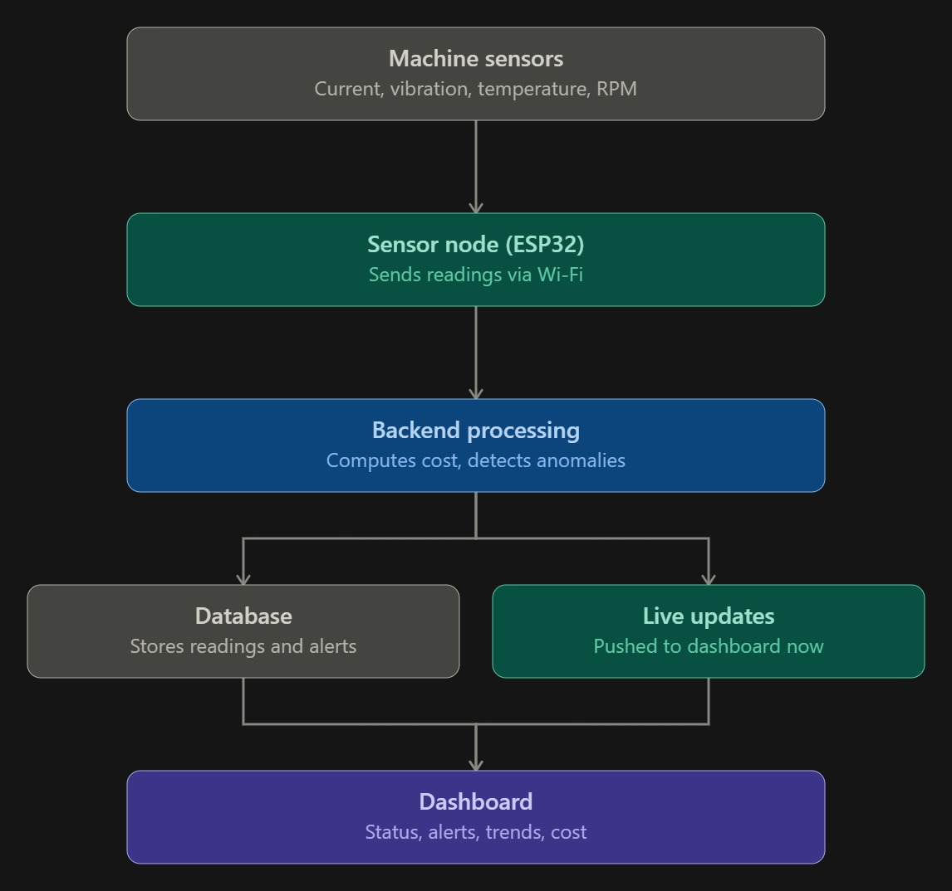



YUVA YODHA
Energy Tech Hackathon 2026
SCHNEIDER ELECTRIC
How MachineSense Works
End-to-end data flow, from the machine to the decision
Machine sensors
Sensor node (ESP32 & Schneider Harmony Hub)
Backend processing
Current, voltage, vibration, temperature, RPM
Sends readings over Wi-Fi / MQTT
Computes cost, runs anomaly detection
Database
Live updates
Stores every reading and alert
Pushed to the dashboard instantly
Dashboard
Status, explained alerts, cost, remaining-life estimate
05 / 12

Slide 6


YUVA YODHA
Energy Tech Hackathon 2026
SCHNEIDER ELECTRIC
System Architecture & Tech Stack
ESP32 Sensors + Schneider PM5000 Modbus Meters
Tech stack
FastAPI backend (HTTP, MQTT + Modbus TCP ingestion)
BACKEND FastAPI, Uvicorn, SQLAlchemy 2.0, Alembic, asyncpg
Anomaly detection + power/cost service
DATA PostgreSQL, MQTT (aiomqtt), WebSockets
ANALYTICS NumPy, SciPy — MAD-based anomaly detection
PostgreSQL + WebSocket broadcast
FRONTEND React 19, TypeScript, Vite, react-router
React dashboard (multi-machine)
TESTING pytest, pytest-asyncio, httpx — 47 tests passing
06 / 12

Slide 7
YUVA YODHA
Energy Tech Hackathon 2026
SCHNEIDER ELECTRIC
Machine Health & Energy Intelligence
Machine health
Energy intelligence
Live cost tracking — Real power, accumulated kWh, and ₹ cost — updated every few seconds.
Vibration — Main signal for catching bearing wear early — ~50% of motor failures start here.
SEC per good unit — Specific Energy Consumption (energy ÷ good units) — the real measure of efficiency, not raw kWh.
Temperature — Rising heat with no load change signals friction or overload.
Day-to-day comparison — Explains output changes using idle time, slow-running periods, and health alerts — not just a number.
Current + RPM — A machine drawing more current or running slower than baseline hints at mechanical resistance.
“Day 2 made 30% fewer good units than Day 1 despite equal run time — 42 minutes of unplanned stops, correlated with a vibration warning.”
Detection method: median + MAD statistical baseline, with debounce logic so a single noisy reading never fires a false alert.
07 / 12

Slide 8



YUVA YODHA
Energy Tech Hackathon 2026
SCHNEIDER ELECTRIC
The AI Decision Engine
What makes this genuinely different from a sensor-plus-dashboard project
Baseline
Detect
Explain
Severity
Act
Inform
Alert
Automate
Shown on the dashboard only — all readings normal.
A person is notified; the decision to act stays human.
Safe, reversible action only — e.g. auto on/off a cooling fan when a machine overheats, saving energy, never touching the core machine itself.
Why it's novel: most hackathon monitoring projects stop at a red/green light. MachineSense explains every alert in plain language and is the only tier allowed to act — safely — on its own.
08 / 12

Slide 9
YUVA YODHA
Energy Tech Hackathon 2026
SCHNEIDER ELECTRIC
Live Dashboard — Working Prototype
09 / 12

Slide 10

YUVA YODHA
Energy Tech Hackathon 2026
SCHNEIDER ELECTRIC
Feasibility & Viability
Cost per machine
Scalability
MachineSense Hybrid Node (ESP32 + Schneider)
● Already supports multiple machines, each with its own independent baseline.
₹1,800 – 2,500
● A fleet overview page lets one operator watch an entire factory at a glance.
Commercial monitoring system
₹15,000 – 25,000+
● Roadmap: one sensor inferring many machines (NILM), and shared learning across whole factory clusters via federated learning — without any factory's raw data leaving its building.
Open-source, free-to-use stack: FastAPI, React, PostgreSQL, MQTT — no licensing cost at any scale.
10 / 12

Slide 11


YUVA YODHA
Energy Tech Hackathon 2026
SCHNEIDER ELECTRIC
Impact & Benefits
8–12×
Early
Lower
cheaper than commercial monitoring, per machine
fault detection, days before failure — not after
unplanned downtime and energy waste
Who benefits
SDG alignment
SME factory owners
Affordable visibility previously reserved for large industry.
Machine operators
Clear, explained alerts instead of unexplained red lights.
India's energy goals
A path for efficiency gains to reach the MSME segment PAT doesn't cover.
SDG 7 — Affordable & Clean Energy
Cuts industrial energy waste at the source.
SDG 9 — Industry, Innovation & Infrastructure
Brings affordable smart-monitoring infrastructure to SMEs.
SDG 12 — Responsible Consumption
Reduces wasted energy and material per unit produced.
11 / 12

Slide 12




YUVA YODHA
Energy Tech Hackathon 2026
SCHNEIDER ELECTRIC
What's Next
Remaining-useful-life
Federated learning
On-device AI (TinyML)
Digital twin view
LSTM/Transformer models to predict days until service, not just Normal/Warning.
Factories improve one shared fault-detection model without ever sharing raw data.
Fault detection running on the sensor node itself — works even without internet.
A live visual model of the machine, not just line charts.
Every sensor, every model, and every automated action exists to close the gap between “something changed” and “exactly why, and what to do about it.”
12 / 12

