Slide 1
LOAN AMOUNT PREDICTION - REGRESSION ANALYSIS
By Vinit H.
vinithorakeri@gmail.com
+916366122333

Slide 2
Why ML for Loan Sanction Prediction ?
Price Prediction is a useful feature for consumers as well as businesses. A price prediction tool motivates users to engage with a brand or evaluate offers in order to spend their money wisely. Price prediction enables businesses to set pricing in a manner that builds customer engagement and loyalty. With Machine Learning (ML) a price prediction problem is formulated as a regression analysis which is a statistical technique used to estimate the relationship between a dependent/target variable and single or multiple independent (interdependent) variables. In regression, the target variable is numeric.
Choosing the right algorithm is essential to predict the Loan sanction amount since the algorithm must be able to capture the nature of the data and provide accurate estimate.

Slide 3
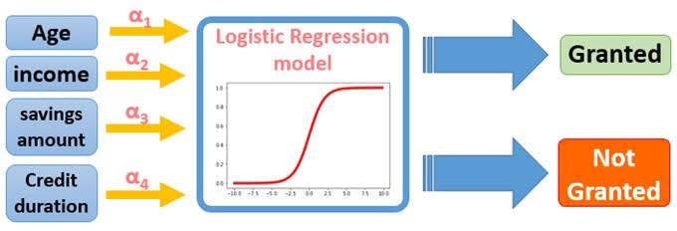
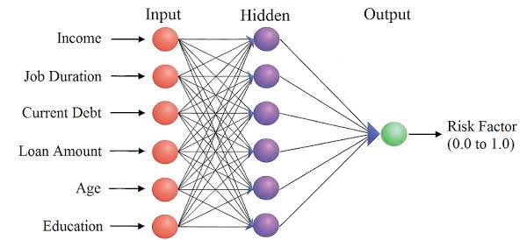

Slide 4
SOLUTION
A Machine learning model that calculates Loan amount that can be disbursed and also detects the factors that influences the eligible amount and making sure that factors does not introduce inequality and/or bias in the decision by appropriate figure re-engineering.
The dataset includes columns which contain details of the applicants who have applied for loans, some of the columns are just basic information and don’t play any role in deciding the loan amount, Such columns can be discarded.

Slide 5
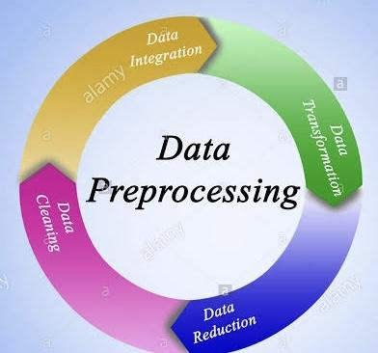
Data Preprocessing
The training dataset is of the shape 30000 x 24.
The columns such as Customer ID, Gender, Name can be ignored as they don’t play a major role in deciding the loan amount.
The Columns such as ‘Income (USD),Income Stability, Profession, Current Loan Expenses (USD), Expense Type 1, Expense Type 2, Dependents, Credit Score, No. of Defaults, Has Active Credit Card, Property ID, Property Age, Co-Applicant, Property Price’ play a vital role in deciding the fitment %.
The fields of the dataset consists of Null Values, we can handle the null values by filling the null values with mean or using probability distribution.

Slide 6
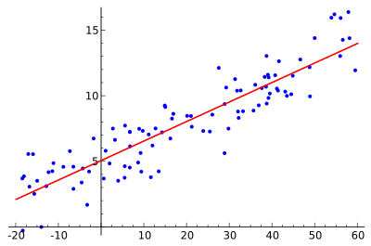

FIT MODELS - Regression Models
Multiple linear regression (MLR), also known simply as multiple regression, is a statistical technique that uses several explanatory variables to predict the outcome of a response variable. The goal of multiple linear regression (MLR) is to model the linear relationship between the explanatory (independent) variables and response (dependent) variable.
In essence, multiple regression is the extension of ordinary least-squares (OLS) regression because it involves more than one explanatory variable.
y = the predicted value of the dependent variable
B0 = the y-intercept (value of y when all other parameters are set to 0).
B1X1= the regression coefficient (B1) of the first independent variable (X1) (a.k.a. the effect that increasing the value of the independent variable has on the predicted y value.

Slide 7
RESULTS - MODEL FITMENT PREDICTION
The Model gives a high accuracy for the Test Dataset, this shows that there is no Outlier influence or Any other kind of Biases that affects the model performance.
Thus,
Financial institutions begin to embrace AI technologies, ML approaches combined with other external factors to decide whether loan has to be sanctioned or not to a particular applicant, if loan is to be given, considering many factors we can alo accurately predict the exact amount that a candidate is eligible for so that there won’t be any cases of default.

