Slide 1
provide_insights_to_executive_in_telecom_domain

Slide 2
Case senario
AtliQo is one of the leading telecom providers in India and launched its 5G plans in May 2022 along with other telecom providers.
However, the management noticed a decline in their active users and revenue growth post 5G launch in May 2022. AtliQo’s business director requested their analytics team to provide a comparison report of KPIs between pre and post-periods of the 5G launch. The management is keen to compare the performance between these periods and get insights that would enable them to make informed decisions to recover their active user rate and other key metrics. They also wonder if they can optimize their internet plans to get more active users. Peter Pandey, a junior data analyst, is assigned to this task.

Slide 3
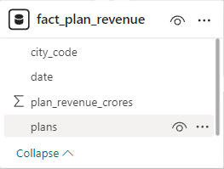
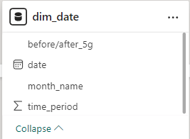
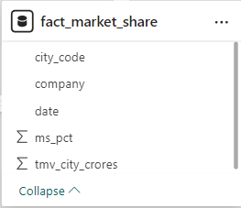
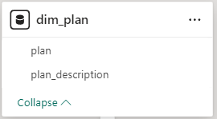
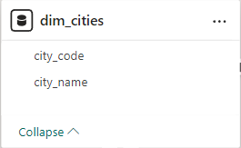
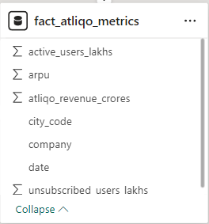
Data Overview

Slide 4
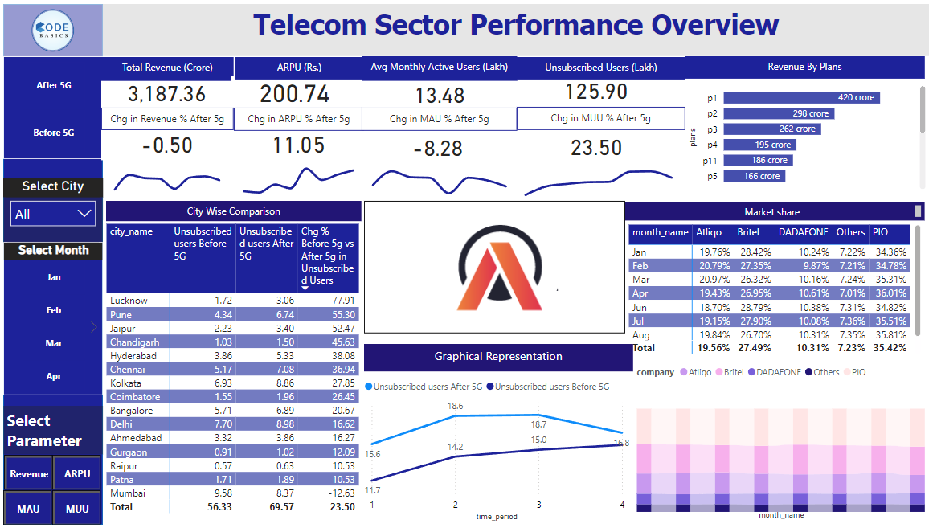
We are going to use Power BI for cleaning data, creating visuals, and extracting meaningful insights.
After cleaning the data, we went through the mock-ups shared with us.
After reviewing the mock-ups, we created useful measures using DAX.
We then used these measures to create visuals.
With the help of these visuals, we created an interactive dashboard.
This dashboard will help us understand performance.
Now, let's see each visual one by one.

Slide 5
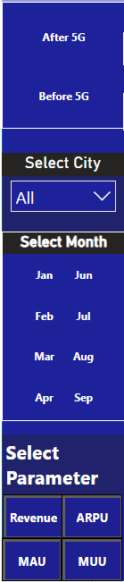
Use these filters to check performance before and after the launch of 5G .
Select the city for which you want to see the performance.
This is the filter bar, where you can select the month, city, and parameters to get the exact information that you need
Select the month to see the performance for that month.
These are the important buttons named Revenue, ARPU, MAU, and MUU to select parameters for the matrix and graph. ARPU means Average Revenue Per User, MAU means Monthly Active Users, and MUU means Monthly Unsubscribed Users.

Slide 6
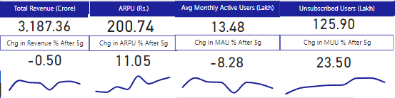
These are the important KPIs that top-level management wants.
The first one is the total revenue in crores from January to September.
The second one tells us how much the company earns from each user in rupees.
The third one is the count of average active users in the city.
The last one is the count of unsubscribed users.
The second line tells us the percentage change after 5G.

Slide 7
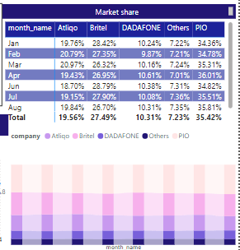
This shows us which company leads in the market in a particular month.

Slide 8
Insights
KPIs show us dropdown in revenue and active users after 5G, with an increase in unsubscribed users, which is not good for the company.
P1 plan is users' favorite plan in both parts, but P11 plan's popularity drops after 5G.
There are cities like Chandigarh, Ahmedabad, Chennai, and Gurgaon where Atlio is giving tough competition to Britel for the 2nd place in market share.
There are also cities like Hyderabad and Mumbai where our performance is linear, but the interesting part is in Patna, Lucknow, and Pune where there is higher competition.
The revenue line does not show much difference; only the ARPU line shows a positive number, which helps the company avoid significant losses.

Slide 9
Target High Churn Areas:
Focus on Pune, Lucknow, and Hyderabad for reducing high unsubscribe rates post-5G.
Conduct surveys to understand churn reasons and address them promptly.
Customer Retention Strategies:
Implement loyalty programs, enhance customer service, and offer personalized offers.
Focus on retaining existing customers through targeted retention initiatives.
Enhance Plan Offerings:
Analyze successful plans like p1 with 420 crore revenue and replicate features.
Consider bundling services and adjusting pricing strategies for competitiveness.
Improve Customer Experience:
Invest in network quality improvements, especially in high churn cities.
Enhance customer support services with multi-channel support options.

Slide 10
Focus on Revenue Growth:
Leverage increased ARPU post-5G by introducing premium services.
Identify upselling and cross-selling opportunities for existing customers.
Marketing and Promotion:
Develop targeted marketing campaigns highlighting 5G benefits in growth regions.
Gather and analyze customer feedback to tailor marketing messages effectively.
Market Share Expansion:
Monitor competitors’ strategies closely and adjust tactics to increase market share.
Form strategic partnerships to offer bundled services and attract new customers.
Data-Driven Decision Making:
Utilize dashboard insights to monitor trends and make informed decisions.
Implement predictive analytics to anticipate customer behavior and growth opportunities.
Innovative Services:
Develop 5G-specific offerings like IoT solutions and smart city initiatives.
Integrate latest technology trends to provide cutting-edge services to customers.

