Slide 1
Solo Squad
Clothing Store
Vinit Mohanbhai Dabhi
8804874

Slide 2
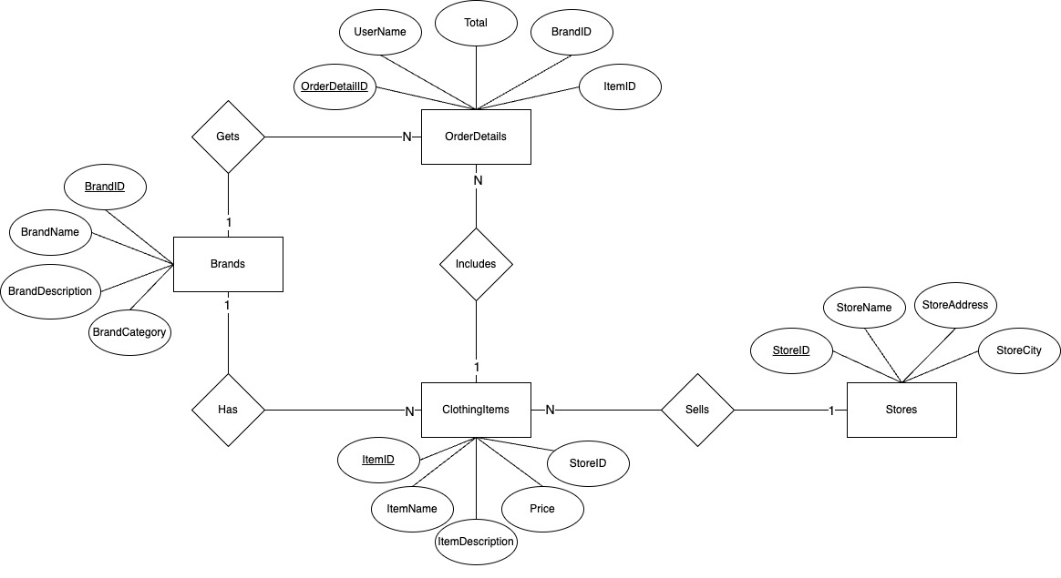
ER - Diagram

Slide 3
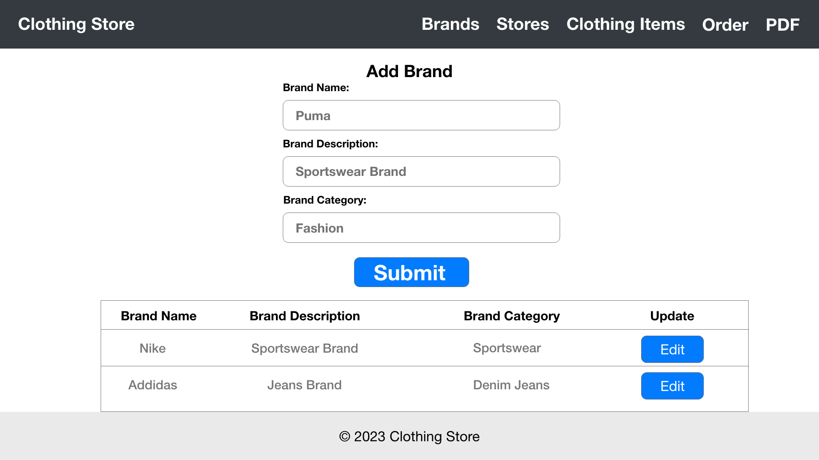
Wireframe

Slide 4
PDF Generate
Average spent amount by each user on our platform
Brands popularity with how many items they listed
Top 3 users who spent the maximum amount for shopping

Slide 5
Thank You

