Slide 1

Dense Layer 1
Input
Convolutional Layer 1
Dense Layer 2
Max Pool Layer 1
Convolutional Layer 2
Flatten
Max Pool Layer 2
Output
mBT
(2,2) filter
(2,2) filter
32 (3,3) filter
1024 neurons
LxLx3
16 (6,6) filter
512 neurons

Slide 2
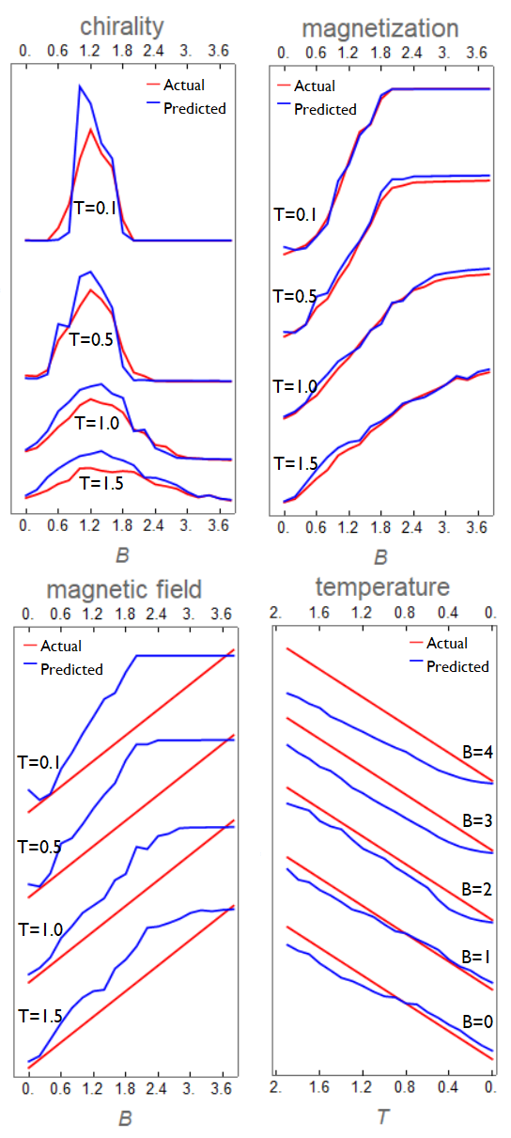
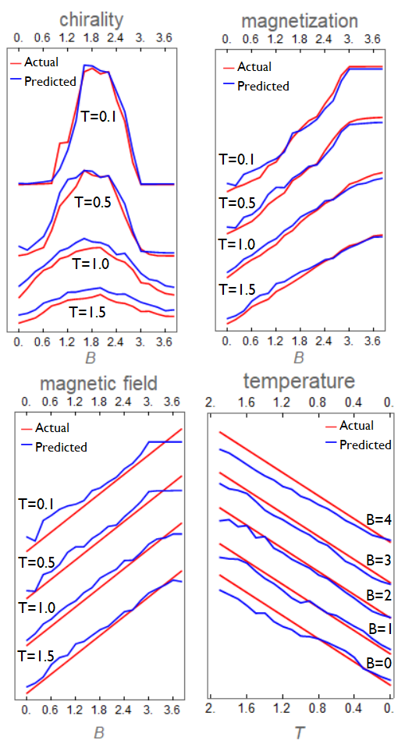
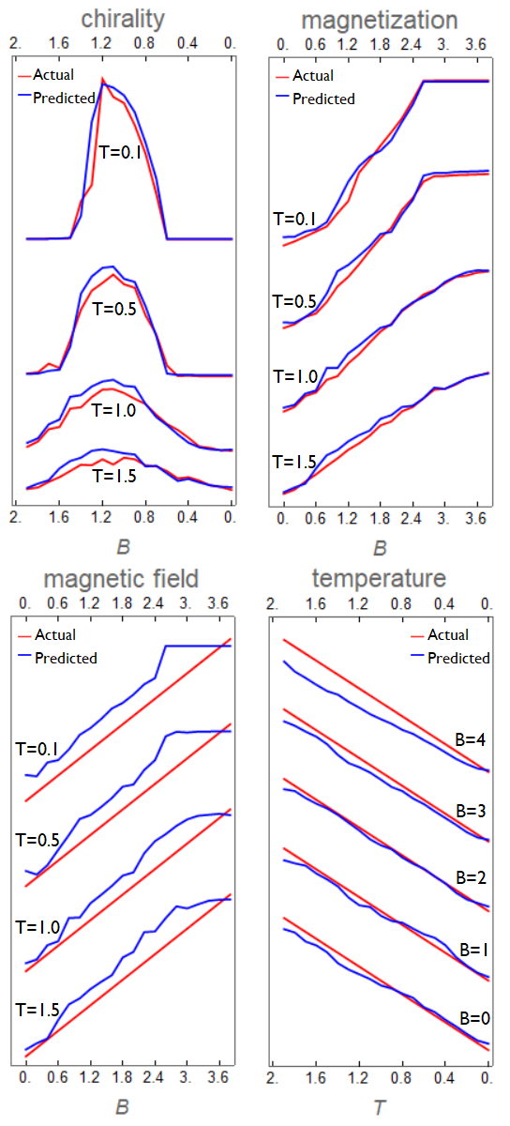
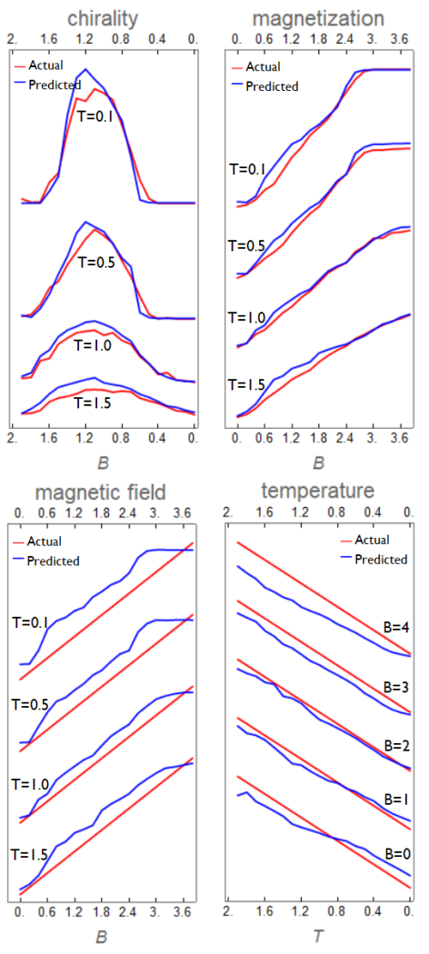
(K=2, p=1)
(K=1, p=0.5)
(K=1, p=1)
(K=2, p=0.5)

