Slide 1


Weather Forecast Management System
Using Fast API, SQL, and MongoDB

Slide 2

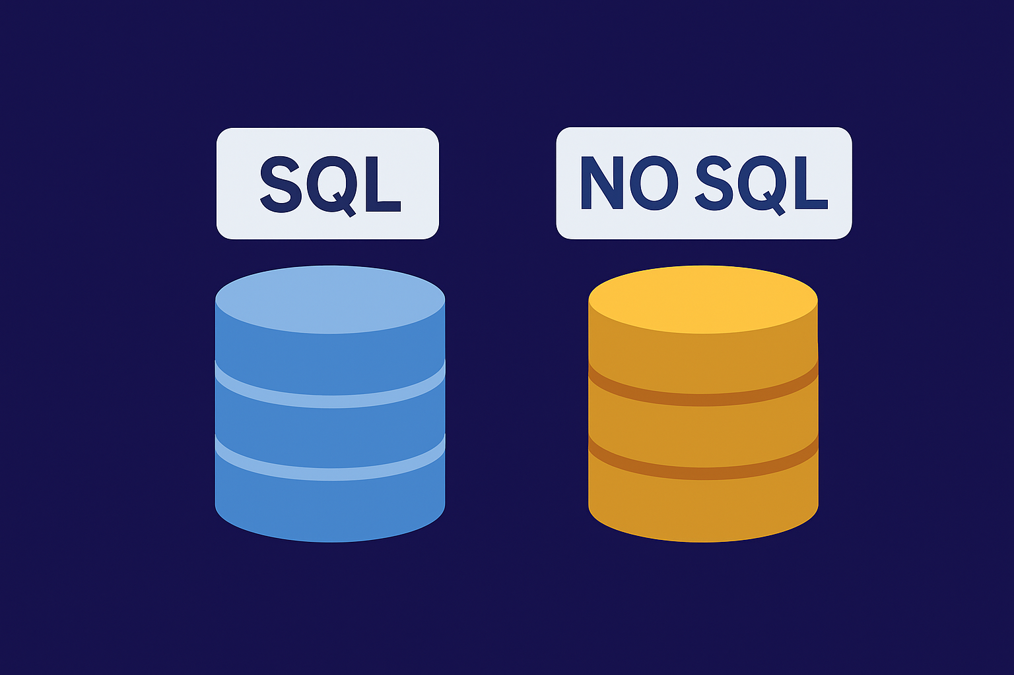

Agenda
Project Overview
Tech Stack
Architecture
Database Design
API Endpoints
Data Flow
Benchmarking SQL vs MongoDB
Optimizations
Results
Conclusion
Weather Forecast Management System

Slide 3
Project Overview
The Weather Forecast Management System collects, stores, and retrieves weather data.
Built with Fast API backend.
Uses SQL (MySQL) for structured storage.
Uses MongoDB for flexible, fast document storage.
Benchmarks SQL vs MongoDB performance.
Weather Forecast Management System

Slide 4
Tech Stack
Fast API - API framework
MySQL with SQL Alchemy ORM
MongoDB with PyMongo
External Weather API integration
Python 3.13
Weather Forecast Management System

Slide 5
System Architecture
User requests weather data via API.
Data fetched from external API.
Stored in both SQL and MongoDB.
Queries benchmarked between SQL & Mongo.
Weather Forecast Management System

Slide 6
Database Design - SQL
Table: WeatherForecast
• id (Primary Key)
• city
• time (datetime)
• temperature
• description
Weather Forecast Management System

Slide 7
Database Design - MongoDB
Collection: weather_forecast
{
city: string,
time: datetime,
temperature: float,
description: string
}
Weather Forecast Management System

Slide 8
API Endpoints
GET/ → Health Check
GET/weather/{city} → Fetches weather forecast for a city
GET/weather/multiple → Fetches weather forecast for multiple cities
POST /weather/save→ Fetch & save weather forecast in JSON file
Weather Forecast Management System

Slide 9
API Endpoints
GET/reports → Loads the JSON
DELETE/reports/{city} → deletes a city’s weather report from the JSON
GET /benchmark/{city} → Compare SQL vs Mongo performance.
Weather Forecast Management System

Slide 10
Data Flow
1. Request received at FastAPI.
2. Weather API called to fetch forecast.
3. End points can be checked in POSTMAN.
4. Data stored in MySQL & MongoDB.
5. Benchmark endpoint compares query times.
Weather Forecast Management System

Slide 11
Sample Benchmark Result
{
sql_time: 0.010 sec,
mongo_time: 0.041 sec,
sql_records: 8,
mongo_records: 8
}
Observation: SQL faster in small dataset.
Weather Forecast Management System

Slide 12
Results & Insights
• SQL generally faster for small datasets.
• Mongo scales better with large datasets.
• Indexing improved Mongo performance.
• Dual DB approach ensures flexibility.
Weather Forecast Management System

Slide 13
Conclusion
Successfully built Fast API-based weather system.
Stored forecasts in SQL & Mongo.
Benchmarked performance differences.
Learned strengths of relational vs NoSQL.
Weather Forecast Management System

Slide 14
Thank You

