Slide 1


Build a Personalized Online Course Recommender System with Machine Learning
Vinicius Torres
15/12/2022

Slide 2

Outline
Introduction and Background
Exploratory Data Analysis
Content-based Recommender System using Unsupervised Learning
Collaborative-filtering based Recommender System using Supervised learning
Conclusion
Appendix

Slide 3
Introduction
The main objective of this analysis was to provide Data Science course’s recommendations based on recorded information on the user’s preferences using both, supervised and unsupervised learning.

Slide 4
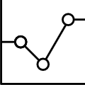
Exploratory Data Analysis

Slide 5
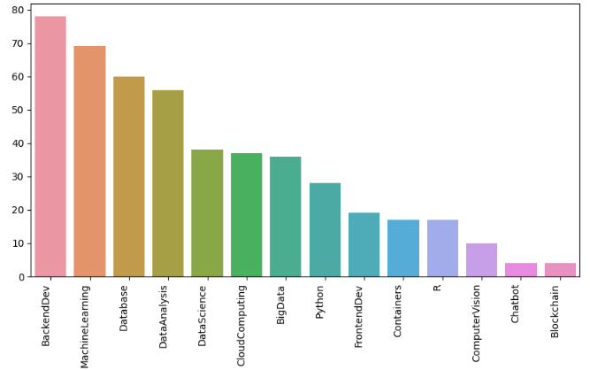
Course counts per genre
BackEndDev, Machine Learning and Database are the topics with the higher number of courses.

Slide 6
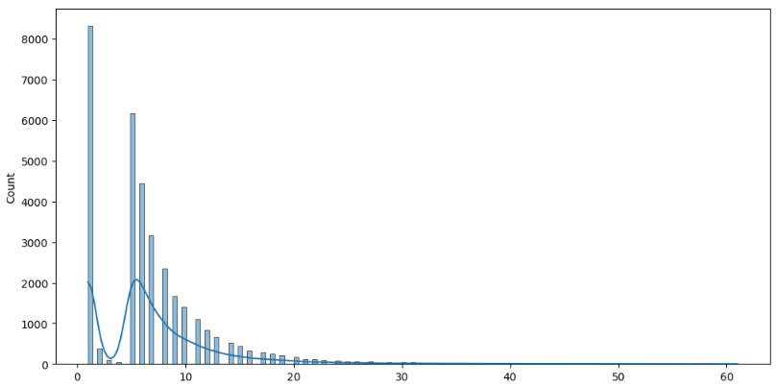
Course enrollment distribution
Most courses have lower enrollment (less than 10) and fewer courses have higher enrollment.

Slide 7
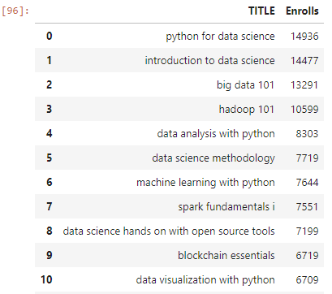
10 most popular courses
Courses with a more general propose seems to be more popular than specifics one.

Slide 8
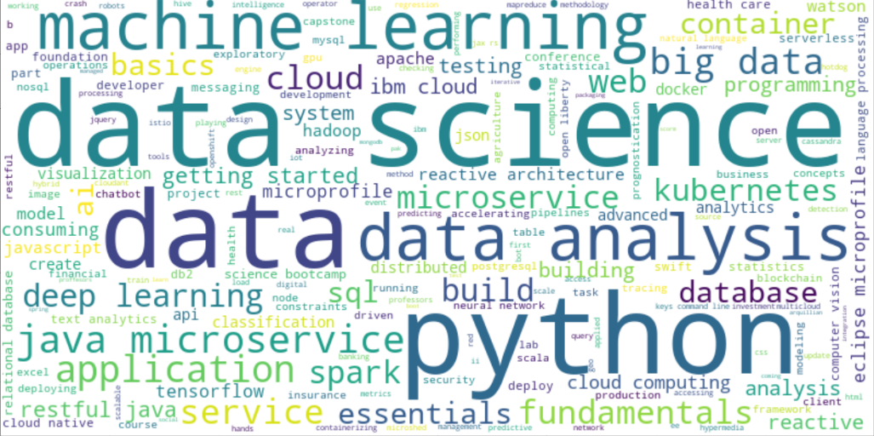
Word cloud of course titles
Data Science, Machine Learning and Python are the most frequents words in the course's titles

Slide 9
Content-based Recommender System using Unsupervised Learning
Cluster2
Cluster1

Slide 10
Flowchart of content-based recommender system using course similarity
If yes, then reccomend the course
Build a Similarity Matrix from each Courses BoW’s Combination.
iterate each unselect course and check if your similarity with a user interested course is above a threshold.
.
choose user interested courses

Slide 11
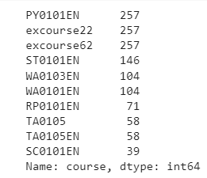
Evaluation results of course similarity based recommender system
Threshold to consider similar courses: 60%
On average, 1.985 new/unseen courses have been recommended to each user
Top Recommended Courses and Frequency

Slide 12
Flowchart of clustering-based recommender system
Get profile vectors for each user and course topics
Make Recommendation based on popular courses from each cluster
PCA to reduce dimensionality
Standarlize the data
Apply Kmeans

Slide 13
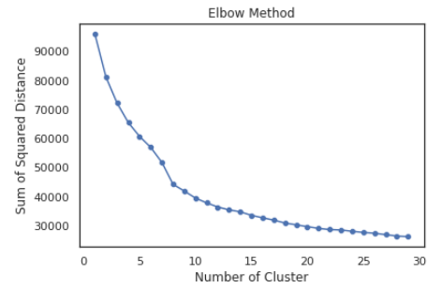
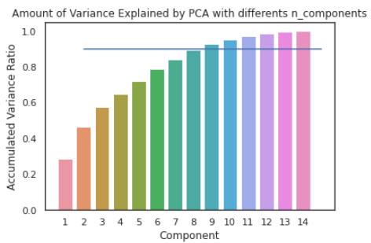
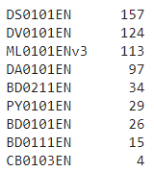
Evaluation results of clustering-based recommender system
Top Recommended Courses and Frequency
Number of Clusters for Kmeans: 10
Number of Components for PCA: 9 (Explain 90% from the variance)
Threshold to consider a course popular: > 100 enrollments
On average, 0.599 new/unseen courses have been recommended to each user

