Slide 1
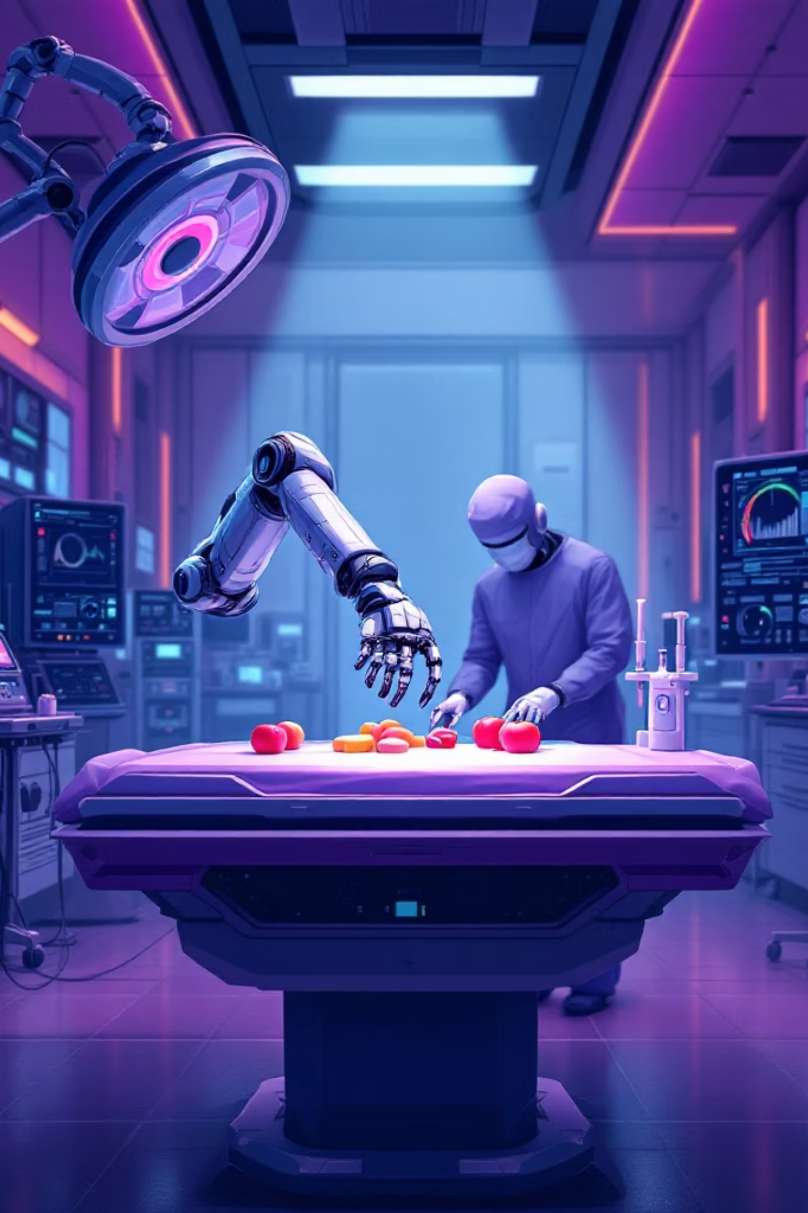

Real-Time Video Segmentation for Autonomous Robotic Manipulation
Vinith Reddy

Slide 2




Project Overview
Objective
Input
Enable autonomous robotic assistance in surgery through real-time semantic segmentation of surgical scenes
30Hz RGB video stream from daVinci Surgical System performing object manipulation tasks
Output
Binary segmentation masks highlighting robot arms and manipulated objects for imitation learning

Slide 3
Why This Matters
The Challenge
Our Solution
Current daVinci Surgical System operates under full teleoperation, limiting scalability. Automating the third arm enhances surgical dexterity but requires robust, real-time perception.
Lightweight U-Net trained on SAM2-generated masks, achieving 30Hz inference while maintaining 95.6% Dice score accuracy
The Gap
Existing zero-shot methods like SAM2 offer high-quality masks but are too slow (1.6 FPS). Classical CV techniques are fast but fail to generalize due to occlusions and lighting variations.

Slide 4


Dataset & Tasks
Collected using daVinci Surgical Robot at Stanford Robotics Center, 30Hz video at 576×324 resolution
Object Transfer Task
Object Shifting Task
Two arms: one picks up object, passes to second arm. 100 demonstrations, 450 frames each
Three arms synchronously move objects to bowl. 70 demonstrations, 600 frames each

Slide 5
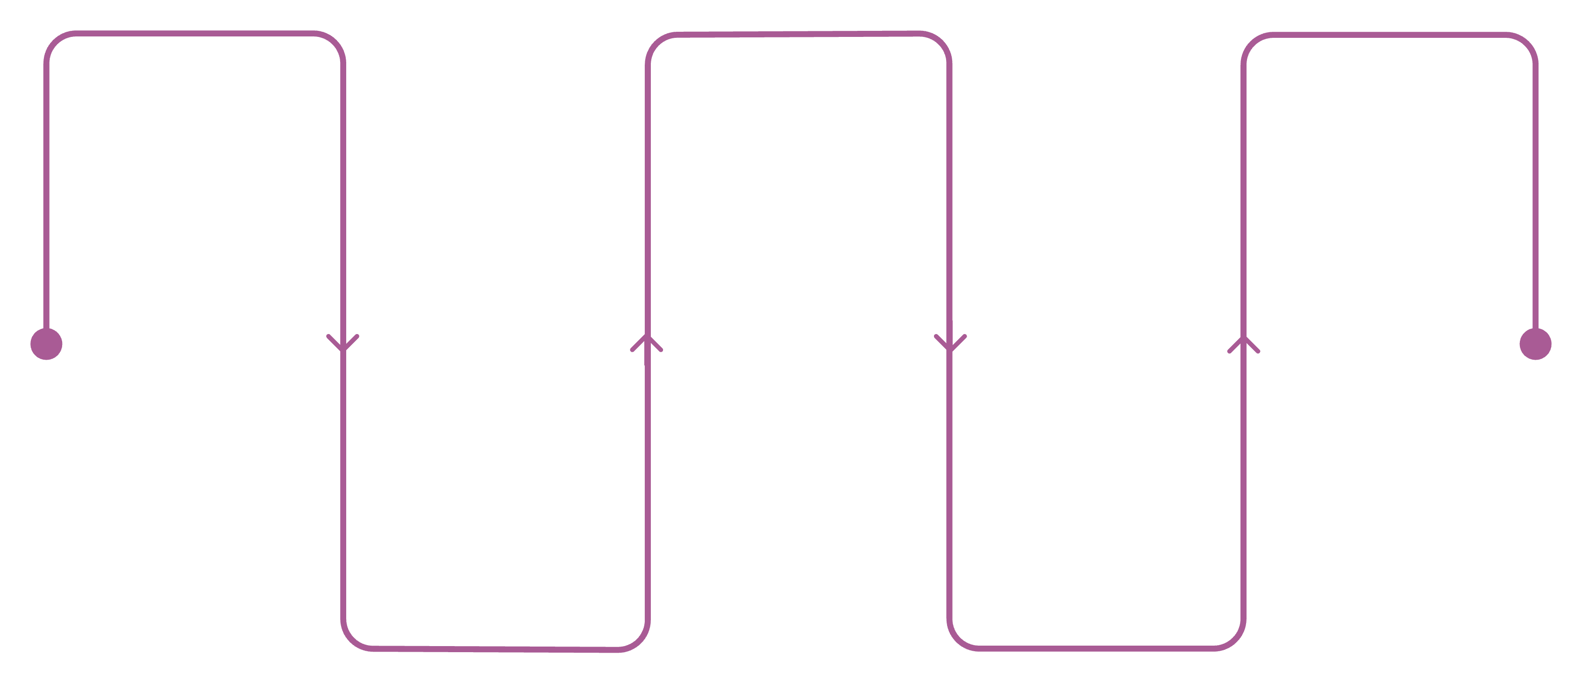
Two-Stage Pipeline
SAM2 Masking
Dataset Assembly
Real-Time Inference
Manual prompts on first frame
Compile high-quality masks and images
Deploy U-Net for live video masks
Mask Propagation
U-Net Training
Cross-frame attention over 600 frames
Train lightweight model on 256×256 data

Slide 6
Baseline Methods Tested
Classical Computer Vision
CLIPSeg (Zero-Shot)
SAM2 (Foundation Model)
HSV thresholding attempted for object detection. Failed due to arms blending with environment, noisy inconsistent masks, no temporal consistency
Natural language prompts produced coarse masks. Unreliable prompt tuning for surgical classes under-represented in training corpus
High-quality masks but 600ms per frame (1.6 FPS). Manual initialization required, infeasible for real-time robotic control

Slide 7
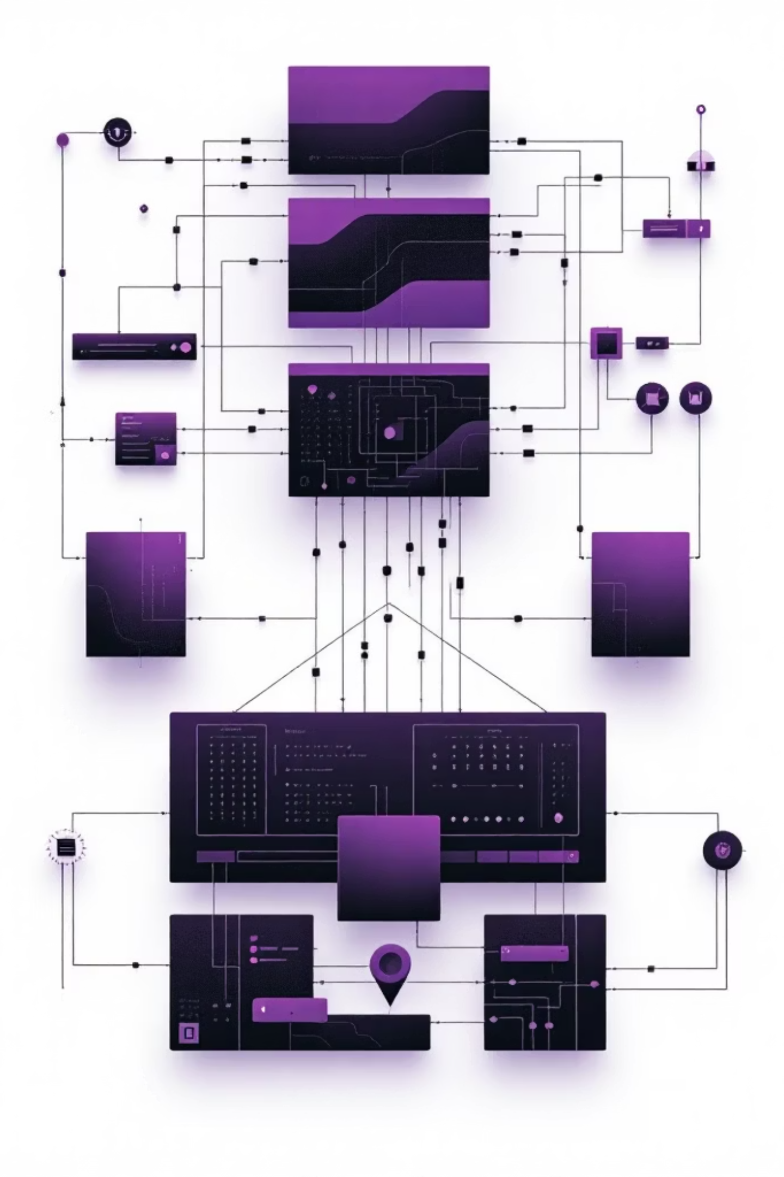
U-Net Architecture
Encoder-Decoder Design
Training Details
Two convolutional blocks with 3×3 convolutions and ReLU activations
MaxPooling for spatial downsampling
Bottleneck layer with 256 channels
Transposed convolutions for upsampling
Skip connections preserve spatial details
Input: 256×256 RGB frames
Loss: Binary Cross-Entropy
Optimizer: Adam (1e-4 learning rate)
Batch size: 4
Convergence: 60 epochs

Slide 8




Qualitative Results
U-Net segmentation outputs match SAM2 quality (95.6% Dice), enabling real-time deployment at 30Hz for closed-loop robotic control

Slide 9




Future Directions
Imitation Learning
Integrate masks into policy networks controlling third robotic arm for autonomous assistance
Depth Estimation
Estimate depth from RGB sequences to provide richer inputs for manipulation policies
Subtask Recognition
Video classification to predict specific surgical subtasks for intelligent assistance

