Slide 1

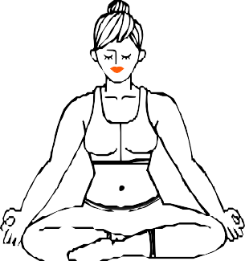


YOGALYZE
An ai powered Yoga trainer

Slide 2
Why yoga is important?
Yoga is important for a variety of reasons, as it offers benefits for both physical and mental well-being. Here’s why it stands out:
Physical Benefits:
Improves flexibility, strength, and balance through poses and movements.
Helps alleviate chronic pain, like lower back pain, by strengthening muscles and improving posture.
Enhances cardiovascular health, boosts immunity, and supports better sleep.
Mental Benefits:
Reduces stress and anxiety with mindful breathing and meditation.
Lowers cortisol levels (the stress hormone) while promoting relaxation and focus.
Improves mood and emotional resilience, fostering mental clarity and self-awareness.
Plus, yoga helps you feel more connected to yourself or something larger. It started in India long ago and is now used worldwide because it works for lots of people. Whether you want to get fit, relax, or feel steady, yoga can help. Want to try it out?

Slide 3
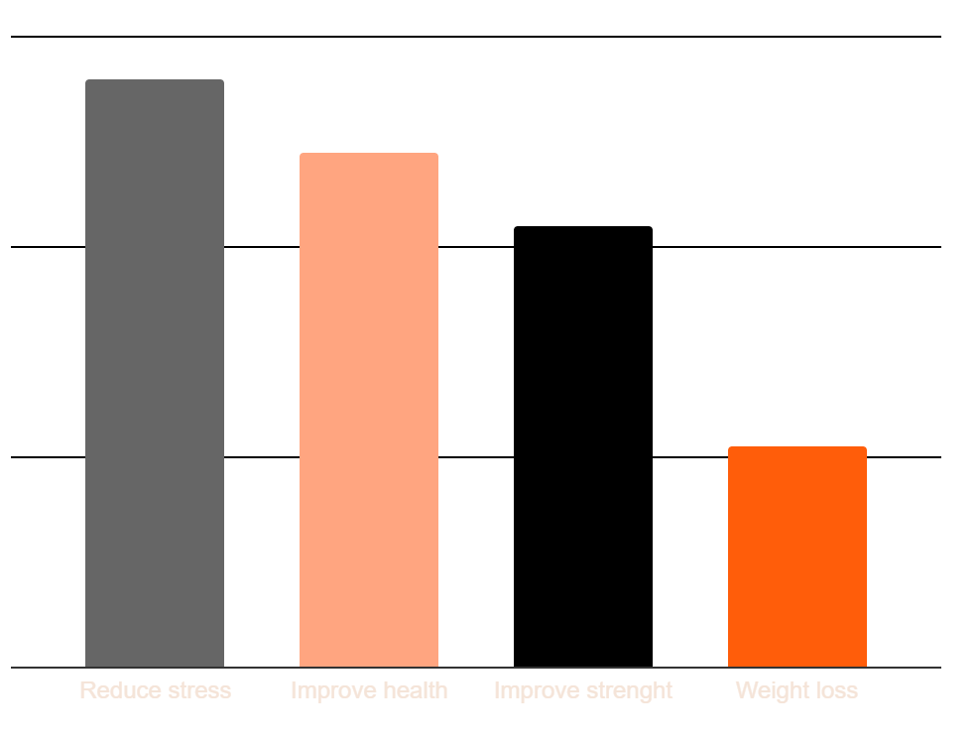
WHY START YOGA?
TO REDUCE STRESS
Venus is the second planet from the Sun
TO IMPROVE HEALTH
Jupiter is the biggest planet of them all
TO IMPROVE STRENGTH
Despite being red, Mars is a very cold place
FOR WEIGHT LOSS
Saturn is a gas giant and has several rings
56% 49% 49% 21%

Slide 4





BASIC YOGA ASANAS
UTKATASANA
This pose strengthens your legs, upper back, and shoulders
BALASANA
Allows the body and mind to relax, restore, and come back to center
ADHO MUKHA SVANASANA
This pose strengthens and lengthens the entire body
URDHVA MUKHA SHVANASANA
Strengthens your upper body and stretches out your chest and spine

Slide 5
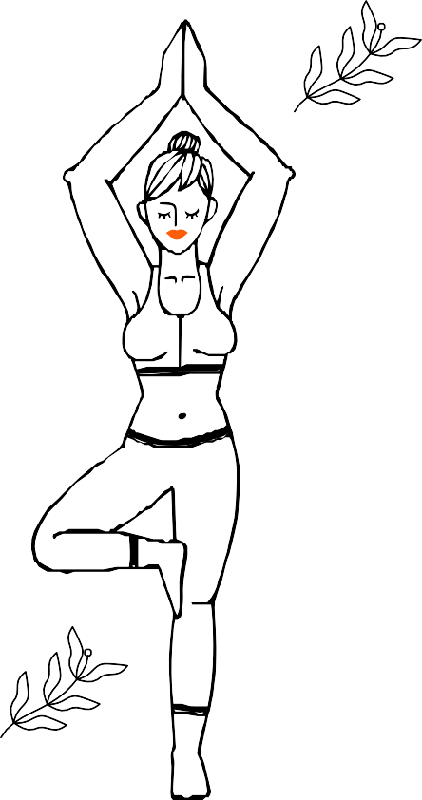
Problem Statement
Background
Traditional yoga practice often requires in-person instruction from certified trainers, making it inaccessible to many due to high costs, scheduling constraints, and geographical limitations. Many individuals interested in yoga cannot afford consistent professional guidance, leading to improper form, potential injuries, and diminished benefits from their practice.
Problem
The accessibility gap in yoga instruction creates several challenges:
High costs of personal trainers prevent many from receiving proper guidance
Limited availability of qualified instructors in certain areas
Scheduling conflicts between trainers and practitioners
Lack of immediate feedback during home practice
Difficulty in tracking progress and maintaining proper form without supervision.

Slide 6


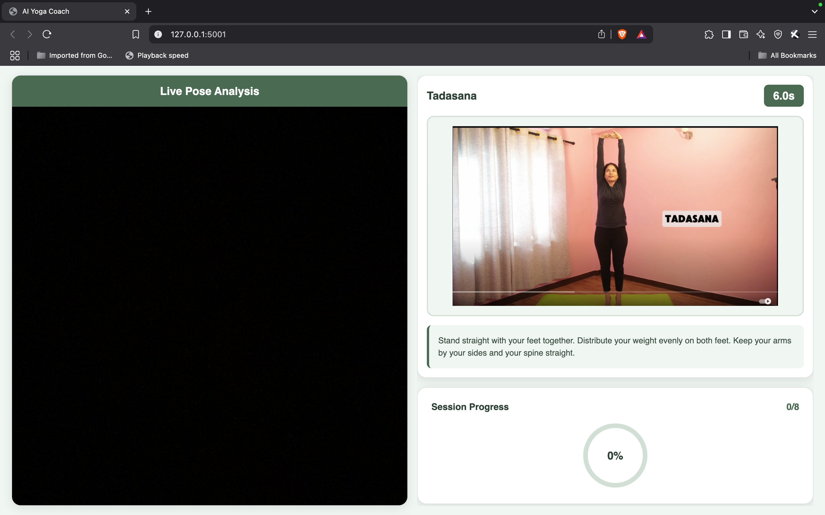
SOLUTION
AI-powered yoga trainer that uses computer vision to provide real- time pose detection, guidance, and feedback for users practicing yoga sequences.

Slide 7
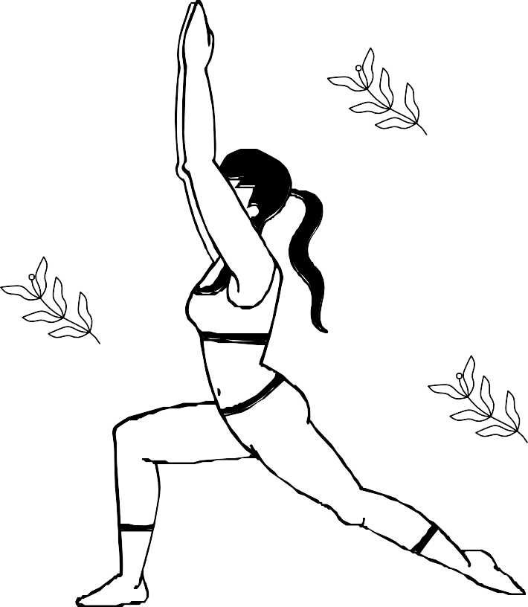
Computer Vision Yoga Assistant
Our AI Yoga Trainer application addresses these challenges by providing an accessible, affordable alternative to human instructors. By leveraging computer vision technology and machine learning models, the application:
Provides real-time pose detection and feedback using webcam input
Guides users through predefined yoga sequences with proper timing
Offers visual demonstrations of correct poses
Delivers verbal instructions for each asana
Tracks progress through sequences and provides completion metrics
Ensures proper form through continuous pose validation
This technology democratizes access to quality yoga instruction, allowing practitioners to receive expert-level guidance without the high costs of personal training. By making yoga more accessible, we aim to improve physical and mental wellbeing for a broader population while providing a platform for consistent, structured practice regardless of location or economic constraints.

Slide 8
Tech Stack
Machine Learning: Computer Vision & Pose Detection: scikit-learn OpenCV Pickle Mediapipe
Data Handling: Backend & Web Framework: NumPy Flask Flask-CORS

Slide 9


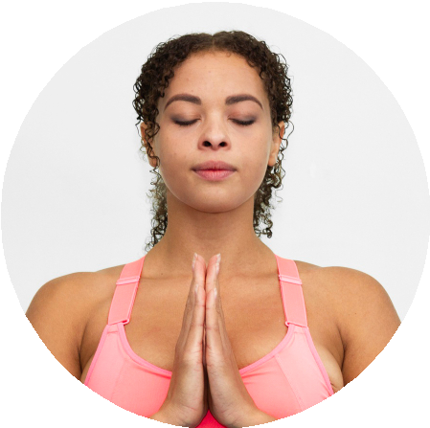

OUR TEAM
Advitya Singh
Yaswanth kumar
Vinith Reddy
Working with computer vision
Will take care of frontend and flask.
Will take care of dataset and preprocessing.

Slide 10
SHUT THE MIND, AND THE SOUL WILL SPEAK

Slide 11

Thanks!
Do you have any questions?
vinithlankireddy@gmail.com

