Slide 1



Hr_Attrition1
View in Power BI
Last data refresh:
8/7/2023 4:02:40 AM UTC
Downloaded at:
8/7/2023 4:09:04 AM UTC

Slide 2
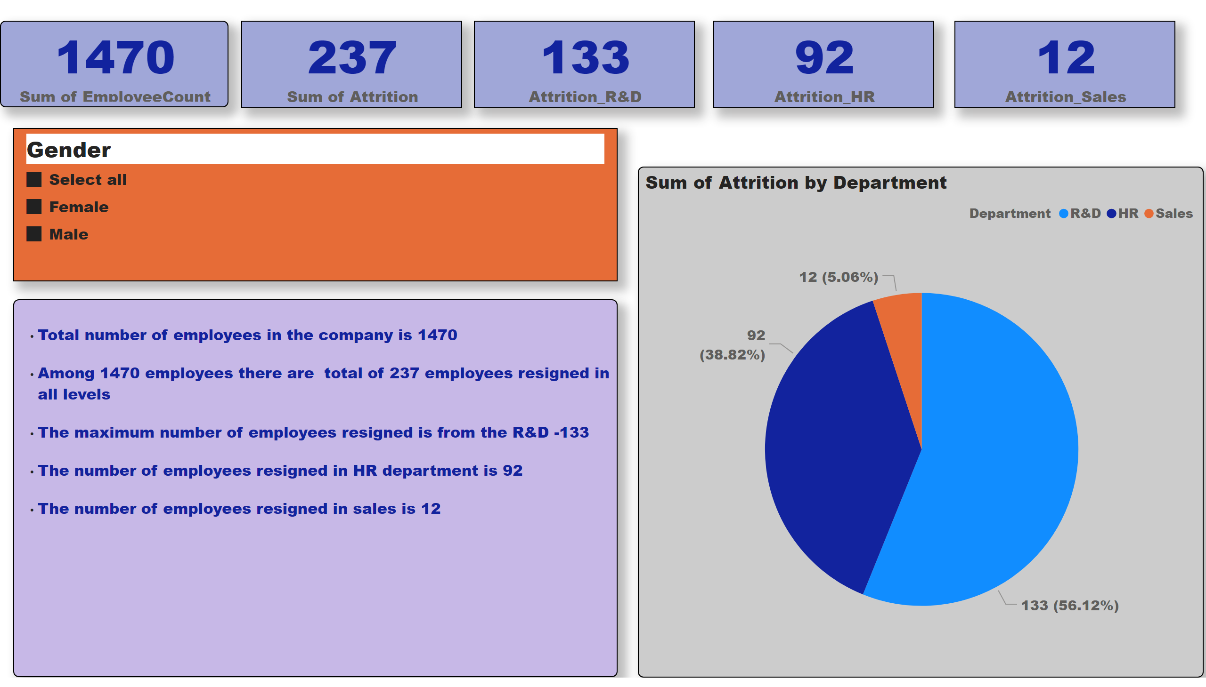
0verview
Notes:
card
No alt text provided
card
No alt text provided
slicer
No alt text provided
pieChart
No alt text provided
textbox
No alt text provided
card
No alt text provided
card
No alt text provided
card
No alt text provided

Slide 3
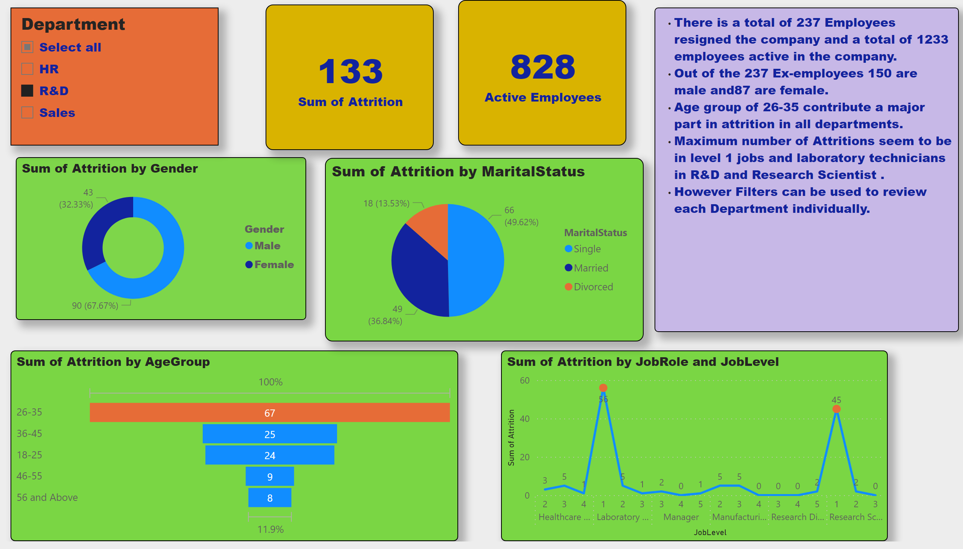
Demographics
Notes:
donutChart
No alt text provided
card
No alt text provided
lineChart
No alt text provided
funnel
No alt text provided
textbox
No alt text provided
card
No alt text provided
slicer
No alt text provided
pieChart
No alt text provided

Slide 4
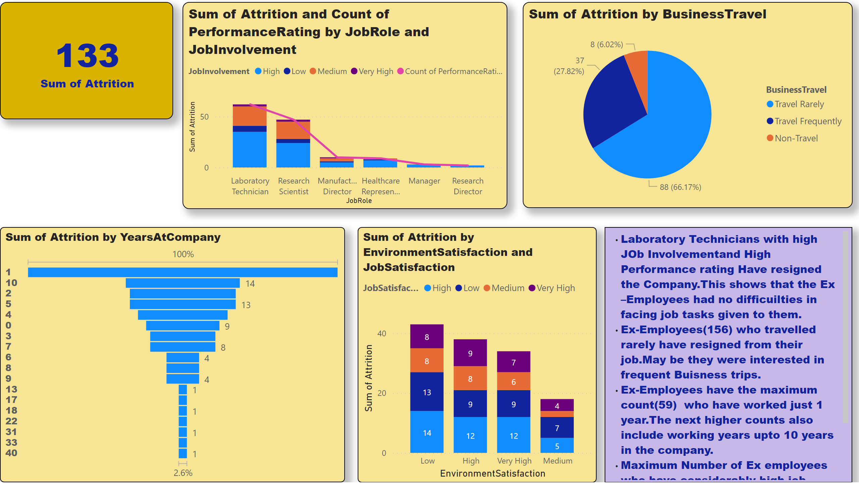
Portfolio-1
Notes:
columnChart
No alt text provided
funnel
No alt text provided
textbox
No alt text provided
lineStackedColumnComboChart
No alt text provided
actionButton
No alt text provided
slicer
No alt text provided
card
No alt text provided
pieChart
No alt text provided
slicer
No alt text provided

Slide 5
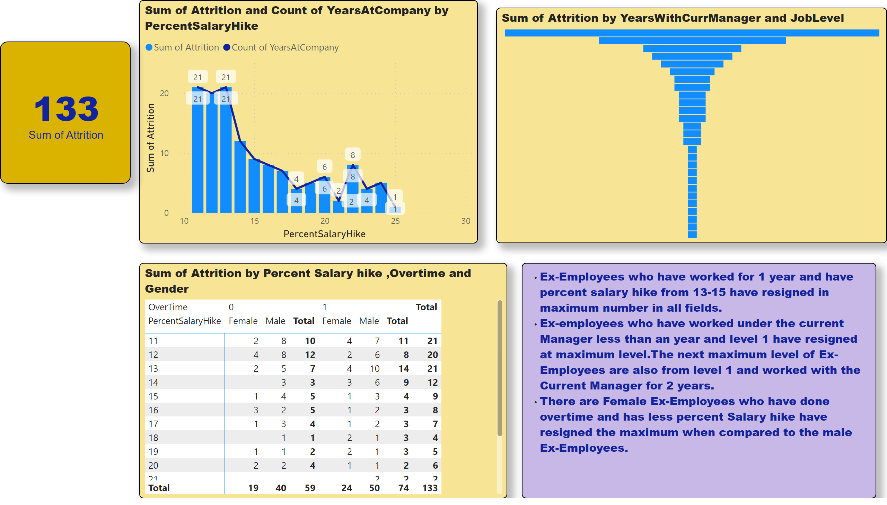
Portfolio-2
Notes:
Sum of Attrition by Percent Salary hike ,Overtime and Gender
No alt text provided
lineStackedColumnComboChart
No alt text provided
funnel
No alt text provided
textbox
No alt text provided
slicer
No alt text provided
slicer
No alt text provided
card
No alt text provided

Slide 6
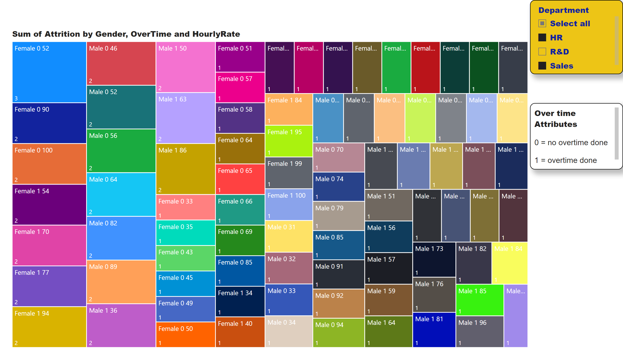
Income and Performance
Notes:
treemap
No alt text provided
slicer
No alt text provided
textbox
No alt text provided

Slide 7
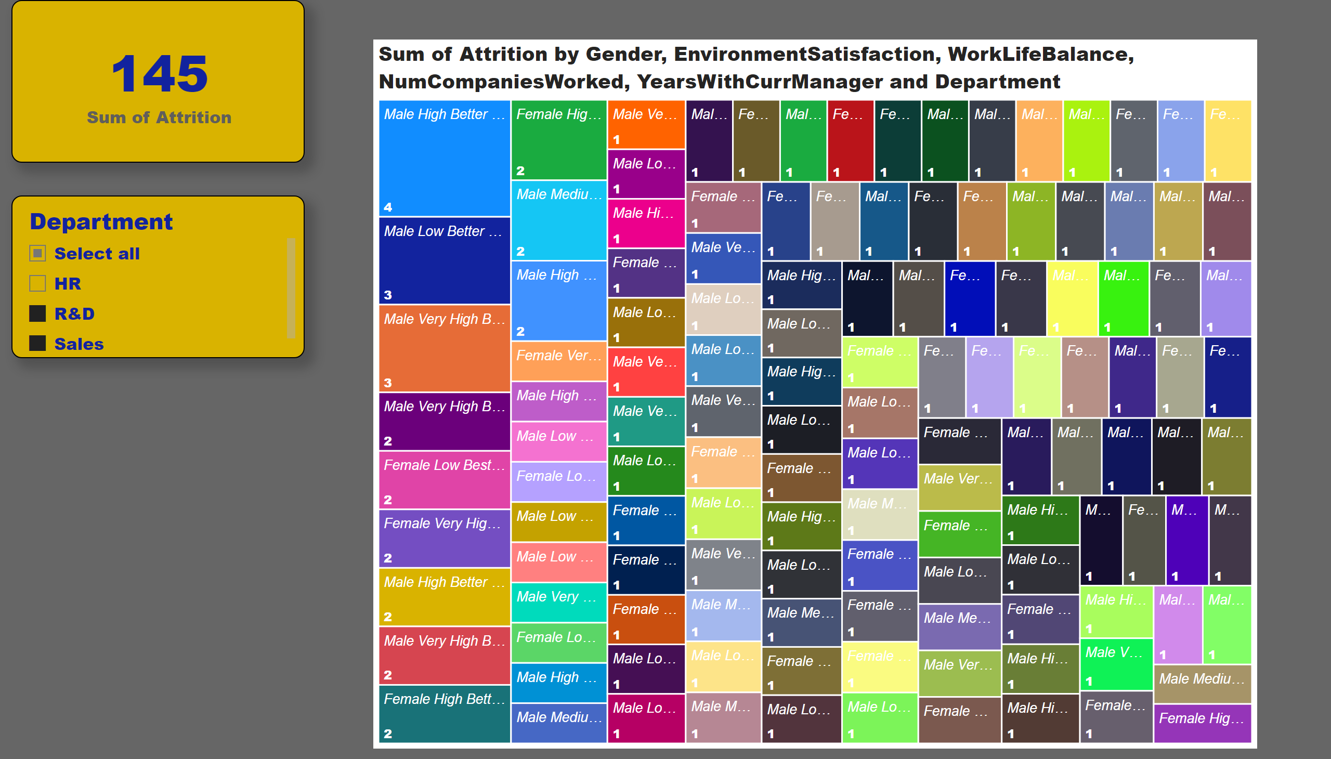
Stress Analysis
Notes:
treemap
No alt text provided
slicer
No alt text provided
card
No alt text provided

Slide 8
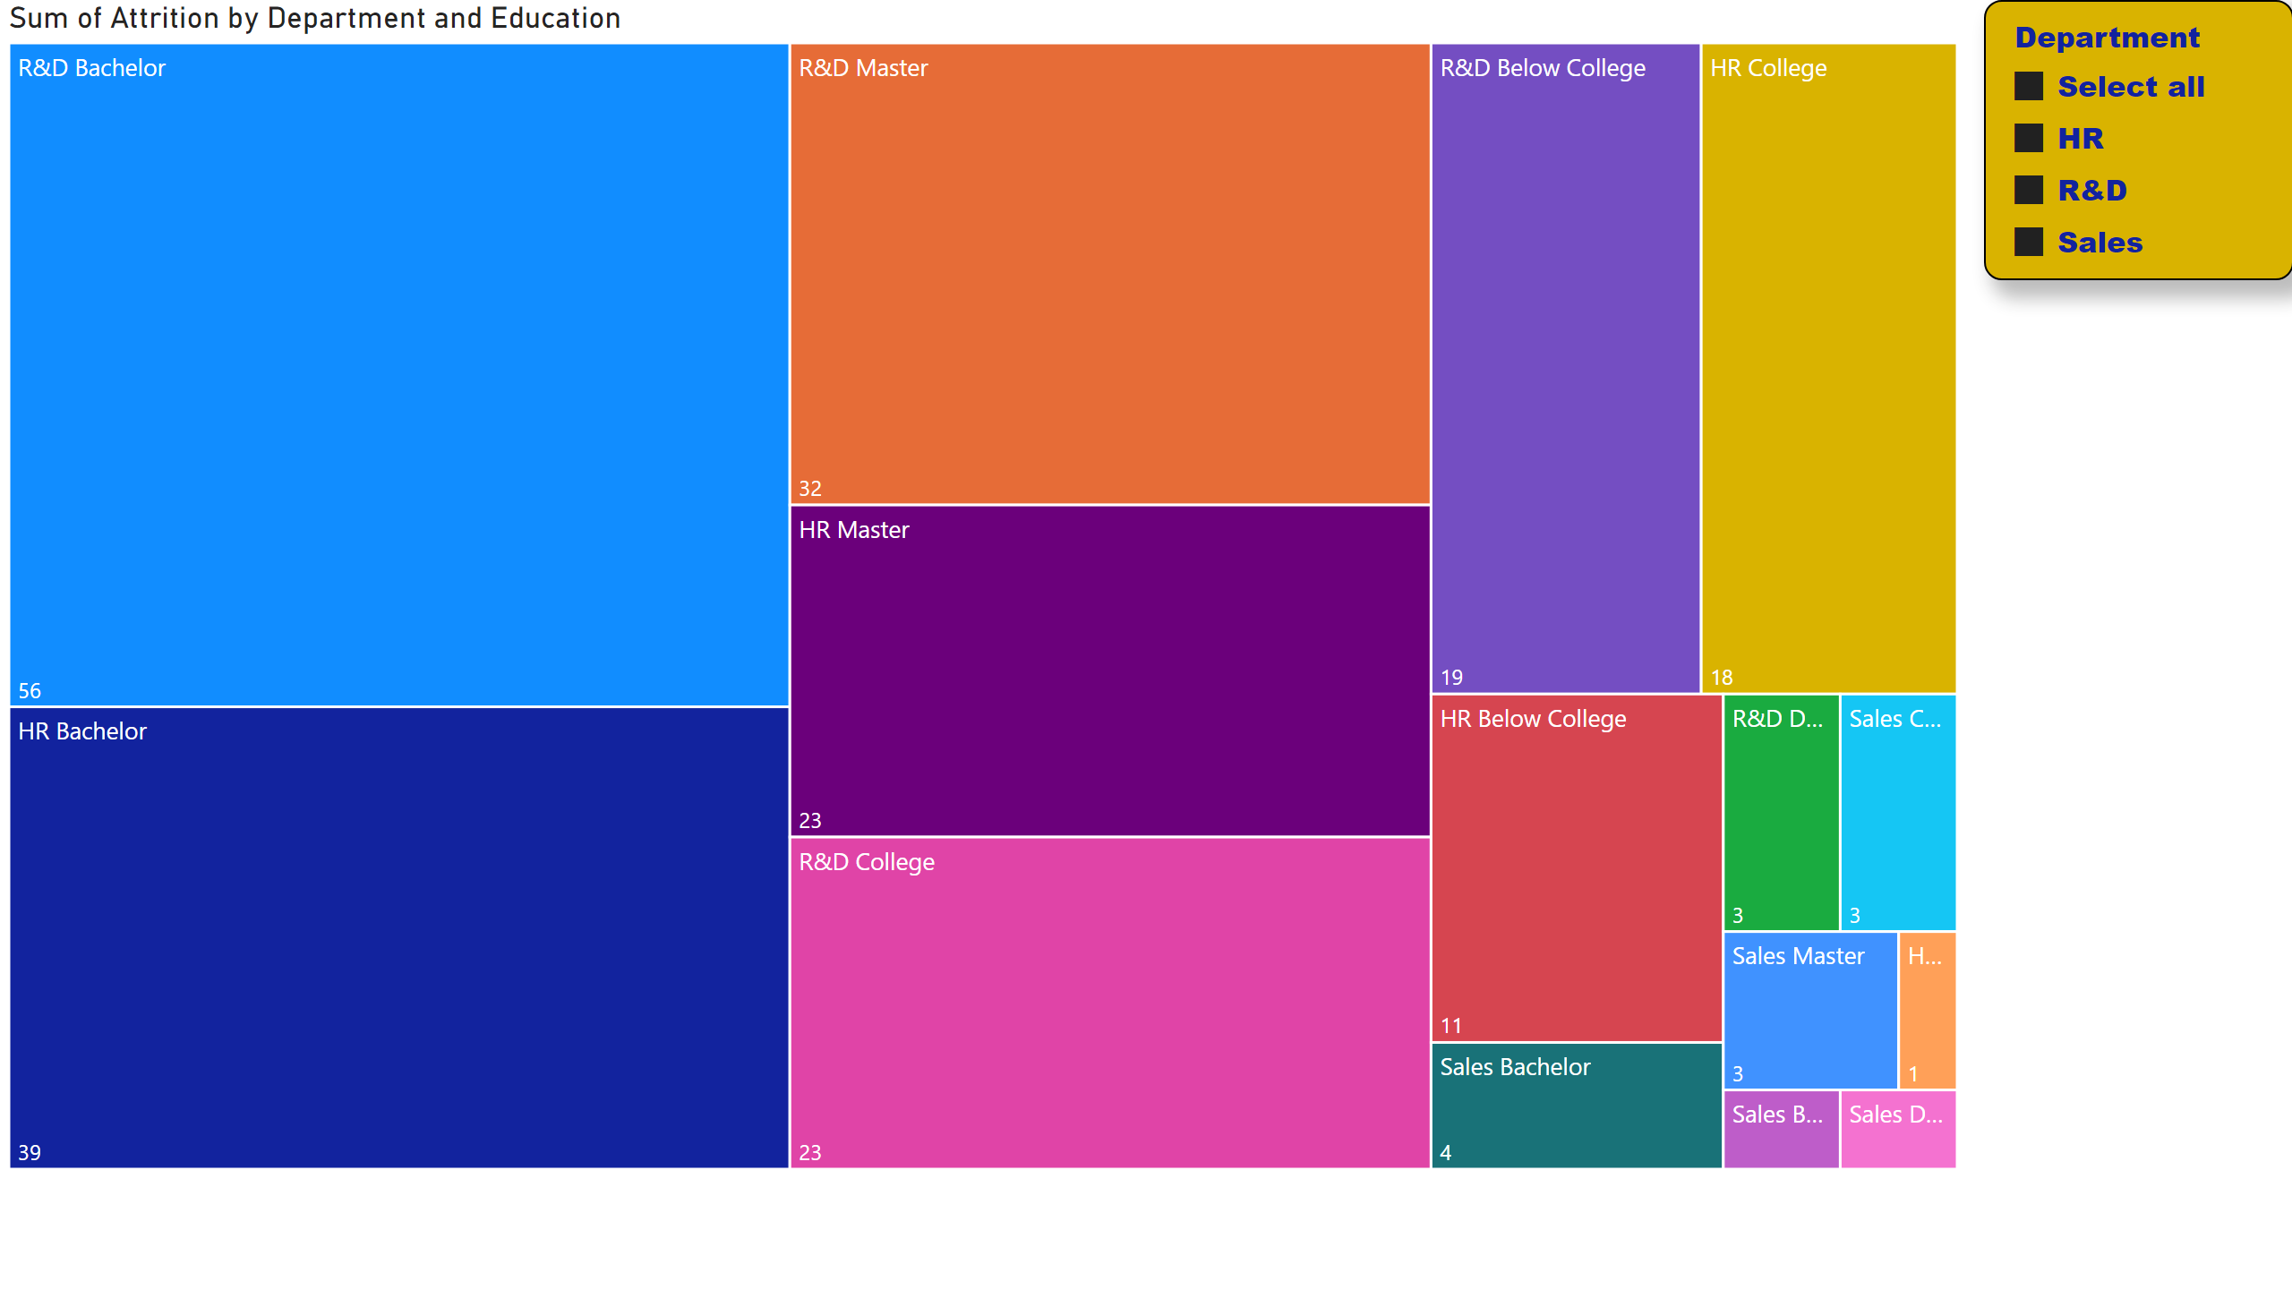
Education and Performance
Notes:
treemap
No alt text provided
slicer
No alt text provided

Slide 9
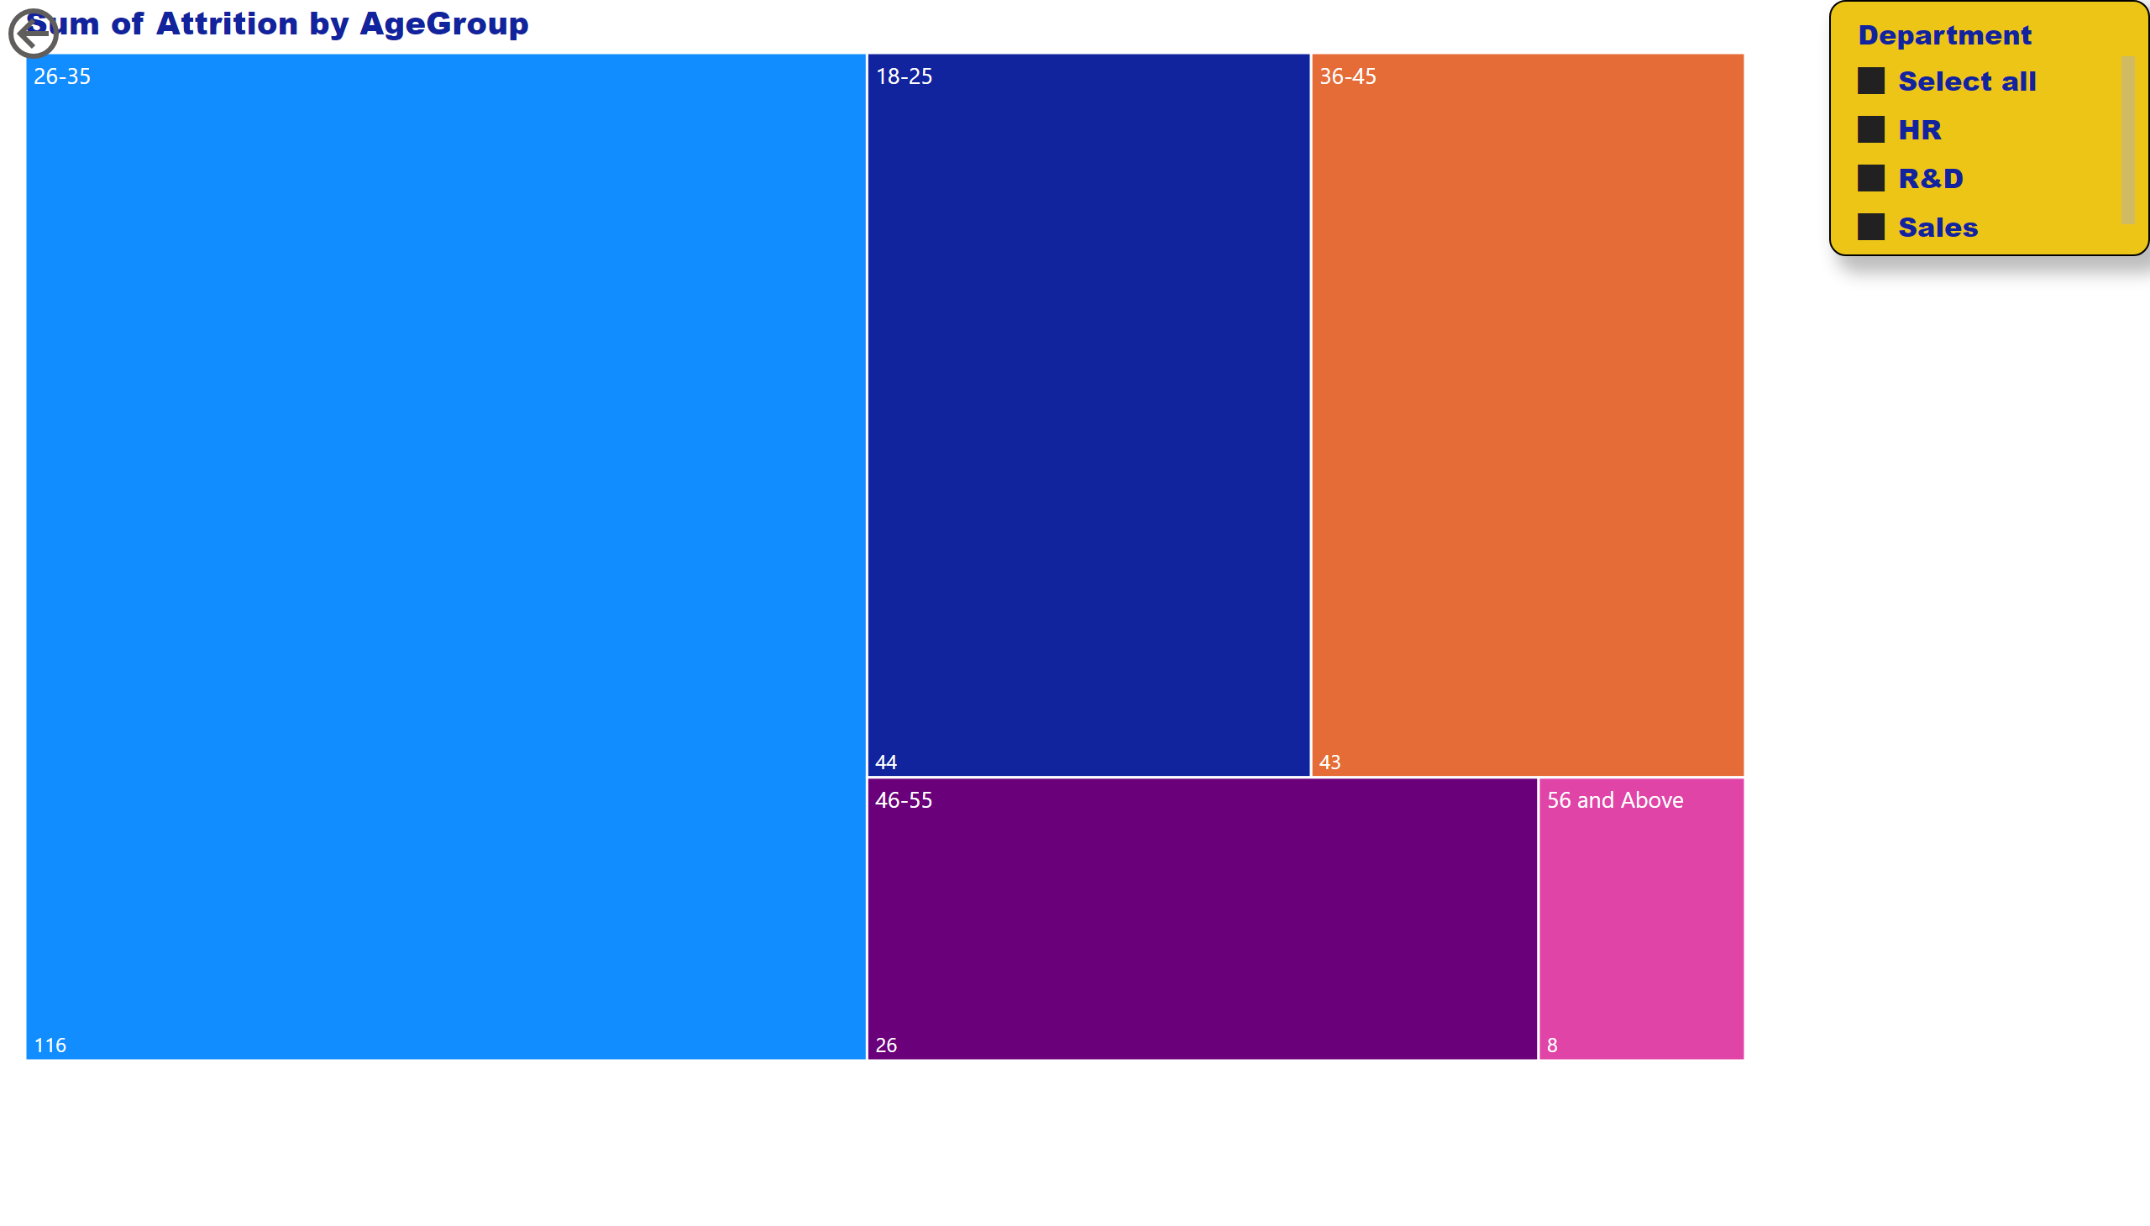
Final Analysis
Notes:
treemap
No alt text provided
actionButton
No alt text provided
slicer
No alt text provided

Slide 10
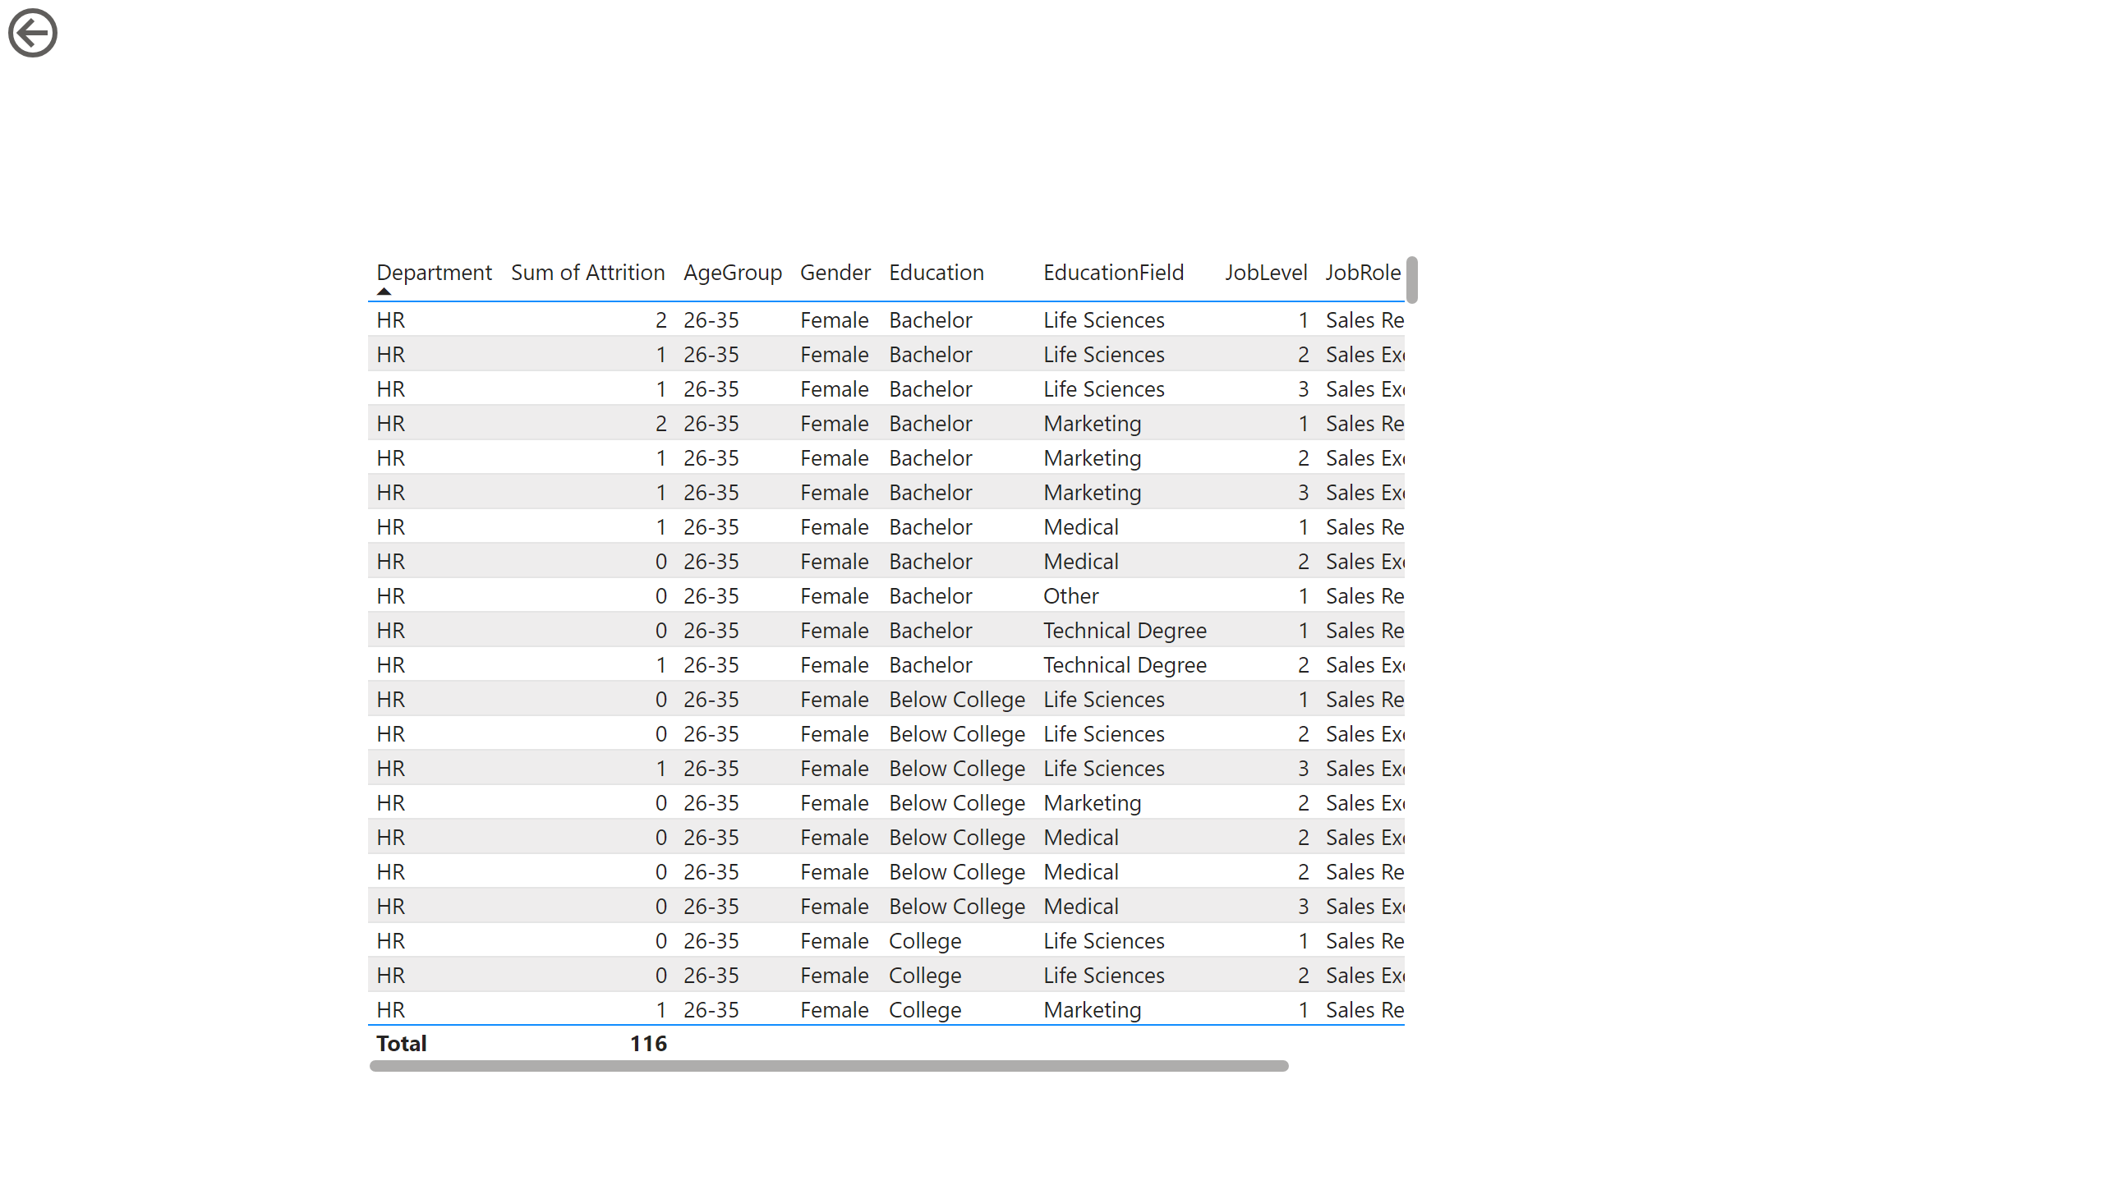
Detailed Report
Notes:
tableEx
No alt text provided
actionButton
No alt text provided

