Slide 1
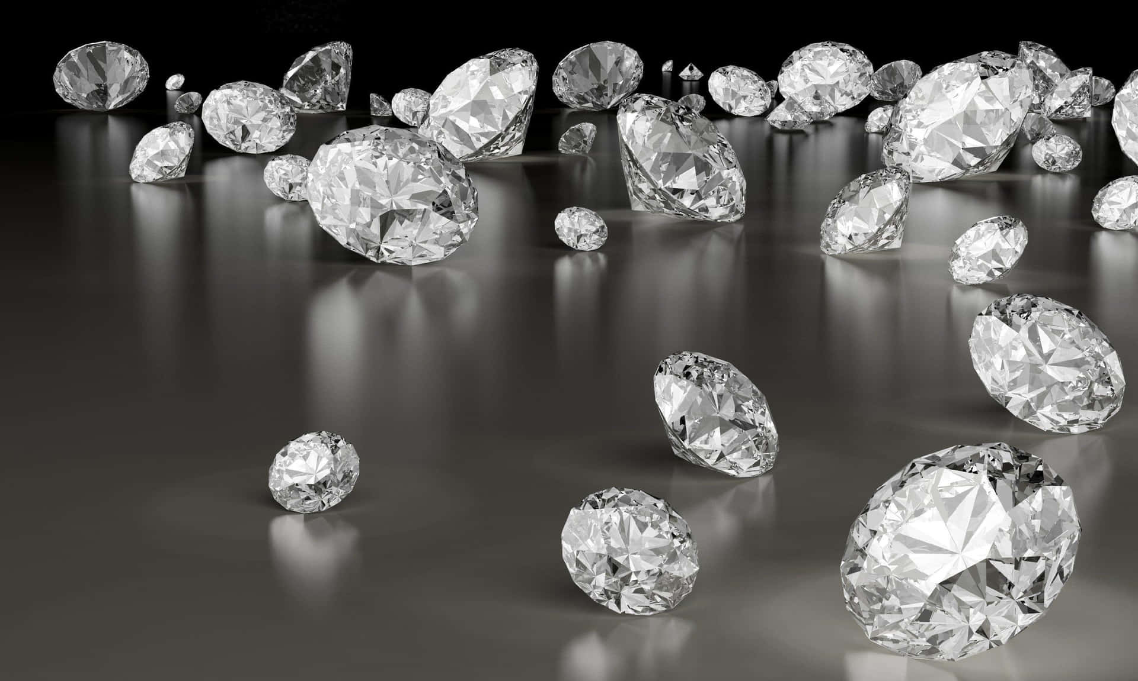
Diamond Price Prediction

Slide 2
Project Purpose
The primary purpose of this project is to develop a predictive model that accurately estimates the price of diamonds based on various attributes such as carat weight, cut, color, clarity, and possibly other relevant features.
By leveraging machine learning techniques, the project aims to provide valuable insights and predictions that can assist stakeholders in making informed decisions related to diamond pricing.
Business Problem
The business problem revolves around the challenges faced by stakeholders in the diamond industry, including jewelers, diamond retailers, and consumers:
Dynamic Pricing Strategy: Developing effective strategies to adjust prices based on real-time market demand, competitor pricing, and customer behavior.
Revenue Optimization: Maximizing revenue by accurately forecasting and setting prices that reflect market conditions and customer willingness to pay.
Discount Management: Managing discounts and promotional offers to maintain price integrity while stimulating sales.
Price Transparency: Customers often seek transparency in diamond pricing. Providing an accurate and data-driven pricing model can enhance trust and satisfaction among buyers

Slide 3
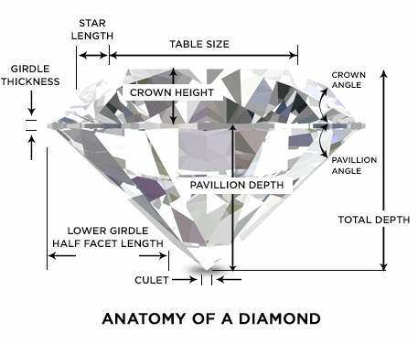
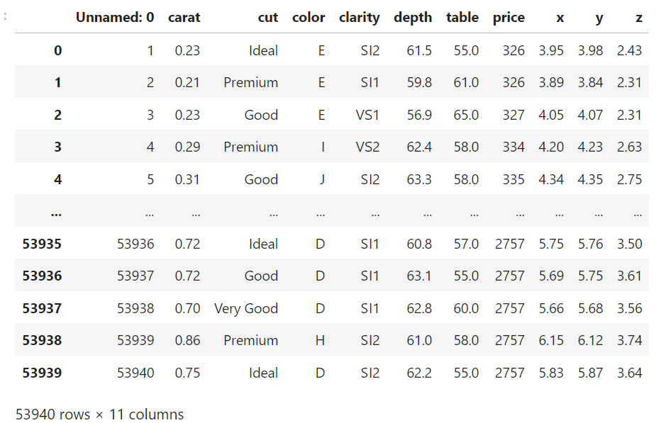
Dataset description and key features:
This dataset contains the prices and other attributes of with almost 54,000 records.
Content:
carat weight of the diamond (0.2--5.01)
cut quality of the cut (Fair, Good, Very Good, Premium, Ideal)
color diamond colour, from J (worst) to D (best)
clarity a measurement of how clear the diamond is (I1 (worst), SI2, SI1, VS2, VS1, VVS2, VVS1, IF (best))
depth total depth percentage = z / mean(x, y) = 2 * z / (x + y) (43--79)
table width of top of diamond relative to widest point (43--95)
price in US dollars (18,823)
x length in mm (0--10.74)
y width in mm (0--58.9)
z depth in mm (0--31.8)

Slide 4
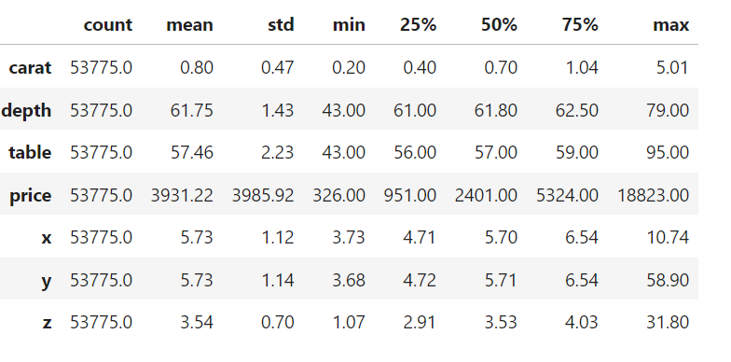
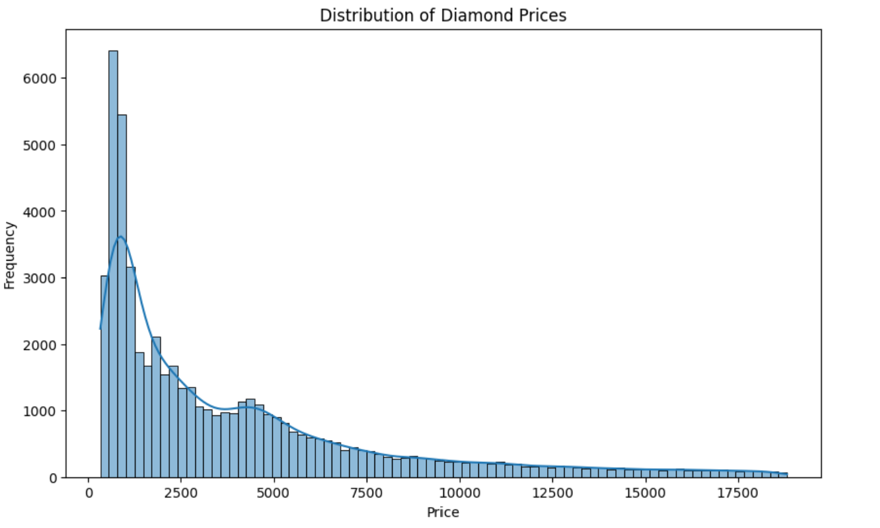
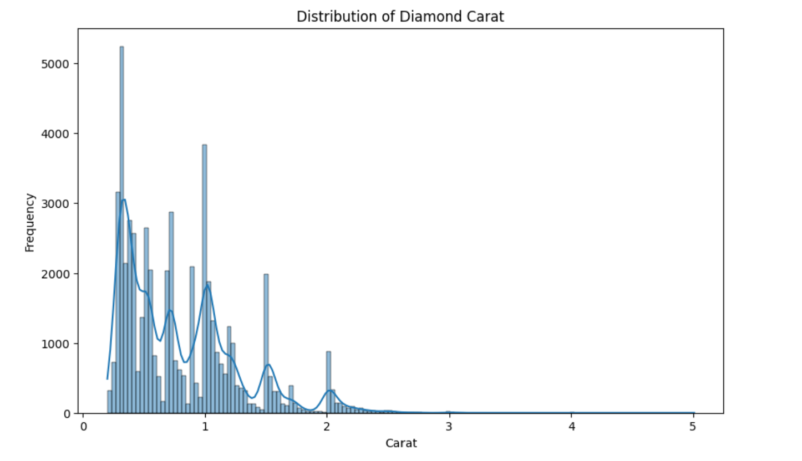
The count, mean, min and max rows are self-explanatory.
The std shows the standard deviation, and the 25%, 50% and 75% rows show the corresponding percentiles.
Histogram to understand distribution of Diamond Prices and carat

Slide 5
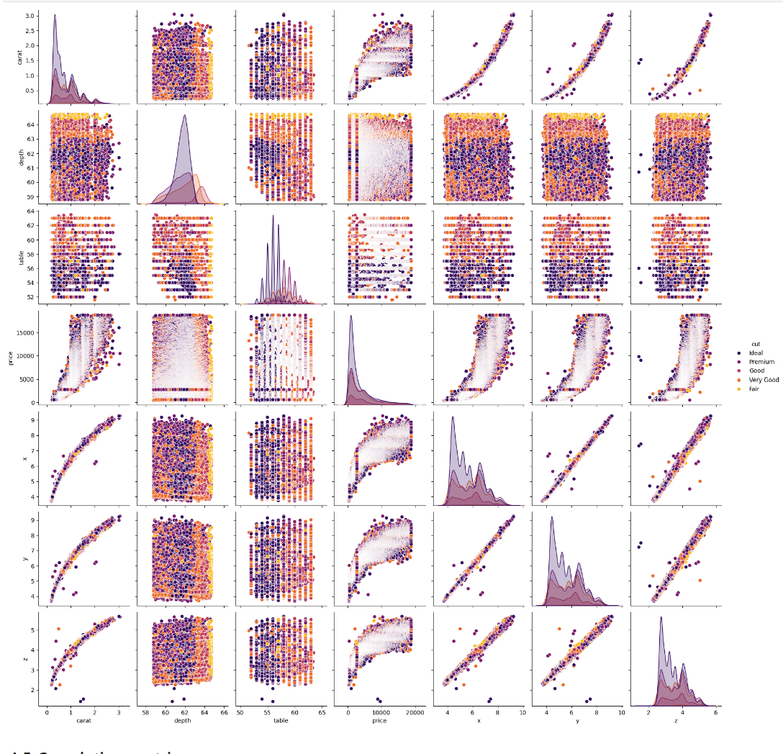
Sns.histplot:

Slide 6
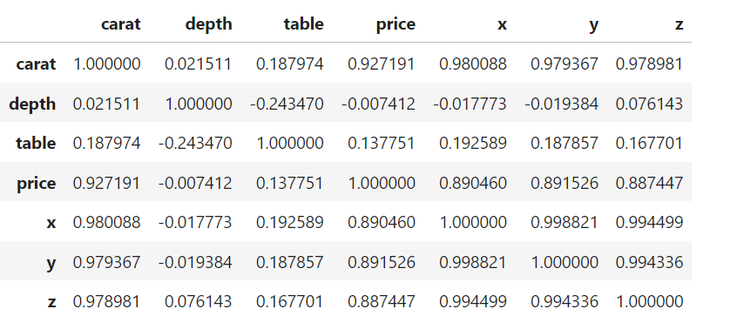
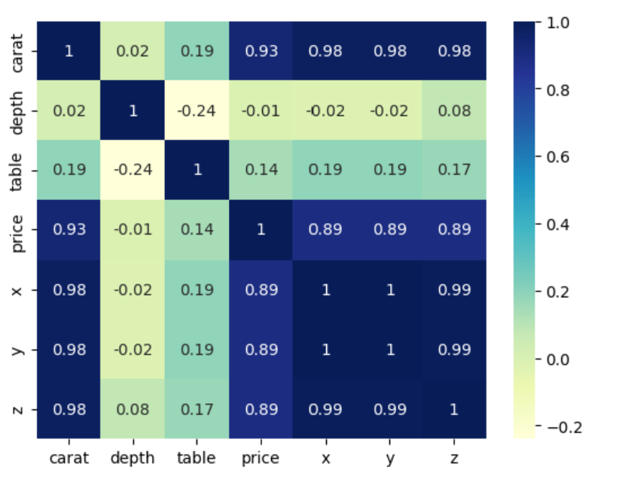
CONCLUSIONS :
1. Depth is inversely related to Price.
This is because if a Diamond's Depth percentage is too large or small the Diamond will become 'Dark' in appearance because it will no longer return an Attractive amount of light.
2. The Price of the Diamond is highly correlated to Carat, and its Dimensions.
3. The Weight (Carat) of a diamond has the most significant impact on its Price.
Since, the larger a stone is, the Rarer it is, one 2 carat diamond will be more 'Expensive' than the total cost of two 1 Carat Diamonds of the same Quality.
4. The Length(x) , Width(y) and Height(z) seems to be higly related to Price and even each other.
5. Self Relation ie. of a feature to itself is 1 as expected.
6. Some other Inferences can also be drawn.

Slide 7
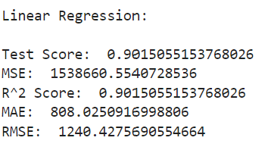
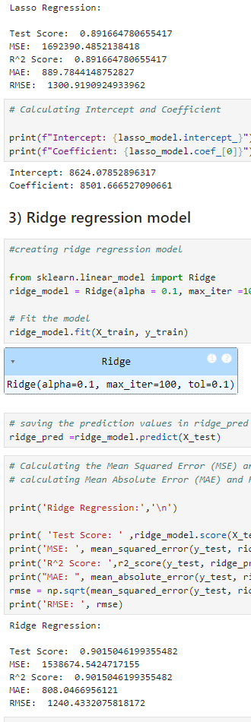
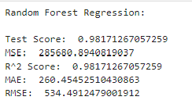
Building Regression Models to find the most accurate
1) Linear regression
2) Lasso regression model
3) Ridge regression model
4) Random Forest regression model
Random Forest Regression shows the highest test score (𝑅2 = 0.981), indicating that it explains a significant portion of the variance in the target variable (price).
This model is the most effective among the ones tested, suggesting it captures complex relationships and interactions between features better than the others.

Slide 8
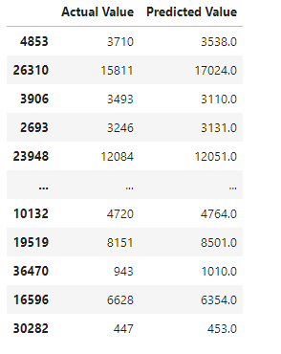
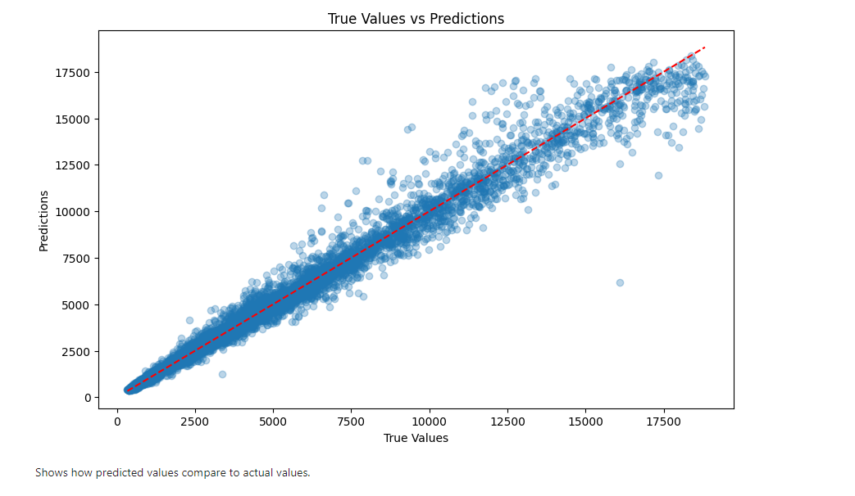
Cross-Validation:
Output:
Cross-validated R^2 Scores: [0.89488577 0.89353129 0.89865888 0.89969162 0.89393054]
Average Cross-validated R^2 Score: 0.8961396183825133
This analysis confirms that the selected model is effective and reliable in predicting the target variable, as evidenced by the high average 𝑅2 score.
Visual representation of Model Performance

