Slide 1

Predicting Term Deposit Subscription in Bank Marketing Campaign
- Vinitha Sampathkumar

Slide 2

Agenda:
Understanding Problem Statement
EDA-Exploring trends in Data Set
Model Building
Hyperparameter Tuning and Model Evaluation
Results & Outcome
Recommendation to marketing team

Slide 3
Problem Statement:
This dataset pertains to direct marketing campaigns conducted by a Portuguese bank, where the campaigns were primarily executed through phone calls.
To determine whether clients would subscribe to a term deposit, multiple contacts were often made.
The goal is to predict whether a client will subscribe to the term deposit (‘yes’) or (‘no’).
Dataset Link: https://www.kaggle.com/datasets/adilashrafi/bank-marketing-classification-task/data

Slide 4
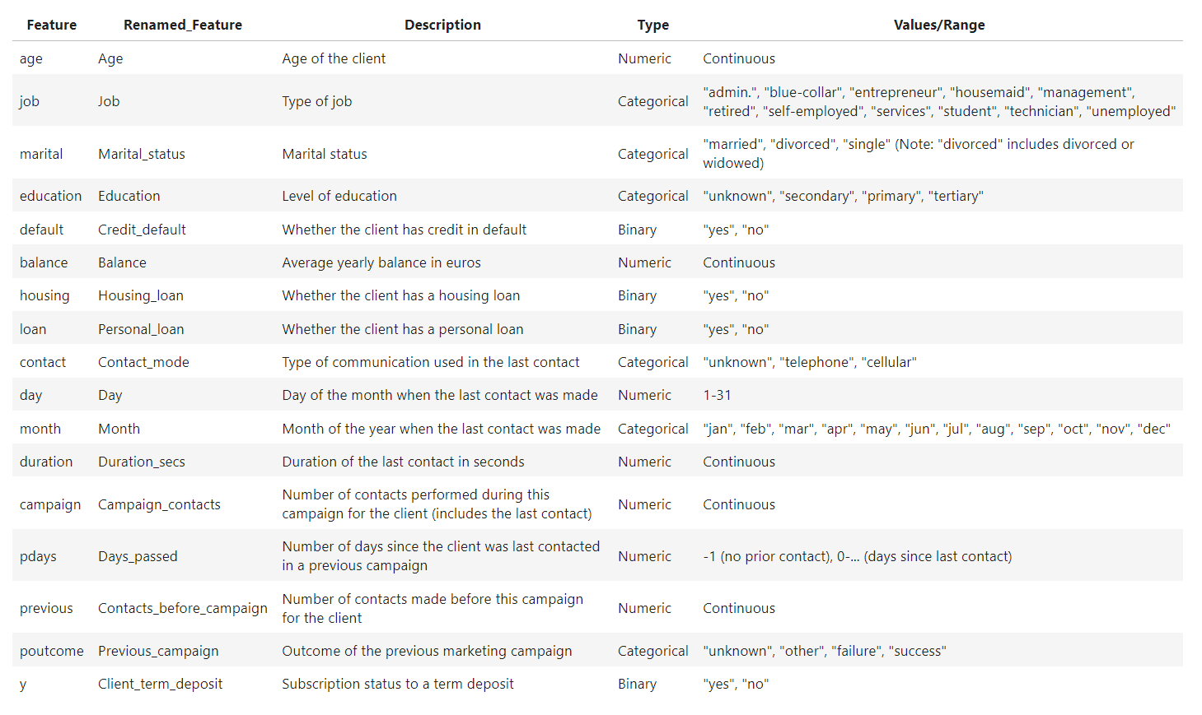
Data Dictionary

Slide 5
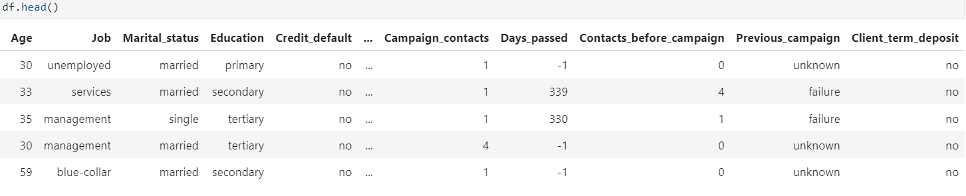
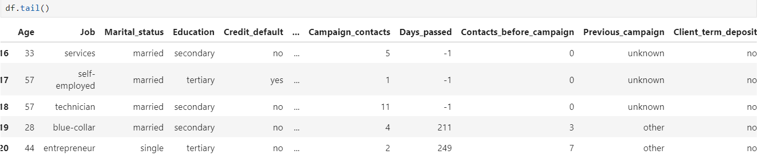

Slide 6
Data Exploration:
The dataset has 4521 rows and 17 features (columns).
10 categorical features.
7 Numerical features.
No null values.
No Duplicate values.
No Missing Values.

Slide 7
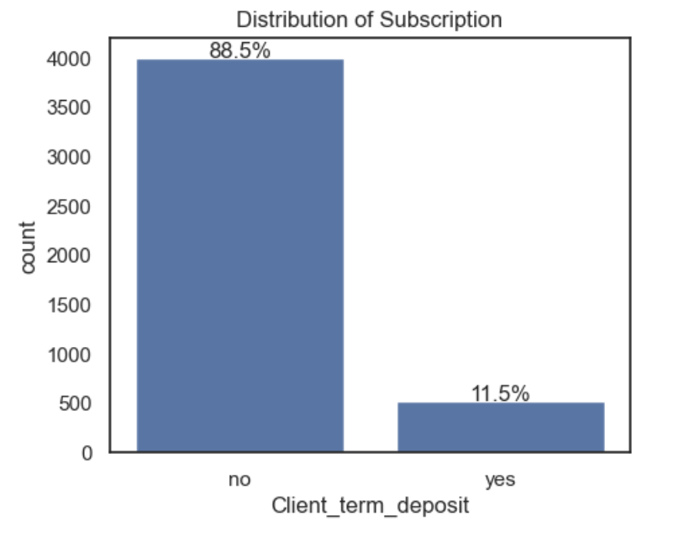
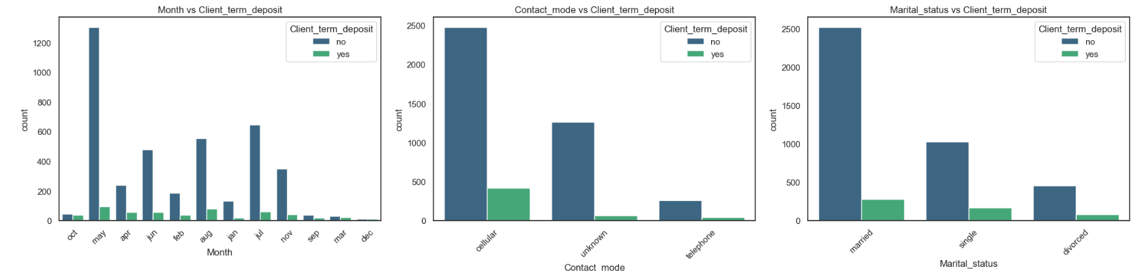
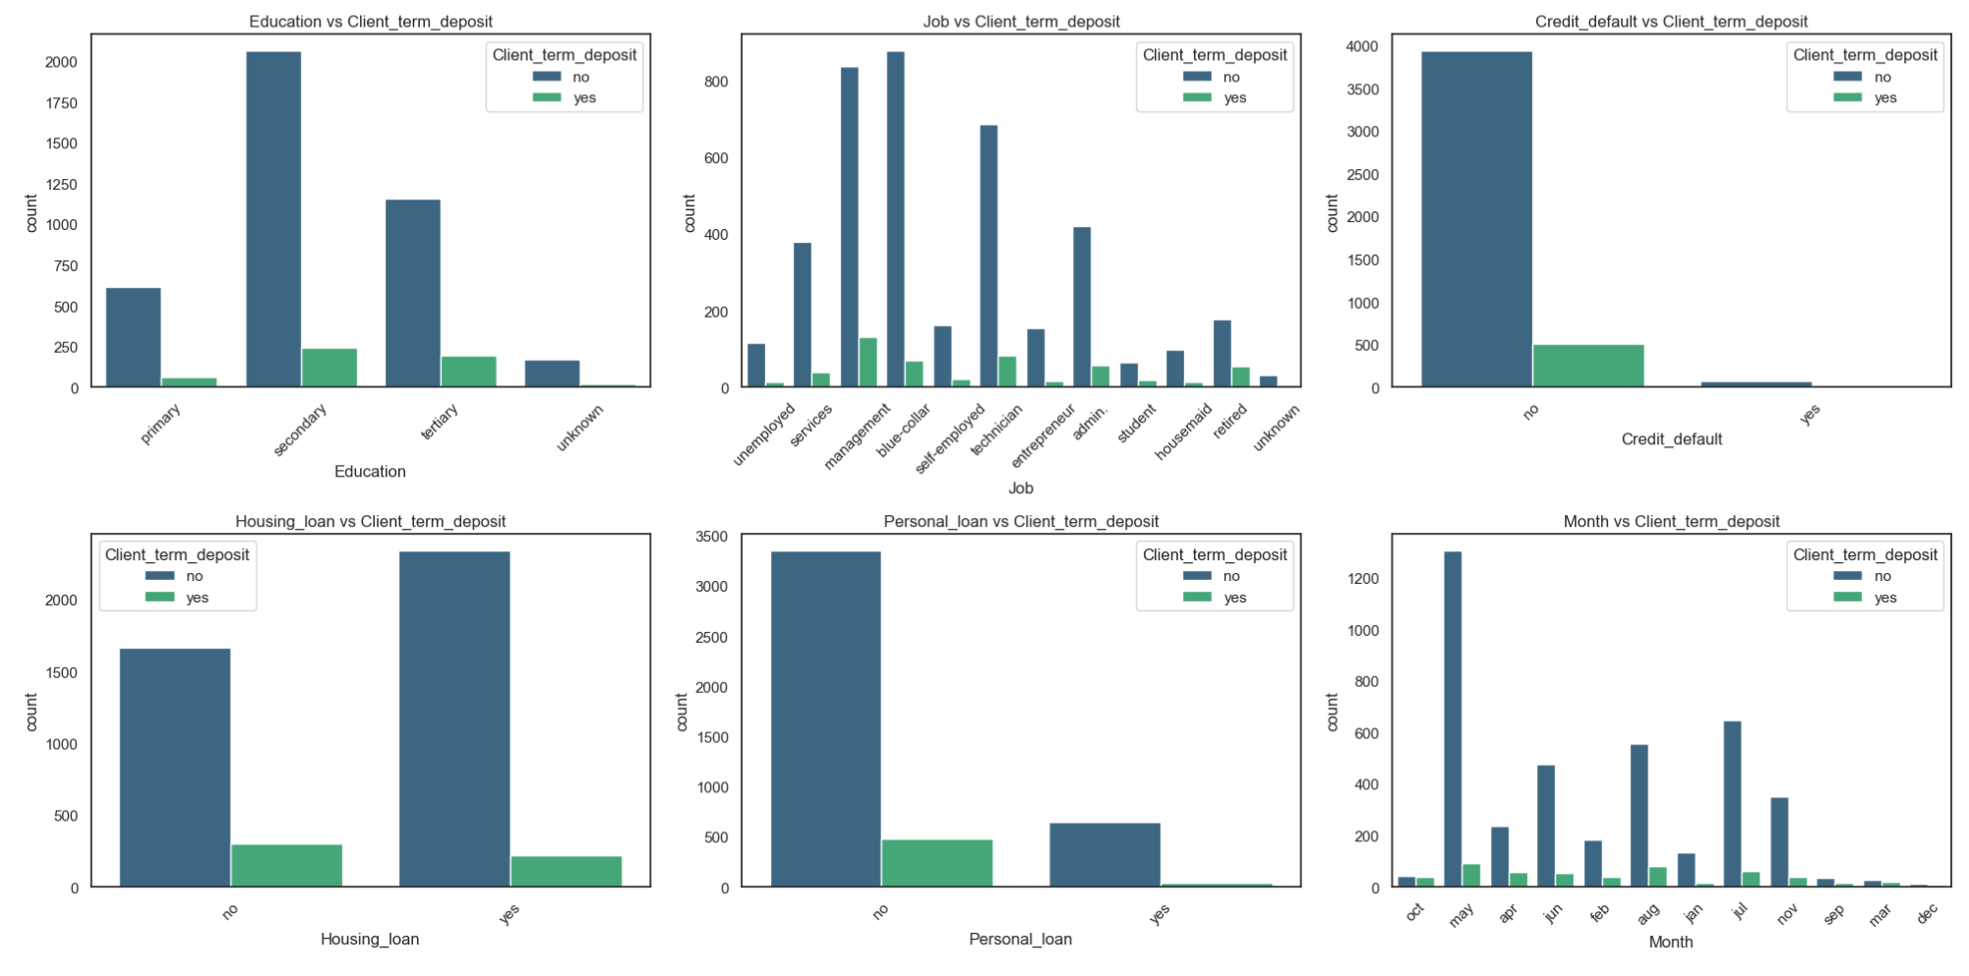
Visualizations:
Distribution of the target variable

Slide 8
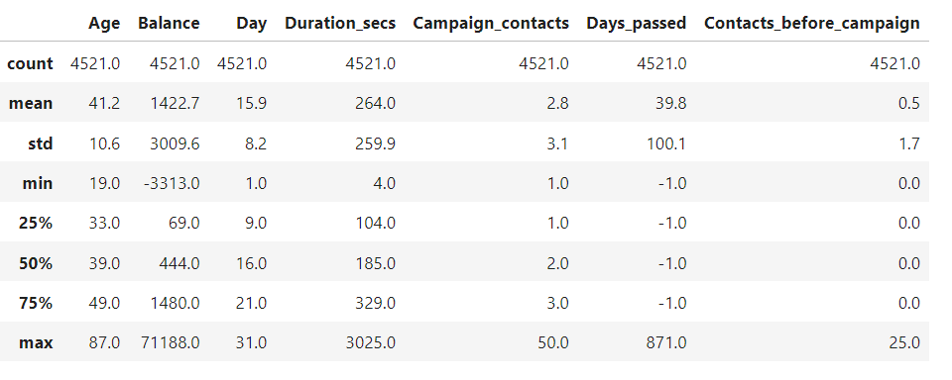
Exploratory Data Analysis (EDA):
Summary statistics of numerical columns:

Slide 9
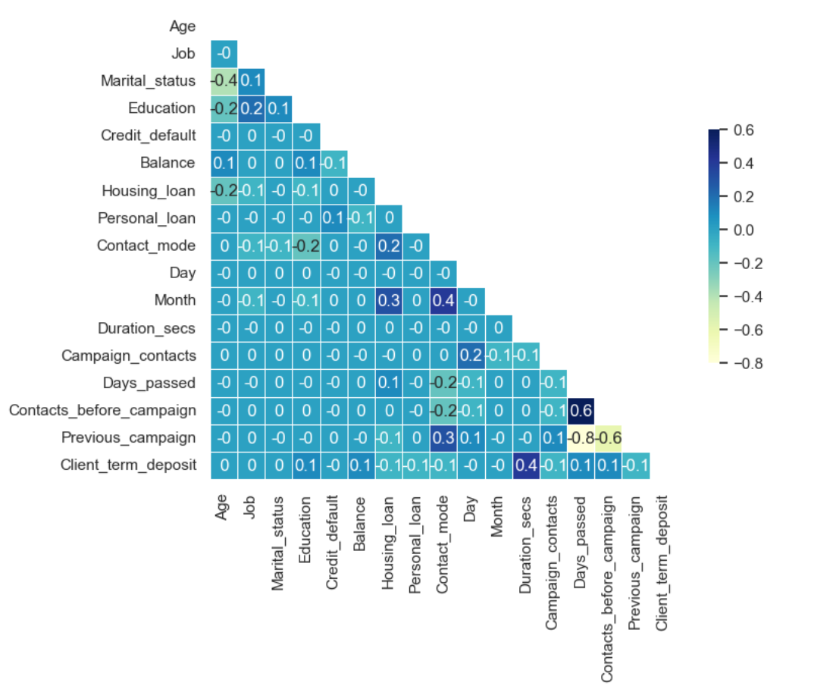
Correlation Heatmap:

Slide 10
Classification Models:
Logistic Regression
Support Vector Machines
Naive Bayes
Classification
Models
Decision Tree
K-Nearest Neighbour
Random Forest
XGBoost

Slide 11
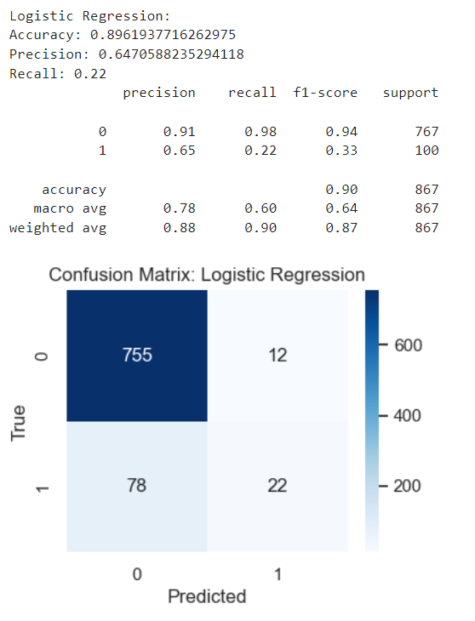
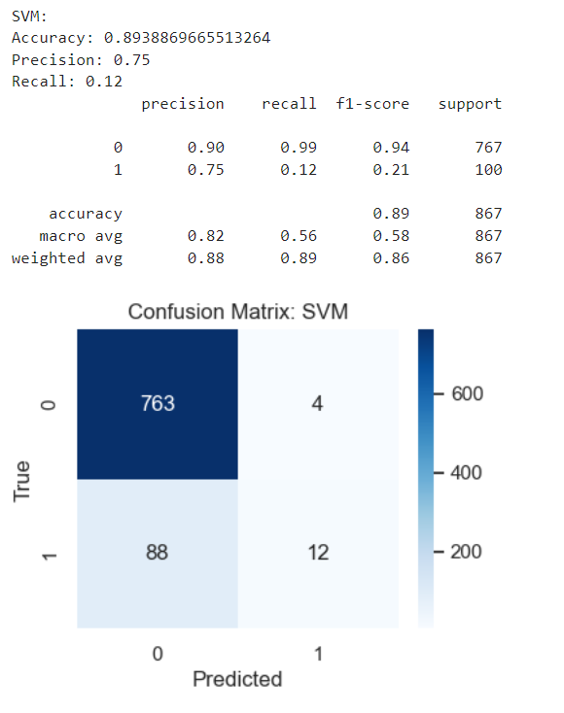
Logistic Regression
Support Vector Machines

Slide 12
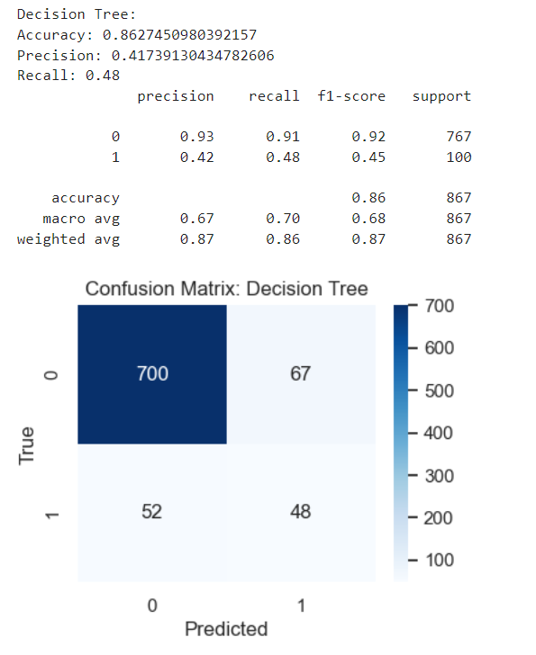

Decision Tree
Random Forest

Slide 13
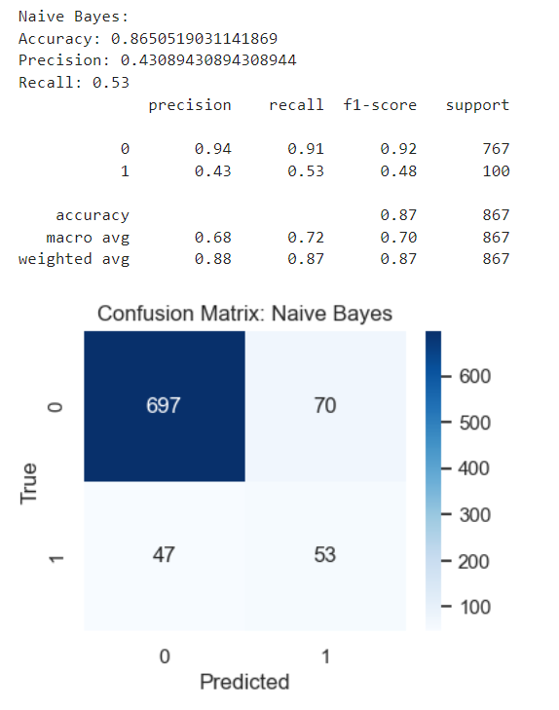
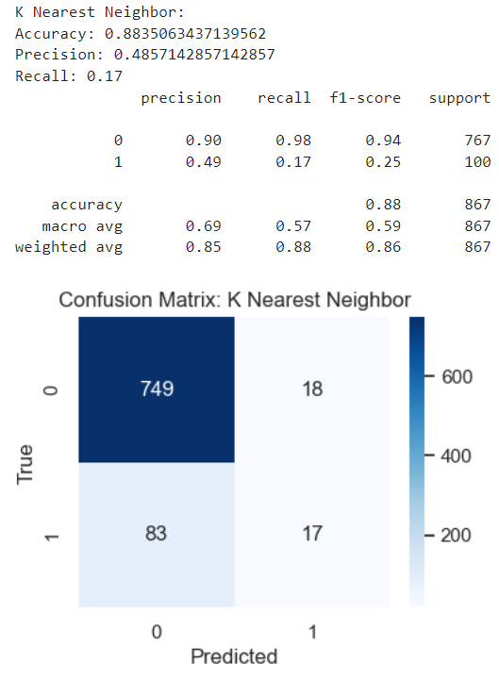
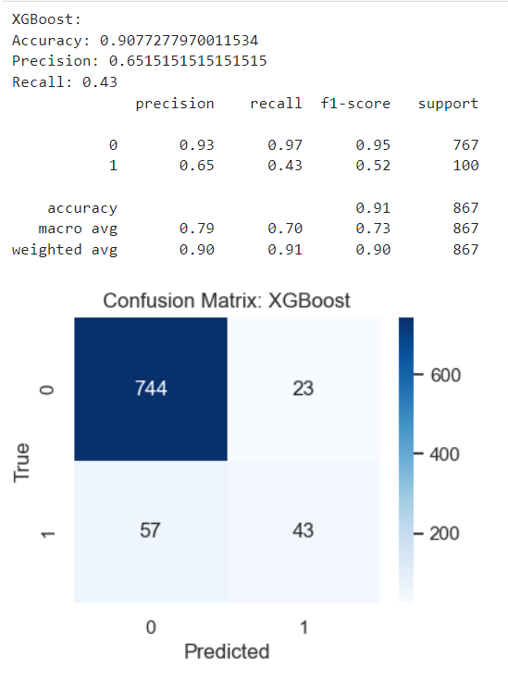
Naive Bayes
K-Nearest Neighbour
XGBoost

Slide 14
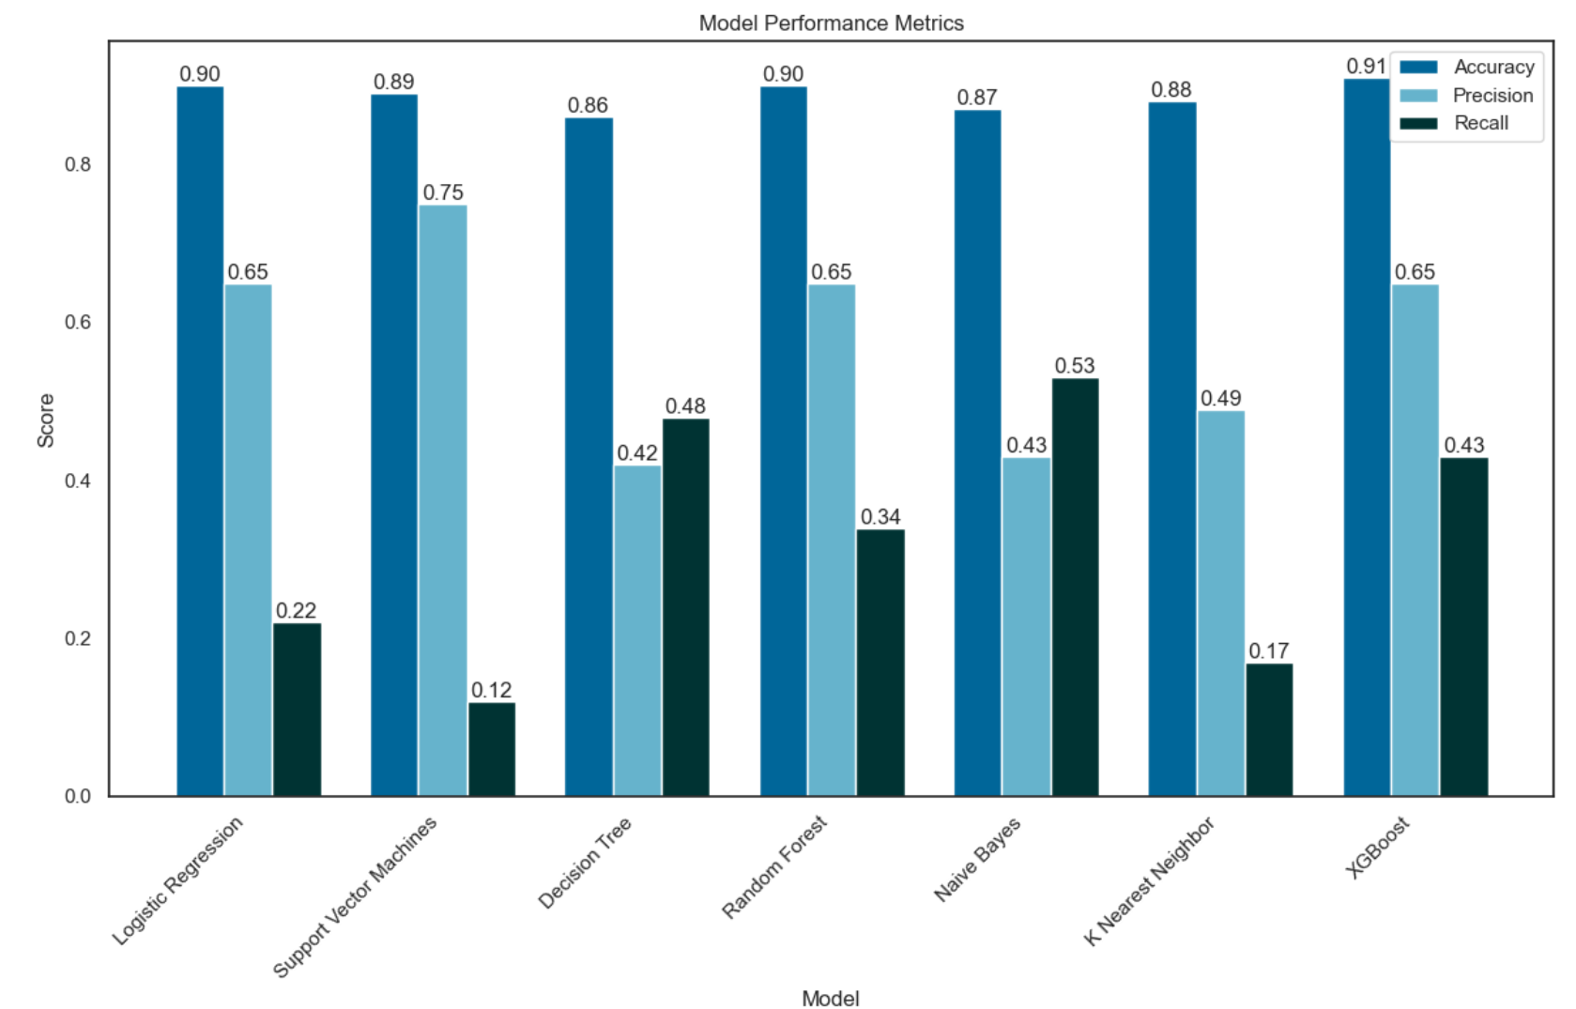
Model Performance Metrics:

Slide 15
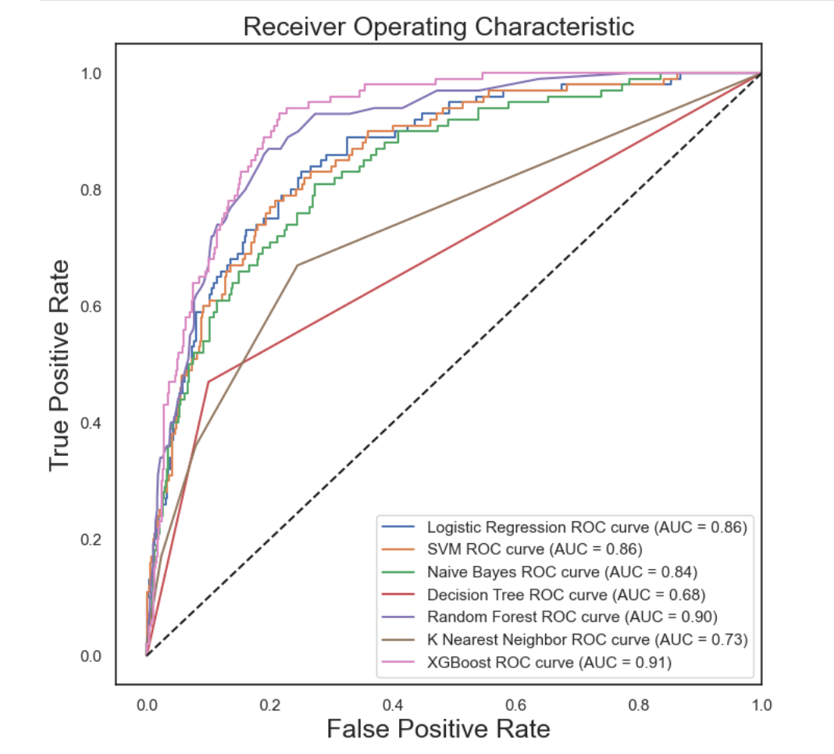
ROC Curve:

Slide 16
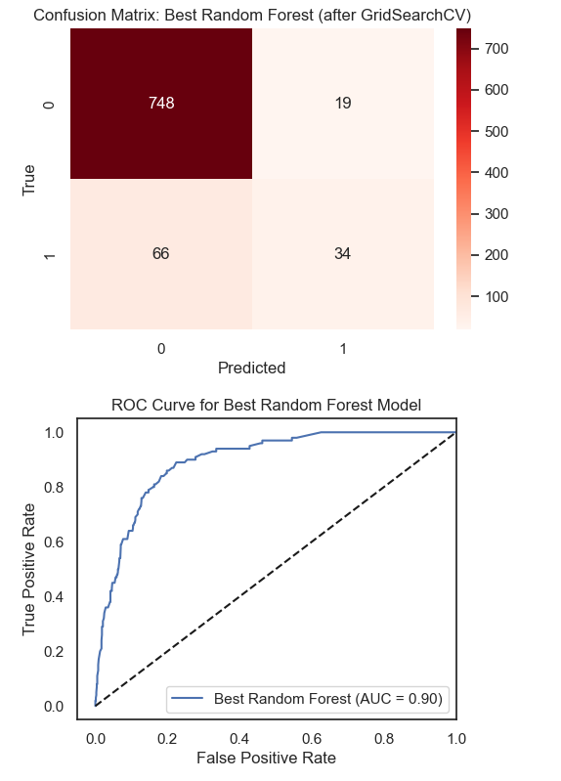
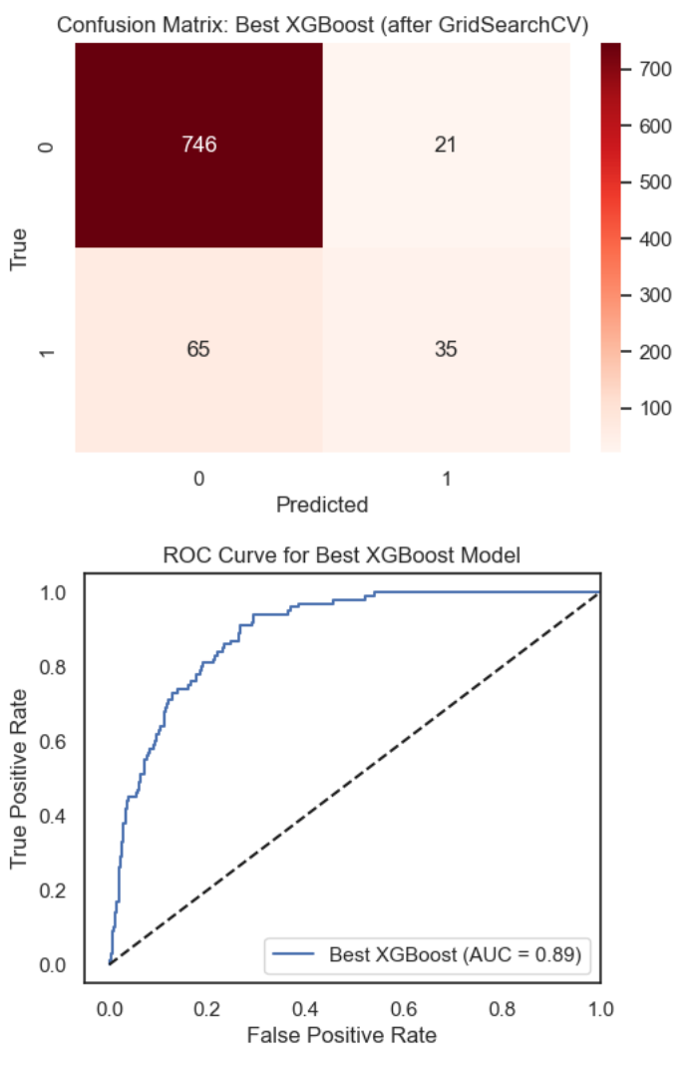
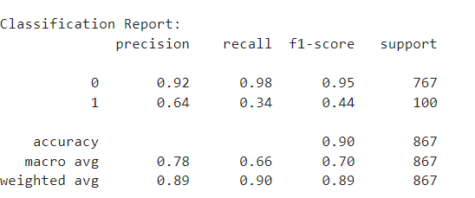
Comparison of Random Forest and XGBoost Models After GridSearchCV:
Classifier | Accuracy | Precision | Recall | F1 Score
Random Forest | 86 | 53 | 43 | 41
Random Forest + GridSearchCV | 90 | 88 | 90 | 88
XGBoost | 90 | 43 | 65 | 45
XGBoost + GridSearchCV | 90 | 88 | 90 | 88
Random Forest: Good balance between accuracy and interpretability (AUC = 0.90).
XGBoost: Slightly better accuracy but potentially less interpretable (AUC = 0.89).

Slide 17
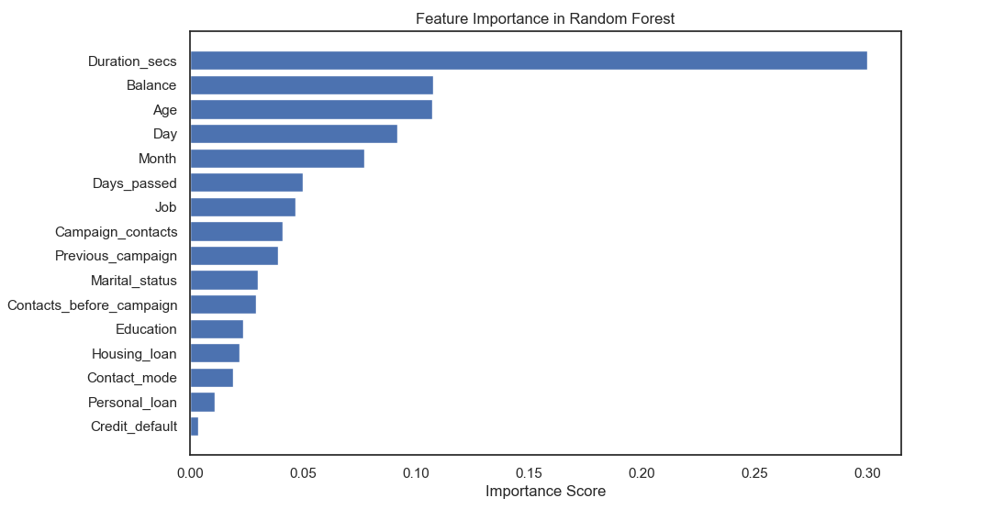
Feature Importance :
Importance Scores (x-axis):
Feature importance scores quantify the contribution of each feature to the model’s performance.
The feature Duration_secs has the highest importance score.
The least important feature according to this chart is Credit_default.

Slide 18
Conclusions:
The Month of May has the maximum subscriptions followed by August.
Blue-collar, management and technician showed maximum interest in subscription.
Compared to married and single, Divorced people have less interest in term deposits.
People with secondary education followed by tertiary education were subscribed to term deposit.
Generally people who don't have credit in default are interested in a deposit. Majority of the people have a home loan but only few of them opted for a term deposit.
Cellular communication is seen as more effective in comparison to other communication types.
The calls with large duration have more tendency for conversion. Majority of people were not contacted previously before this campaign.
The choice between "Random Forest" and "XGBoost" for predicting Effectiveness has been evaluated. Random Forest After GridSearchCV is preferred due to its accuracy of 90% % with F1- Score of (0.8884)and its superior interpretability, which facilitates a clearer understanding and explanation of the model’s predictions compared to XGBoost.
Future Scope:
We could also analyse the impact of positive account balance maintained by the clients and where the previous column = 0 can be potential client database to pitch for Term deposit.

Slide 19
Thank You.

