Slide 1

Global AI Index ‘Nations' Innovation, Investment and Implementation Levels’
- Vinitha Sampathkumar

Slide 2
Agenda:
Understanding Problem Statement
EDA-Exploring trends in Data Set
Unsupervised Learning
Supervised Learning
Results & Outcome
Kaggle dataset: https://www.kaggle.com/datasets/katerynameleshenko/ai-index/data Tortoisemedia: https://www.tortoisemedia.com/intelligence/global-ai/

Slide 3
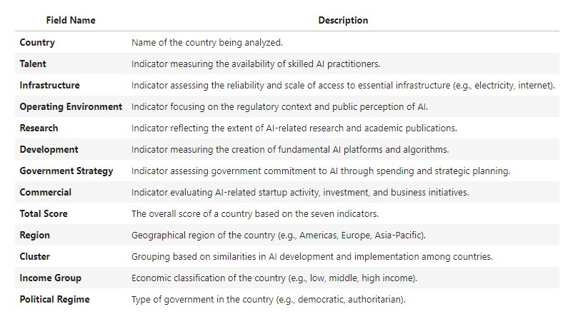
Understanding Problem Statement
Problem Statement: Predicting AI Development Potential among the Cluster
Implementation
Talent Measures the availability of skilled AI practitioners..
Infrastructure assesses the scale of advanced computing infrastructure and semiconductor manufacturing.
Operating Environment focuses on the regulatory context of and public opinion on artificial intelligence.
Innovation
Research looks at the quantity and quality of specialist academic and industry research.
Development Focuses on new AI models and their applications in patents across various fields.
Investment
Government Strategy Gauges government commitment through spending and national strategies.
Commercial Focuses on new AI models and their applications in patents across various fields.

Slide 4
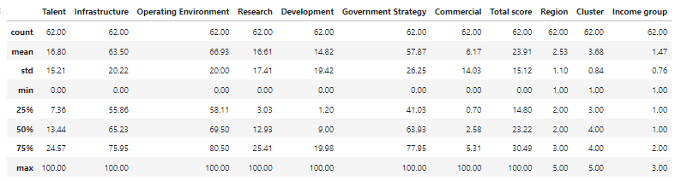
EDA-Exploring trends in Data Set
Data Exploration:
The dataset has 62 rows and 13 features (columns).
5 categorical features.
8 Numerical features.
No null values.
No Duplicate values.
No Missing Values.
Basic statistics:

Slide 5
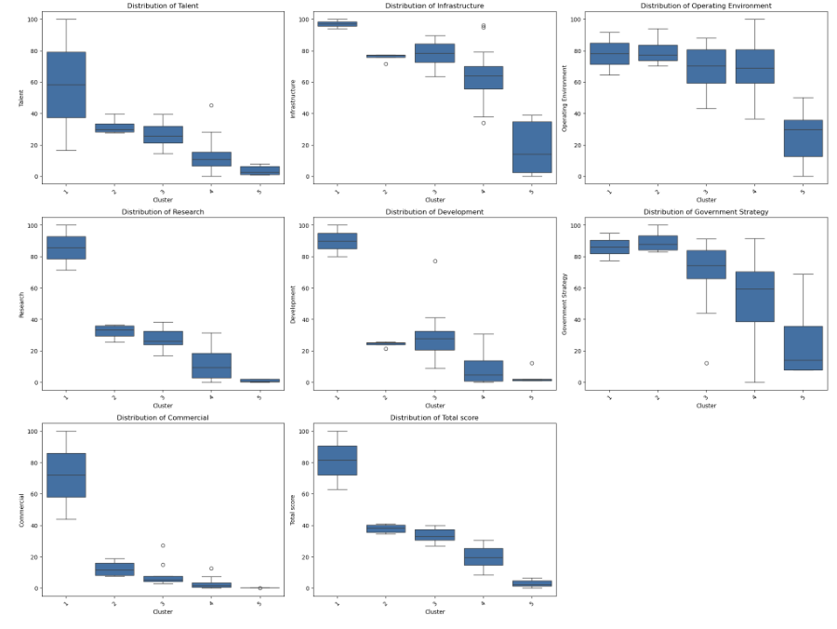

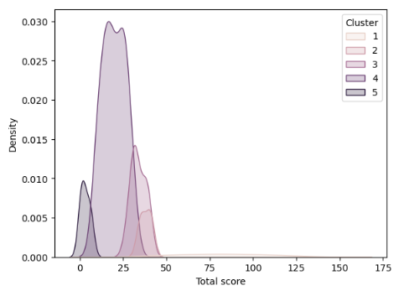
Visualizations:

Slide 6
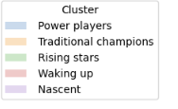
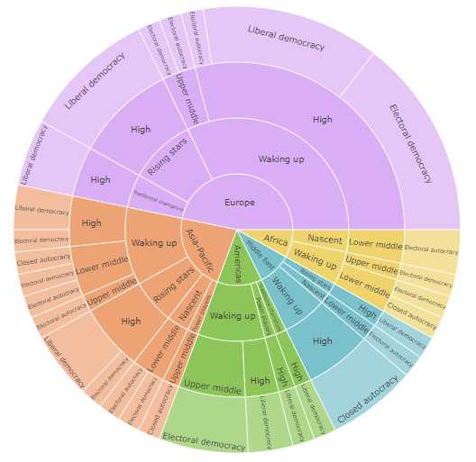
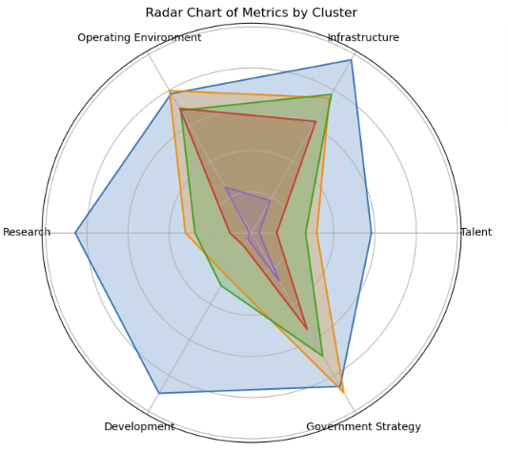
Number of countries by region, cluster, Income group and political regime

Slide 7
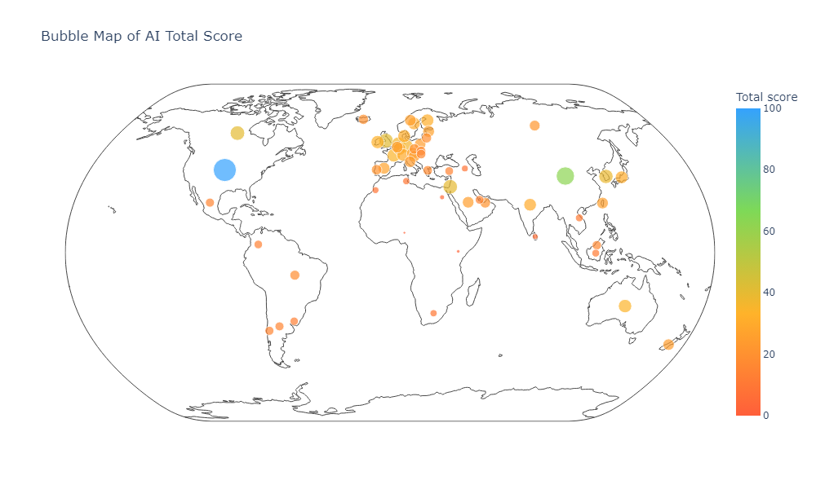

Slide 8
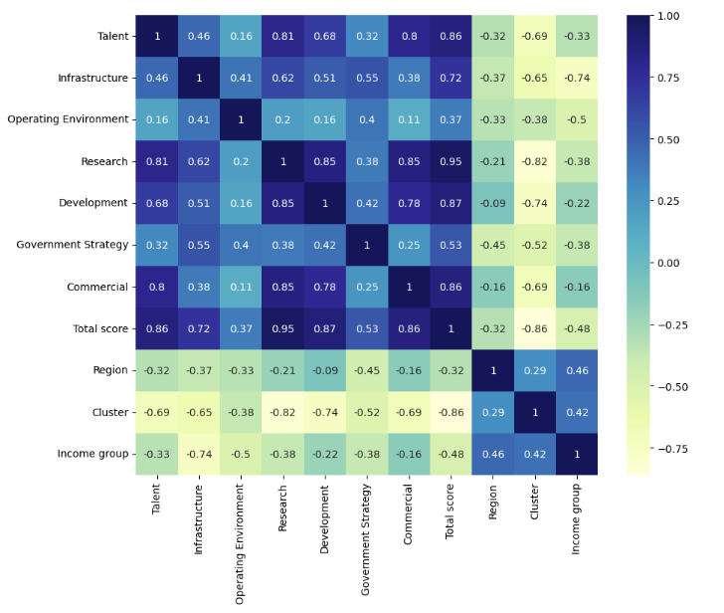
Correlation Heatmap:
Key Observations:
High Correlations:
Research and Total Score (0.946): Indicates that higher research capabilities strongly correlate with higher overall scores.
Research and Talent (0.810): Suggests that areas with more talent tend to have better research outputs.
Development and Total Score (0.866): Highlights that development efforts are closely linked to overall success.
Moderate Correlations:
Talent and Commercial (0.795): Suggests a relationship where talent availability impacts commercial success.
Infrastructure and Research (0.617): Indicates that better infrastructure may support more effective research.
Lower Correlations:
Operating Environment shows relatively low correlations with other factors, suggesting it may have a lesser impact on AI implementation and outcomes compared to other indicators.

Slide 9
Unsupervised Learning(Clustering)
Univariate Clustering on Total score and Research
Bivariate Clustering
Implementation - Infrastructure + Operating Environment
Innovation - Research + Development
Investment - Government Strategy + Commercial
Multivariate Clustering on Talent, Infrastructure, Operating Environment, Research, Development, Government Strategy, Commercial, Total score, Region, Cluster, Income group

Slide 10
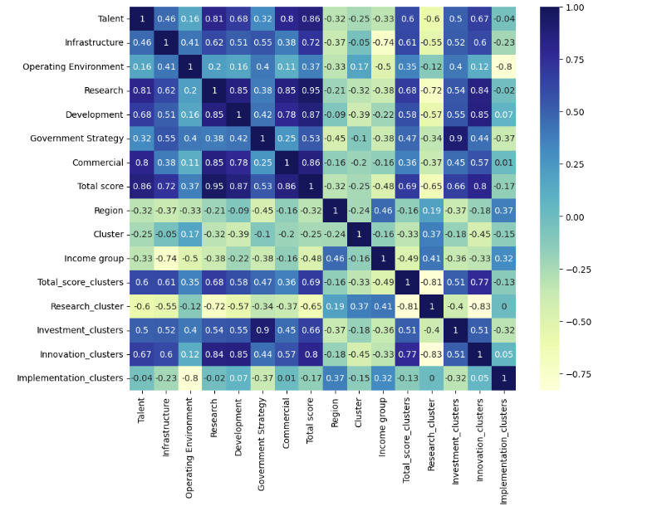

Slide 11

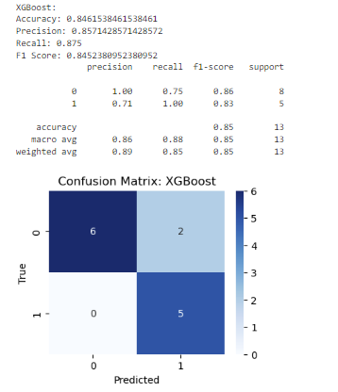
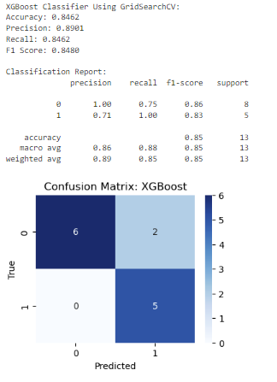
Supervised Learning

Slide 12
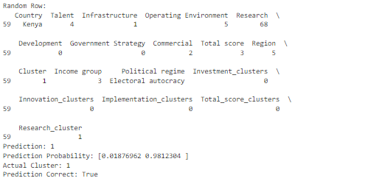
Random Row Prediction and Validation in AI Development Clusters

Slide 13

Conclusions:
A strong positive correlation indicates that countries excelling in research are also likely to perform well in developing new AI models. This highlights the importance of investing in academic and industry research as a foundation for innovation.
Total Score and Commercial Activity suggest that higher overall scores are associated with robust commercial ecosystems, highlighting the importance of business initiatives in fostering AI growth.
Future Scope:
Targeted investments in talent development, infrastructure, and government strategy can significantly enhance AI capabilities, especially in regions currently lagging behind.

