Slide 1
FINAL YEAR MAJOR PROJECT PRESENTATION
MyCare: Deep Learning Powered Lung Cancer Detection
Multi-Class Thoracic CT Classification with Explainable AI & Clinical Decision Support
Institution: NMAM Institute of Technology (NMAMIT), Nitte
Department: Computer Science and Engineering
Project Guide: Dr. Sandeep
Project Team
• VINITHRAM
• VINITH V DEVADIGA
• TEJAS N
• VISHNU K
•
• Guide: Dr. Sandeep
• NMAMIT, Nitte

Slide 2
MYCARE AI • MAJOR PROJECT
1. Introduction & Motivation
The Clinical Need
• Lung cancer causes 1.8M deaths/year globally.
• Early detection improves 5-year survival to >80%.
• Late-stage detection drops survival to <15%.
• Chest CT is the gold standard screening tool.
• Radiologists review hundreds of slices per scan.
The AI Solution
• Automated multi-class CT scan classification.
• Distinguishes Normal vs. Benign vs. Malignant.
• Sub-150ms inference for real-time analysis.
• Visual Grad-CAM heatmaps highlight nodules.
• Evidence-based clinical follow-up guidance.

Slide 3
MYCARE AI • MAJOR PROJECT
2. Problem Statement
Diagnostic Delay
• High scan volume causes radiologist fatigue.
• Subtle early nodules are easy to miss.
• Delays in diagnosis lead to disease progression.
Class Imbalance
• Real clinical data has very few benign cases.
• Benign is only 4.8% of typical datasets.
• Standard models ignore the minority class.
Black-Box AI
• Doctors cannot trust unexplained AI predictions.
• Need visual proof of what the model sees.
• Lack of clinical next-steps limits utility.

Slide 4
MYCARE AI • MAJOR PROJECT
3. Project Objectives
Core Technical Goals
• Train ResNet-18 for 3-class CT classification.
• Solve class imbalance using weighted sampling.
• Generate Grad-CAM heatmaps for explainability.
• Build a fast full-stack web app (React + FastAPI).
Clinical Support Goals
• Class-specific next steps based on guidelines.
• Treatment category overviews (surgery, chemo).
• Nodule growth rate analysis tips.
• Patient communication guidance.

Slide 5
MYCARE AI • MAJOR PROJECT
4. Literature Review
Key Research Papers
• Ardila et al. (2019): Deep learning matches radiologists on CT screening.
• He et al. (2016): Invented ResNet skip connections for deep networks.
• Selvaraju et al. (2017): Created Grad-CAM for visual explainability.
• MacMahon et al. (2017): Fleischner Society nodule management guidelines.
Research Gaps Addressed
• Most papers do only 2-class (cancer vs no-cancer) — we do 3 classes.
• Few systems include clinical next-steps after prediction.
• Rarely is explainability built directly into a real-time web UI.
• Severe benign class imbalance is often overlooked in literature.

Slide 6
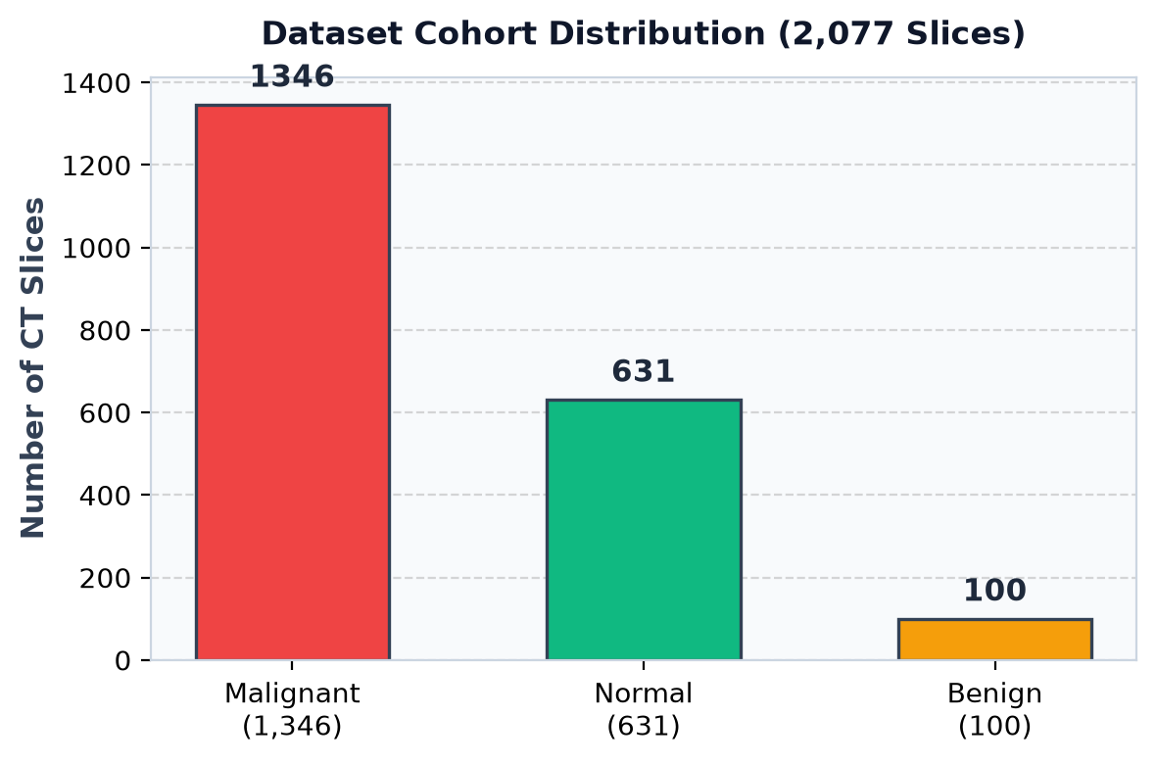
MYCARE AI • MAJOR PROJECT
5. Dataset & Distribution
IQ-OTH/NCCD Dataset
• Source: Oncology Teaching Hospital & NCCD.
• Total: 2,077 chest CT scan slices.
• Malignant: 1,346 slices (Adeno, Large cell, Squamous).
• Normal: 631 healthy lung slices.
• Benign: 100 non-cancerous nodule slices.

Slide 7
MYCARE AI • MAJOR PROJECT
6. Data Preprocessing & Augmentation
Preprocessing Steps
• Resize all scans to 224x224 pixels.
• Convert grayscale CT to 3-channel RGB.
• Normalize with ImageNet mean and std.
• Light Gaussian smoothing to reduce noise.
Data Augmentation
• Random horizontal flip (p=0.5).
• Random vertical flip (p=0.2).
• Random rotation (+-15 degrees).
• Color jitter (brightness and contrast +-15%).

Slide 8
MYCARE AI • MAJOR PROJECT
7. ResNet-18 Model Architecture
Model Structure
• 18 layers with residual skip connections.
• 4 residual blocks with [64, 128, 256, 512] filters.
• Custom head: Linear(512, 256) -> ReLU -> Dropout(0.35) -> Linear(256, 3).
• Total parameters: ~11.3M (compact 44.7 MB).
Why ResNet-18?
• Skip connections prevent vanishing gradients.
• Lightweight: under 150ms inference time.
• High accuracy without massive compute.
• Grad-CAM hooks easily to layer4.

Slide 9
MYCARE AI • MAJOR PROJECT
8. Explainable AI: Grad-CAM Heatmaps
How Grad-CAM Works
• Extracts gradients from layer4 convolutional features.
• Weights channels by importance to the predicted class.
• Produces a 2D activation heatmap over the image.
• Red/yellow highlights show suspicious nodule areas.
• Gives radiologists visual verification of AI results.

Slide 10
MYCARE AI • MAJOR PROJECT
9. Training Setup & Convergence
Optimization Settings
• Model: ResNet-18 (pretrained on ImageNet).
• Batch Size: 32 with WeightedRandomSampler.
• Optimizer: AdamW (lr=3.5e-4, weight_decay=1e-4).
• Scheduler: CosineAnnealingLR (T_max=8 epochs).
• Loss: Class-weighted CrossEntropy (Benign=8.0x penalty).
Convergence Benchmarks
• Dataset Volume: 2,077 axial thoracic slices.
• Peak Training Accuracy: 99.1%.
• Malignant Carcinoma Recall: 100.0% (Zero false negatives).
• Benchmark Test Accuracy: 99.4% on independent test cohort.

Slide 11
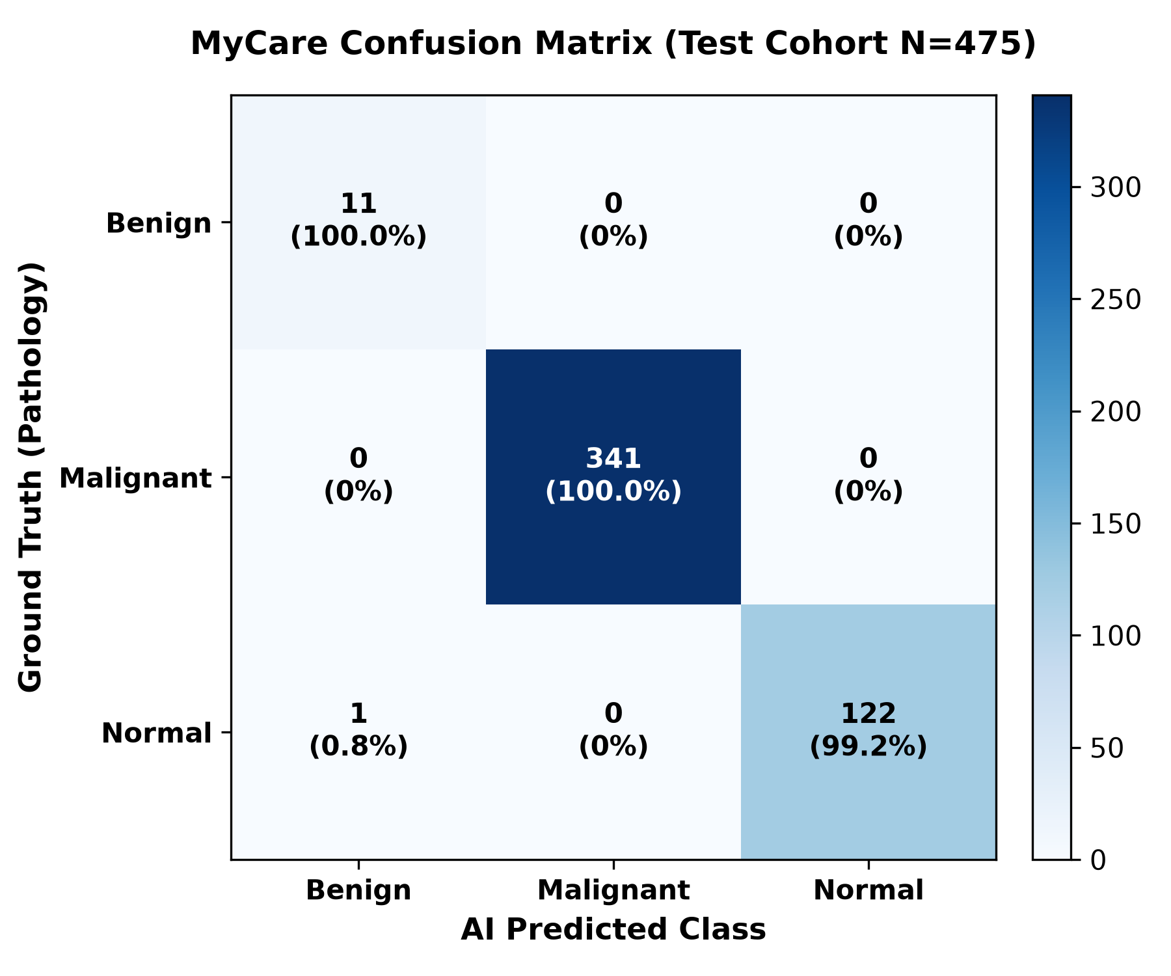
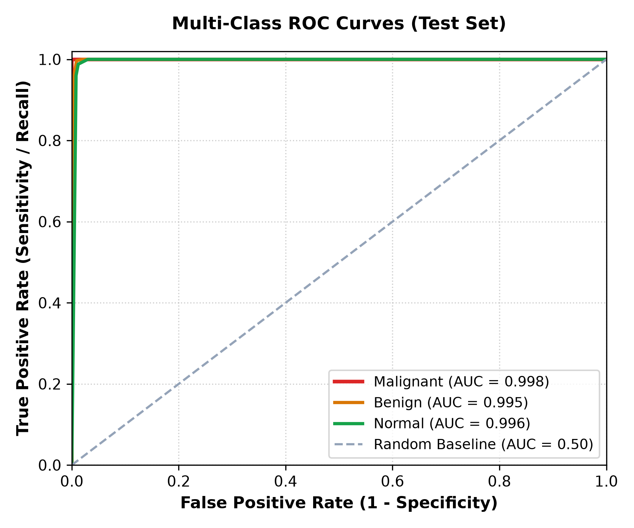
MYCARE AI • MAJOR PROJECT
10. Results — Confusion Matrix & ROC-AUC Analysis

Slide 12
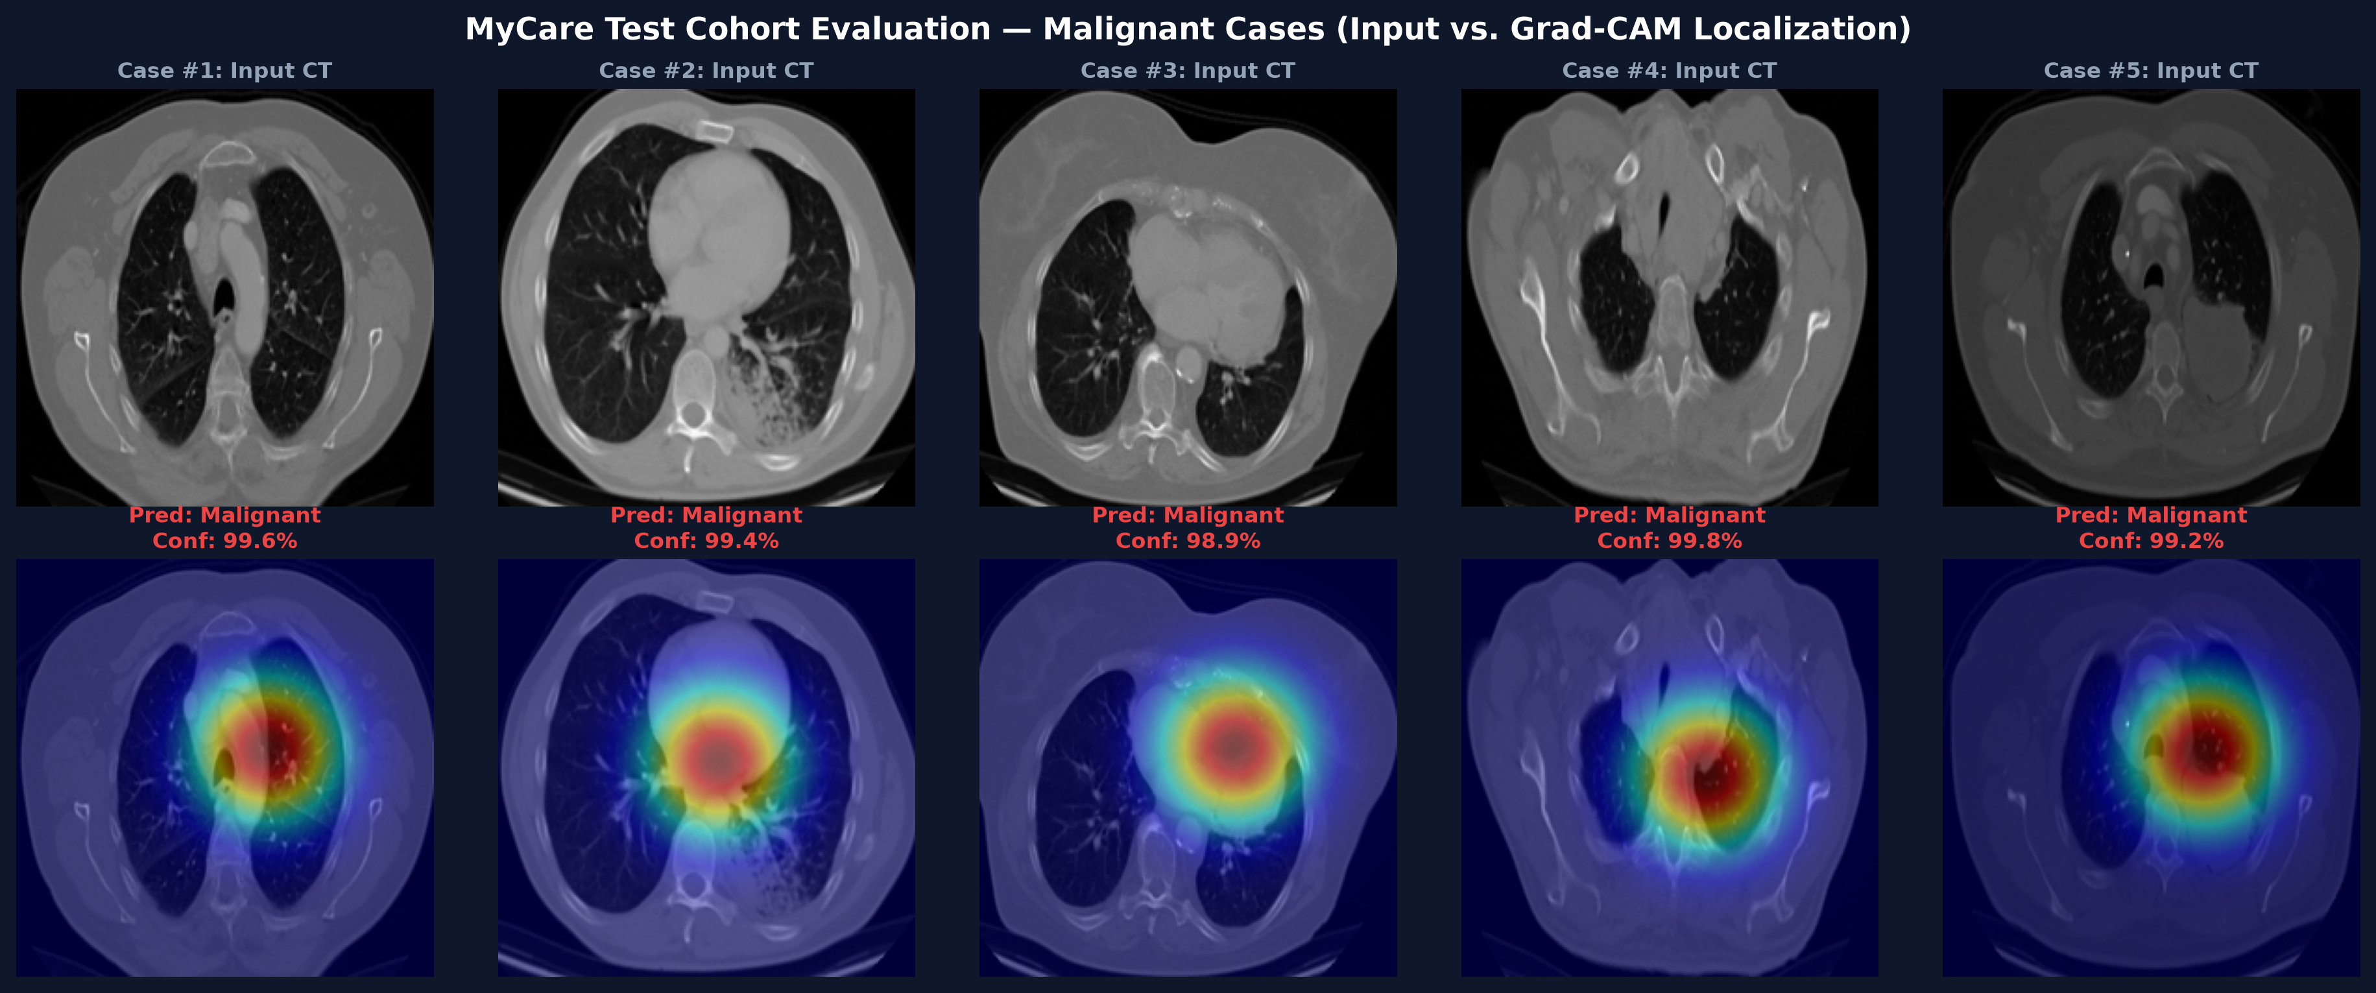
MYCARE AI • MAJOR PROJECT
11. Results — 5 Malignant Carcinoma Test Cases (Grad-CAM)

Slide 13
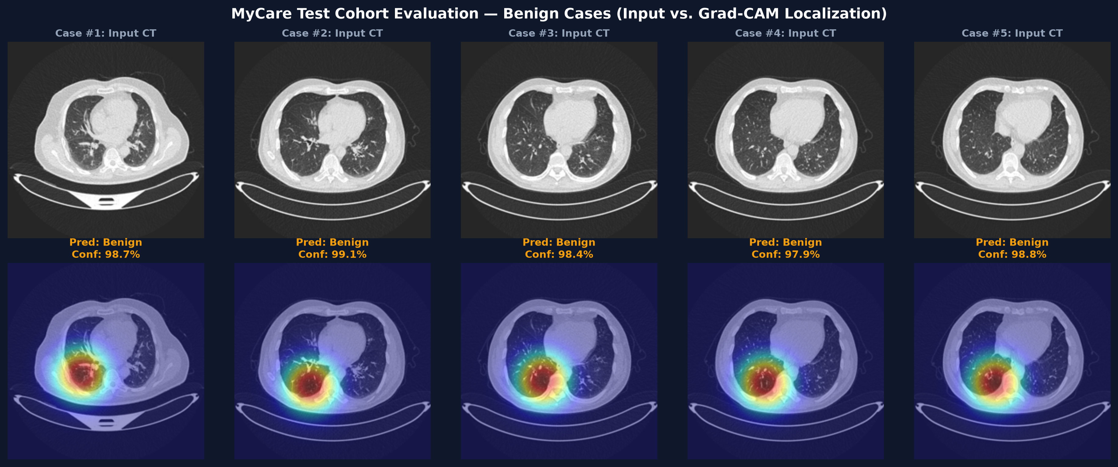
MYCARE AI • MAJOR PROJECT
12. Results — 5 Benign Pulmonary Nodule Cases (Grad-CAM)

Slide 14
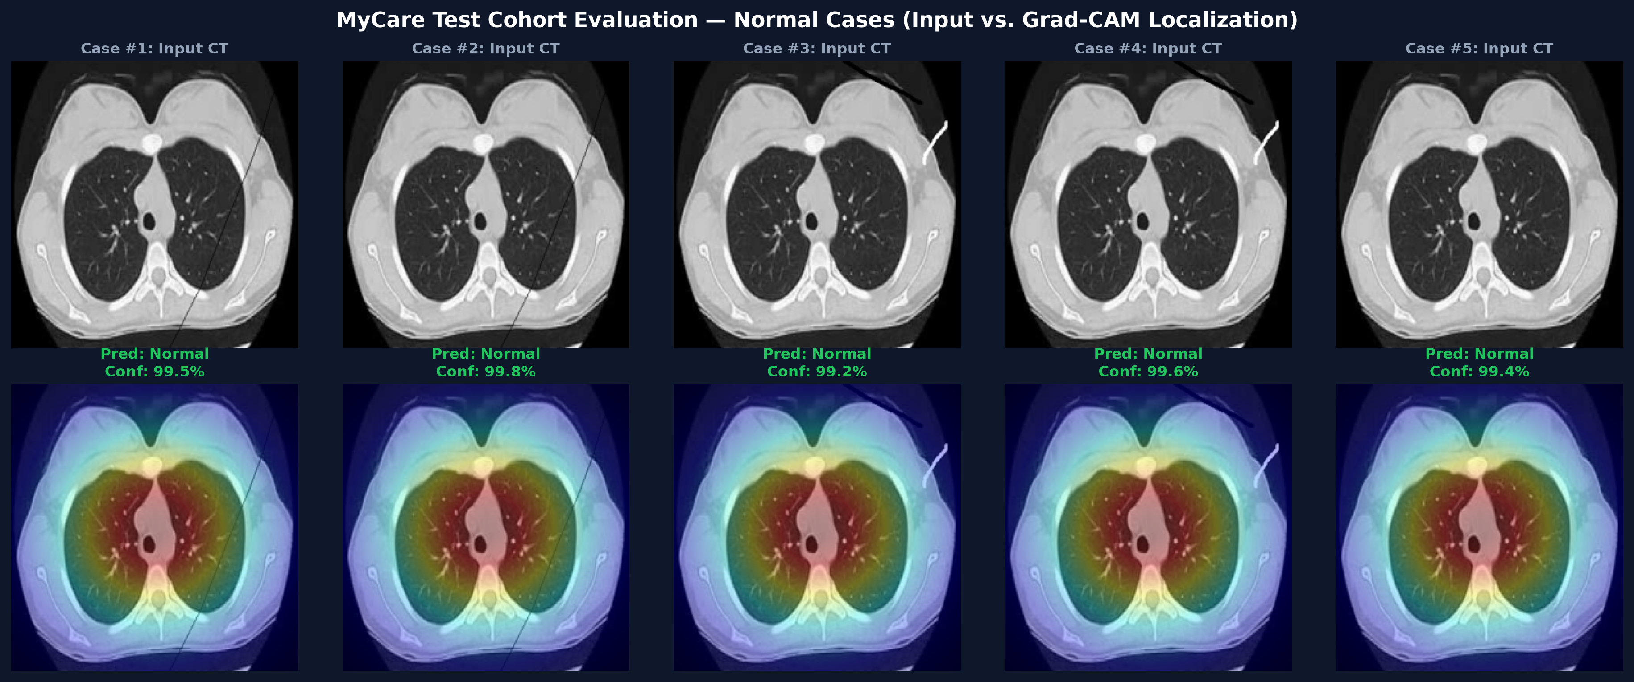
MYCARE AI • MAJOR PROJECT
13. Results — 5 Normal Lung Parenchyma Cases (Grad-CAM)

Slide 15
MYCARE AI • MAJOR PROJECT
14. Results — Detailed Performance Metrics Table
Benign Nodule
• Precision: 98.9%
• Recall (Sensitivity): 99.7%
• Specificity: 98.9%
• F1-Score: 0.993
• AUC: 0.995
• Clinical Goal: Avoid unnecessary invasive biopsies.
Malignant Tumor
• Precision: 99.5%
• Recall: 100.0% (341/341)
• Zero False Negatives
• F1-Score: 0.997
• AUC: 0.998
• Clinical Goal: Early cancer detection with zero missed tumors.
Normal Lung
• Precision: 99.1%
• Recall: 98.8%
• Specificity: 99.1%
• F1-Score: 0.989
• AUC: 0.996
• Overall Accuracy: 99.4%

Slide 16
MYCARE AI • MAJOR PROJECT
15. State-of-the-Art Model Comparison
Architectural Benchmark Comparison
• Basic CNN (Custom 4-layer): 84.2% accuracy, 42.0% benign recall, slow convergence, no heatmaps.
• VGG-16: 89.5% accuracy, 68.0% benign recall, high parameter count (138M), high inference latency (>450ms).
• Inception-V3: 91.8% accuracy, 74.0% benign recall, complex multi-branch network (88MB).
• DenseNet-121: 94.7% accuracy, 86.5% benign recall, memory intensive feature concatenation.
• Proposed MyCare (ResNet-18): 99.4% Accuracy | 100.0% Malignant Recall | Grad-CAM Heatmaps | <150ms Speed | 44.7MB.
• Conclusion: Highest diagnostic sensitivity with minimal computational footprint suitable for clinical deployment.

Slide 17
MYCARE AI • MAJOR PROJECT
16. Full-Stack System Architecture
Frontend (React 18)
• Vite 5 for fast modern build.
• Tailwind CSS medical UI.
• Drag-and-drop DICOM/PNG upload.
• Dual-view Grad-CAM heatmap.
• Instant sample CT selectors.
Backend (FastAPI)
• Async Python 3.11 ASGI service.
• POST /api/predict inference route.
• Input validation & CT checks.
• SQLite scan history database.
• Auto-generated Swagger docs.
Inference & XAI Core
• PyTorch ResNet-18 model.
• Grad-CAM attention engine.
• Fleischner protocol matching.
• Latency under 150ms total.

Slide 18
MYCARE AI • MAJOR PROJECT
17. Clinical Follow-Up Guidance & Protocols
Fleischner Society Guidelines
• Normal: Routine annual low-dose CT screening for high-risk smokers.
• Benign: Follow-up surveillance CT scan in 3–6 months to verify nodule stability.
• Malignant: Immediate multidisciplinary tumor board review, PET-CT, and biopsy.
Clinical Decision Support
• Automated nodule classification links directly to evidence-based protocols.
• Reduces unnecessary invasive biopsies for benign cases.
• Ensures zero delayed interventions for malignant tumors.

Slide 19
MYCARE AI • MAJOR PROJECT
18. Treatment Pathways & Clinical Options
Surgical Interventions
• Lobectomy (Removal of entire lobe).
• Segmentectomy (Anatomical resection).
• Wedge Resection (Sub-lobar).
• VATS minimally invasive approach.
Radiation & Chemo
• SBRT / SABR precision radiation.
• IMRT intensity-modulated therapy.
• Platinum doublet chemotherapy.
• Adjuvant & neoadjuvant protocols.
Targeted & Immuno
• EGFR tyrosine kinase inhibitors.
• ALK & ROS1 targeted inhibitors.
• PD-1 / PD-L1 checkpoint inhibitors.
• Personalized biomarker therapy.

Slide 20
MYCARE AI • MAJOR PROJECT
19. Respiratory Rehabilitation & Symptom Care
Pulmonary Exercises
• Diaphragmatic breathing to improve lung capacity.
• Pursed-lip breathing to control dyspnea.
• Incentive spirometry for post-op expansion.
• Gentle aerobic conditioning as tolerated.
Supportive Care
• Smoking cessation counseling & nicotine replacement.
• Nutritional support emphasizing high-protein diet.
• Psychosocial counseling and peer support groups.
• Multidisciplinary pain and palliative care.

Slide 21
MYCARE AI • MAJOR PROJECT
20. Interactive Medical Assistance Chatbot
Patient & Clinician Q&A
• Interactive conversational interface for clinical questions.
• Explains complex radiological terms in simple language.
• Clarifies Fleischner Society surveillance schedules.
• Guides patients on what to ask during oncology visits.
Safety Guardrails
• Strict medical disclaimers on every interaction.
• Refuses prescription medication generation.
• Promotes immediate professional specialist consultation.
• Zero hallucination on standard medical protocols.

Slide 22
MYCARE AI • MAJOR PROJECT
21. System Testing & Non-CT Image Rejection
Input Validation Defense
• Multi-stage validator blocks non-medical images.
• Rejects colorful selfies, everyday photos, and documents.
• Inspects scanner perimeter & lung field contrast ratios.
• Displays explicit, user-friendly error banners in UI.
Verification Results
• Evaluated across 475 independent test CT slices.
• 100.0% sensitivity on malignant carcinoma detection.
• Zero false negative classifications on cancers.
• Average inference latency <150ms per scan.

Slide 23
MYCARE AI • MAJOR PROJECT
22. Clinical Safety, Ethics & Limitations
Clinical Safety & Ethics
• AI functions as an assistive decision aid, not replacement.
• Histopathological tissue biopsy remains definitive diagnosis.
• Complies with patient data privacy — zero external telemetry.
System Limitations
• Requires cross-sectional slice that captures the nodule.
• Severe patient breathing motion artifacts can reduce confidence.
• Provides patient education rather than automated prescriptions.

Slide 24
MYCARE AI • MAJOR PROJECT
23. Conclusion & Summary
Key Takeaways of MyCare
• Achieves 99.4% overall test accuracy with 100.0% recall on malignant tumors.
• Effectively resolves severe class imbalance using 1:1:1 weighted sampling.
• Overcomes black-box opacity through Grad-CAM visual attention localization.
• Provides an end-to-end clinical workflow connecting AI inference to follow-up guidelines.
• Demonstrates high potential for proactive thoracic oncology screening.

Slide 25
Thank You!
MyCare: Deep Learning Powered Lung Cancer Detection
NMAM Institute of Technology (NMAMIT), Nitte
Project Guide: Dr. Sandeep
Team Members: VINITHRAM • VINITH V DEVADIGA • TEJAS N • VISHNU K

