Slide 1


SMART INDIA HACKATHON 2026
• Problem Statement ID – SIH26191
• Problem Statement Title – Intelligent Identification of Hazard-Based Red Zones, Carrying Capacity Assessment, and Immediate Relocation Needs for Vulnerable Habitations.
• Theme – Disaster Management
• PS Category – Software
• Team ID – 170297
• Team Name – NOVACORE

Slide 2
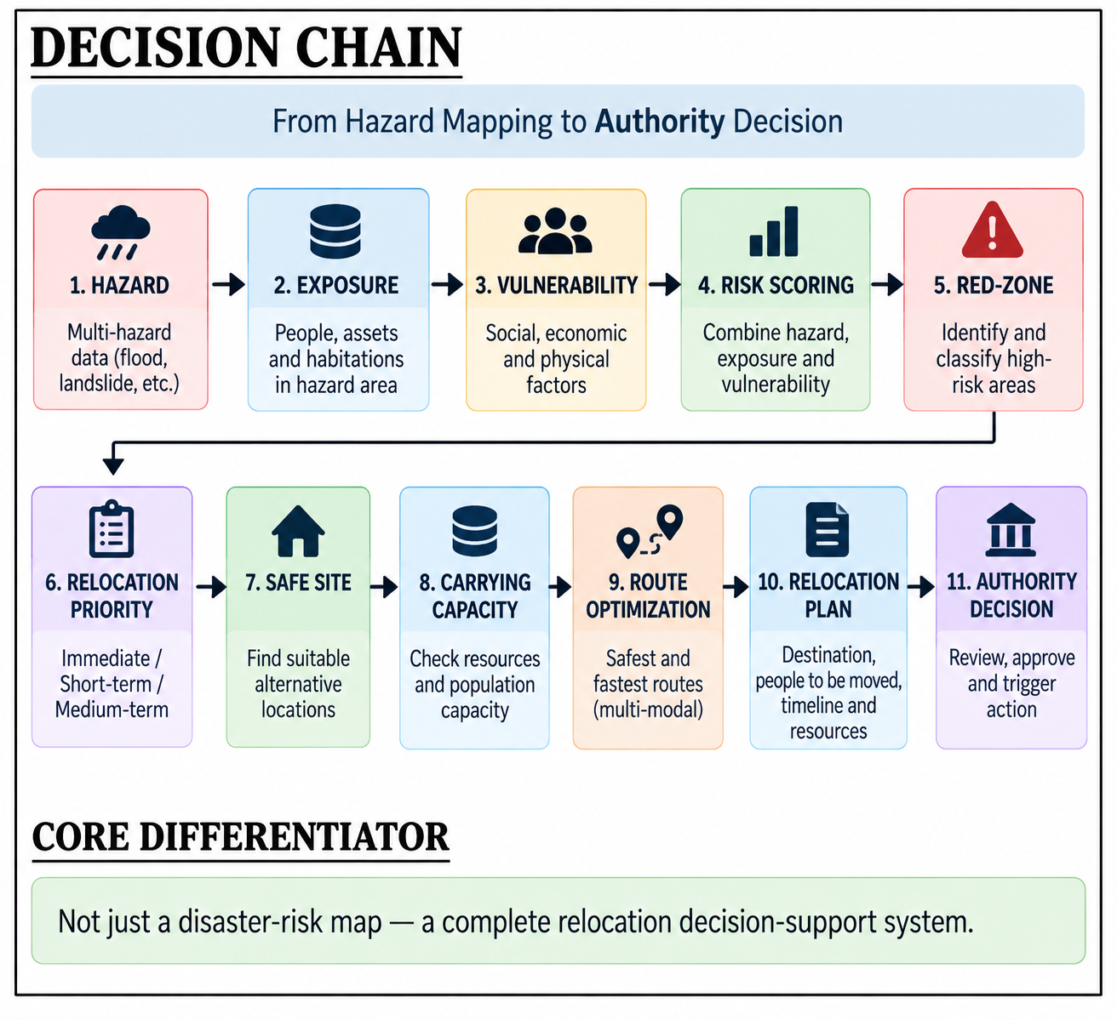
PROPOSED SOLUTION: RAKSHASETU (Smart Disaster Intelligence)
RAKSHASETU — AI-Powered Hazard-Zone, Vulnerability & Relocation Intelligence Platform | GitHub: https://github.com/vinitmishraaa/RAKSHASETU
🔴 1. Dynamic Hazard-Based Red-Zone Delineation
➢ Identifies zones Unsuitable for Permanent Habitation dynamically via live sensor feeds.
➢ 4 PS Hazards Modeled: Floods, Landslides, Coastal Erosion, and Cloudbursts.
➢ GIS Animated Blowout Rings: Pulsating radar perimeters pinpoint threat severity.
📱 PROJECT LINKS & REPOSITORIES (Click to Open):
• GitHub Code Repository: https://github.com/vinitmishraaa/RAKSHASETU
• Live Web Dashboard: http://localhost:5173 | FastAPI Docs: /docs
📷 [PLACE PHOTO HERE]
Main Dashboard: Multi-Hazard Red-Zone GIS Map
👉 Screenshot from http://localhost:5173 with State='West Bengal' and Red Zones filter ON.
⏱️ 2. 3-Tier Relocation Need Prioritization
➢ 🔴 Immediate (0–48 Hours): Rapid tactical evacuation for acute life-threats.
➢ 🟠 Short-Term (1–3 Months): Pre-monsoon planned relocation before floods/slides.
➢ 🟡 Medium-Term (6–12 Months): Sustainable rehabilitation & permanent housing.
📷 [PLACE PHOTO HERE]
Carrying Capacity Assessment & Stress Gauge Card
👉 Screenshot from Relocation page showing capacity progress bar, stress %, and headroom.
🏢 3. Carrying Capacity Assessment & Overcrowding Mitigation
➢ Evaluates Total Capacity, Pre-Occupancy, and Net Absorption Headroom.
➢ Automated Multi-Site Split: Prevents secondary disaster outbreak when stress >85%.
➢ 100% Zero Operating Cost: Built completely on open-source APIs (Open-Meteo, USGS, OSM).

Slide 3
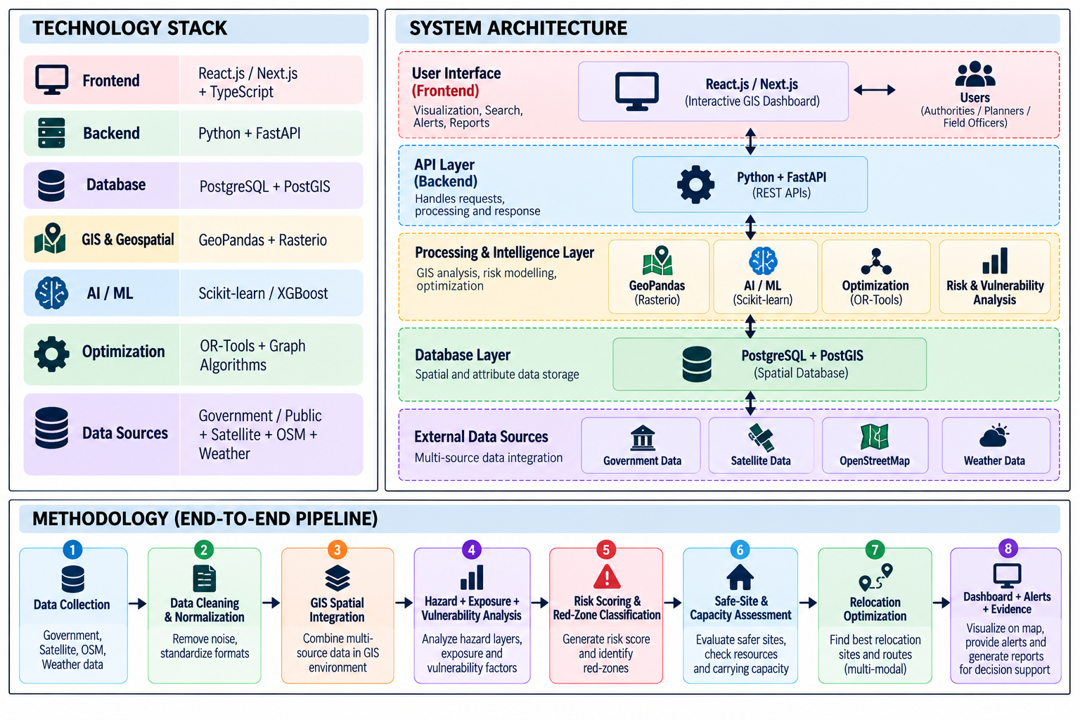
TECHNICAL APPROACH: End-to-End System Workflow
Step 1: Telemetry
Live Open Data
• Open-Meteo Weather
• USGS Earthquakes
• NDMA SACHET CAP
Step 2: Risk Engine
3-Pillar Formula
• Hazard Intensity (40%)
• Vulnerability (35%)
• Disaster History (25%)
Step 3: Red Zones
Red-Zone Delineation
• Multi-hazard unsuitability
• 4 Hazards: Flood, Slide,
Erosion, Cloudburst
Step 4: Safe Sites
Capacity Assessment
• Headroom & stress %
• Overcrowding split
• OSRM road routing
Step 5: Action
SDMA Action Corridor
• 4-Step guided flow
• Google Maps driving
• 🖨️ Printable order
💻 TECHNOLOGY STACK & SMART FEATURES:
• Frontend: React 18, TypeScript, Vite, Leaflet.js, Recharts, Custom Glassmorphism UI.
• Backend: Python 3.12, FastAPI, In-Memory Administrative Directory (36 States/UTs).
• Road Network Routing: Open Source Routing Machine (OSRM) driving route geometry & live ETA.
• 3-Pillar Risk Engine: 40% Hazard Intensity + 35% Vulnerability + 25% Disaster History Recurrence.
• Carrying Capacity Engine: Dynamic absorption headroom gauge & automated split allocation.
• SDMA Decision Suite: 4-Step evacuation corridor, Google Maps mobile handoff, printable order brief.
• GitHub Code Link: https://github.com/vinitmishraaa/RAKSHASETU
📷 [PLACE PHOTO HERE]
4-Step Guided Official Relocation Corridor & Road Route
👉 Screenshot from Relocation page showing 4 steps, OSRM road distance, ETA, and turn-by-turn guidance.
📷 [PLACE PHOTO HERE]
Official SDMA Relocation Order Print Preview
👉 Screenshot of the print dialog after clicking 'Export / Print Official SDMA Relocation Order'.

Slide 4
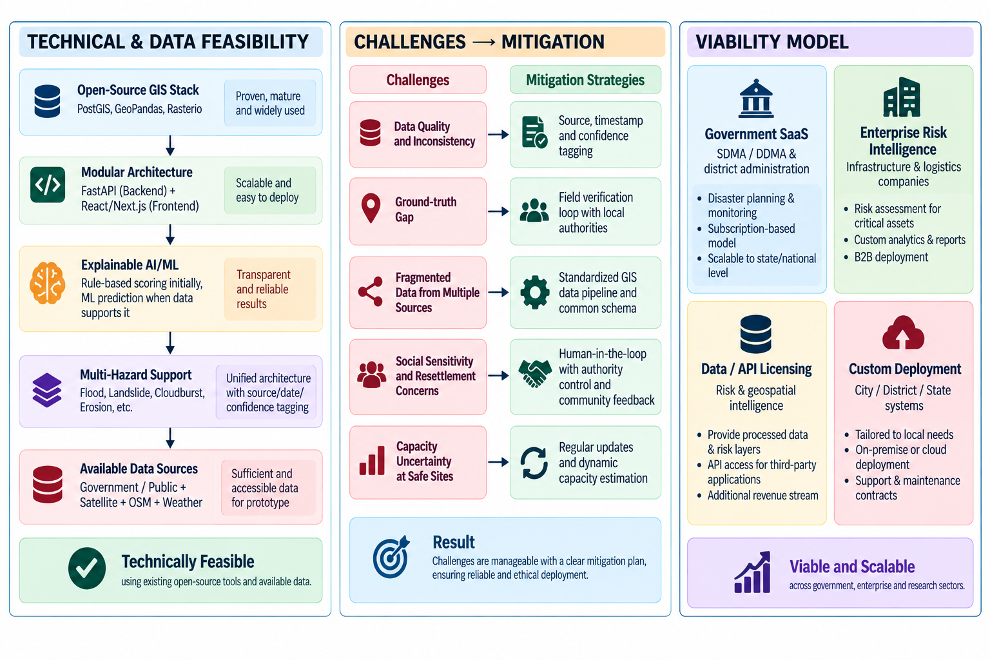
FEASIBILITY & VIABILITY: Operational & Comparative Assessment
Operational Dimension | Traditional Reactive Method | RakshaSetu Proactive AI-GIS | Key Advantage
Response Timing | Post-disaster rescue (Panic & delay) | Proactive pre-disaster tiers (0-48h, 1-3m, 6-12m) | Zero panic & loss
Hazard Delineation | Manual, localized post-event survey | Dynamic GIS Multi-Hazard Red-Zone mapping | High precision
Safe Site Allocation | Ad-hoc intake (Severe overcrowding) | Carrying capacity headroom stress % analysis | Prevents stampede
Evacuation Routing | Unverified paths (often blocked) | OSRM real road network & Google Maps handoff | Guaranteed ETA
Financial Cost | Expensive proprietary GIS licenses | 100% Open-source zero-key architecture | ₹0 Software Bills
📷 [PLACE PHOTO HERE]
Safe Sites Infrastructure & Headroom Stress Meter
👉 Screenshot from Safe Sites page (/safe-sites) showing shelter cards with capacity, occupancy, and headroom.
📷 [PLACE PHOTO HERE]
Multi-Site Split Allocation to Prevent Overcrowding
👉 Screenshot showing Relocation page recommendation when high population is allocated safely across shelters.
🎯 3 REASONS WHY RAKSHASETU IS 100% FEASIBLE & VIABLE:
➢ Zero Key Operating Cost: Relies on public Open-Meteo, USGS, NDMA CAP and OpenStreetMap with no cloud bills.
➢ Deterministic & Explainable AI: Formulated on clear mathematical equations (40% Hazard, 35% Vulnerability, 25% History) avoiding black-box errors.
➢ Pan-India Immediate Deployment: All 28 States and 8 UTs pre-indexed; instantly scalable to every SDMA and DDMA.

Slide 5
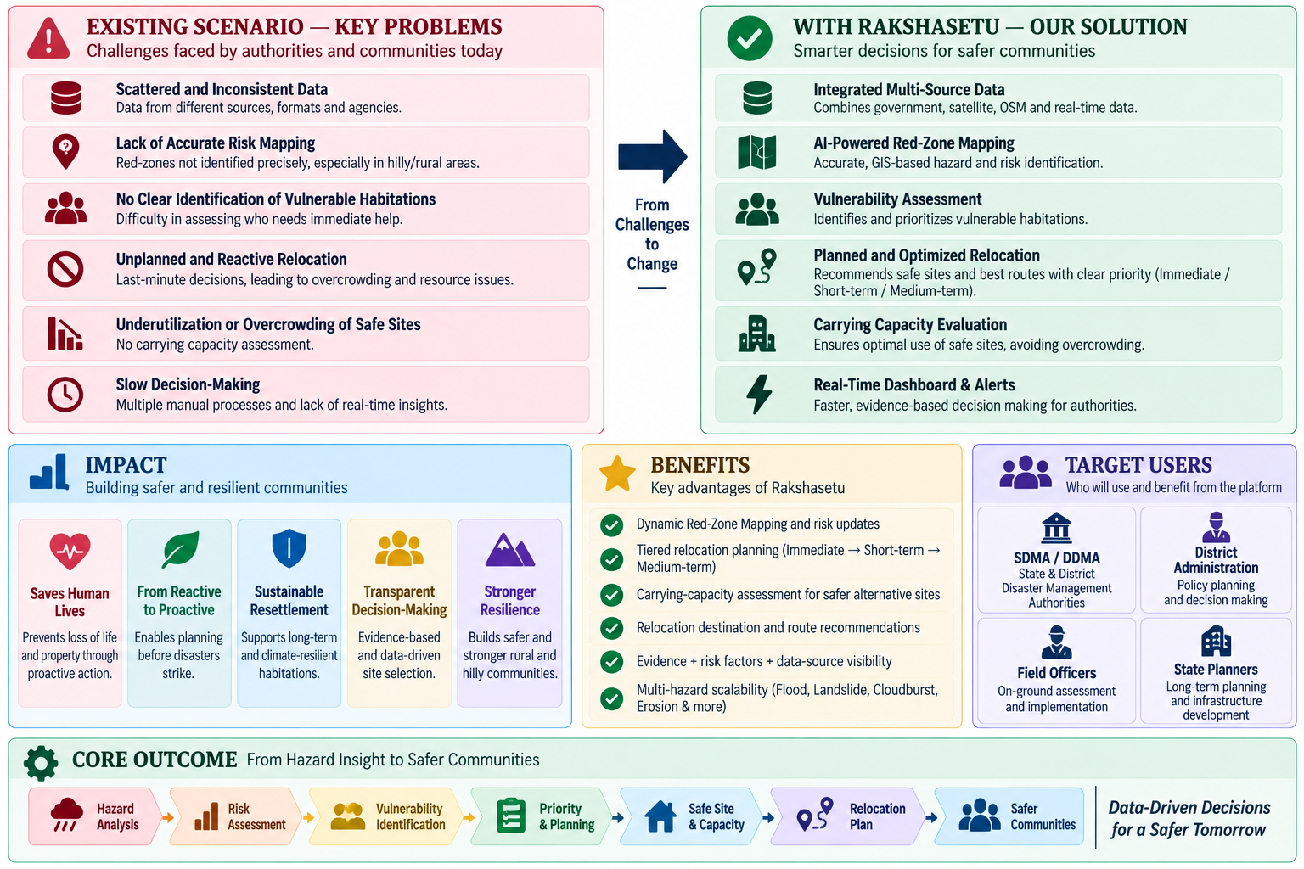
IMPACT & BENEFITS: Saving Lives, Preventing Overcrowding & Empowering SDMA
🛡️ 1. Life & Infrastructure Protection (Shifting Reactive to Proactive)
Eliminates repeated loss of life and property in perennial flood, landslide, erosion, and cloudburst belts by moving vulnerable habitations BEFORE disaster strikes.
📷 [PLACE PHOTO HERE]
Recharts Live Analytics: 3-Tier Distribution & 4-Hazard Profile
👉 Screenshot from Analytics page (/analytics) showing 3-Tier Pie Chart and 4-Hazard Bar Chart.
🏢 2. Prevention of Secondary Disasters & Post-Evacuation Overcrowding
Mathematical carrying capacity assessment caps intake at safe thresholds, preventing sanitation collapse, epidemic outbreaks, and resource exhaustion at relief centres.
📋 3. Empowering SDMA, DDMA & Incident Commanders with Action Orders
Generates signed official relocation briefs, driver turn-by-turn routes, and automated SMS/Email alert dispatch to pre-configured disaster response officers.
📷 [PLACE PHOTO HERE]
Officer Alert Desk & Dual-Tone Emergency Siren Tester
👉 Screenshot from Alerts page (/alerts) showing 5 response officers with Email/SMS dispatch and siren tester.
📊 PROVED MEASURABLE OUTCOMES (Per Vulnerable District):
• 0–48 Hours Evacuation Window: Immediate alerts for high-risk red-zone communities.
• 85% Carrying Capacity Threshold: Triggers multi-site diversion to protect shelter safety.
• 100% Open Data Transparency: Zero recurring software or mapping license burden.
• 36 States & UTs Pre-Indexed: Ready for instant pan-India adoption by NDRF / MHA.

Slide 6

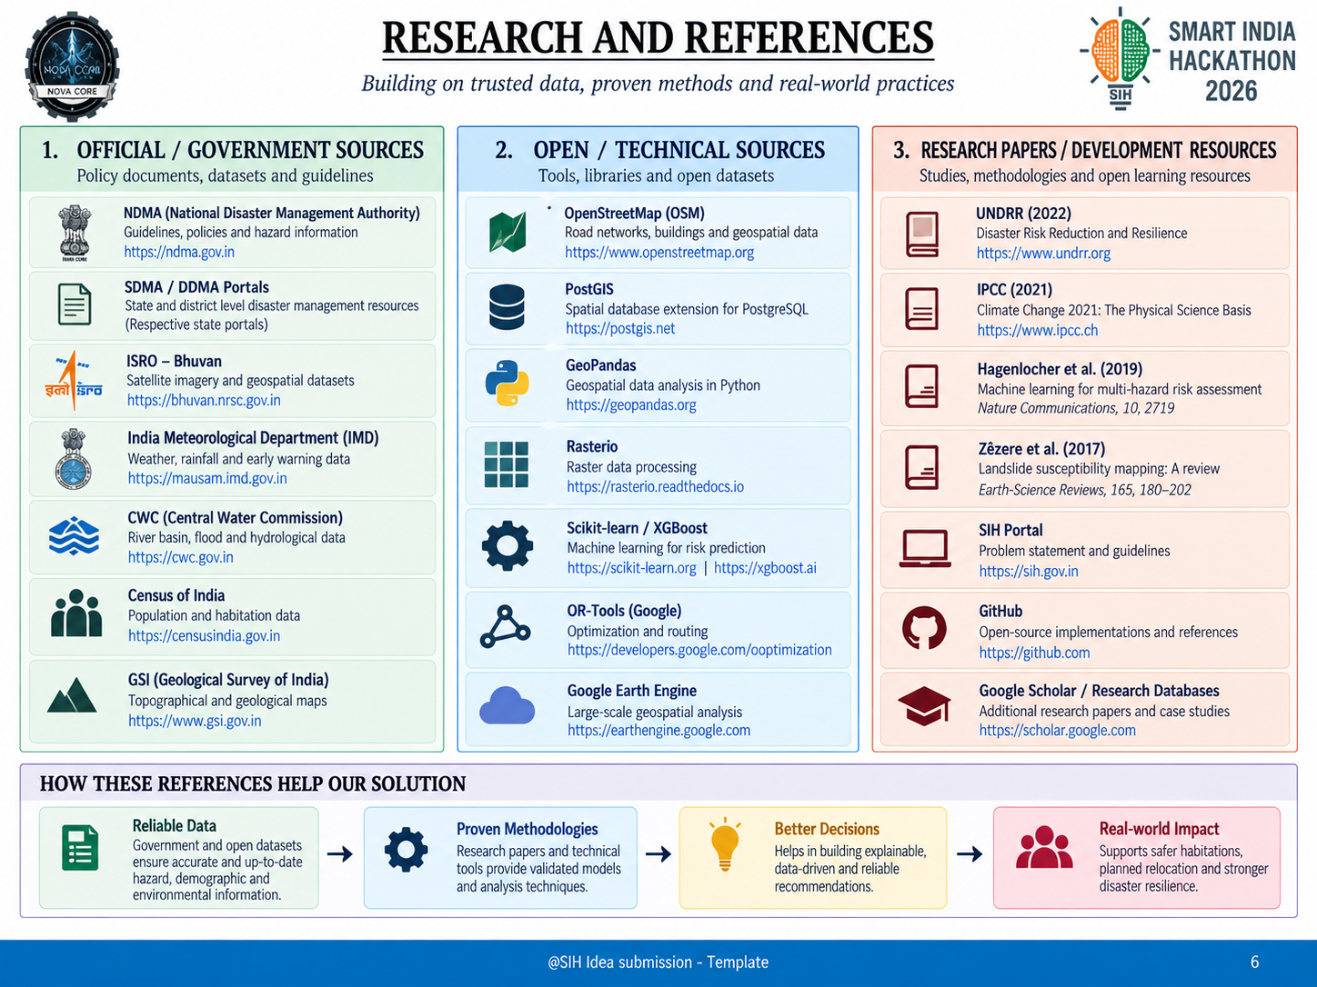
RESEARCH, PROJECT LINKS & FUTURE ROADMAP
📱 OFFICIAL PROJECT DELIVERABLES & REPOSITORIES:
• GitHub Code Repository: https://github.com/vinitmishraaa/RAKSHASETU | Branch: main (Tested & Verified)
• Local Command Center: http://localhost:5173 | FastAPI Backend REST Endpoints: http://127.0.0.1:8000/docs
🏛️ Official Government Sources
• Ministry of Home Affairs (MHA)
https://mha.gov.in
• National Disaster Response Force (NDRF)
https://ndrf.gov.in
• NDMA SACHET (CAP Early Warning)
https://sachet.ndma.gov.in
• India Meteorological Department (IMD)
https://mausam.imd.gov.in
• Geological Survey of India (GSI - Landslides)
https://gsi.gov.in
• Central Water Commission (CWC - Floods)
https://cwc.gov.in
• Census of India (Village Demographics)
https://censusindia.gov.in
🌐 Open Technical Data Sources
• Open-Meteo API (Live Weather & Wind)
https://open-meteo.com
• USGS Seismology (Earthquake Hypocenters)
https://earthquake.usgs.gov
• OpenStreetMap (Roads & Critical Buildings)
https://openstreetmap.org
• OSRM Project (Road Routing Engine)
http://project-osrm.org
• GDACS (Global Disaster Alert & Coordination)
https://gdacs.org
• NASA GIBS (Satellite True-Color Imagery)
https://earthdata.nasa.gov
• Leaflet.js & Recharts (Visualization)
https://leafletjs.com
📚 Research & Standards
• UNDRR Sendai Framework 2015–2030
Target 4: Disaster Resilient Infrastructure
• IPCC AR6 Vulnerability Guidelines
Climate-induced resettlement standards
• Smart India Hackathon 2026 Portal
Problem Statement ID: SIH26191
• NDMA SOP on Disaster Relocation
Standard capacity allocations per person
• Team NOVACORE Research Paper
Proactive GIS Carrying Capacity Models
• Open Source MIT License
Fully libre software for public good
🌟 HOW THESE SCIENTIFIC & TECHNICAL REFERENCES VALIDATE RAKSHASETU:
✅ Reliable Open Data: Official government and live sensor feeds ensure real-time hazard detection without manual delay.
✅ Proven Mathematical Methodology: 3-Pillar risk formula and carrying capacity headroom calculations ensure zero subjective bias.
✅ Immediate Administrative Adoption: Structured to fit directly into SDMA / DDMA standard operating procedures for MHA / NDRF.

