Slide 1
DATA ANALYSIS
Customer Shopping Behavior Analysis
Uncovering insights from 3,900 purchases using MySQL and Power BI

Slide 2
Dataset Overview & MySQL Staging
3,900
18
0
Total Purchases
Data Columns
Duplicate Records
Comprehensive transaction data
Customer demographics & behavior tracking keys
Validated via window ranking queries
Process Flow
01
02
03
Staging Table
Column Standardization
Duplicate & Null Audits
Created a copy table (csb) using CREATE TABLE LIKE for safe analysis.
Fixed corrupted source characters by renaming tracking fields to standard Customer_id.
Used a ROW_NUMBER() CTE and exhaustive TRIM() queries to ensure flawless data integrity.
04
05
Feature Engineering
Redundancy Cleanup
Leveraged CASE WHEN conditional logic to build custom age groups and numeric frequency mappings.
Permanently dropped unused attributes (Promo Code Used) using schema alterations to streamline modeling.

Slide 3
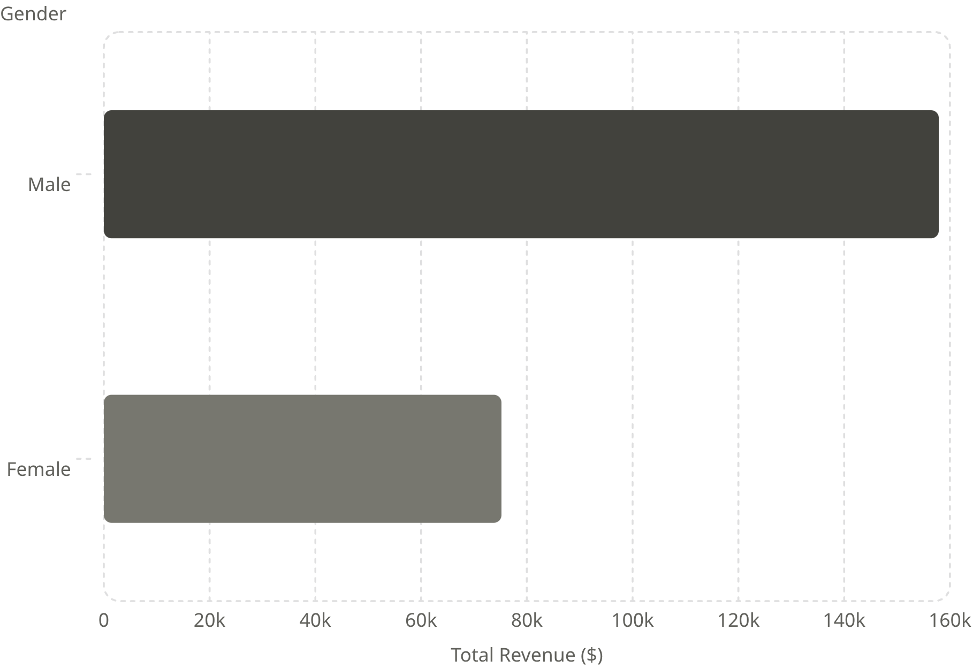

Revenue by Gender Analysis
Data Insights
Male Demographics: $157,890 total revenue
Female Demographics: $75,191 total revenue
Strategic Takeaway: Target core segments with personalized marketing campaigns to heavily optimize specific demographic revenue streams.

Slide 4
High-Value Discount Users
Customers using discounts while spending above average
Smart Shoppers
Strategic Opportunity
Identified a critical group of 839 unique customer profiles maximizing promotional codes while maintaining high-ticket baskets.
Build high-end upsell workflows to offer exclusive premium upgrades to these high-value buyers.

Slide 5

Top-Rated Products By Customer Sentiment
Gloves
Sandals
Boots
Rating: 3.86 Stars — Exceptional satisfaction score.
Rating: 3.84 Stars — Consistently strong customer feedback.
Rating: 3.82 Stars — High category performance tier.

Slide 6
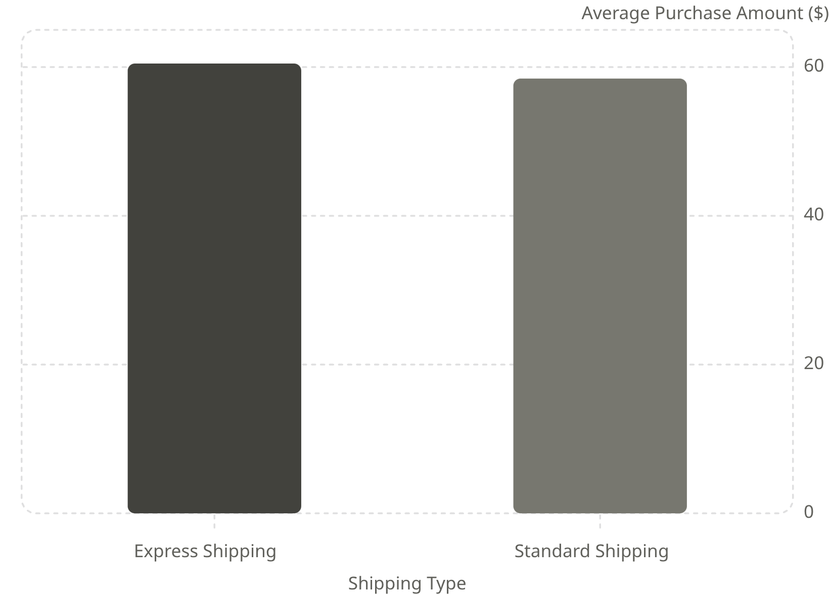
Shipping Preferences
Impact Metrics Comparison
Express Shipping: $60.48 Average purchase amount
Standard Shipping: $58.46 Average purchase amount
Core Takeaway: Express distribution channels generate higher overall transaction size averages compared to standard delivery methods.

Slide 7
Subscription Impact
$170.4K
$62.6K
Non-Subscriber Revenue
Subscriber Revenue
Contributed by non-subscribers (73% of user volume count).
Generated by subscription memberships (27% of user volume count).
Consistent Ticket Sizes: Both subscriber and non-subscriber cohorts spend an average of roughly $59 per transaction, highlighting volume as the main growth lever.

Slide 8




Customer Lifecycle Segmentation
New
1
83 Customers
Returning
2
701 Customers
Loyal
3
3,116 Customers
Loyal (3,116 Customers): High-volume, reliable consumers with long-term platform history.
Returning (701 Customers): Steady repeat shoppers showing strong engagement trends.
New (83 Customers): First-time buyers requiring strategic immediate outreach.
Core Goal: Build robust relational paths that convert "New" arrivals to "Returning" users, and "Returning" users into permanently locked "Loyal" segments.

Slide 9
Strategic Recommendations
Boost Subscriptions
Customer Loyalty Programs
Launch target incentives aimed directly at the 73% non-subscriber base to grow predictable, recurring subscription streams.
Design personalized milestones for "Returning" users to increase active customer lifetime value.
Optimize Discount Policies
Targeted Marketing
Monitor margin guardrails closely around highly discount-dependent product groups like hats and sneakers.
Focus acquisition and marketing budgets heavily toward high-revenue age brackets (Young Adults / Middle-aged cohorts).

