Slide 1
TEAM LOG5j CYBERSPRINT’23 CHANDIGARH UNIVERSITY

Slide 2

About FamPay
Fampay is an Indian fintech startup that offers a neo-banking platform for teenagers. The platform provides a range of financial services including payments, banking, and rewards.
Fampay's mission is to empower the next generation to be financially responsible and independent. The company has raised significant funding from investors and is rapidly growing in the Indian market.

Slide 3
Approach to the problem.

Slide 4

Our Solution!
FamBoard – A leader board for friends
FamPots – A way to save money
OnlyFams – Lend/Receive money

Slide 5
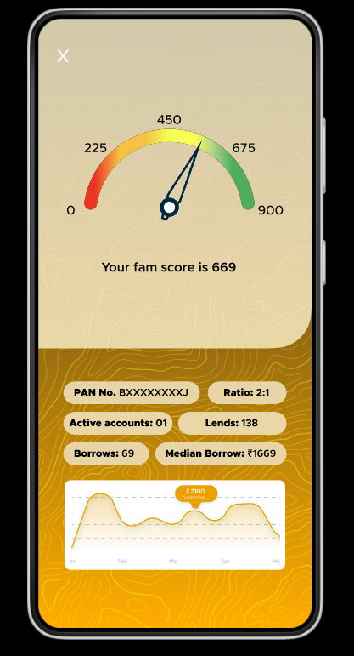
INTRODUCING Fam Score
A score will be allotted to the user on the basis of user expenditure patterns.
How much the user spends and repays on time.
It acts as a limit setter for the OnlyFams feature.

Slide 6

FamBoard
A ranking system based on your spends, giving the users a good FamScore and a unique auto-generated username defining the characteristic of the user. Ex: Wanderlust
This username is further used for requesting in OnlyFams.

Slide 7
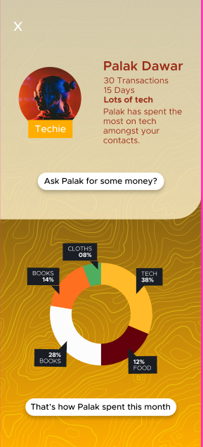
Profile of Friends
Add your friends and see their unique username and their average spending details

Slide 8
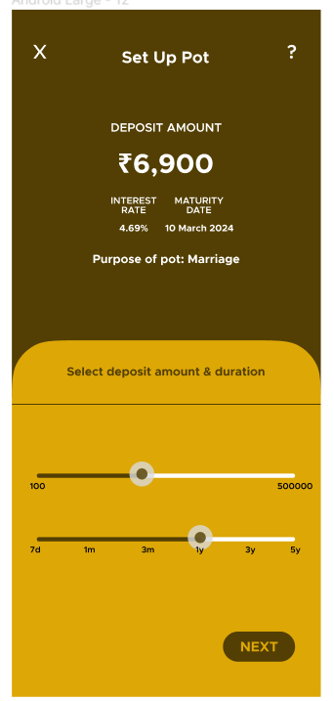
POTS
A way to save money and achieve your goals.
Save small today.
Go big tomorrow.

Slide 9
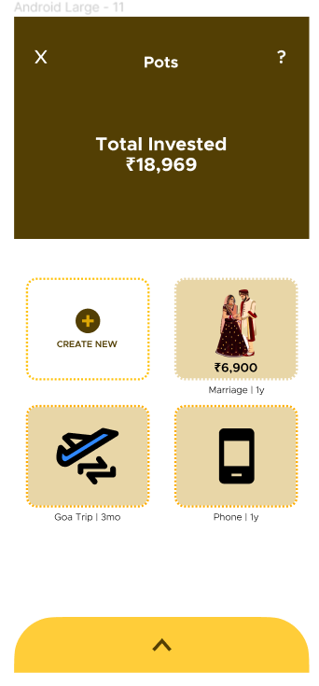
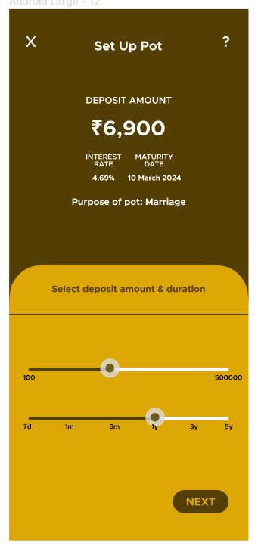
POTS

Slide 10
WORKFLOW

Slide 12
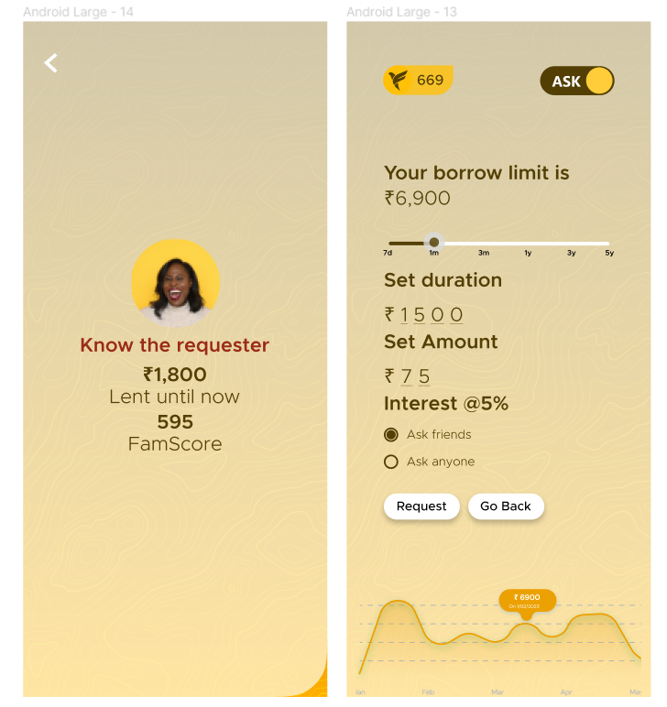
OnlyFam
The all new way to grow your money in days with high security by Fampay.
Borrow Money? Or
Be the Lender.
All at the same place.

Slide 13
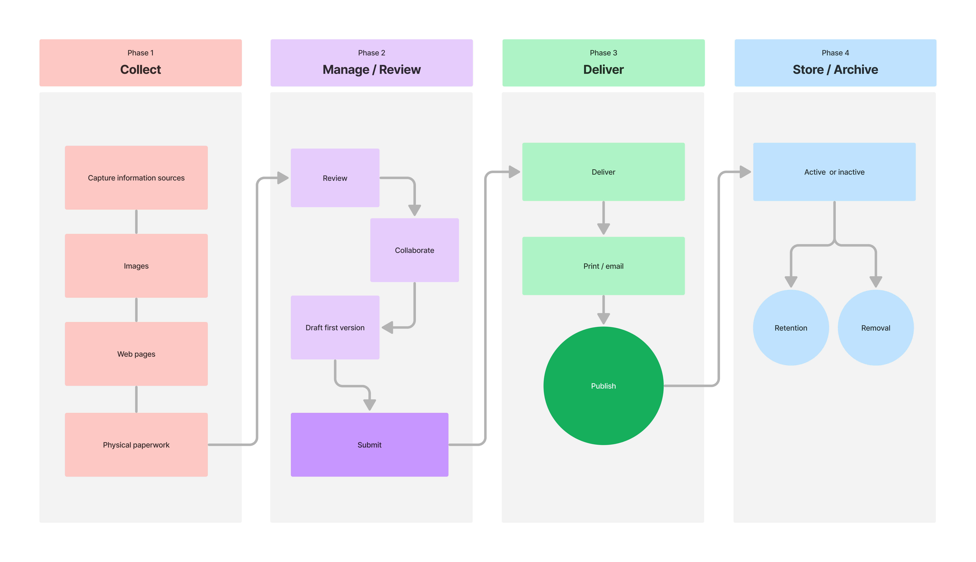

Slide 14
Thank You! 🎈
Presented by:
Palak Dawar, Shruti Sharma, Khushal Jain, Ankan Bose, Vinit Kundu.

