Slide 1



Access360: Maximizing Mobility for Hamilton’s ATS Riders
Presented By:
Vinit Padia

Slide 2
Problem Statement
This phase aims to investigate potential solutions for addressing the issue highlighted in the previously stated problem statement. The main objective is to enhance the accessibility and connectivity of the existing ATS riders in Hamilton by identifying viable alternatives, such as community bussing services, as well as facilitating their integration with any present and future transit options.
Approach
Similar to the previous phase, a comprehensive analysis of the given dataset and the previous dataset has been conducted, revealing certain pivotal metrics. The primary focus of this phase has been on developing potential community bussing routes and solutions, based on clustering FSAs in proximity to one another.

Slide 3
Data Background
The dataset under consideration is composed of approximately half a million ATS records of 2022. This dataset was cross-referenced with the 2019 dataset to understand the change in the ridership patterns. The purpose of the Phase 2 analysis is to assess the feasibility of utilizing community buses to complement ATS services. ATS is investigating potential solutions to enhance connectivity with existing public transportation options. The analysis aims to address various questions that would assist in achieving these objectives.

Slide 4
Methodology
Prior to conducting a detailed analysis of the given dataset to investigate key metrics, a comprehensive rundown was carried out. This involved addressing the following tasks:
Removal of Duplicate & Null Values
Unified Date & Time Format
Unified Postal Code Formats
Introduction of Calculated Fields

Slide 5
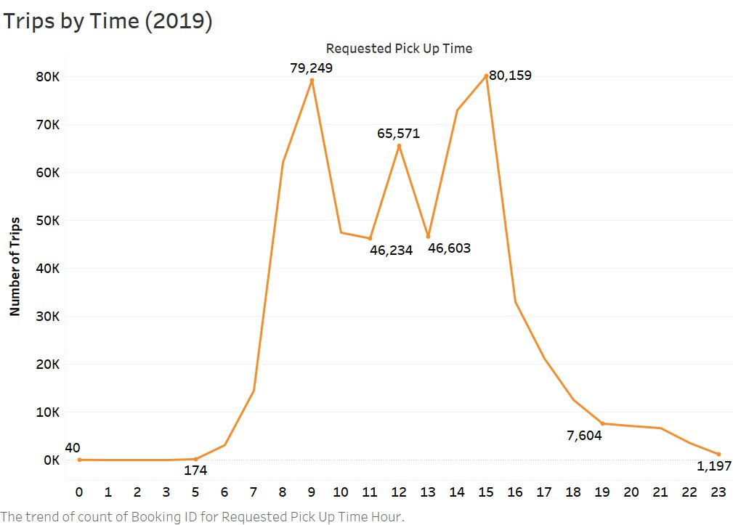
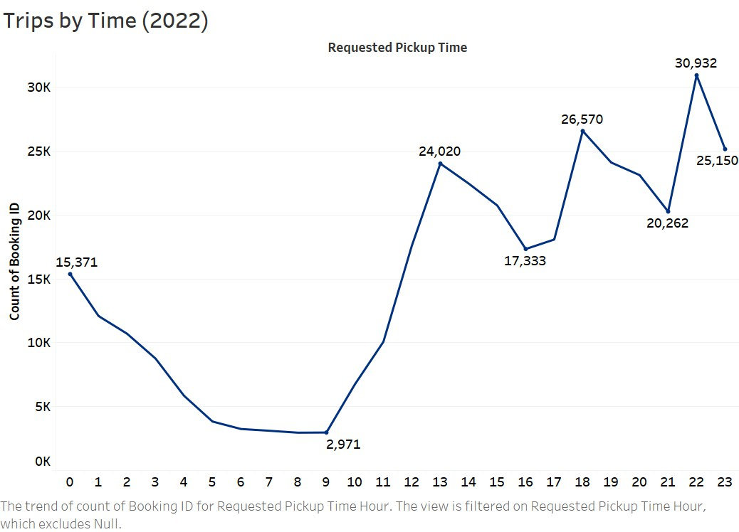

Trips by Time
Peak Hours
Based on the analysis, a shift in the Peak Hours is observed in 2022, as compared to the 2019 data.
Identifying Peak Hours was crucial in determining the hours of services for the proposed community bussing.

Slide 6
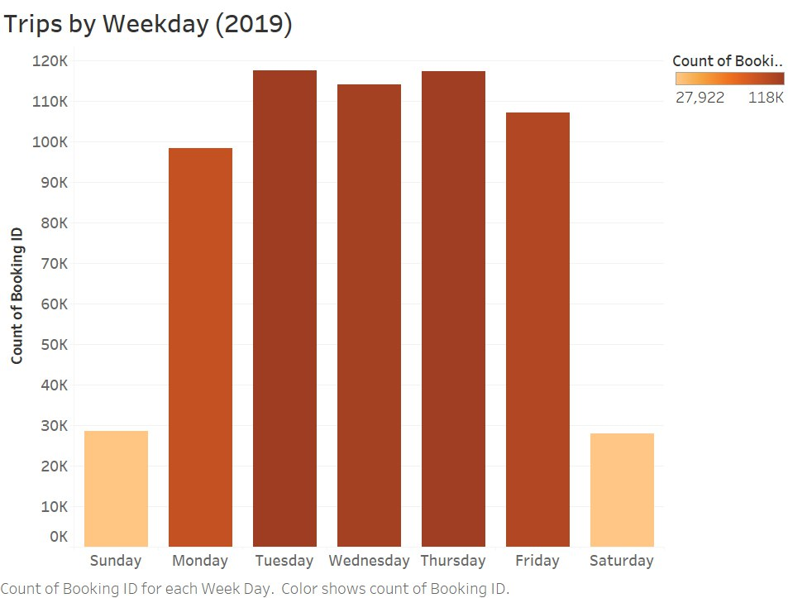
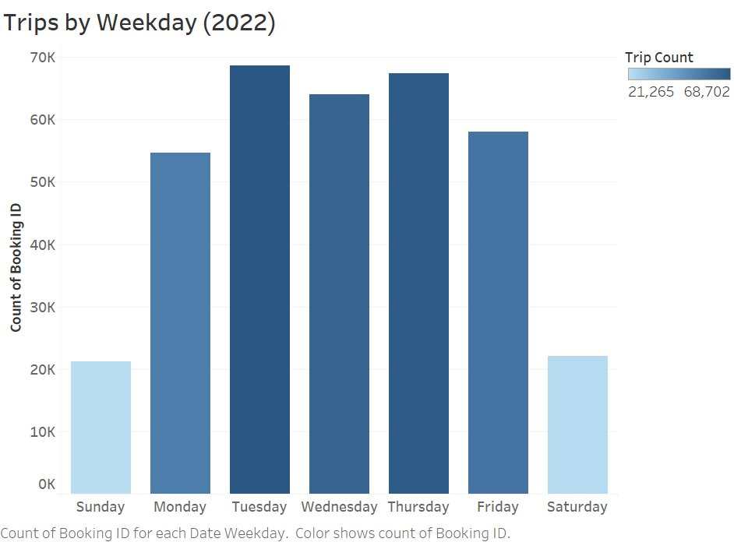
Trips by Weekday
The comparison of the Trips by the day of the week, it is observed that in both the 2019 and 2022 datasets, Monday through Friday remain the busiest time of the week.
The above conclusion helped us to recommend the days of services for the proposed community bussing service (Monday through Friday).

Slide 7
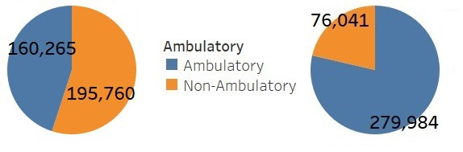
Ambulatory vs Non Ambulatory
On analysing the ‘Ambulatory’ field, which had a ‘Flag’ type response, the resulting percentage of Ambulatory versus Non Ambulatory trips indicated a large discrepancy from the percentage mentioned by the judges in the keynote session.
A definition of Ambulatory Trips was provided in the Phase-2 documents with specified certain space types to be considered as Ambulatory.
Basis the definition provided, AM(Ambulatory), WK(Walker),XA(Extra Large Ambulatory), AW (Extra Large Walker) have been considered as Ambulatory.
The resulting calculated field helped us to deduce a result in line with actual proportion of Ambulatory versus Non Ambulatory trips. The same is presented below.
Dataset
Calculated

Slide 8
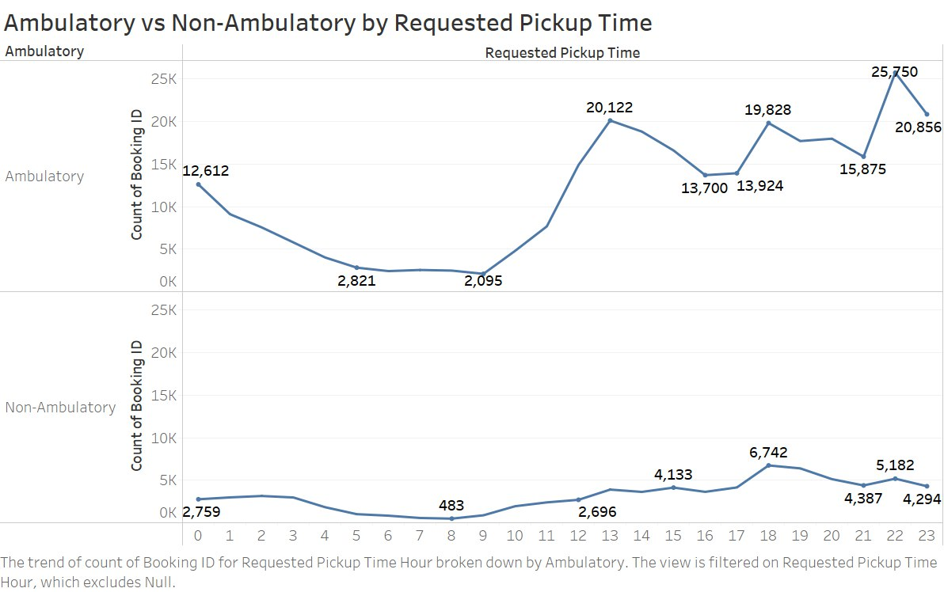
Ambulatory vs Non Ambulatory
On considering the correct calculated field for Ambulatory trips, it is observed that the peak hours for Requested Pick Up time, remained in line with over-all peak hours of ATS services for 2022.

Slide 9
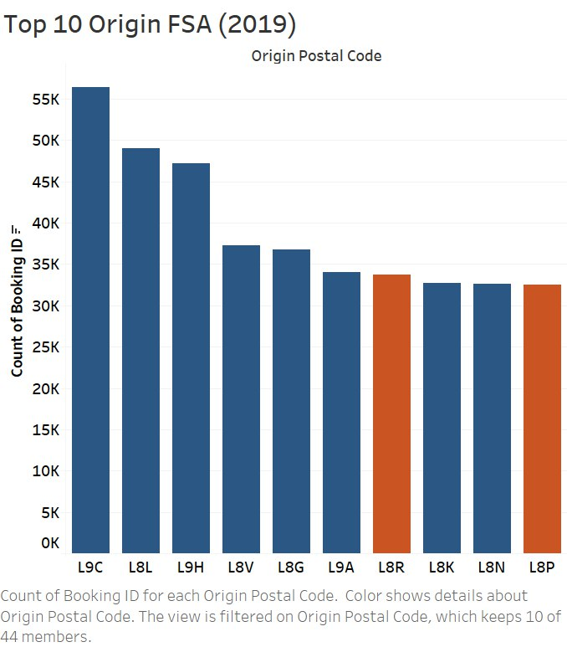
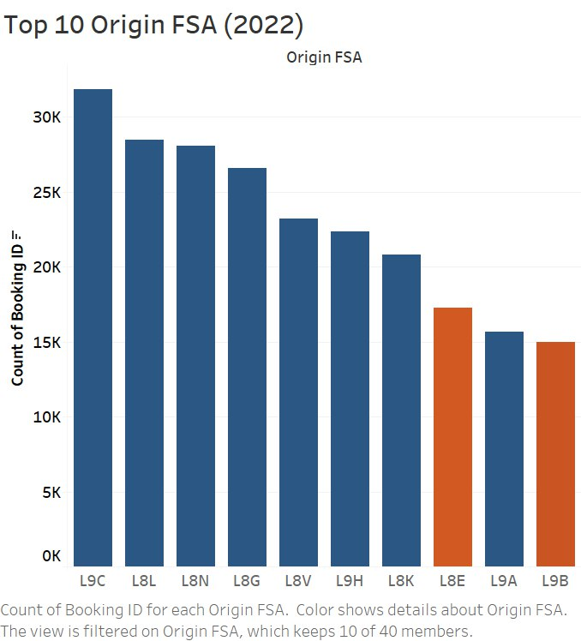
Top 10 Origin Forward Sortation Areas (FSA)
The comparison of the Origin FSA indicate that in both the 2019 and 2022 dataset, the Top 5 Origin Postal Code remain unchanged (highlighted in Blue), with 2 postal codes in each dataset having different results (highlighted in orange).

Slide 10
Intra-Regional Trips
To determine the regions in which the community bussing services can be introduced, it was crucial to identify the FSAs with the highest intra-region trip count.
For this purpose, we considered the top 20 busiest Origin FSAs and filtered the trips having the same Origin and Destination FSAs.
Thus, we identified the Top 10 FSAs having highest Intra-region trips.
In order to understand the demand for the ATS services in these FSAs, daily intra-region trip count was calculated for the Top 10 FSAs.

Slide 11
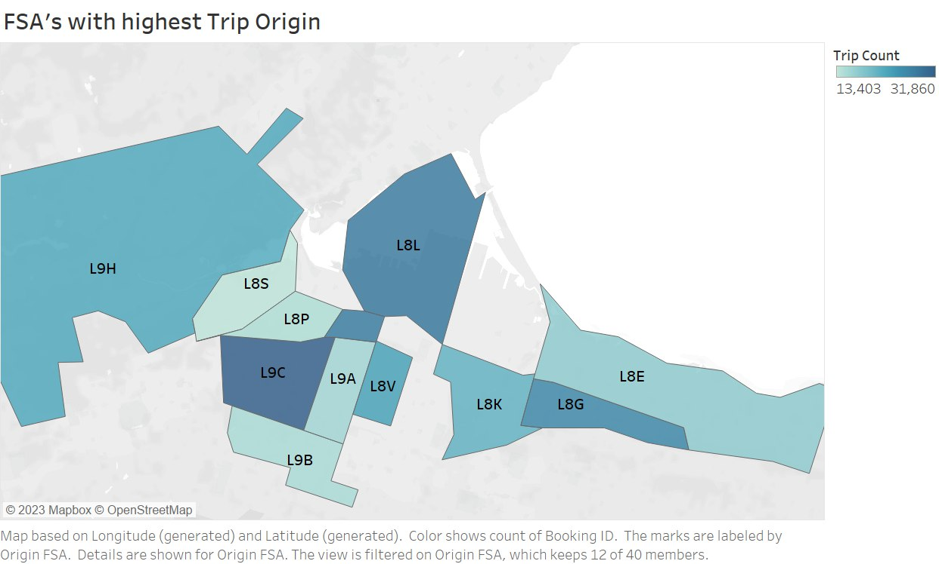
Intra-Regional Trips
The Table indicates the Top 10 Origin FSAs along with the Total Intra-Region trips and the Daily Trips in these Top 10 regions.
The Top 10 Origin FSAs are represented in the Heat Map on the right.

Slide 12
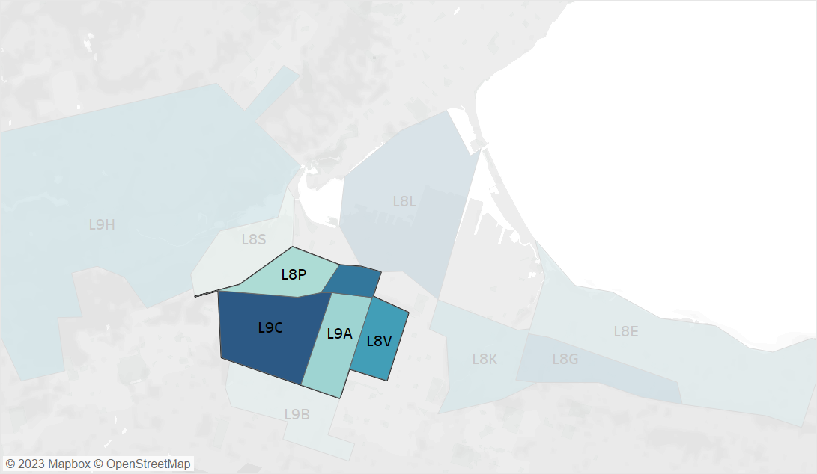
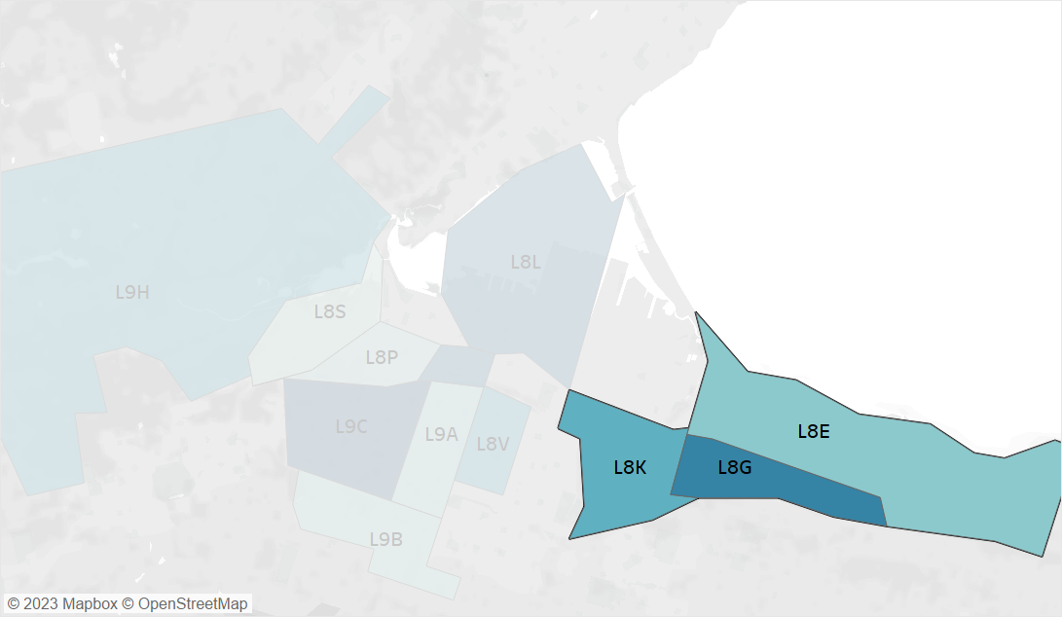
Cluster Analysis
Cluster 1
Cluster 2
For Cluster 1, L9A, L9C, L8N, L8P and L8V have been grouped together.
For Cluster 2, L8E, L8G and L8K have been grouped together.
Based on the fewer number of daily intra-region trips in these FSAs, it was decided to form two Clusters based on the proximity of the FSAs.

Slide 13
Cluster Analysis
In order to justify the introduction of a potential community bussing service within the Cluster, it was crucial to identify the average trip duration within the cluster.
The average Trip duration within the Cluster was computed by calculating the trip duration of each FSA amongst other FSAs within the same cluster.
Based on the above, the average trip durations for Cluster 1 and Cluster 2 were found to be reasonable to recommend the community bussing services within these clusters.
To further support the recommendation, the 2019 dataset showed similar busiest FSAs. However, the daily intra-region trip count for 2019 was almost twice as that of 2022. This can be primarily accounted on Pre & Post COVID times.

Slide 14
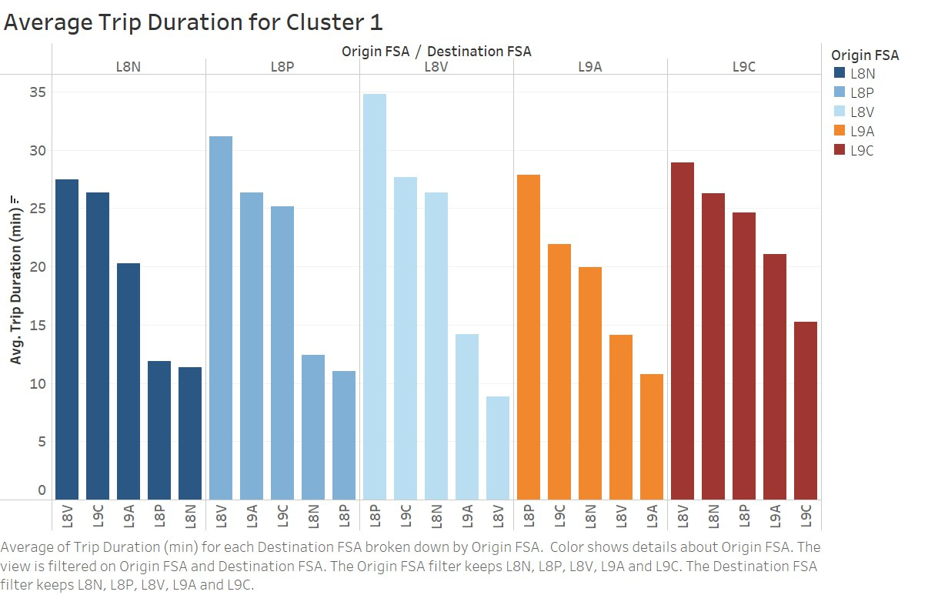
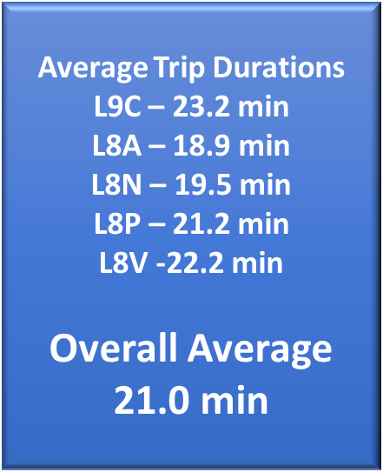
Cluster 1 Analysis
The average trip duration within Cluster 1 was found to be 21 minutes.

Slide 15
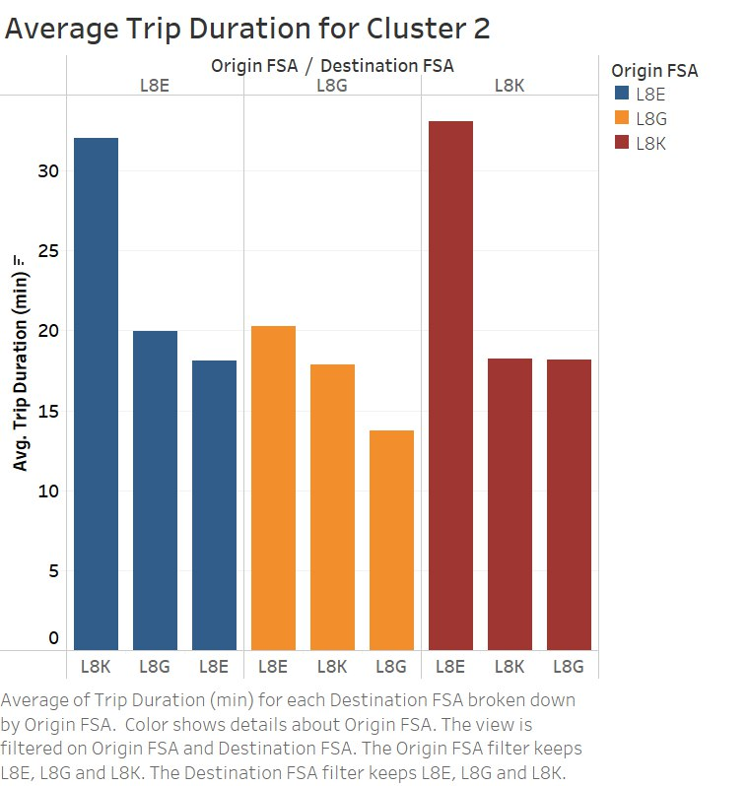
Cluster 2 Analysis
The average trip duration within Cluster 2 was found to be 21.3 minutes.

Slide 16
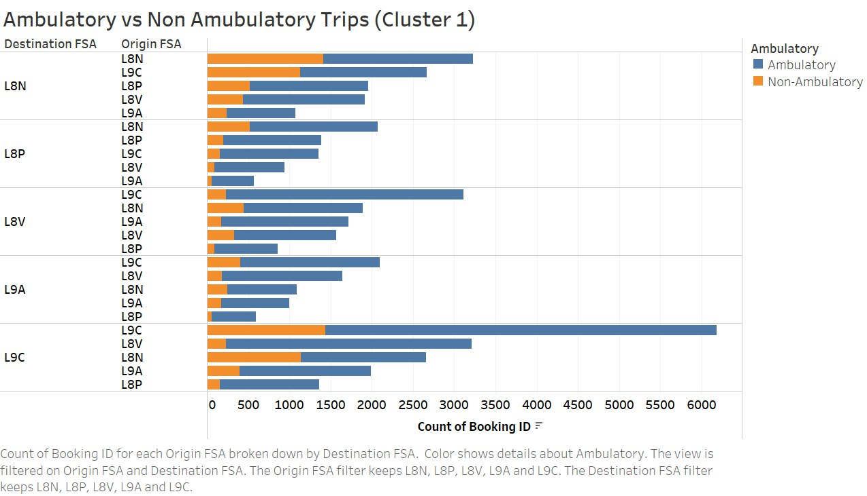
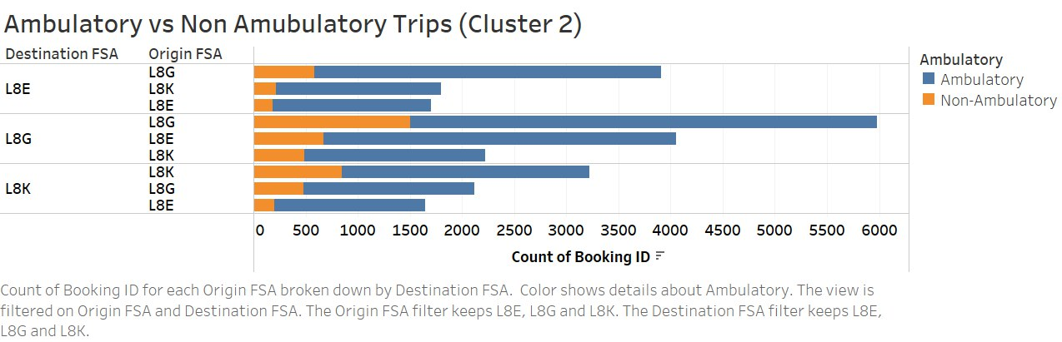
Cluster Analysis – Ambulatory vs Non Ambulatory
The Ambulatory and Non Ambulatory space type was identified for the two Clusters, and Ambulatory trips were found to be dominant.
This will be significant to determine the space distribution in suggested vehicle type for the community bussing services.

Slide 17
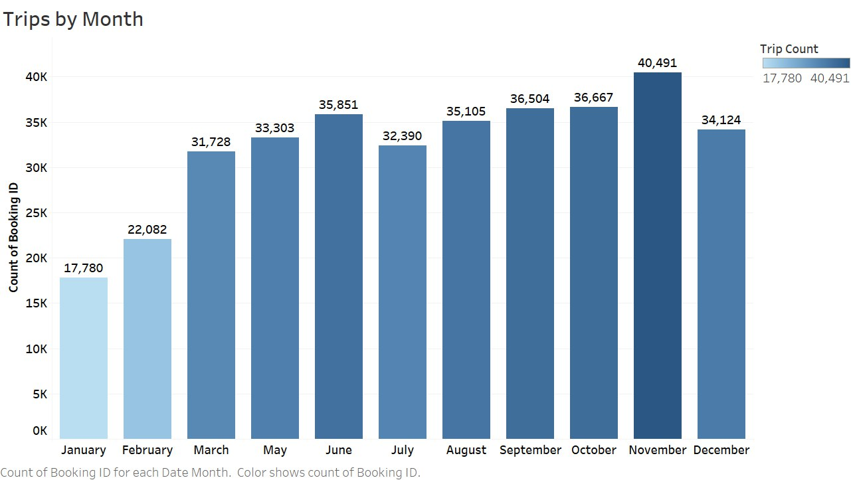
Conclusion/Recommendations
The COVID-19 outbreak had a noticeable impact on the number of trips recorded in the early part of the new dataset. However, there was a gradual recovery in the Spring of 2022.
The gradual rise in ridership indicates the emergence of an upward trend that is expected to continue and result in increased demand for ATS services.

Slide 18
Conclusion/Recommendations
According to the analysis of the Origin FSA data, the top three areas of origin have an average of 15 daily trips, which is not sufficient to justify starting a community bussing service for a single FSA.
Therefore, it is recommended that the top Origin FSAs be clustered based on proximity to each other to enable the implementation of a community bussing service.
Based on the analysis, we have identified two clusters, Cluster 1 and Cluster 2, as mentioned in the previous slides. On combining the FSA trips of the clusters, we observe that Cluster 1 has a daily count of 37 trips and Cluster 2 has a daily count of 30 trips.
Thus, a community bussing services in these two clusters can be proposed catering not only to ATS riders but also to other members of the community. However, it should be emphasized that the stops for the community bussing will be selected based on the busiest postal codes for ATS.

Slide 19
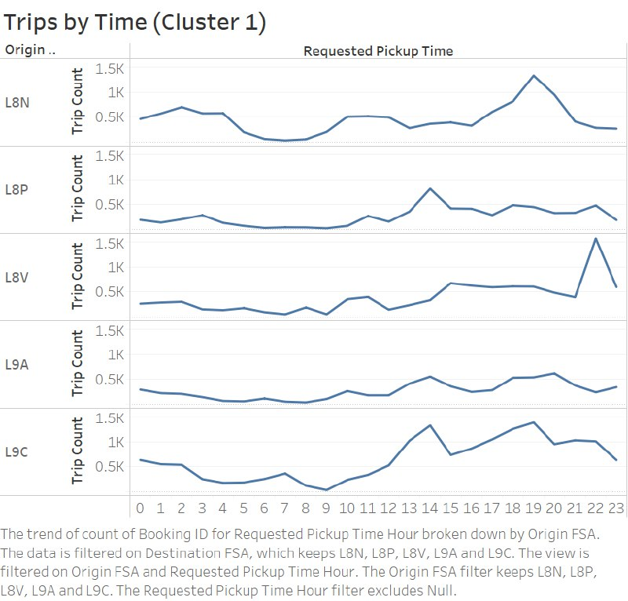
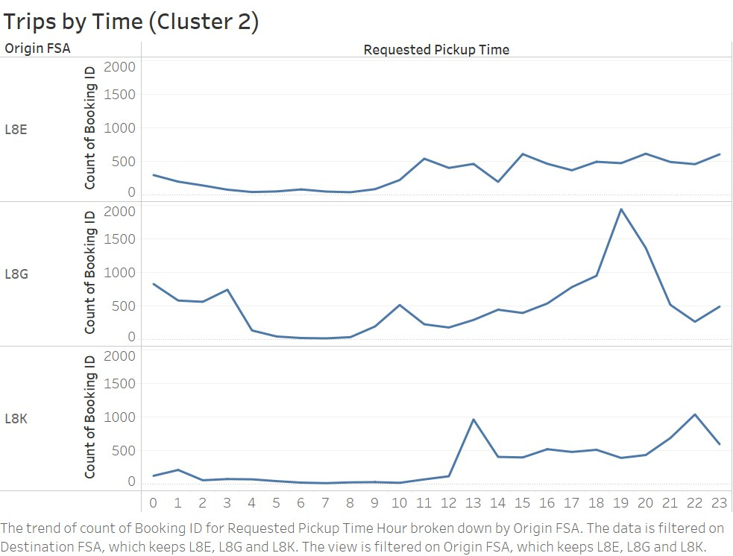
Conclusion/Recommendations
Based on the 2022 dataset, it is observed that the peak hour is on the rise from 8:00 am which continues till midnight.
Keeping this in mind, we propose the community bus service starting at 7:00 am with the last bus departing at 11:30 pm.
The proposed interval for the bus services is 45 mins. This proposed interval can accommodate approximately 250 passengers daily including around 45 non ambulatory riders based on the vehicle design suggested in the next slide.

Slide 20
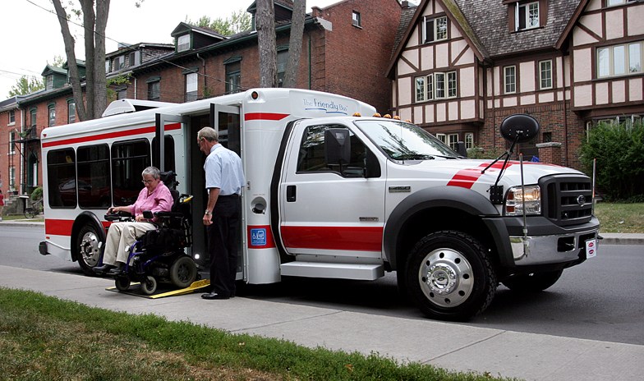
Conclusion/Recommendations
Source: http://www.americanbusproducts.com/friendlybus/image-library.html
The model we suggest for the community bussing services is the ‘The Friendly Bus’, which is also currently being used by TTC.
It has a step-in floor height of only 8 inches, meaning Equal Access with no wheelchair lifts required.
The seating and floor plan layout of each fleet can be customized to suit individual requirements. To ensure maximum seating capacity, the paratransit bus provides nine passenger seats along with two designated positions for mobility equipment.
This design can easily accommodate the demand of ATS riders in the clusters as well as cater to other members of the community traveling along the same route.

Slide 21
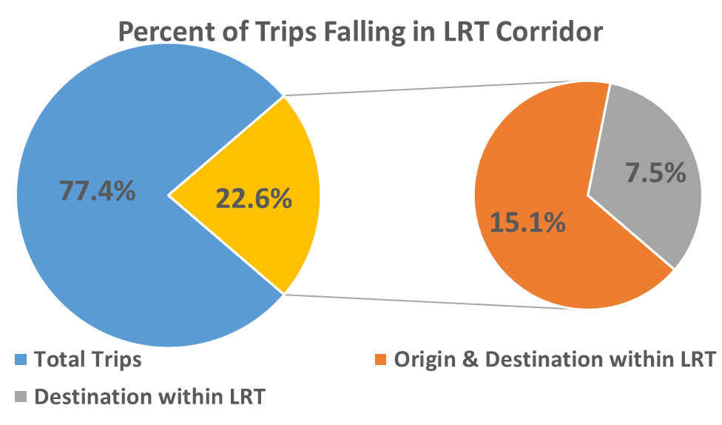
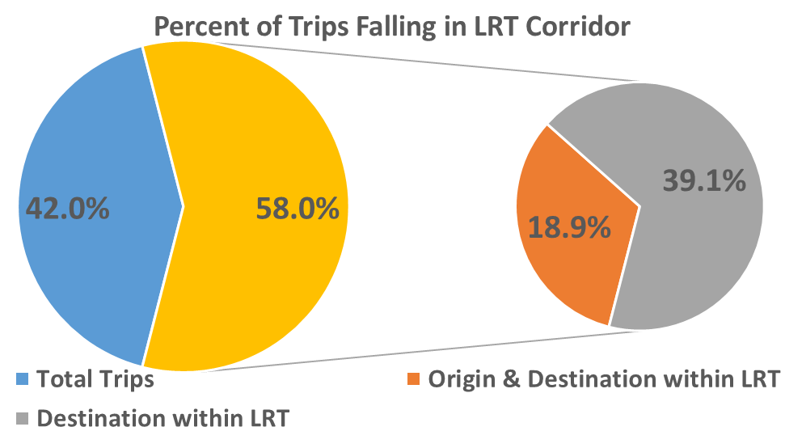
Conclusion/Recommendations
2019 Dataset
2022 Dataset
Based on 2022 dataset, it is observed that 58.0% of the ATS trips, fall on the upcoming LRT corridor, of which 39.1% trips originate outside the corridor but finish within the LRT Corridor, and 18.9% of the trips Originate and End within the LRT corridor.
When compared to the 2019 dataset, it is a significant increase in the percentage of trips falling on the LRT corridor, thus, providing an opportunity to integrate more ATS riders with LRT.
Thus, converting maximum of these riders to the LRT can help reduce the burden on ATS in the region and allow ATS to concentrate on other high demand areas.

Slide 22
THANK YOU

