Slide 1
Detecting Bias in Word Embedding Models
Professor Ameet Soni
Professor Krista Thomason
Swarthmore College
Lecture notes to introduce lab practicum

Slide 2
Background - NLP
Natural Language Processing (NLP)
Goal: help computers understand human language
Artificial Intelligence + Linguistics
General tasks:
Generation language/communicate with humans
Analyze/understand humans

Slide 3
Example NLP tasks
Translation between two languages
Extract information from text (“Find all relevant Title VII case law”)
Sentiment analysis (“Is this review positive or negative?”)
Personal Assistant
Search
Summarization
Etc.

Slide 4
Difficulties
Goal: map meaning to words
Problem: this is very hard; language is
Ambiguous – same word can mean different concepts
Rich – the same concept can be said with many words
“Meaning” is never observed directly
Representation: how should computers encode words?

Slide 5
Example
“John saw the woman with the telescope wrapped in paper”
What’s wrapped in paper?
Who has the telescope?

Slide 6
Word Embeddings
Words are not discrete concepts
e.g., search “Seattle hotel” vs “Seattle motel” should be similar
Idea: words with similar meaning occur in similar contexts
“hotel” and “motel” are used similarly in sentences
Word embeddings: represented words by what they co-occur with
“book”, “room”, “rate” are commonly used with “hotel” and “motel”

Slide 7
Fast Forward
Add theory, math, advances in computing, lots of data…

Slide 8
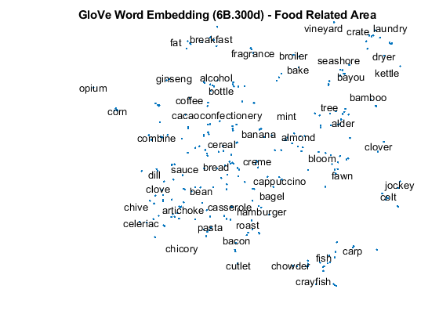
Embeddings Visualized
Similar items cluster together
Note: these are 2D projections of the original embeddings using principal component analysis (PCA)
Matlab.com
Notes:
Note: these are 2D projections of high-dimension vectors such that we see as much of the variation possible.
This is typically done with principal component analysis (PCA)

Slide 9
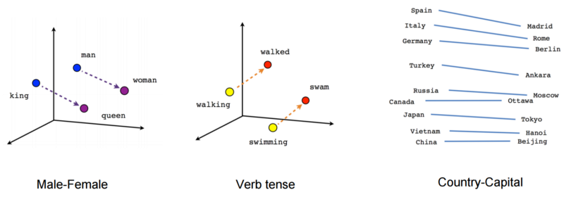
Learning Semantics
https://www.tensorflow.org/tutorials/representation/word2vec
Note: these are 2D or 3D projections of the original embeddings using principal component analysis (PCA)

Slide 10
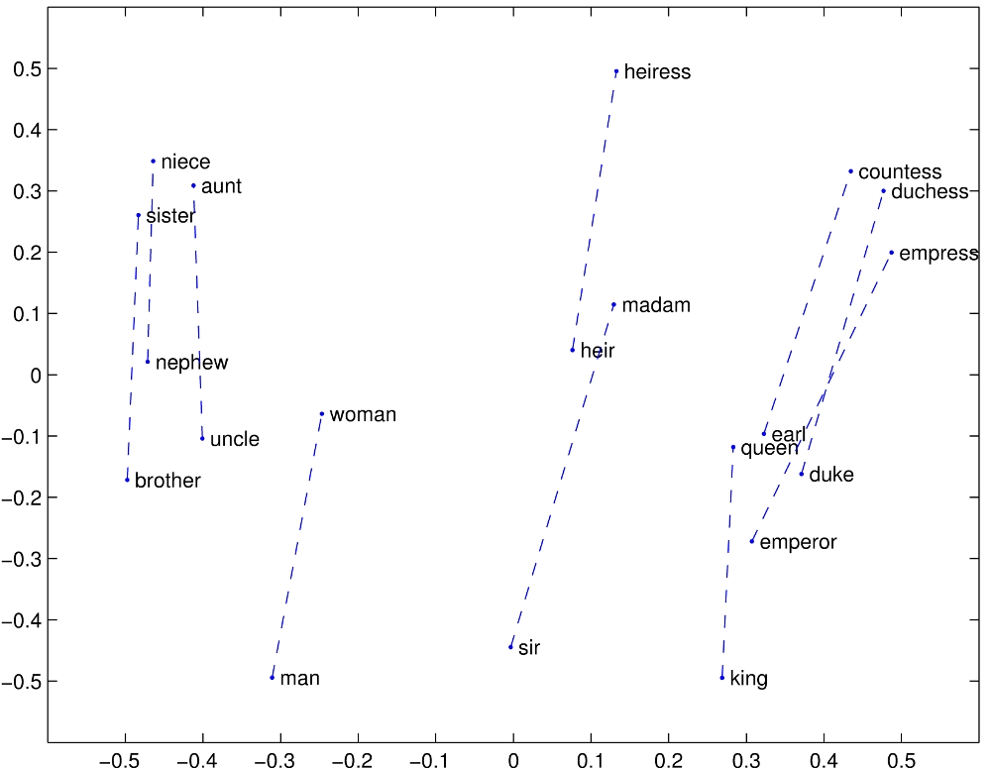
Learning Relationships
“Vector differences capture as much as possible the meaning specified by the juxtaposition of two words”
https://nlp.stanford.edu/projects/glove/images/man_woman.jpg

Slide 11
Word Embedding Today
Many approaches
Many success stories
Data driven – learned through provided text e.g., Wikipedia
Dense and distributed representations

Slide 12
Lab Practicum Part 1: Learning Embeddings
Given: learned word embeddings
GloVe algorithm https://nlp.stanford.edu/projects/glove/
Training corpus: twitter, wikipedia, web
Goal: validate the usefulness of word embeddings
Read handout and README.md to run findSimilarWords.py

Slide 13
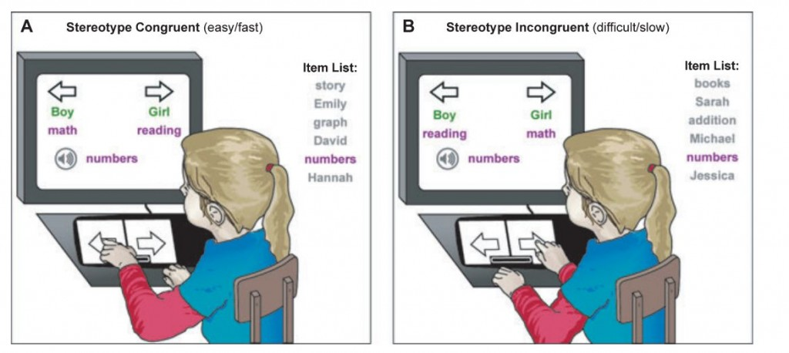
Lab Practicum Part 2: Word Embedding Association Tests
From Caliskan et al., “Semantics derived automatically from language corpora contain human-like biases”
Modeled after Implicit Association Test
Read documentation and run weatTest.py
Complete Lab Practicum Assignment

Slide 14
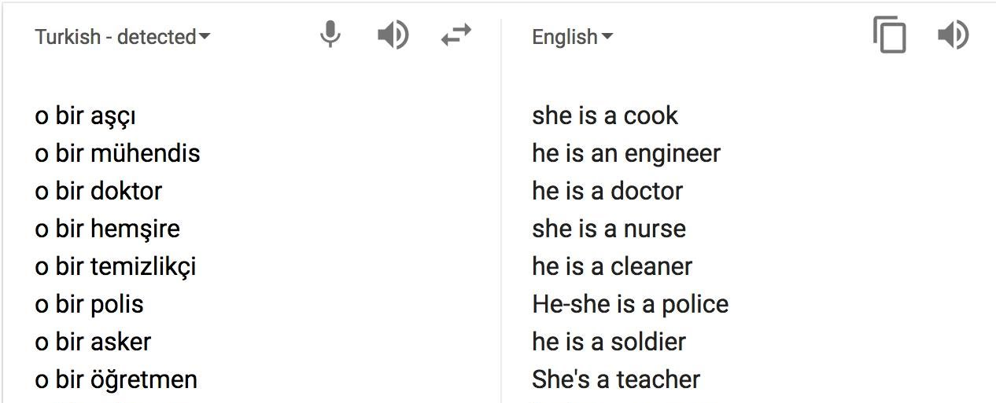
Real-World Example:
Gender Bias in Google Translate
In Turkish, o is a gender neutral pronoun (he, she, or it)

Slide 15
Real-World Example:
Gender Bias in Google Translate
In Turkish, o is a gender neutral pronoun (he, she, or it)
Notes:
Another example: translate “He is a nurse, she is a doctor” to Turkish and then back results in “She is a nurse, he is a doctor”

