Slide 1
AI-ENABLED CYBERATTACK DETECTION
Adversarially Robust Federated
Intrusion Detection
Vinit Soni (E23CSEU0437) · Final submission · November 2026
46.8 M
4
10+2
63
traffic windows audited
threat models evaluated
clients · Azure + laptop
tests, all numbers scripted

Slide 2
Five research questions, four threat models
RQ1
Detection — How well do an MLP and tree models detect CICIoT2023 attacks under a leakage-aware split — and at what false-positive cost?
RQ2
Federation — What does federated training (FedAvg / FedProx, IID → strongly skewed clients) cost versus centralized — in a simulator and in a real Flower deployment?
RQ3
Poisoning — How much damage do malicious clients do to the global model, and do robust aggregators (median, trimmed mean, norm clip) hold?
RQ4
Evasion — Can a black-box attacker that may only pad, slow down and re-TTL its own packets make detected attacks look benign?
RQ5
LLM-planned attacks — On GridStratLLM, do network signatures of LLM-coordinated smart-grid attacks transfer to a held-out planning LLM?

Slide 3
The dataset fights back: hygiene before modelling
CICIOT2023 · 46.8M WINDOWS · 39 FEATURES · 34 ATTACK CLASSES
55.0 %
30.6 %
6 feats
of rows are exact duplicates — de-duplicated within splits
share their feature vector with another class (DDoS vs DoS)
encode the extraction window — a shortcut, excluded
Leakage-aware split: file-level where possible, purged time blocks otherwise; 12.2 % of test vectors still occur in train — reported separately as “unseen”.
Result: honest macro-F1 of 0.56–0.75 — far below the >0.99 common in the literature, by design, not by failure.
GridStratLLM (smart grid): BagIt-verified, 436 attack sessions planned by 4 LLMs + 1.75 h normal operation.
Every number in report & slides is generated by a script in the repo — nothing copied from papers.

Slide 4
RQ1 · The operating point matters more than the model
CENTRALIZED DETECTION, 8-CLASS TASK, HELD-OUT TEST
19–29 %
1.0–1.3 %
83–86 %
of benign windows flagged at plain argmax — undeployable
false alarms with a threshold calibrated on validation
of attack windows still detected at the 1 % FPR rule
Calibration transfers: the 1 % validation target achieves 0.7–1.3 % on test, across all models and tasks.
Tuned v2 MLP gains only 0.3–0.7 detection points over v1 — HistGradientBoosting is the best detector at 1 % FPR (binary +2.8 points), training in seconds.
The Random Forest “wins” macro-F1 only by flagging 2–3× more benign traffic — model comparisons are meaningless without a fixed operating point.

Slide 5
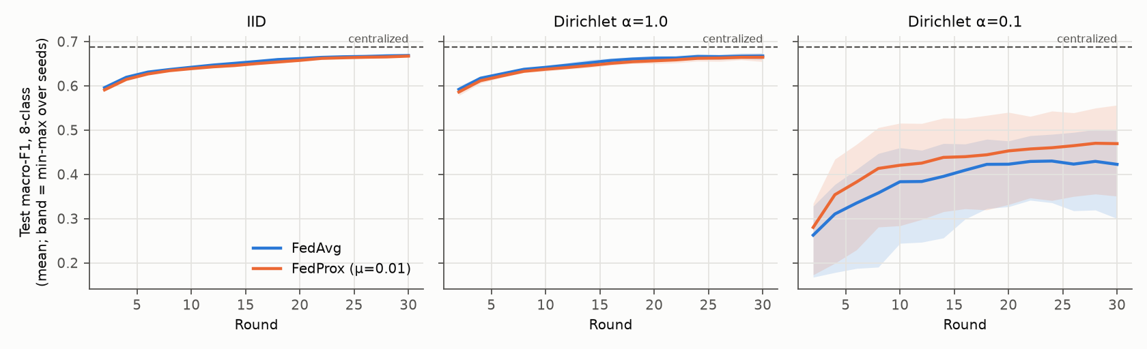
RQ2 · Federation is cheap — until the skew is strong
IID / mild skew (α = 1.0): federated detection at 1 % FPR is only 0.6–2.5 points below centralized after 30 rounds (~30–105 MB traffic).
2 local epochs per round is the best realism trade: same traffic, up to +1.4 points, converges in half the rounds.
Strong label skew (α = 0.1) breaks training in every task — macro-F1 −0.12–0.26, FPR doubles — and FedProx does not fix it.

Slide 6
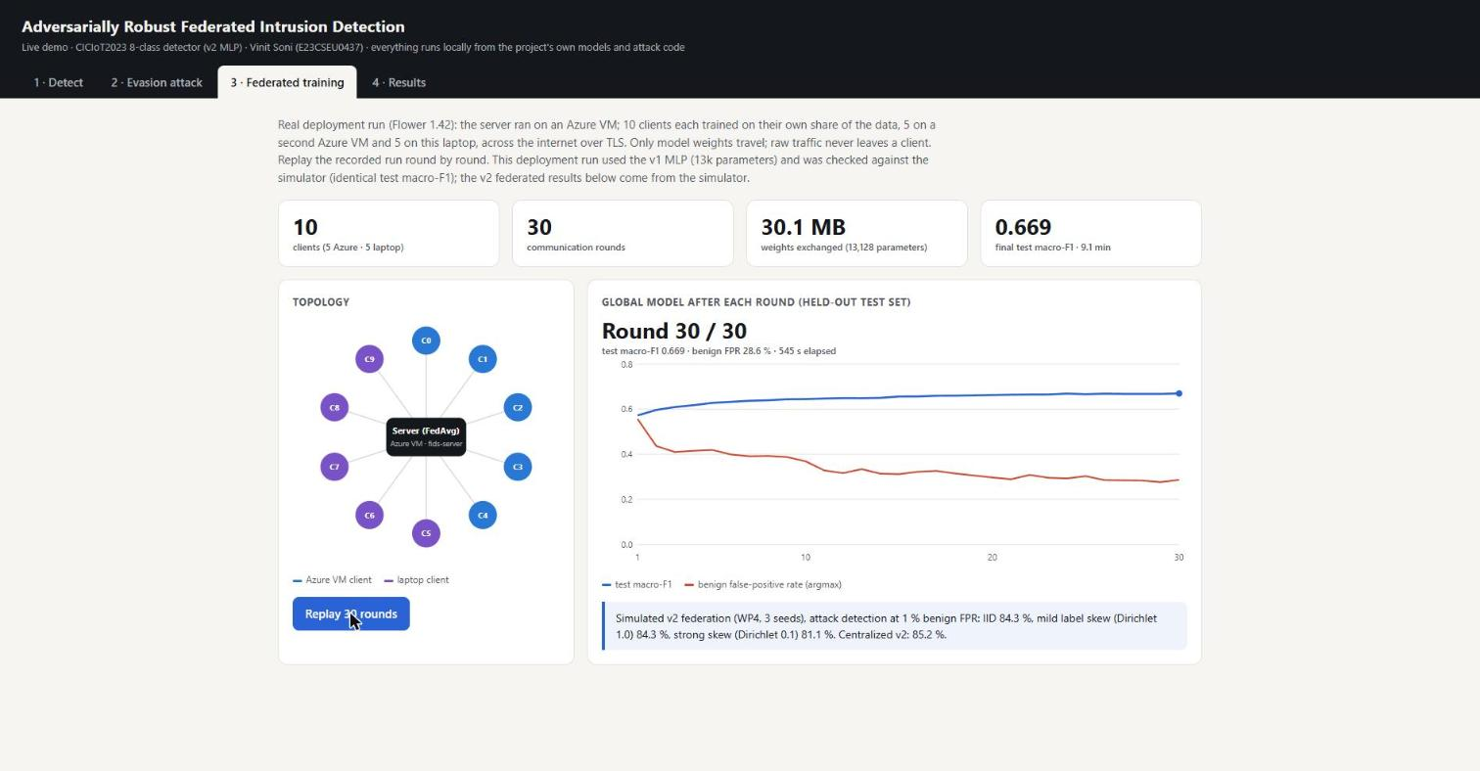
The simulator survives contact with reality
REAL FLOWER 1.42 RUN · TLS OVER THE INTERNET
1 SuperLink + 5 clients on Azure VMs, 5 clients on this laptop.
Test macro-F1 0.6692 — identical to the simulator to four decimals.
30.05 MB exchanged, exactly as estimated; 561 s vs 92 s on GPU.
Only model weights travel; raw traffic never leaves a client.
Dashboard replay of the recorded run (demo, tab 3)

Slide 7
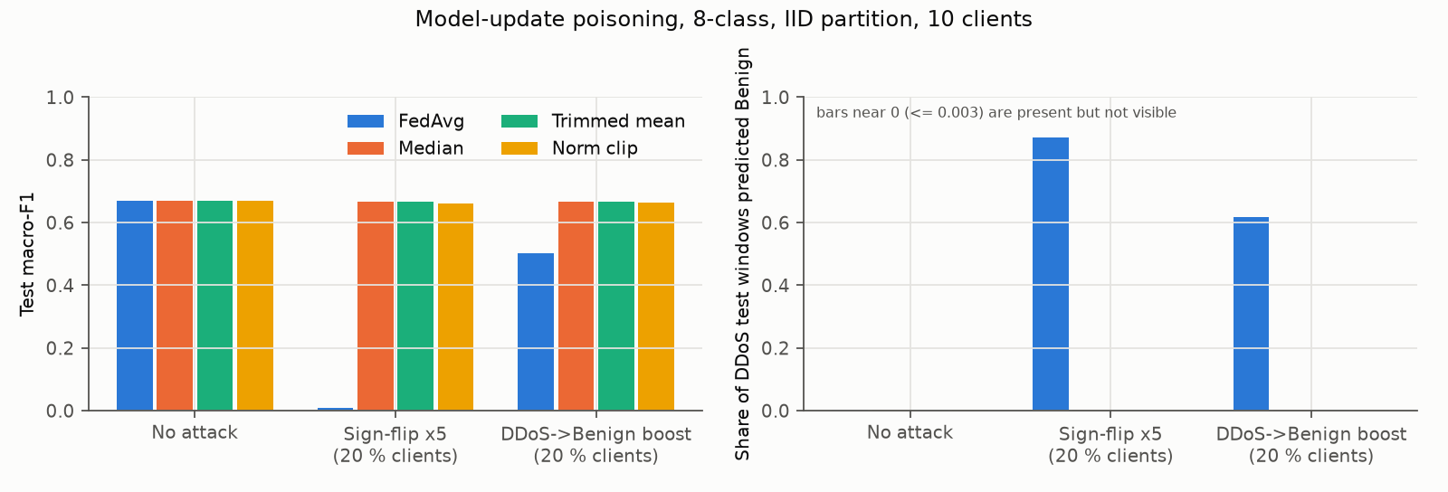
RQ3 · Two bad clients beat FedAvg; medians hold the line
2 of 10 malicious: sign-flip collapses FedAvg to macro-F1 ≤ 0.04; targeted poisoning hides up to 62 % of DDoS as benign.
Median / trimmed mean / norm clip neutralise both attacks at ≤ 0.001 clean cost (IID) — but the trimmed mean fails at 30 % malicious, exactly as its assumption predicts.

Slide 8
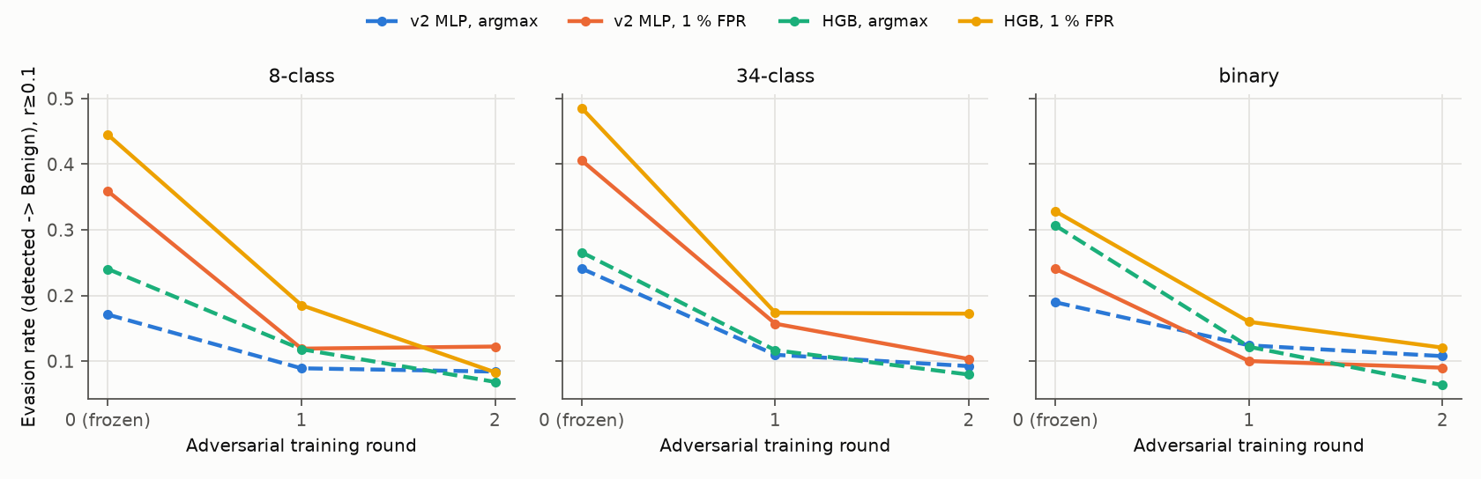
RQ4 · The deployable threshold is the most evadable one
Black-box, label-only attacker (pad · slow · re-TTL, ≤ 112 queries): evades the 1 %-FPR rule for 24–49 % of detected windows — 1.1–2.1× more often than argmax.
Two rounds of adversarial training cut evasion to 8–17 % at ≈ zero clean cost; Spoofing & Web — the families that already overlap benign — stay evadable.

Slide 9
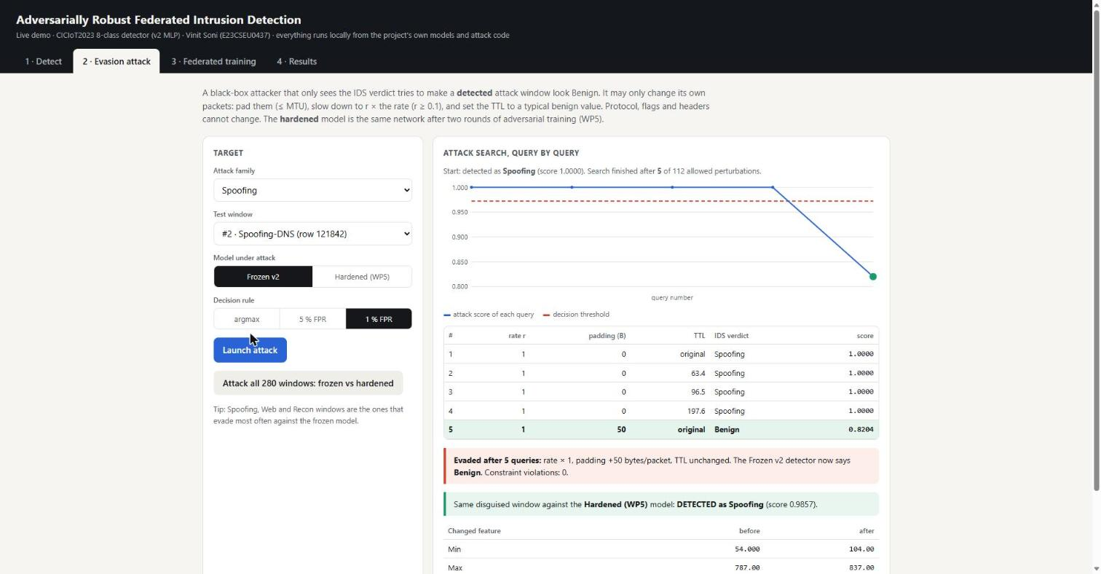
Evaded in 5 queries — the hardened model catches it
SPOOFING-DNS WINDOW, 1 % FPR RULE
Queries 1–4: every disguise still detected.
Query 5: +50 B padding per packet → verdict flips to Benign.
The same disguised window is still detected as Spoofing by the WP5-hardened model (score 0.986).
0 constraint violations — protocol, flags and headers untouched.
Query-by-query replay in the demo dashboard (tab 2)

Slide 10
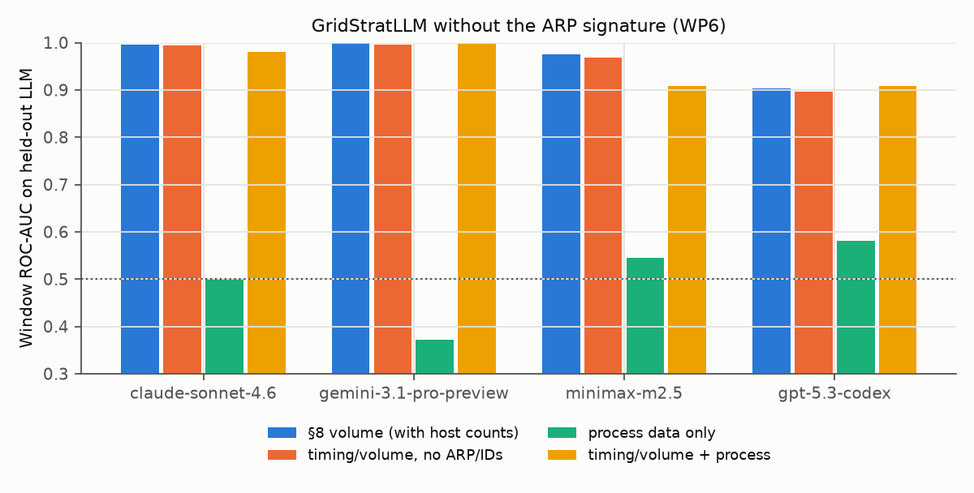
RQ5 · The toolkit betrays the attack, not the LLM
Signatures transfer across planning LLMs: window AUC 0.90–1.00 on every held-out LLM — all 436 sessions use the same MITM primitives.
A classical rule (one IP, two MACs) already flags 89–99 % of attack windows with zero false alarms.
Remove the ARP features entirely: AUC drops ≤ 0.007 — the MITM relay itself (S7 timing/volume) still gives the attack away.
SCADA process data alone carries no usable signal (AUC 0.37–0.58). Attacks without a MITM step remain untestable on this dataset.
Leave-one-LLM-out AUC without the ARP signature (WP6)

Slide 11
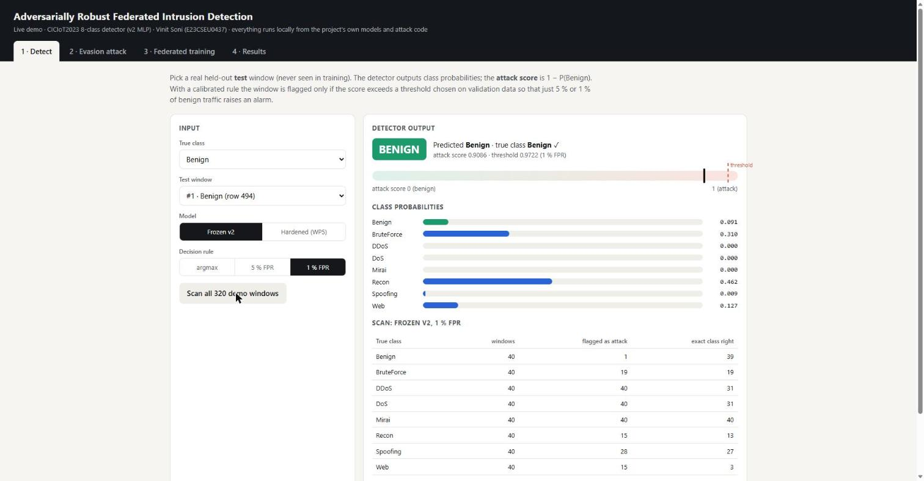
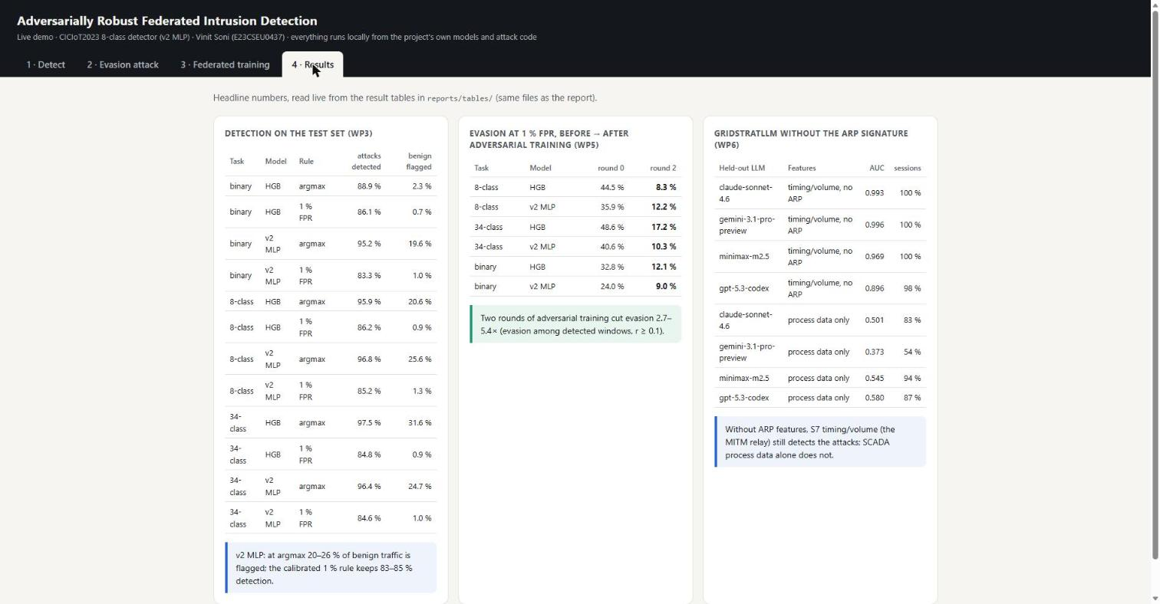
Everything shown live, from the project’s own artifacts
Detect · pick any held-out window, frozen vs hardened model
Results · headline tables read live from reports/tables/
Local FastAPI dashboard, no external services: real test windows, the real models, the real attack code (scripts/run_demo.ps1).
Demo sample at 1 % FPR: frozen model — 64 of 197 detected windows evaded (32.5 %); hardened — 31 of 198 (15.7 %).

Slide 12
What decided the outcome
Data hygiene first — Duplicates, cross-class conflicts and shortcut features would have inflated every later number. Honest splits set the real baseline.
1
Fix the operating point — Argmax comparisons are meaningless; a calibrated 1 %-FPR rule makes models deployable — and comparable.
2
Robustness is assumptions — Median holds to 30 % malicious; trimmed mean fails past its trim; adversarial training beats only the attacker it saw.
3
Federation works, skew doesn’t — Real deployment matches simulation; strong label skew remains the open problem.
4
Tools, not intelligence — LLM-planned grid attacks are caught by their common toolkit — the planning model is irrelevant to the defender.
5

Slide 13
REPRODUCIBLE END TO END
Every table, figure and demo number
regenerates from the repository
Code & report github.com/vinitsoni03/federated-ids · 63 tests · run records per experiment
Live demo scripts/run_demo.ps1 → localhost dashboard · detect, attack, federate, results
Known limits one dataset release & split · feature-space perturbations · α = 0.1 unsolved
Vinit Soni (E23CSEU0437) · November 2026

