Slide 1
Java Getting started
Java Install
Some PCs might have Java already installed.
To check if you have Java installed on a Windows PC, search in the start bar for Java or type the following in Command Prompt (cmd.exe):
C:\Users\Your Name>java -version

Slide 2
If Java is installed, you will see something like this (depending on version):
java version "11.0.1" 2018-10-16 LTS
Java(TM) SE Runtime Environment 18.9 (build 11.0.1+13-LTS)
Java HotSpot(TM) 64-Bit Server VM 18.9 (build 11.0.1+13-LTS, mixed mode)
If you do not have Java installed on your computer, you can download it for free from oracle.com.

Slide 3
Setup for Windows
To install Java on Windows:
Go to "System Properties" (Can be found on Control Panel > System and Security > System > Advanced System Settings)
Click on the "Environment variables" button under the "Advanced" tab
Then, select the "Path" variable in System variables and click on the "Edit" button
Click on the "New" button and add the path where Java is installed, followed by \bin. By default, Java is installed in C:\Program Files\Java\jdk-11.0.1 (If nothing else was specified when you installed it). In that case, You will have to add a new path with: C:\Program Files\Java\jdk-11.0.1\bin
Then, click "OK", and save the settings
At last, open Command Prompt (cmd.exe) and type java -version to see if Java is running on your machine

Slide 4
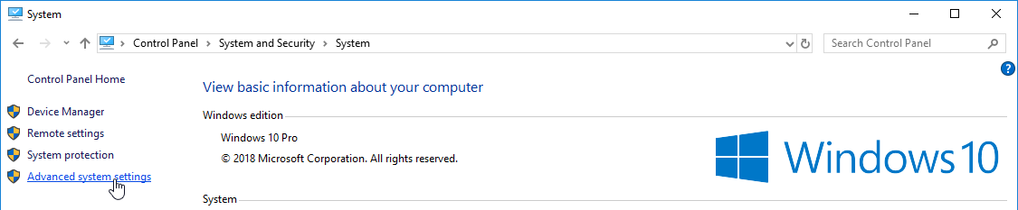

Slide 5
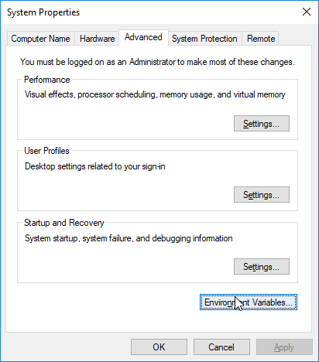
step-2

Slide 6
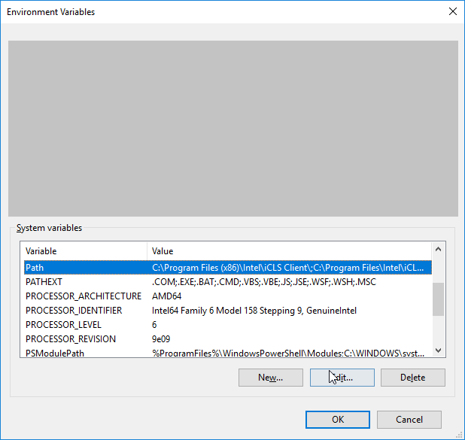
step-3

Slide 7
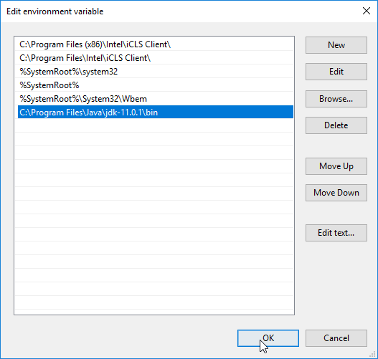
step-4

Slide 8
step-5
Write the following in the command line (cmd.exe):
C:\Users\Your Name>java -version
If Java was successfully installed, you will see something like this (depending on version):
java version "11.0.1" 2018-10-16 LTS
Java(TM) SE Runtime Environment 18.9 (build 11.0.1+13-LTS)
Java HotSpot(TM) 64-Bit Server VM 18.9 (build 11.0.1+13-LTS, mixed mode)

Slide 9
Java Syntax
MyClass.java
public class MyClass {
public static void main(String[] args) {
System.out.println("Hello World");
}
}

Slide 10
java syntax
Every line of code that runs in Java must be inside a class. In our example, we named the class MyClass. A class should always start with an uppercase first letter.
Note: Java is case-sensitive: "MyClass" and "myclass" has different meaning.
The name of the java file must match the class name. When saving the file, save it using the class name and add ".java" to the end of the filename. To run the example above on your computer, make sure that Java is properly installed: Go to the Get Started Chapter for how to install Java. The output should be:
output: Hello World

Slide 11
The main Method
The main() method is required and you will see it in every Java program:
public static void main(String[] args)
Any code inside the main() method will be executed. You don't have to understand the keywords before and after main. You will get to know them bit by bit while reading this tutorial.
For now, just remember that every Java program has a class name which must match the filename, and that every program must contain the main() method.

Slide 12
System.out.println()
Inside the main() method, we can use the println() method to print a line of text to the screen:
public static void main(String[] args) {
System.out.println("Hello World");
}

