Slide 1


Web-Engineering I
Course STG-TINF24A
May – July 2025

Slide 2
Final Project

Slide 3
Exercise
Review your project idea and reconfirm that it is the right thing to do! If not, come up with another idea!
What is your project idea?
Why did you want to implement it?
What makes it better or different to similar web pages?
Who is your target user group? Is it one or multiple with different needs?
Describe your main process flows in a flow chart.
Describe the steps of the processes and who needs to do what
Create a site map (homepage and all the other relevant pages to use your web application)
Create a tree structure for the site map.
Develop a mockup of the homepage and one of the main processes.
Use Figma or any other tool you prefer to create mockups of the main pages.
Define what your MVP (Minimimal Viable Product) will look like.
What are you going to implement as a minimum that is usable?

Slide 4
1. Project Idea
Project Idea:
Book logging platform. Users can search/ add books, track reading status, write reviews, add tags, link entries with moods, music, location and images.
Why This Project?:
Websites like Goodreads feel impersonal. This website aims for a journal-like experience.
What Makes It Unique?:
Focus on emotional connection, not just stats
Mood & music tagging, location-based entries (reading on vacation)
Designed like a digital reading diary (maybe social media feel)
Target audience:
Students and young adults who love expressive journaling

Slide 5
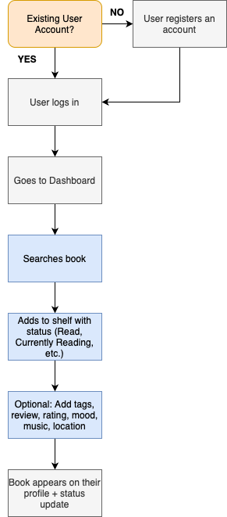
2. Main Flow Process
After logging in, the user sees their dashboard with an overview of reading activities and stats
They can search for books
Once a book is selected, it’s added to their shelf with reading status
Users can optionally expand the entry with a review, tags…
The book appears on their profile, statistics update automatically
(Explore page to see other entries)

Slide 6
Steps and Roles in the Processes
Step | What Happens | Who Does It
1. Sign up / Log in | Authenticated user session begins | User
2. Search Book | Query Google Books API or use manual entry form | User / Website
3. Add Book | Select/add title, status | User
4. Customize Entry | Add reflection, location, mood, music, tags | User
5. View Profile | Overview of stats, bookshelves, lists | User
6. View Dashboard | See updates, inspiration | User
7. (Optional) Comment / Like others’ reviews | Community features | User

Slide 7
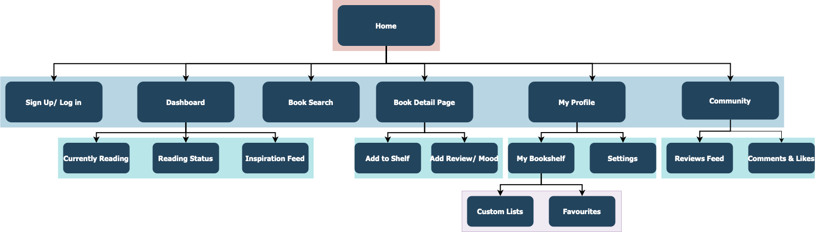
Site Map

Slide 8
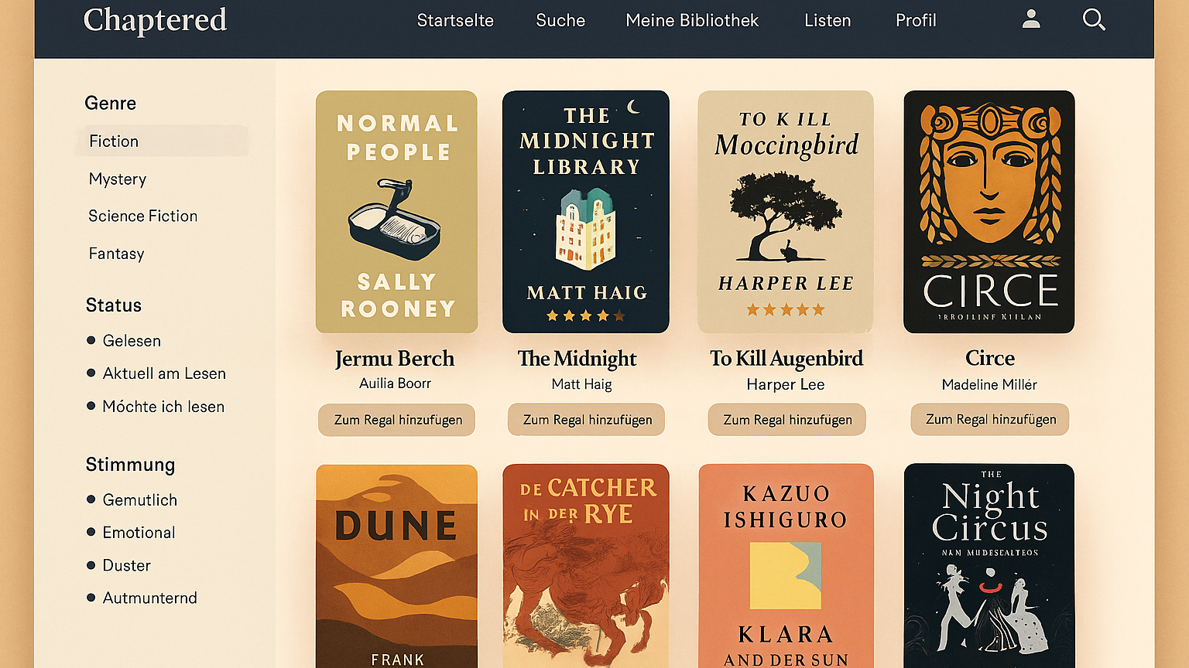
Site Mockup

Slide 9
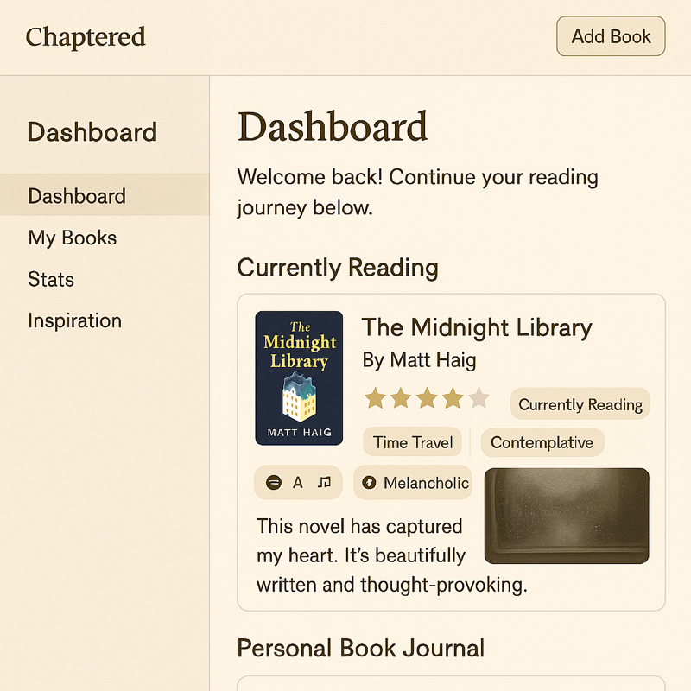

Slide 10
Minimal Viable Product
Must-Haves:
Sign up/ Log in
Book Search (API)
Add book to shelf with basic status
View profile with book list
Add simple review + rating
Book detail page
Basic stats page (total read books)
”Moods”
Not in MVP:
Community
Custom lists
Reading challenge & quotes

Slide 11
Questions and answers

