Slide 1
Strings 12.1, 12.3
CMPT 225

Slide 2

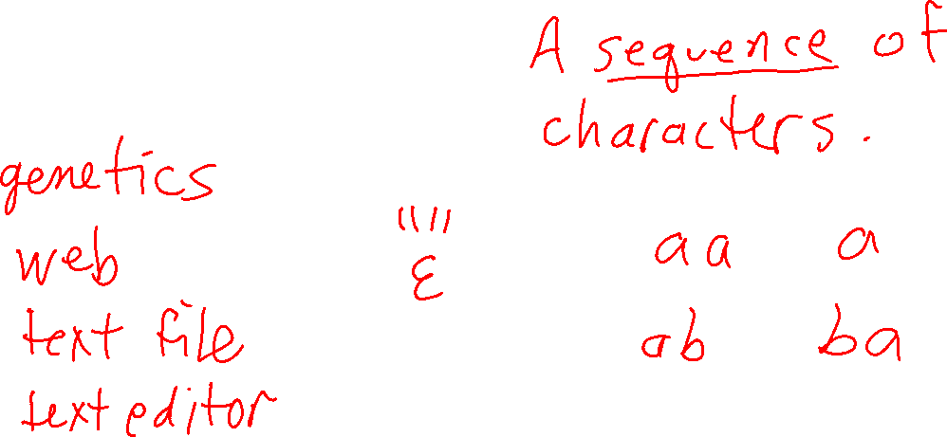
What is a string?

Slide 3
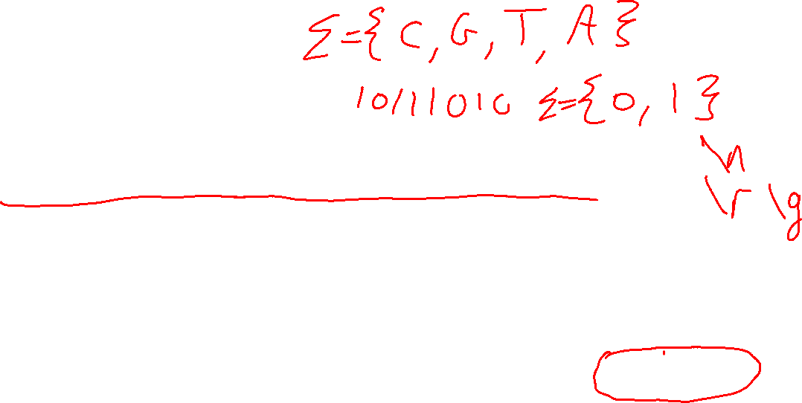
What is a string?
A string is a contiguous sequence of characters.
CGTAAACTGCTTTAATCAAACGC
www.sfu.ca
individual characters in the string are precisely defined values (e.g. Unicode)

Slide 4
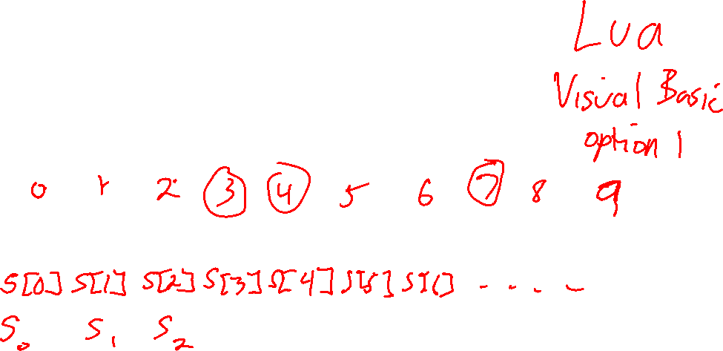
What is a string?
A string is a contiguous sequence of characters.
Question What are the index values of the characters in a string?
w | w | w | . | s | f | u | . | c | a
s

Slide 5
What is a string?
A string is a contiguous sequence of characters.
Careful! C++ starts indexing at 0, but some languages, and some books/papers, start at 1
0 | 1 | 2 | 3 | 4 | 5 | 6 | 7 | 8 | 9
w | w | w | . | s | f | u | . | c | a
s

Slide 6
What is a string?
A string is a contiguous sequence of characters.
0 | 1 | 2 | 3 | 4 | 5 | 6 | 7 | 8 | 9
w | w | w | . | s | f | u | . | c | a
s
String s consists of 10 characters: s[0], s[1], s[2], s[3], s[4], s[5], s[6], s[7], s[8], s[9]

Slide 7
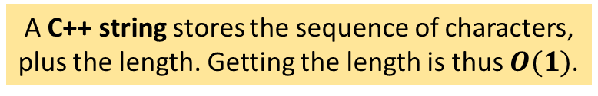
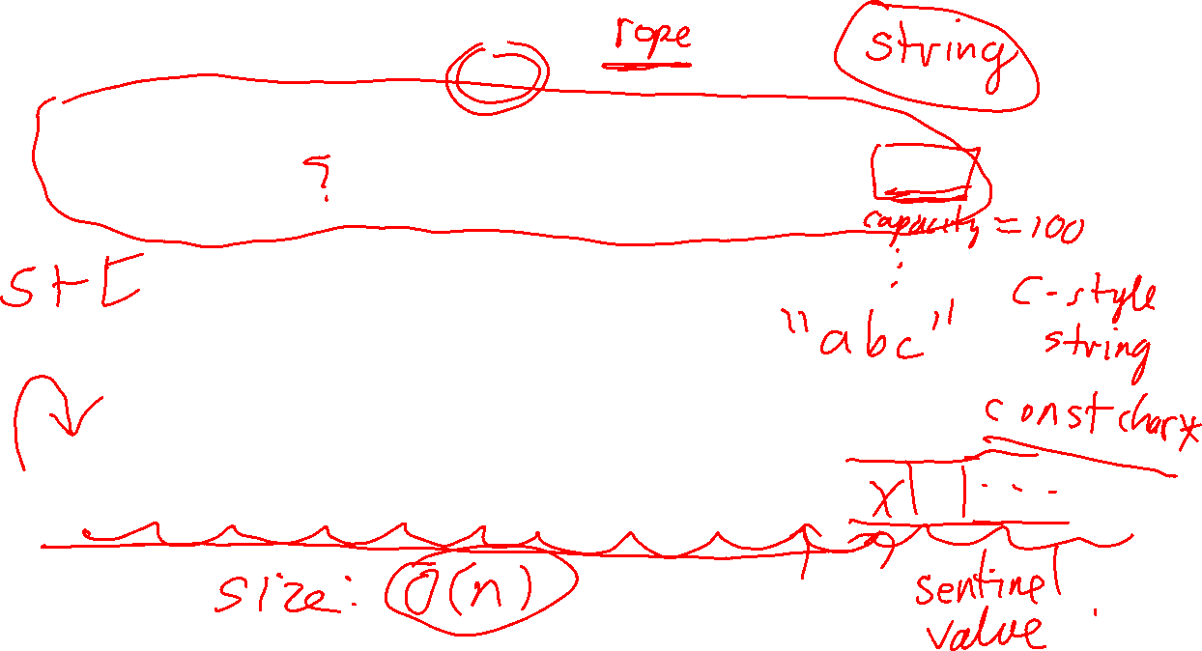
A C++ string stores the sequence of characters, plus the length. Getting the length is thus $O(1)$.
0 | 1 | 2 | 3 | 4 | 5 | 6 | 7 | 8 | 9
w | w | w | . | s | f | u | . | c | a
s
Size: 10
Question
A C-style string is just an array of characters. How does it know its length?
0 | 1 | 2 | 3 | 4 | 5 | 6 | 7 | 8 | 9
w | w | w | . | s | f | u | . | c | a
t

Slide 8
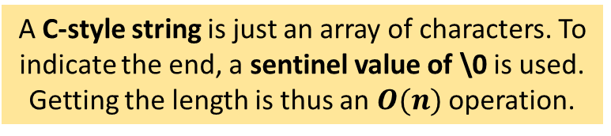
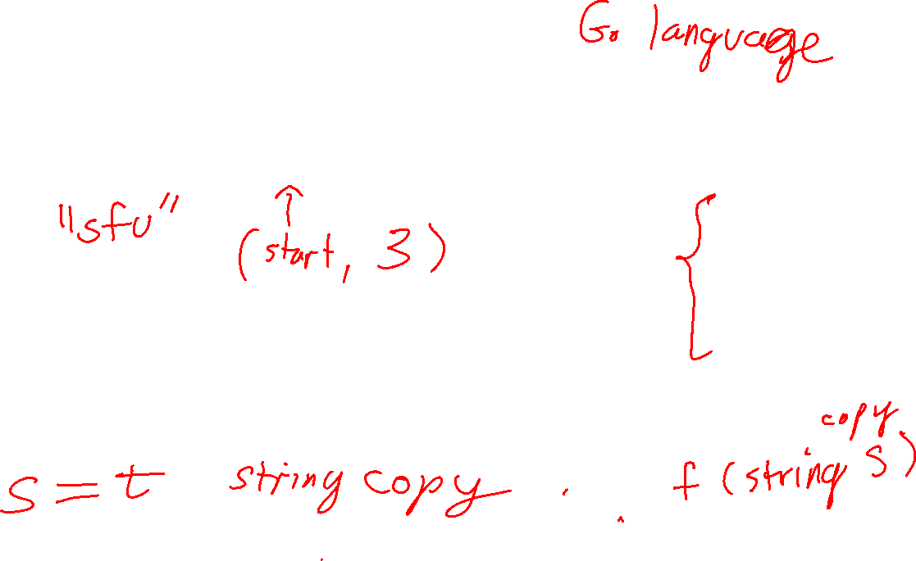
A C++ string stores the sequence of characters, plus the length. Getting the length is thus $O(1)$.
0 | 1 | 2 | 3 | 4 | 5 | 6 | 7 | 8 | 9
w | w | w | . | s | f | u | . | c | a
s
Size: 10
In general, you should avoid C-style strings. They can be surprisingly difficult to use correctly, in part because their memory management is left to the programmer.
A C-style string is just an array of characters. To indicate the end, a sentinel value of \0 is used. Getting the length is thus an $O(n)$ operation.
0 | 1 | 2 | 3 | 4 | 5 | 6 | 7 | 8 | 9 | 10
w | w | w | . | s | f | u | . | c | a | \0
t

Slide 9
The string_view Type
0 | 1 | 2 | 3 | 4 | 5 | 6 | 7 | 8 | 9
w | w | w | . | s | f | u | . | c | a
s
Size: 10
Question
Suppose you want to somehow refer to the substring “sfu” is this string? How can you do that in C++?

Slide 10
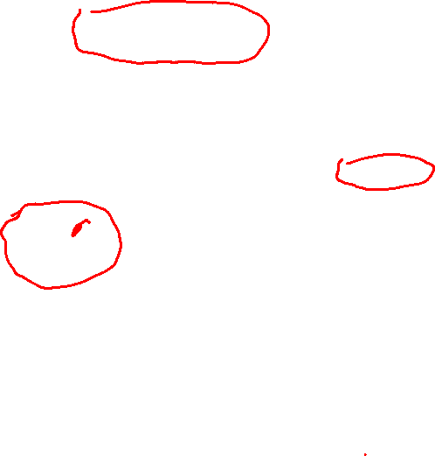
The string_view Type
0 | 1 | 2 | 3 | 4 | 5 | 6 | 7 | 8 | 9
w | w | w | . | s | f | u | . | c | a
s
Size: 10
A string_view object typically “points” to an underlying C++ or C-style string. It is sometimes called a fat pointer because it behaves similarly to a regular pointer, but uses more memory.
begin: length: 3
string_view sv "sfu"
C++ has another very useful string-like type called std::string_view. It’s usually implemented as a pointer to a character (in a sequence of characters), plus a length.

Slide 11
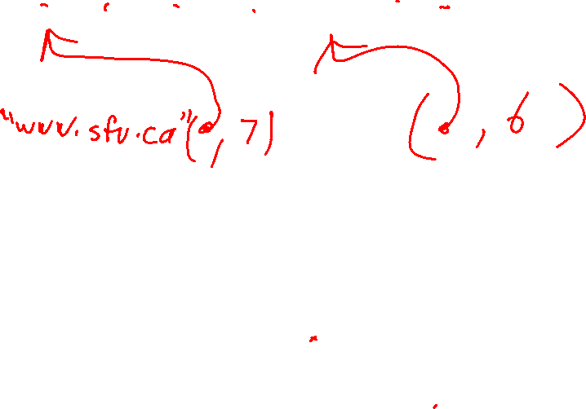
The string_view Type
0 | 1 | 2 | 3 | 4 | 5 | 6 | 7 | 8 | 9
w | w | w | . | s | f | u | . | c | a
s
Size: 10
begin: length: 3
string_view sv "sfu"
Questions
Create a string_view that refers to "www.sfu"
Create a string_view that refers to "sfu.ca"

Slide 12
The string_view Type
0 | 1 | 2 | 3 | 4 | 5 | 6 | 7 | 8 | 9
w | w | w | . | s | f | u | . | c | a
s
Size: 10
begin: length: 7
Multiple string views can point to the same underlying string, even overlapping as shown here.
string_view sv2 "www.sfu"
begin: length: 6
string_view sv3 "sfu.ca"
begin: length: 3
string_view sv "sfu"

Slide 13
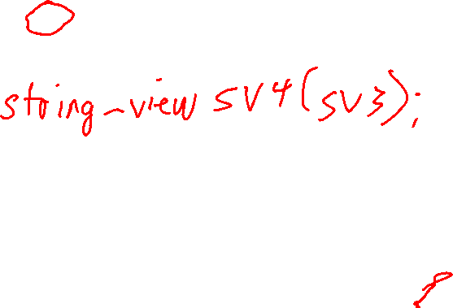
The string_view Type
0 | 1 | 2 | 3 | 4 | 5 | 6 | 7 | 8 | 9
w | w | w | . | s | f | u | . | c | a
s
Size: 10
begin: length: 7
Question
What happens if you copy of string_view sv3?
string_view sv2 "www.sfu"
begin: length: 6
string_view sv3 "sfu.ca"
begin: length: 3
string_view sv "sfu"

Slide 14
The string_view Type
0 | 1 | 2 | 3 | 4 | 5 | 6 | 7 | 8 | 9
w | w | w | . | s | f | u | . | c | a
s
Size: 10
begin: length: 7
string_view sv2 "www.sfu"
begin: length: 6
string_view sv3 "sfu.ca"
begin: length: 3
string_view sv "sfu"
begin: length: 6
string_view sv4(sv3) "sfu.ca"
copying a string_view is cheap: it only copies the begin/length, not the underlying string

Slide 15
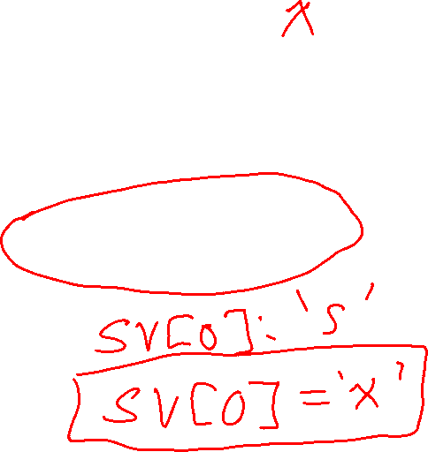
The string_view Type
0 | 1 | 2 | 3 | 4 | 5 | 6 | 7 | 8 | 9
w | w | w | . | s | f | u | . | c | a
s
Size: 10
Question
Can you modify the underlying string with a string_view?
begin: length: 7
string_view sv2 "www.sfu"
begin: length: 6
string_view sv3 "sfu.ca"
begin: length: 3
string_view sv "sfu"
begin: length: 6
string_view sv4(sv3) "sfu.ca"

Slide 16
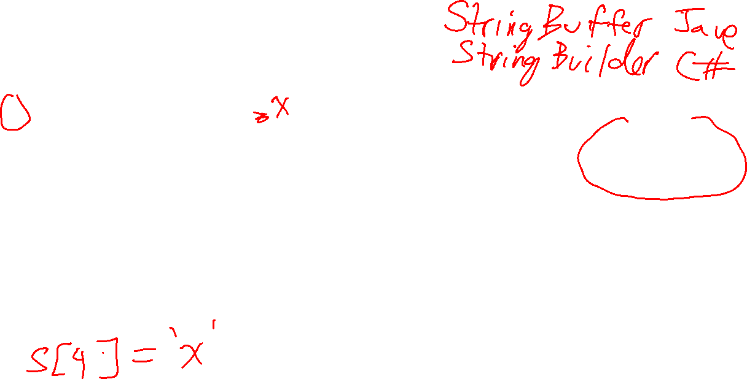
The string_view Type
0 | 1 | 2 | 3 | 4 | 5 | 6 | 7 | 8 | 9
w | w | w | . | s | f | u | . | c | a
s
Size: 10
you cannot modify a string_view itself, and through the string_view you cannot modify the underlying string it points to
begin: length: 7
string_view sv2 "www.sfu"
begin: length: 6
string_view sv3 "sfu.ca"
But it is quite possible to modify the underlying in some other way. Use caution!
begin: length: 3
string_view sv "sfu"
begin: length: 6
string_view sv4(sv3) "sfu.ca"

Slide 17
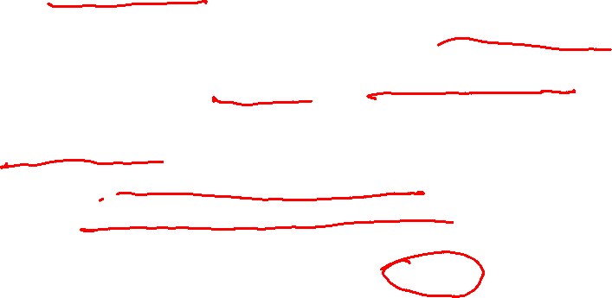
Immutable vs Mutable Strings
Strings in most modern programming languages are immutable
once you create a string it cannot be changed in any way
operations like copying and getting sub-strings from it are fast and easy using string_view-like ideas
C++ and C-style strings are mutable
this makes changing characters in them fast and easy
but copying operations are expensive
plus mutable strings make using shared pointers and references and string_view riskier, because the underlying characters could change
A common solution provided by many languages is to provide both mutable and immutable strings.
In C++, the default string is mutable, while in most other languages the default string is immutable.

Slide 18
The Dangers of string Mutability
The following example shows why C++’s strings being mutable can be a problem when using string_view ...

Slide 19
string s = "fold";
0 | 1 | 2 | 3
f | o | l | d
s

Slide 20
string s = "fold";
string_view sv(s);
0 | 1 | 2 | 3
f | o | l | d
s
sv: ( , 4)

Slide 21
string s = "fold";
string_view sv(s);
cout << sv << endl;
0 | 1 | 2 | 3
f | o | l | d
s
sv: ( , 4)
fold

Slide 22

string s = "fold";
string_view sv(s);
cout << sv << endl;
sv = sv.substr(1, 3);
0 | 1 | 2 | 3
f | o | l | d
s
sv: ( , 3)
sv.substr(i,n) returns a new string_view of size n starting at index i of sv

Slide 23
string s = "fold";
string_view sv(s);
cout << sv << endl;
sv = sv.substr(1, 3);
cout << sv << endl;
0 | 1 | 2 | 3
f | o | l | d
s
sv: ( , 3)
old
So far, so good! All the string_view operations make sense and work correctly.

Slide 24
string s = "fold";
string_view sv(s);
cout << sv << endl;
sv = sv.substr(1, 3);
cout << sv << endl;
s = "foldable";
0 | 1 | 2 | 3 | 4 | 5 | 6 | 7
f | o | l | d | a | b | l | e
s
sv: ( , 3)
Uh oh: s has changed, and sv doesn’t know about the change

Slide 25

string s = "fold";
string_view sv(s);
cout << sv << endl;
sv = sv.substr(1, 3);
cout << sv << endl;
s = "foldable";
cout << sv << endl;
0 | 1 | 2 | 3 | 4 | 5 | 6 | 7
f | o | l | d | a | b | l | e
s
sv: ( , 3)
old
We got lucky: sv is still the same value, i.e. it appears not to have changed

Slide 26

string s = "fold";
string_view sv(s);
cout << sv << endl;
sv = sv.substr(1, 3);
cout << sv << endl;
s = "foldable";
cout << sv << endl;
s = "!";
0
!
s
sv: ( , 3)
through no fault of its own, sv is no longer a valid string_view!
Uh oh: s has changed again, and this time it’s bad

Slide 27

string s = "fold";
string_view sv(s);
cout << sv << endl;
sv = sv.substr(1, 3);
cout << sv << endl;
s = "foldable";
cout << sv << endl;
s = "!";
cout << sv << endl;
0
!
s
sv: ( , 3)
ld
it prints “ld” for me. But it could print anything, or crash, it is no longer valid
when run with valgrind, no error is reported!

Slide 28
The Dangers of string Mutability
The moral is to be very careful using string_view in C++!
They are like pointers to strings: be certain that the underlying string won’t change.
Easier said than done sometimes!
Replacing const string& in functions is one place where it is usually okay to use a string_view instead …

Slide 29
When should you use string_view?

Slide 30
When Should You use string_view?
Replacing const string& in functions can make them more flexible and efficient …

Slide 31
C-style string
int count_char(string_view s, char c)
{
int count = 0;
for (int i = 0; i < s.size(); i++)
{
if (s[i] == c) count++;
}
return count;
}
assert(contains("Hello", 'e'))
C++ string
assert(contains(string("Hello"), 'e'))
string_view
assert(contains(string_view("Hello"), 'e'))
count_char works efficiently with C-style strings, C++ strings, and string views

Slide 32
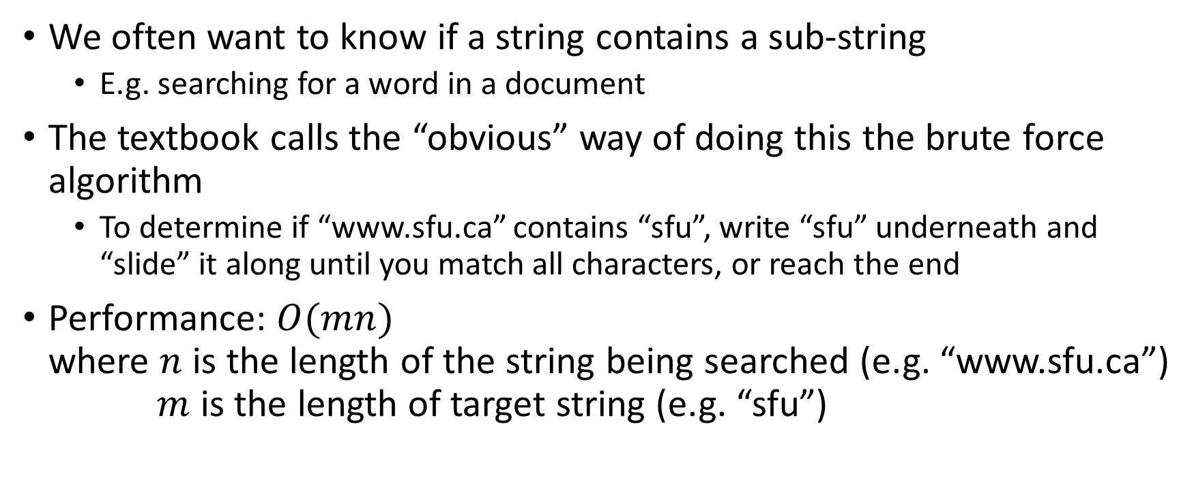
Finding Substrings in a String: Brute Force
We often want to know if a string contains a sub-string
E.g. searching for a word in a document
The textbook calls the “obvious” way of doing this the brute force algorithm
To determine if “www.sfu.ca” contains “sfu”, write “sfu” underneath and “slide” it along until you match all characters, or reach the end
Performance: $O(mn)$ where $n$ is the length of the string being searched (e.g. “www.sfu.ca”) $m$ is the length of target string (e.g. “sfu”)

Slide 33
//
// Returns true if source contains target as sub-string,
// and false otherwise.
//
// Based on code from the textbook.
//
bool contains_text(string_view source, string_view target)
{
int n = source.size();
int m = target.size();
for (int i = 0; i <= n - m; i++)
{
int j = 0;
while (j < m && source[i + j] == target[j])
{
j++;
}
if (j == m)
{
return true;
}
}
return false;
}
source and target are not changed, so we can use string_view
instead of returning true/false, you could instead return a pointer (or index) to the first match

