Slide 1
Binary Search Trees 10.1 – 10.2
CMPT 225

Slide 2
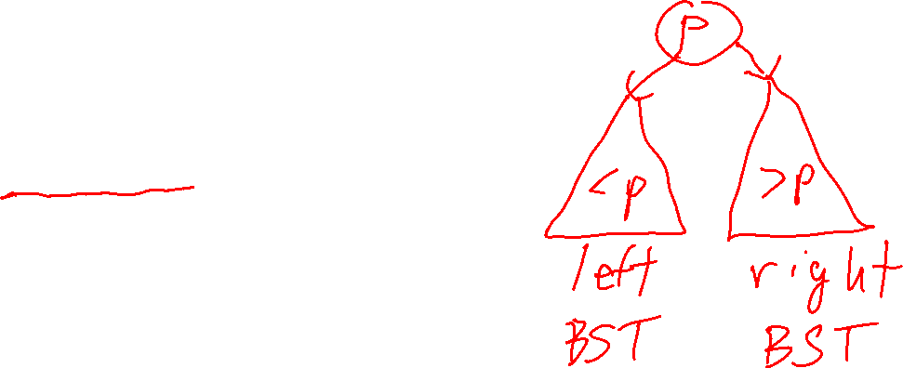
Binary Search Tree (BST)
Draw a diagram showing the structure of a BST.
A binary search tree, or BST for short, is a binary tree that is either:
The empty tree
Or a binary tree with the property that for every node p in it, all the keys in p’s left sub-tree are less than p’s key, and all the keys in p’s right sub-tree are bigger than p’s key
We assume all keys are unique, i.e. no duplicate keys.

Slide 3

Binary Search Tree (BST)
Holds for every node p in the BST.
A binary search tree, or BST for short, is a binary tree that is either:
The empty tree
Or a binary tree with the property that for every node p in it, all the keys in p’s left sub-tree are less than p’s key, and all the keys in p’s right sub-tree are bigger than p’s key
p
k
all keys < k
all keys > k
left sub-tree is a BST
right sub-tree is a BST
We assume all keys are unique, i.e. no duplicate keys.

Slide 4



This is a binary search tree (BST)
Example 1
Is this a BST?
10
10
7
22
7
22
2
8
14
30
2
14
30

Slide 5
This is a binary search tree (BST)
Example 1
Is this a BST?
10
10
7
22
7
22
2
8
14
30
2
14
30

Slide 6

This is a binary search tree (BST)
Example 2
Is this a BST?
10
22
7
22
7
10
2
8
14
30
2
14
30

Slide 7

This is a binary search tree (BST)
Example 2
Is this a BST?
10
22
7
22
7
10
2
8
14
30
2
14
30

Slide 8

This is NOT a binary search tree (BST)
Example 3
Can you swap two keys to make it a BST?
12
4
10
1
11
15

Slide 9

This is NOT a binary search tree (BST)
Example 3
Can you swap two keys to make it a BST?
12
10
4
10
4
12
1
11
15
1
11
15

Slide 10
This is NOT a binary search tree (BST)
Example 4
Can you swap two keys, other than 12 and 10, to make it a BST?
12
4
10
1
11
15

Slide 11
This is NOT a binary search tree (BST)
Example 4
Can you swap two keys, other than 12 and 10, to make it a BST?
12
4
10
No! No other keys can be swapped to make this a BST.
1
11
15

Slide 12

This is a binary search tree (BST)
Example 5
Are these two trees BSTs?
21
21
5
17
17
9
9
9
17
5
5
21

Slide 13

This is a binary search tree (BST)
Example 5
Are these two trees BSTs?
21
21
5
17
17
9
9
9
17
5
5
21

Slide 14
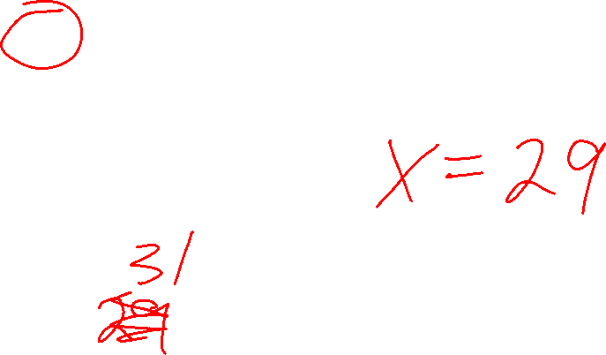
Example 6
Assuming unique integer keys, what are all possible values for X that make this a BST??
12
4
30
1
15
35
28
19
X

Slide 15

Example 6
Assuming unique integer keys, what are all possible values for X that make this a BST??
12
4
30
X = 29
1
15
35
Only value that works!
28
19
X

Slide 16

This is a binary search tree (BST)
Example 7
Which node contains the smallest key? Which contains the biggest?
a
b
c
d
e
f
g
h
i

Slide 17
This is a binary search tree (BST)
Example 7
Which node contains the smallest key? Which contains the biggest?
a
b
c
d is the smallest key
f is the biggest key
d
e
f
What’s the rule for finding the smallest key in a BST?
What’s the rule for finding the smallest key in a BST?
smallest
biggest
g
h
i

Slide 18

This is a binary search tree (BST)
Example 7
Which node contains the smallest key? Which contains the biggest?
a
b
c
d is the smallest key
f is the biggest key
d
e
f
What’s the rule for finding the smallest key in a BST?
What’s the rule for finding the biggest key in a BST?
smallest
biggest
g
p = root while p->left != nullptr: p = p->left
p = root while p->right != nullptr: p = p->right
h
i

Slide 19

Binary Search Tree (BST)
Question Is the entire tree a BST?
root
Suppose a, k, and b are keys and:
a < k < b
left sub-tree is a BST
right sub-tree is a BST
k
a
b
left sub-tree rooted at a is a BST
right sub-tree rooted at b is a BST

Slide 20

Binary Search Tree (BST)
Question Is the entire tree a BST?
No!
root
a, k, and b are keys and:
a < k < b
left sub-tree is a BST
right sub-tree is a BST
k
a
b
left sub-tree rooted at a is a BST
right sub-tree rooted at b is a BST

Slide 21
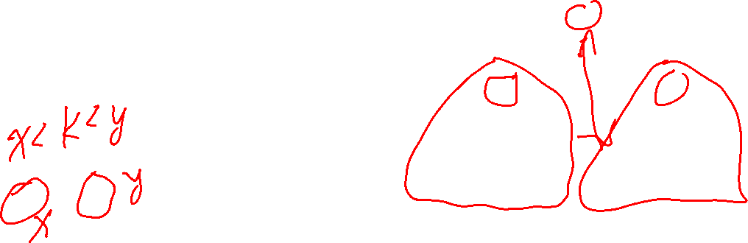
Binary Search Tree (BST)
Question Is the entire tree a BST?
No!
root
a, k, and b are keys and:
a < k < b
left sub-tree is a BST
right sub-tree is a BST
k
10 < 15 < 20
15
a
b
10
20
4
12
14
23
left sub-tree rooted at a is a BST
right sub-tree rooted at b is a BST
left sub-tree is a BST
right sub-tree is a BST
Not a BST: 14 is in the wrong sub-tree

Slide 22
This is a binary search tree (BST)
Example 8
What are all the places in the tree that we could add a new leaf node?
12
4
40
1
30
50
20
15
25

Slide 23

This is a binary search tree (BST)
Example 8
What are all the places in the tree that we could add a new leaf node?
12
12
4
40
4
40
1
30
50
1
30
50
20
20
15
25
15
25

Slide 24
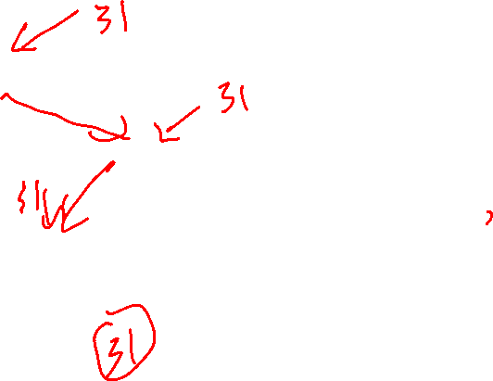
This is a binary search tree (BST)
Example 9
If you add key 31 as a leaf, where are the places it could go so that the resulting tree is a BST?
12
4
33
1
30
35
28
19
29

Slide 25
This is a binary search tree (BST)
Example 9
If you add key 31 as a leaf, where are the places it could go so that the resulting tree is a BST?
12
4
33
1
30
35
28
31
This is the only leaf node that 31 can go in. In any other leaf node the BST rule is broken.
19
29

Slide 26
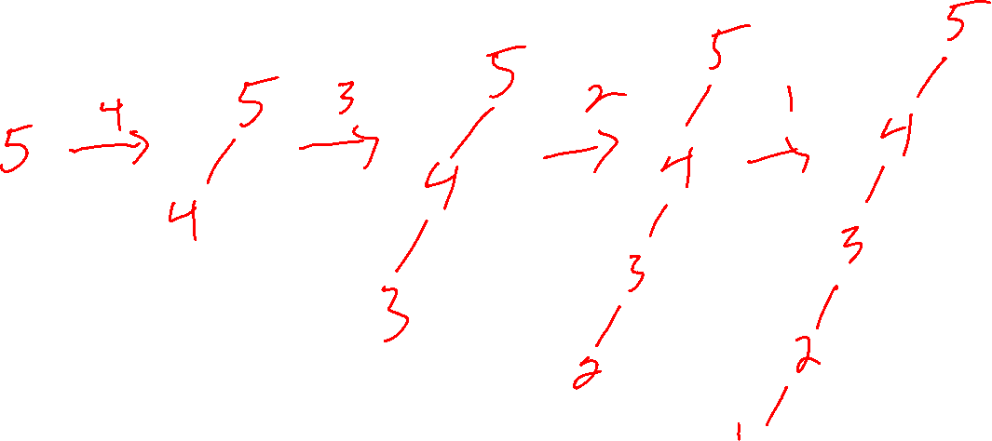
Example 9.5
What BST do you get if you add 5, 4, 3, 2, 1 at leaves, in that order?

Slide 27
Example 9.5
What BST do you get if you add 5, 4, 3, 2, 1 at leaves, in that order?
5
5
5
4
5
4
4
3
2
1
5
4
3
4
3
3
2
2
1

Slide 28
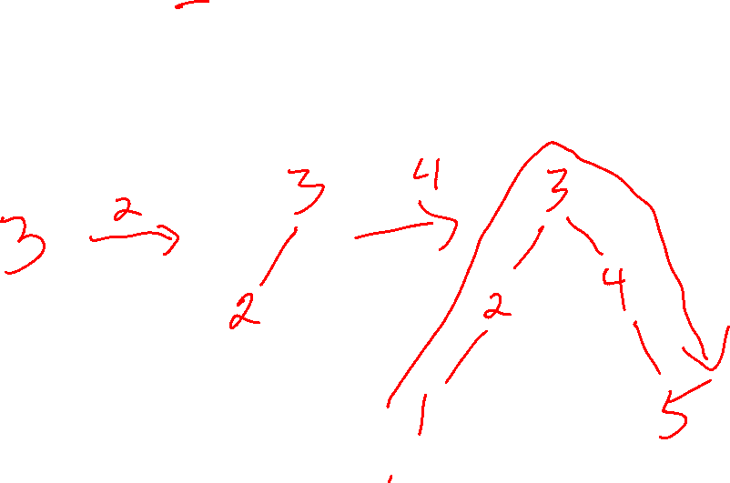
Example 9.5
What BST do you get if you add 3, 2, 4, 1, 5 at leaves, in that order?

Slide 29
Example 9.5
What BST do you get if you add 3, 2, 4, 1, 5 at leaves, in that order?
3
3
3
3
3
2
4
1
2
4
5
2
4
2
2
4
1
1
4
Fact: The order in which you insert keys into a BST affects its shape.

Slide 30

This is a binary search tree (BST)
Example 10
What happens if you delete the root node (key 12)?
12
4
30
1
25
35
18
27
15
20

Slide 31

Example 10
What happens if you delete the root node (key 12)?
After deleting the root there are two separate BSTs.
How can we re-combine the two separate BSTs into a single BST?
4
30
1
25
35
18
27
15
20

Slide 32
Example 10
What happens if you delete the root node (key 12)?
30
25
35
How can we re-combine the two separate BSTs into a single BST?
18
27
15
20
This is one way of re-combining the trees. Can you find another way?
4
1

Slide 33
Example 10
What happens if you delete the root node (key 12)?
4
1
30
How can we re-combine the two separate BSTs into a single BST?
25
35
18
27
15
20
This is another way to re-combine the trees.

Slide 34
This is a binary search tree (BST)
Example 11
What happens if you delete the root node (key 12)?
12
4
33
3
9
30
35
28
31
15
29

Slide 35

This is a binary search tree (BST)
Example 11
What happens if you delete the root node (key 12)?
How can we re-combine the two separate BSTs into a single BST?
4
33
3
9
30
35
28
31
15
29

Slide 36
This is a binary search tree (BST)
Example 11
What happens if you delete the root node (key 12)?
33
30
35
You get two different BSTs. How can they be re-combined?
28
31
15
29
4
This is one way of re-combining the trees. Can you find another way?
3
9

Slide 37
This is a binary search tree (BST)
Example 11
What happens if you delete the root node (key 12)?
4
3
9
You get two different BSTs. How can they be re-combined?
33
This is another way of re-combining the trees.
30
35
28
31
15
29

Slide 38

This is a binary search tree (BST)
Example 11.1
What happens if you delete key 30?
12
4
40
3
9
30
50
28
35
33
37

Slide 39
This is a binary search tree (BST)
Example 11.1
What happens if you delete key 30?
Three trees! One rooted a 12 One rooted at 28 One rooted at 35
12
4
40
3
9
50
How could you re-combine them into one binary search tree?
28
35
33
37

Slide 40
This is a binary search tree (BST)
Example 11.1
What happens if you delete key 30?
12
4
40
One way to do it.
3
9
35
50
33
37
28

Slide 41
This is a binary search tree (BST)
Example 11.1
What happens if you delete key 30?
12
4
40
3
9
50
Can you find a different way to re-combine them?
28
35
33
37

Slide 42
This is a binary search tree (BST)
Example 11.1
What happens if you delete key 30?
12
A different way to re-combine the trees.
4
40
3
9
28
50
35
33
37

Slide 43
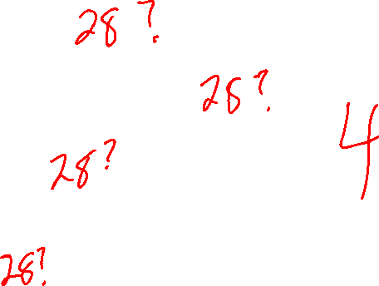
This is a binary search tree (BST)
Example 12
How many comparisons must you do to check if key 28 is in the BST?
12
4
33
1
30
35
28
19
29

Slide 44

This is a binary search tree (BST)
Example 12
How many comparisons must you do to check if key 28 is in the BST?
12
4 comparisons are needed to find 28
4
33
1
30
35
28
19
29

Slide 45
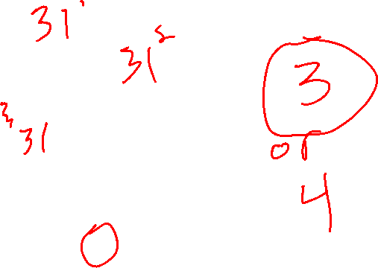
This is a binary search tree (BST)
Example 12
How many comparisons must you do to prove 31 is not in the BST?
12
4
33
1
30
35
28
19
29

Slide 46
This is a binary search tree (BST)
Example 12
How many comparisons must you do to prove 31 is not in the BST?
12
3 comparisons are need to show 31 is not in the BST
4
33
1
30
35
28
19
29

Slide 47
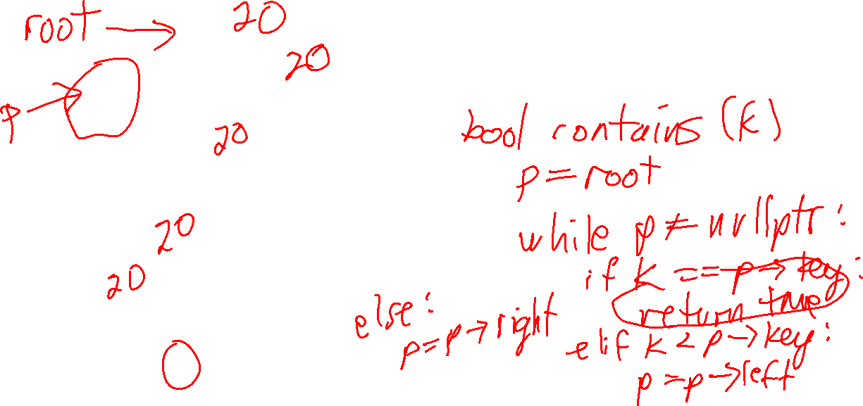
This is a binary search tree (BST)
Example 13
What’s an algorithm for checking if a key is in a BST?
12
4
33
1
30
35
28
19
29

Slide 48

This is a binary search tree (BST)
Example 13
What’s an algorithm for checking if a key is in a BST?
12
bool contains(k) p = root while p != nullptr: if k == p->key: return true
else if k < p->key: p = p->left else if k > p->key: p = p->right
return false
4
33
1
30
35
28
19
29

Slide 49
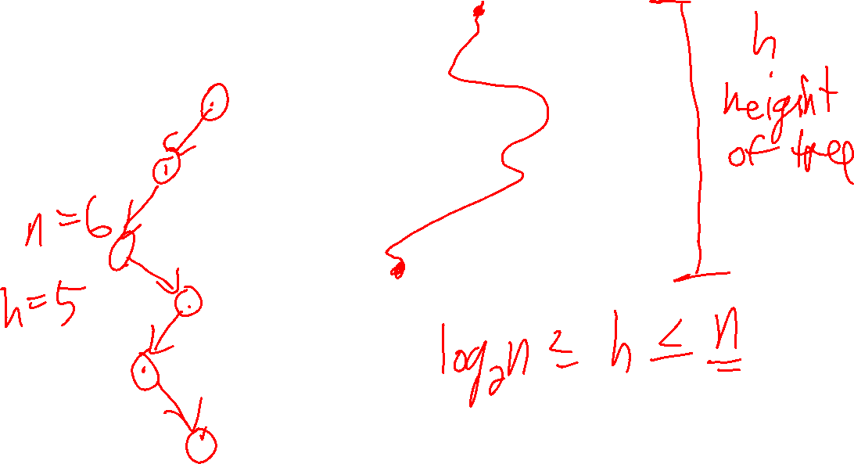
In the worst case, how many comparisons might you need to do to find if a key is in a BST?
Binary search tree

Slide 50
In the worst case, how many comparisons might you need to do to find if a key is in a BST?
Binary search tree
Height h of the tree ranges from n to log n
In the worst case, you need to search from the root to the deepest leaf.
In the worst case, O(h) comparisons needed, where h is the height of the tree.

Slide 51
In the worst case, how many comparisons might you need to do to find if a key is in a BST?
Binary search tree
Height h of the tree ranges from n to log n
The worst-case performance of contains(k) is O(h), where h is the height of the tree.
bool contains(k) p = root while p != nullptr: if k == p->key: return true
else if k < p->key: p = p->left else if k > p->key: p = p->right
return false

Slide 52

Binary Search Trees
These height-based BST operations take worst case O(height of tree) when:
Searching for a key
Adding a key
Deleting a key
Adding and deleting keys can change the shape of the BST
They could increase the height, slowing down height-based tree operations
In practice, plain BSTs can become quite tall, making them perform very poorly

Slide 53

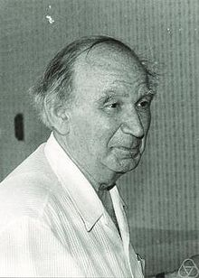
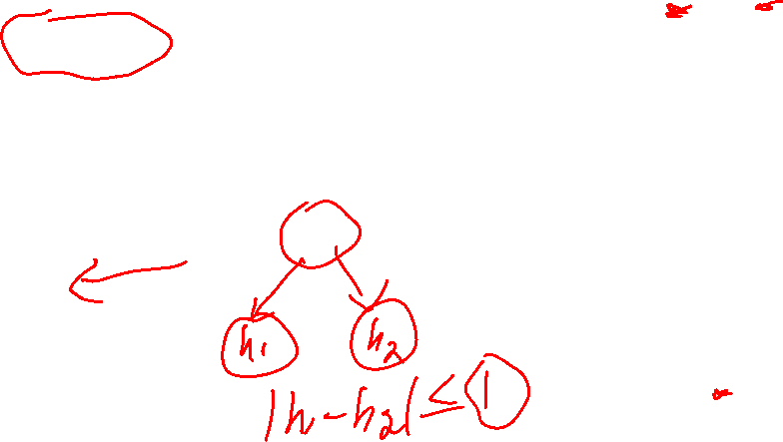
AVL Trees
AVL trees are binary search trees whose height is guaranteed to be O(log n)
AVL trees satisfy the height-balance property:
Here are the two inventors of the AVL tree. Can you guess why they’re called AVL trees?
Georgy Adelson-Velsky
Height-balance Property The heights of the children of all internal nodes differ by at most 1.
Evgenii Landis

Slide 54
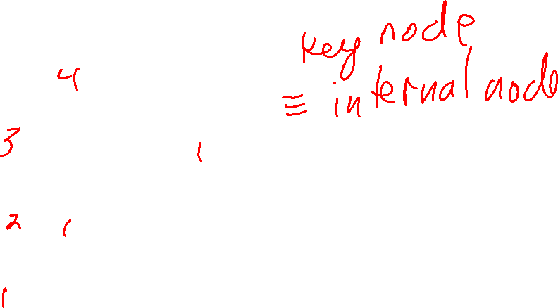
What are the heights of each node?
33
Important For AVL trees the little blue boxes representing empty nodes (null pointers) are considered height 0.
30
35
28
31
0
0
29
0
0
0
0
0

Slide 55
What are the heights of each node?
4
33
Important For AVL trees the little blue boxes representing empty nodes (null pointers) are considered height 0.
3
35
30
1
2
31
28
1
0
0
29
1
0
0
0
0
0

Slide 56

Does this tree satisfy the Height-balance Property?
Height-balance Property The heights of the children of all internal nodes differ by at most 1.
4
33
Important For AVL trees, we count the blue boxes as external nodes, and the circles with keys as internal nodes.
2
3
35
30
1
1
0
2
31
28
1
0
0
1
0
29
1
0
0
0
0
0
0

Slide 57

Does this tree satisfy the Height-balance Property?
Height-balance Property The heights of the children of all internal nodes differ by at most 1.
4
33
No! To be height-balanced, every key node’s children must differ by at most 1.
But the root node has children whose height differs by 2, so it is not height-balanced.
Important For AVL trees, we count the blue boxes as external nodes, and the circles with keys as internal nodes.
2
3
35
30
1
1
0
2
31
28
1
0
0
1
0
29
1
0
0
0
0
Not height-balanced,
so not an AVL tree.
0
0

Slide 58
To show it’s an AVL tree, verify two things:
it’s a BST
it satisfies the height-balance property
Height-balance Property The heights of the children of all internal nodes differ by at most 1.
Is this an AVL tree?
33
Important For AVL trees the little blue boxes representing empty nodes (null pointers) are considered height 0.
30
35
28
31
0
0
0
0
0
0

Slide 59
To show it’s an AVL tree, verify two things:
it’s a BST
it satisfies the height-balance property
Height-balance Property The heights of the children of all internal nodes differ by at most 1.
Is this an AVL tree?
33
Important For AVL trees the little blue boxes representing empty nodes null pointers) are considered height 0.
30
35
Is it a BST?
28
31
0
0
0
0
0
0

Slide 60
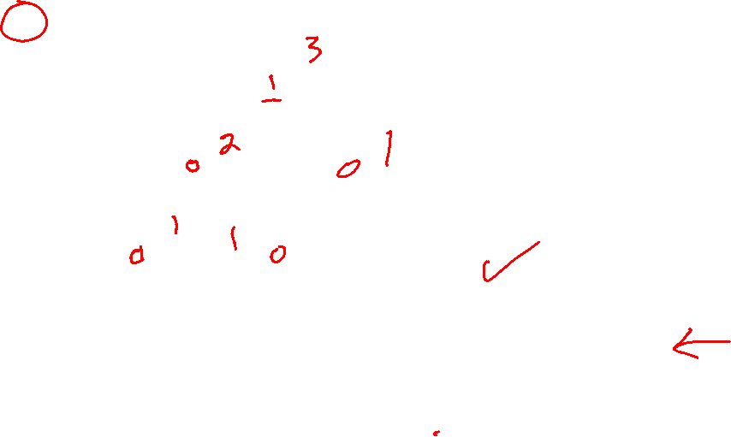
To show it’s an AVL tree, verify two things:
it’s a BST
it satisfies the height-balance property
Height-balance Property The heights of the children of all internal nodes differ by at most 1.
Is this an AVL tree?
33
Important For AVL trees the little blue boxes representing empty nodes (null pointers) are considered height 0.
30
35
Is it a BST?
28
31
0
0
Is it height-balanced?
0
0
0
0
What are the heights of all the nodes?
What are the height-balance differences?

Slide 61
To show it’s an AVL tree, verify two things:
it’s a BST
it satisfies the height-balance property
Height-balance Property The heights of the children of all internal nodes differ by at most 1.
Is this an AVL tree?
3
33
Important For AVL trees the little blue boxes representing empty nodes are considered height 0.
2
30
35
Is it a BST?
1
1
28
31
1
0
0
Is it height-balanced?
0
0
0
0
What are the heights of all the nodes?
What are the height-balance differences?

Slide 62
To show it’s an AVL tree, verify two things:
it’s a BST
it satisfies the height-balance property
Height-balance Property The heights of the children of all internal nodes differ by at most 1.
Is this an AVL tree?
3
33
Important For AVL trees the little blue boxes representing empty nodes are considered height 0.
1
2
30
35
Is it a BST?
1
0
0
1
28
31
1
0
0
0
0
Is it height-balanced?
0
0
0
0
What are the heights of all the nodes?
All the differences are at most 1.
What are the height-balance differences?

Slide 63
Height-balance Property The heights of the children of all internal nodes differ by at most 1.
root
Question
If the entire tree is an AVL tree, must the left and right sub-trees of the root also be AVL trees?
left
right

Slide 64
Height-balance Property The heights of the children of all internal nodes differ by at most 1.
root
Question
If the entire tree is an AVL tree, must the left and right sub-trees of the root also be AVL trees?
left
right
Yes!
left and right are both AVL trees. In fact, all sub-trees of an AVL tree are also AVL trees.

Slide 65

AVL Trees
Key fact! The height of an AVL tree with n keys is O(log n) (see Proposition 10.2 in the textbook for a proof of this fact)
Since AVL trees are binary search trees, these operations run in worst-case O(log n) time for an AVL tree!
Height-based BST operations take worst case O(height of tree) when:
Searching for a key
Adding a key
Deleting a key

Slide 66
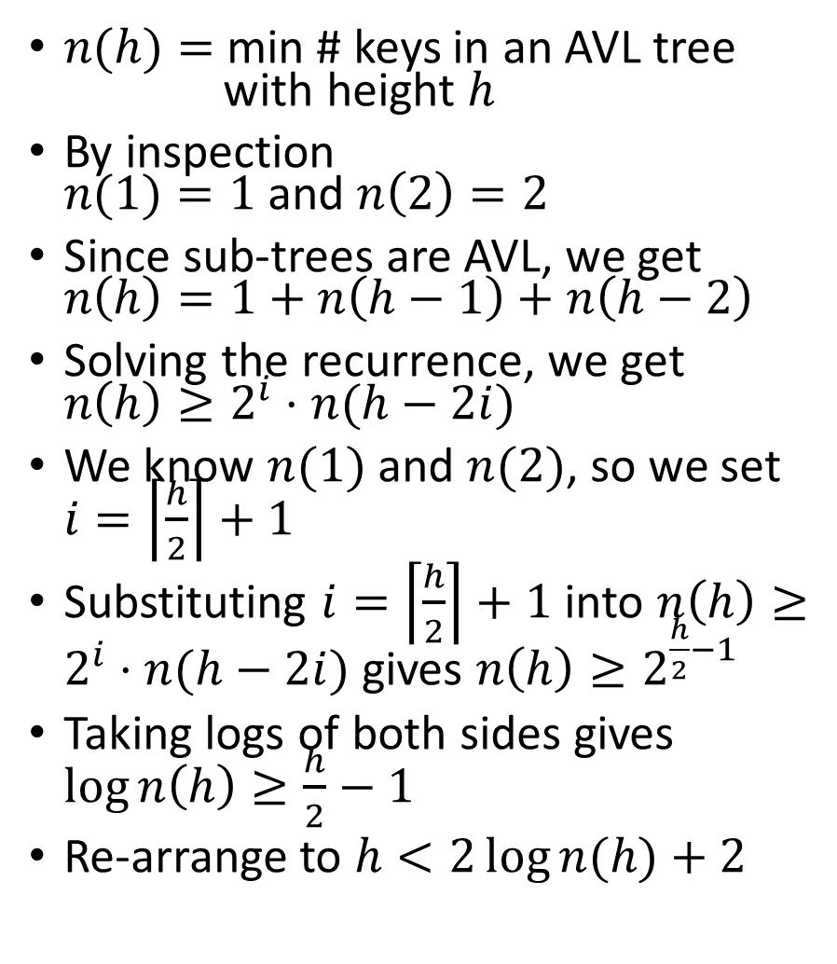

$n(h)=$min # keys in an AVL tree with height $h$
By inspection $n(1)=1$and $n\left(2\right)=2$
Since sub-trees are AVL, we get $n\left(h\right)=1+n\left(h−1\right)+n\left(h−2\right)$
Solving the recurrence, we get $n\left(h\right)≥2^{i}⋅n(h−2i)$
We know $n(1)$ and $n(2)$, so we set $i=\left\lceil \frac{h}{2}\right\rceil +1$
Substituting $i=\left\lceil \frac{h}{2}\right\rceil +1$ into $n\left(h\right)≥2^{i}⋅n(h−2i)$ gives $n\left(h\right)≥2^{\frac{h}{2}−1}$
Taking logs of both sides gives $\log{n\left(h\right)≥\frac{h}{2}−1}$
Re-arrange to $h<2\log{n(h)}+2$
Sketch of the proof that an AVL tree with n keys has height O(log n) (Proposition 10.2 in the textbook)
This says the height of an AVL tree is less than two plus two times the log of the number of keys in the tree.

Slide 67

AVL Trees
Key fact! The height of an AVL tree with n keys is O(log n) (see Proposition 10.2 in the textbook for a proof of this fact)
Since AVL trees are binary search trees, these operations run in worst-case O(log n) time for an AVL tree!
Height-based BST operations take worst case O(height of tree) when:
Searching for a key
Adding a key
Deleting a key
But there’s a problem ... Adding/removing can change the shape of a BST, and so could ruin the height-balance property!

Slide 68
AVL Trees
Key fact! The height of an AVL tree with n keys is O(log n) (see Proposition 10.2 in the textbook for a proof of this fact)
Since AVL trees are binary search trees, these operations run in worst-case O(log n) time for an AVL tree!
Height-based BST operations take worst case O(height of tree) when:
Searching for a key
Adding a key
Deleting a key
But there’s a problem ... Regular BST add/delete can change the shape of a BST in a way that ruins the height-balance property!
We need add/delete operations that preserve the height-balance property!

Slide 69

AVL Tree Insertion
We need a way to insert a new key into AVL tree that preserves the AVL property
Strategy
Insert the key using regular BST leaf insertion
If necessary, re-organize the tree back to an AVL tree using rotations, aka trinode restructuring

Slide 70
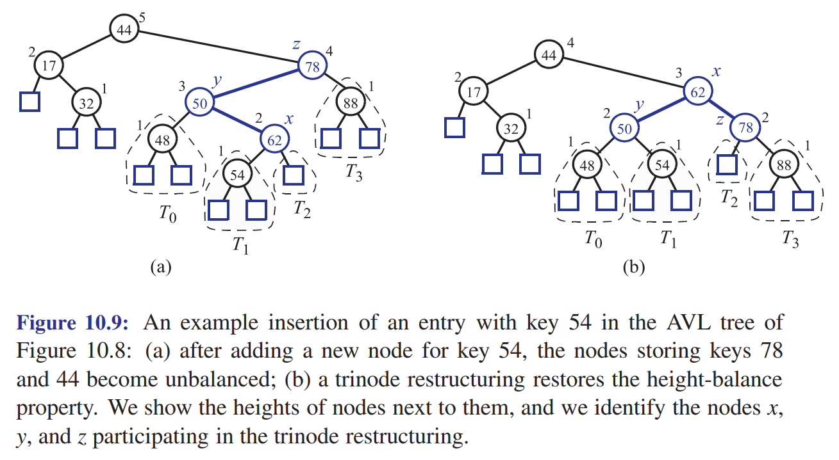


Slide 71


AVL Tree Insertion
For insertion, do a regular BST leaf insertion
Then walk back up the tree towards the root checking the balance of each node as you go
Call the first unbalanced node you find z
If there are no unbalanced nodes, you’re done!
y is the highest child of z
x is the highest child of y
There are 4 ways x, y, and z could appear, and for each way we can re-structure the tree to preserve the AVL property …
A node is unbalanced if the difference in the height of its children is bigger than 2. Otherwise it is balanced.

Slide 72
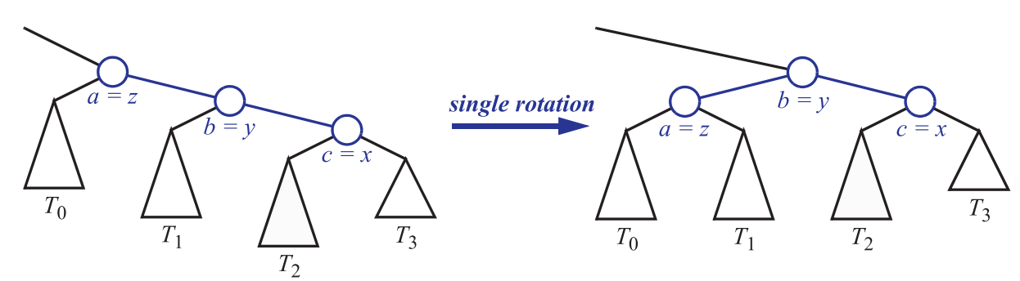

z is the first unbalanced node y is the highest child of z x is the highest child of y

Slide 73
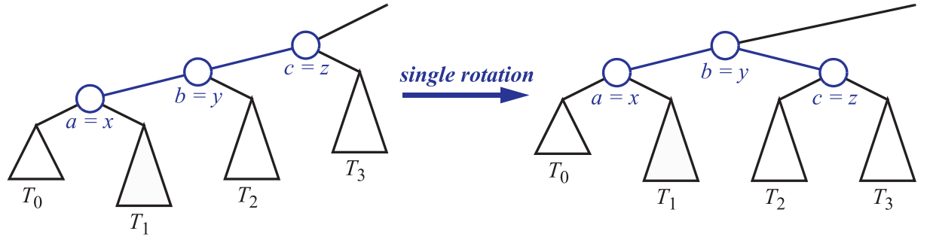

z is the first unbalanced node y is the highest child of z x is the highest child of y

Slide 74
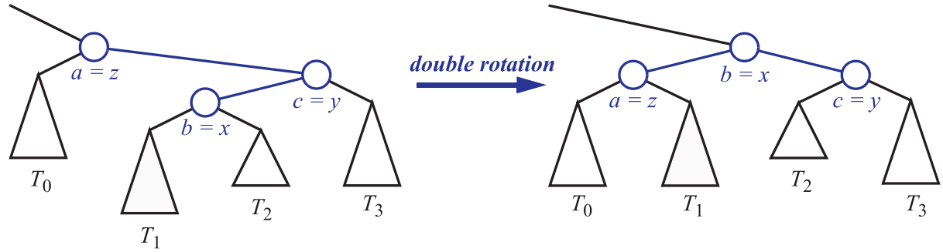

z is the first unbalanced node y is the highest child of z x is the highest child of y

Slide 75
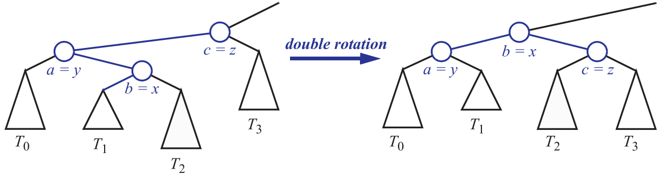
z is the first unbalanced node y is the highest child of z x is the highest child of y

Slide 76
z is the first unbalanced node y is the highest child of z x is the highest child of y
AVL Tree Insertion Rotation Reference

Slide 77
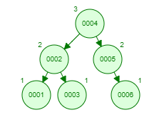

AVL Tree Insertion
Here is a nice animation of an AVL tree you can use to help understand insertion (and deletion).
Insert these values into an empty AVL tree in this order:
1, 2, 3 ,4, 5, 6
Do regular BST leaf insertion.
Walk back up to the root, to find first unbalanced node z
y is the highest child of z
x is the highest child of z
Apply the appropriate rotation to make it an AVL tree.

Slide 78
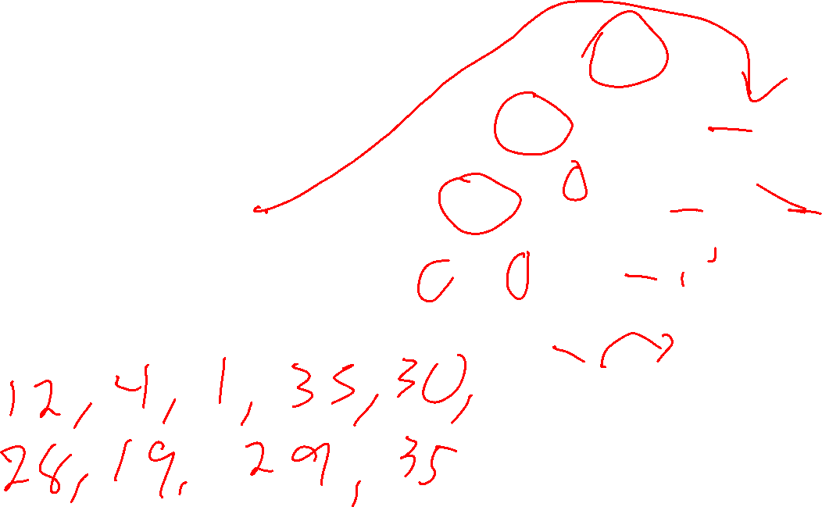
BSTs and Pre-order Traversal
12
print_preorder(p)
if p == nullptr: return
print p->key print_preorder(p->left)
print_preorder(p->right)
4
33
1
30
35
What does print_preorder(12) print?
28
19
29

Slide 79
BSTs and Pre-order Traversal
12
print_preorder(p)
if p == nullptr: return
print p->key print_preorder(p->left)
print_preorder(p->right)
4
33
1
30
35
What does print_preorder(12) print?
28
19
29
12, 4, 1, 33, 30, 28, 19, 29, 35

Slide 80
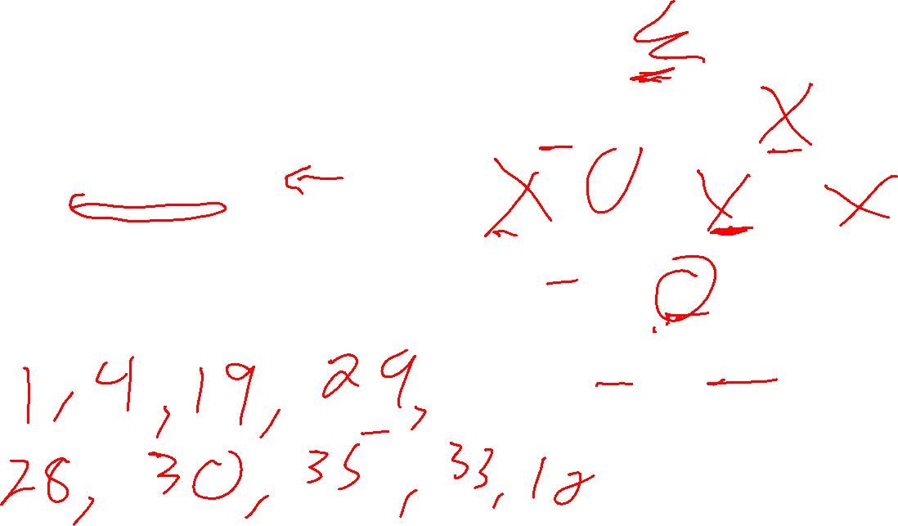
BSTs and Post-order Traversal
12
print_postorder(p)
if p == nullptr: return print_postorder(p->left)
print_postrder(p->right) print p->key
4
33
1
30
35
What does print_postorder(12) print?
28
19
29

Slide 81
BSTs and Post-order Traversal
12
print_postorder(p)
if p == nullptr: return print_postorder(p->left)
print_postrder(p->right) print p->key
4
33
1
30
35
What does print_postorder(12) print?
28
19
29
1, 4, 19, 29, 28, 30, 35, 33, 12

Slide 82
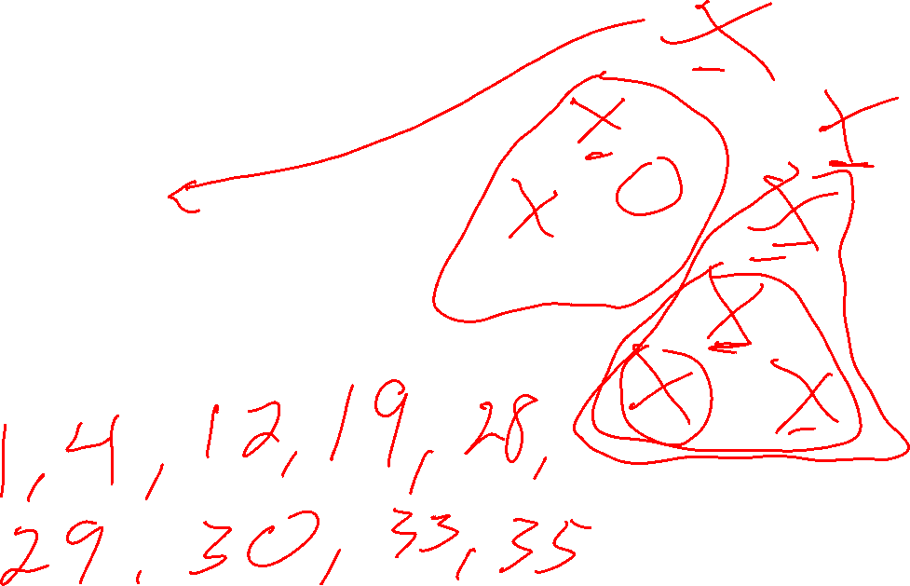
BSTs and In-order Traversal
12
print_inorder(p)
if p == nullptr: return
print_inorder(p->left)
print p->key
print_inorder(p->right)
4
33
1
30
35
What does print_inorder(12) print?
28
19
29

Slide 83
BSTs and In-order Traversal
12
print_inorder(p)
if p == nullptr: return
print_inorder(p->left)
print p->key
print_inorder(p->right)
4
33
1
30
35
What does print_inorder(12) print?
28
19
29
1, 4, 12, 19, 28, 29, 30, 33, 35
Ascending sorted order!

Slide 84
BSTs and In-order Traversal
12
print_inorder(p)
if p == nullptr: return
print_inorder(p->left)
print p->key
print_inorder(p->right)
4
33
1
30
35
What does print_inorder(12) print?
28
19
29
1, 4, 12, 19, 28, 29, 30, 33, 35
Key Fact An in-order traversal of a binary search tree always visits the nodes in ascending sorted order.

Slide 85
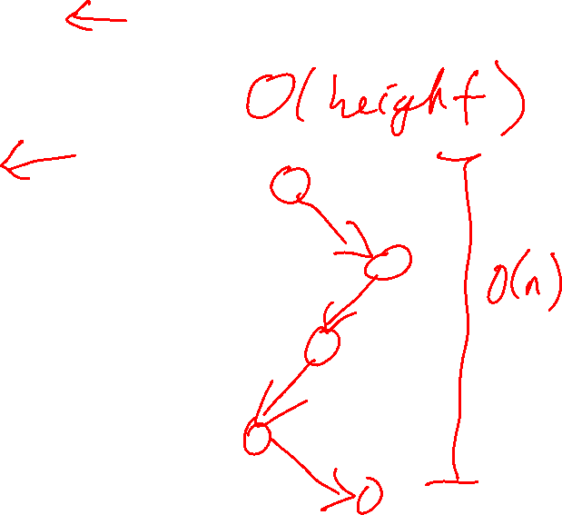
Tree Sort
What is the worst-case performance of tree sort using a plain (not balanced) BST?
Unsorted array
Add all elements to a BST
You can use a binary search tree to sort an array of data:
Insert each array item into the BST
Do an in-order traversal of the tree: the keys are visited in sorted order!
BST
Read back into array using in-order traversal
Sorted array

Slide 86
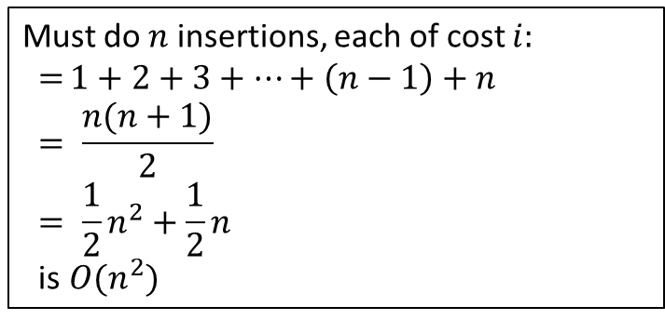
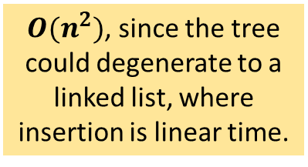
Tree Sort
What is the worst-case performance of tree sort using a plain (not balanced) BST?
Unsorted array
Add all elements to a BST
You can use a binary search tree to sort an array of data:
Insert each array item into the BST
Do an in-order traversal of the tree: the keys are visited in sorted order!
$O(n^{2})$, since the tree could degenerate to a linked list, where insertion is linear time.
BST
Read back into array using in-order traversal
Must do $n$ insertions, each of cost $i$:
$$={1+2+3+…+\left(n−1\right)+n}$$
$$= \frac{n(n+1)}{2}$$
$$= \frac{1}{2}n^{2}+\frac{1}{2}n$$
is$O(n^{2})$
Sorted array

Slide 87
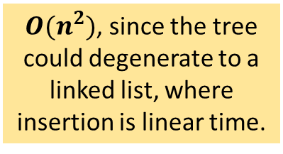
Tree Sort
What is the worst-case performance of tree sort using a plain (not balanced) BST?
What is the worst-case performance of tree sort using an AVL tree?
Unsorted array
Add all elements to a BST
$O(n^{2})$, since the tree could degenerate to a linked list, where insertion is linear time.
BST
Read back into array using in-order traversal
Sorted array

Slide 88
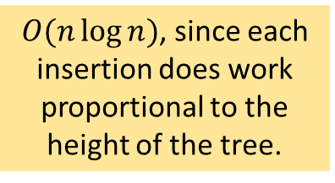
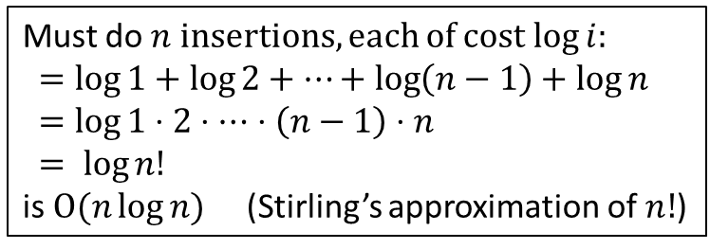
Tree Sort
What is the worst-case performance of tree sort using a plain (not balanced) BST?
What is the worst-case performance of tree sort using an AVL tree?
Unsorted array
Add all elements to a BST
$O(n\log{n})$, since each insertion does work proportional to the height of the tree.
$O(n^{2})$, since the tree could degenerate to a linked list, where insertion is linear time.
BST
Read back into array using in-order traversal
Must do $n$ insertions, each of cost $\log{i}$: $=log{1}+\log{2}+…+\log\left(n−1\right)+\log{n}$
$$=\log{1⋅2⋅⋯}⋅\left(n−1\right)⋅n$$
$$= \log{n!}$$
is $O(n\log{n)}$ (Stirling’s approximation of $n!$)
Sorted array

Slide 89
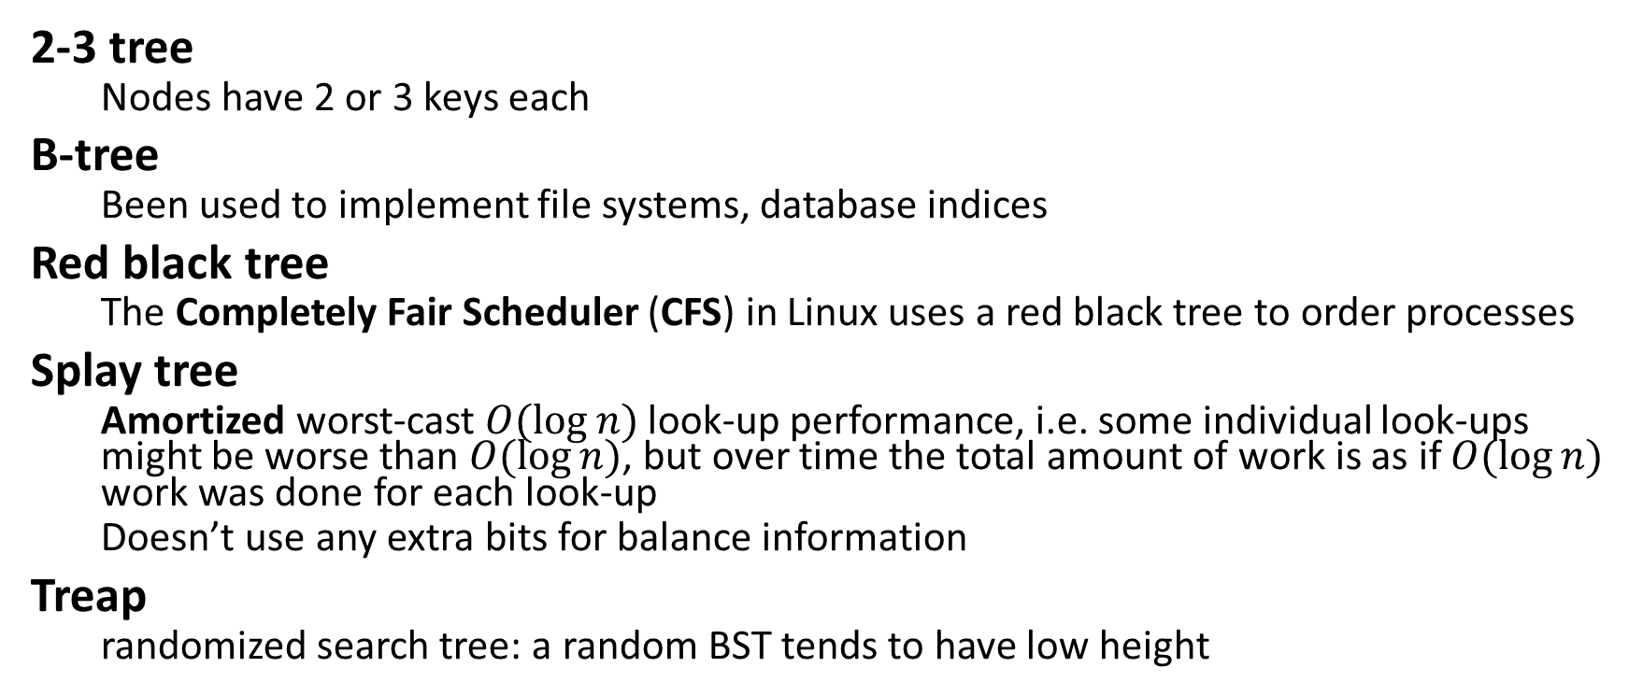

Other Kinds of Balanced Search Trees
2-3 tree
Nodes have 2 or 3 keys each
B-tree
Been used to implement file systems, database indices
Red black tree
The Completely Fair Scheduler (CFS) in Linux uses a red black tree to order processes
Splay tree
Amortized worst-cast $O(log⁡n)$look-up performance, i.e. some individual look-ups might be worse than $O(log⁡n)$, but over time the total amount of work is as if $O(log⁡n)$ work was done for each look-up
Doesn’t use any extra bits for balance information
Treap
randomized search tree: a random BST tends to have low height

