Slide 1
Chapter 7: Trees
CMPT 225

Slide 2
Notes
The midterm exam is next week, Friday June 16th
The midterm is a closed-book exam written on paper during the regular time in the usual lecture room. The questions could be of any type, e.g. reading code, writing code, drawing diagrams, giving definitions, doing math related to O-notation, etc.
You can write C++-like pseudocode
Sample questions will be posted … do them!

Slide 3
Notes
You can implement an efficient queue using a linked list with a head pointer and a tail pointer, and the last node’s next pointer pointing to nullptr
In the previous class I said the last node must point to the head, but that’s not necessary
The textbook implementation uses a circular list

Slide 4
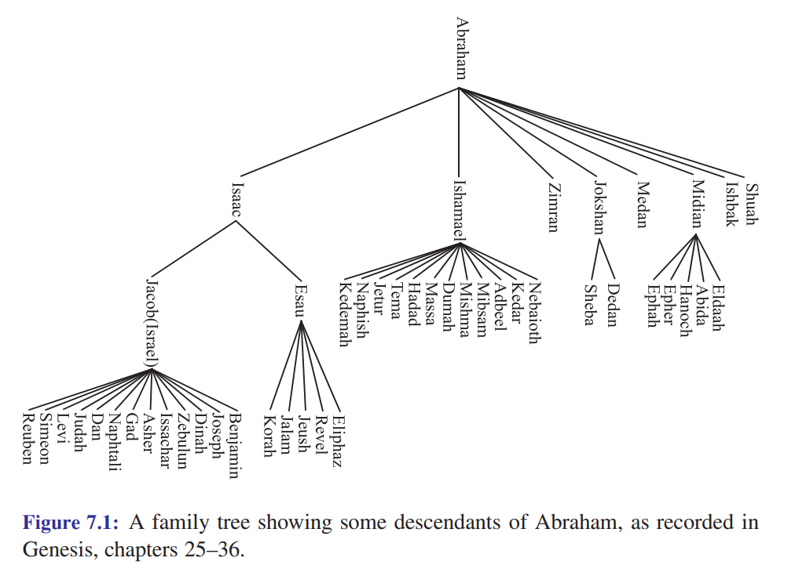
Family Tree

Slide 5
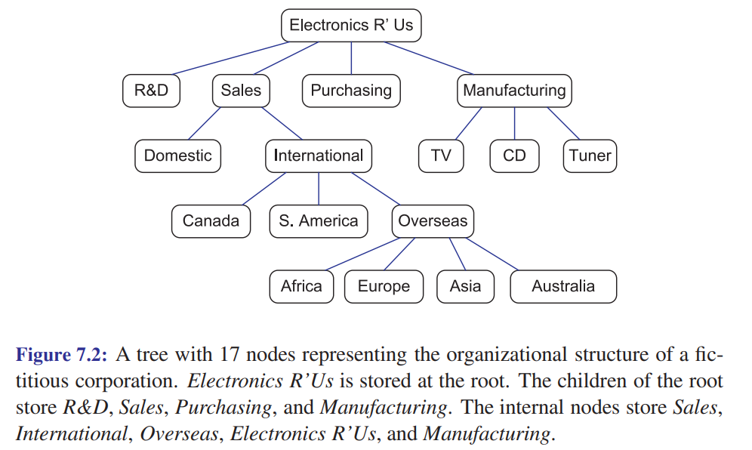
Organization Tree

Slide 6
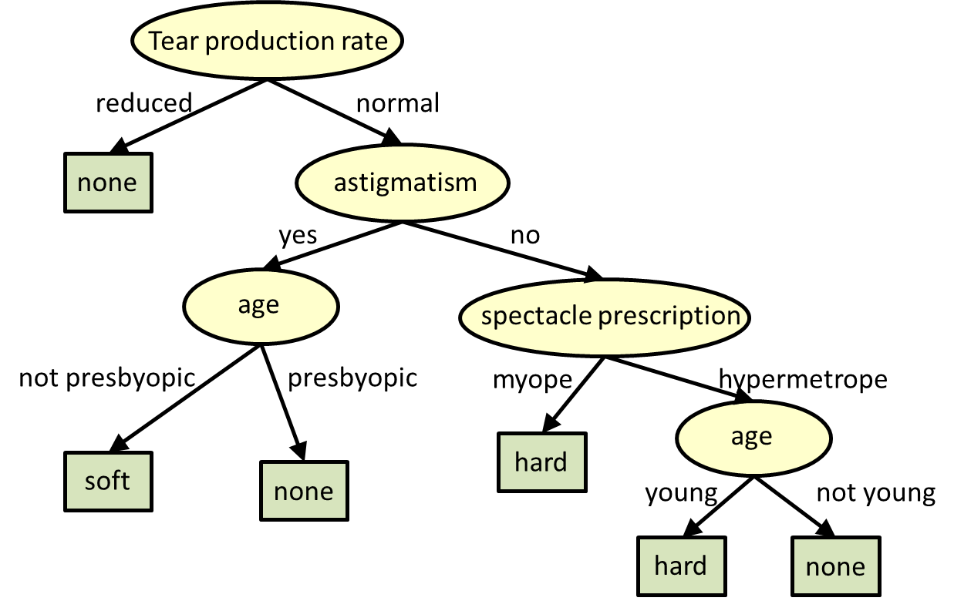
Decision Tree
Decision tree for deciding what type of contact lenses to wear: soft, hard, or none
Presbyopia is the gradual loss of the eyes ability to focus on near-by objects.
Myopic is nearsighted, i.e. can see near-by objects clearly, but not far-away objects.

Slide 7
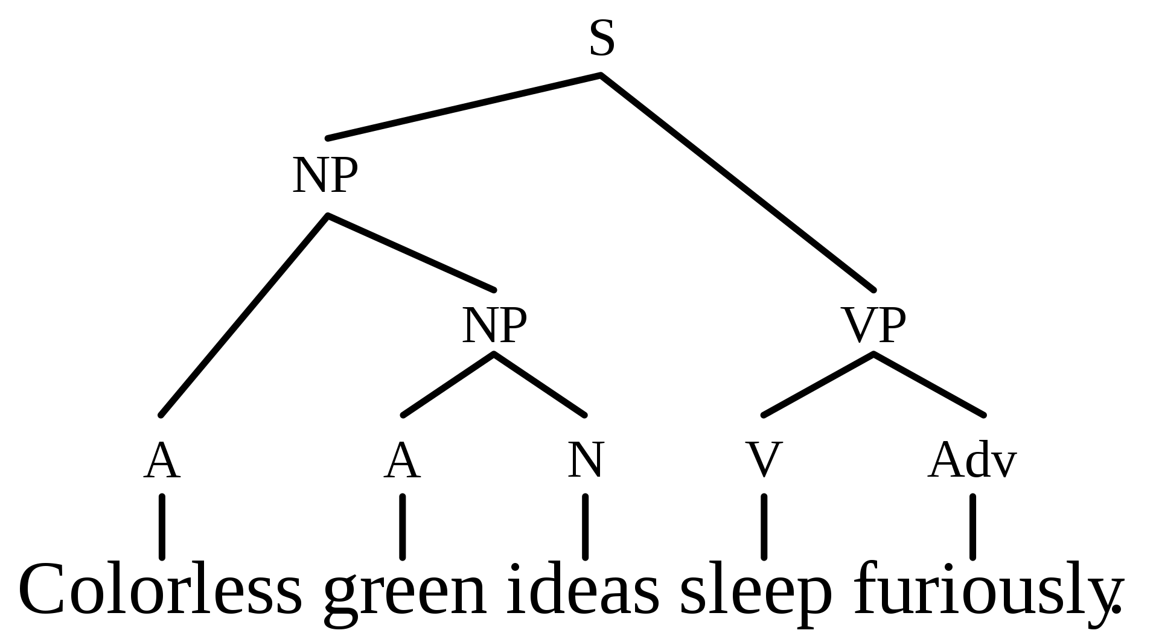
Syntax Tree

Slide 8
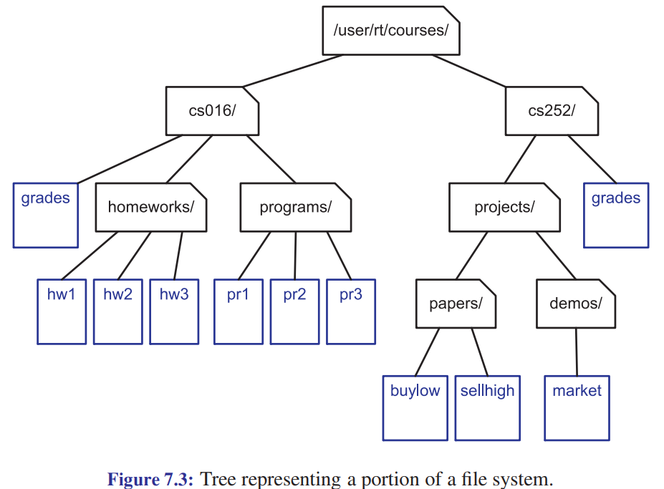
File System Tree

Slide 9
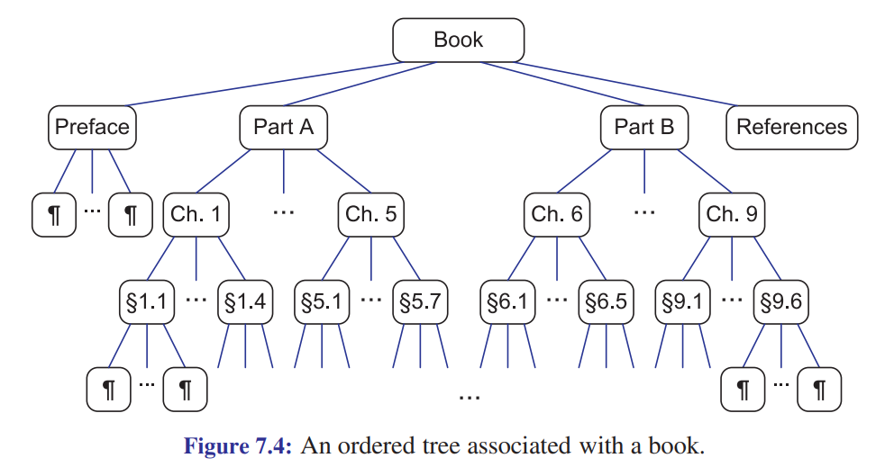
Chapter and Section Structure of a Book

Slide 10
Definition of a Tree
A
A tree T is a set of nodes, storing values, in a parent-child relationship with the following properties:
T could be empty, i.e. it has no nodes. This is called the empty tree.
If T is non-empty, it has a special node called the root of T that has no parent.
Each node v of T different from the root has a unique parent node w. We say v is a child of w, and w is the parent of v.
B
C
D
E
F
G
w
parent
H
v
child

Slide 11
Is it a tree?
A tree T is a set of nodes, storing values, in a parent-child relationship with the following properties:
T could be empty, i.e. it has no nodes. This is called the empty tree.
If T is non-empty, it has a special node called the root of T that has no parent.
Each node v of T different from the root has a unique parent node w. We say v is a child of w, and w is the parent of v.
A
B
C
D
E
F
G
w
parent
H
v
child

Slide 12
Is it a tree?
A tree T is a set of nodes, storing values, in a parent-child relationship with the following properties:
T could be empty, i.e. it has no nodes. This is called the empty tree.
If T is non-empty, it has a special node called the root of T that has no parent.
Each node v of T different from the root has a unique parent node w. We say v is a child of w, and w is the parent of v.
A
B
C
D
w
parent
E
F
G
v
child

Slide 13
A
C
B
C
D
A
B
F
D
E
F
G
same trees
drawn differently
E
G
G
B
E
A
F
D
C

Slide 14
Is it a tree?
A tree T is a set of nodes, storing values, in a parent-child relationship with the following properties:
T could be empty, i.e. it has no nodes. This is called the empty tree.
If T is non-empty, it has a special node called the root of T that has no parent.
Each node v of T different from the root has a unique parent node w. We say v is a child of w, and w is the parent of v.
A
B
C
D
E
F
G
w
parent
H
v
child

Slide 15
Is it a tree?
A tree T is a set of nodes, storing values, in a parent-child relationship with the following properties:
T could be empty, i.e. it has no nodes. This is called the empty tree.
If T is non-empty, it has a special node called the root of T that has no parent.
Each node v of T different from the root has a unique parent node w. We say v is a child of w, and w is the parent of v.
B
C
D
E
F
G
w
parent
H
v
child

Slide 16
Is it a tree?
A tree T is a set of nodes, storing values, in a parent-child relationship with the following properties:
T could be empty, i.e. it has no nodes. This is called the empty tree.
If T is non-empty, it has a special node called the root of T that has no parent.
Each node v of T different from the root has a unique parent node w. We say v is a child of w, and w is the parent of v.
A
B
C
D
E
F
G
w
parent
H
v
child

Slide 17
Is it a tree?
A tree T is a set of nodes, storing values, in a parent-child relationship with the following properties:
T could be empty, i.e. it has no nodes. This is called the empty tree.
If T is non-empty, it has a special node called the root of T that has no parent.
Each node v of T different from the root has a unique parent node w. We say v is a child of w, and w is the parent of v.
A
B
C
D
E
F
G
w
parent
H
v
child

Slide 18
Is it a tree?
A tree T is a set of nodes, storing values, in a parent-child relationship with the following properties:
T could be empty, i.e. it has no nodes. This is called the empty tree.
If T is non-empty, it has a special node called the root of T that has no parent.
Each node v of T different from the root has a unique parent node w. We say v is a child of w, and w is the parent of v.
A
B
C
D
E
F
G
w
parent
H
v
child

Slide 19
Is it a tree?
A tree T is a set of nodes, storing values, in a parent-child relationship with the following properties:
T could be empty, i.e. it has no nodes. This is called the empty tree.
If T is non-empty, it has a special node called the root of T that has no parent.
Each node v of T different from the root has a unique parent node w. We say v is a child of w, and w is the parent of v.
A
w
parent
v
child

Slide 20
Is it a tree?
A tree T is a set of nodes, storing values, in a parent-child relationship with the following properties:
T could be empty, i.e. it has no nodes. This is called the empty tree.
If T is non-empty, it has a special node called the root of T that has no parent.
Each node v of T different from the root has a unique parent node w. We say v is a child of w, and w is the parent of v.
w
parent
v
child

Slide 21
Is it a tree?
A tree T is a set of nodes, storing values, in a parent-child relationship with the following properties:
T could be empty, i.e. it has no nodes. This is called the empty tree.
If T is non-empty, it has a special node called the root of T that has no parent.
Each node v of T different from the root has a unique parent node w. We say v is a child of w, and w is the parent of v.
w
parent
v
child

Slide 22
Is it a tree?
A tree T is a set of nodes, storing values, in a parent-child relationship with the following properties:
T could be empty, i.e. it has no nodes. This is called the empty tree.
If T is non-empty, it has a special node called the root of T that has no parent.
Each node v of T different from the root has a unique parent node w. We say v is a child of w, and w is the parent of v.
A
B
C
D
E
F
G
w
parent
H
v
child

Slide 23
Is it a tree?
A tree T is a set of nodes, storing values, in a parent-child relationship with the following properties:
T could be empty, i.e. it has no nodes. This is called the empty tree.
If T is non-empty, it has a special node called the root of T that has no parent.
Each node v of T different from the root has a unique parent node w. We say v is a child of w, and w is the parent of v.
A
B
C
D
E
F
G
w
parent
H
v
child

Slide 24
Is it a tree?
A tree T is a set of nodes, storing values, in a parent-child relationship with the following properties:
T could be empty, i.e. it has no nodes. This is called the empty tree.
If T is non-empty, it has a special node called the root of T that has no parent.
Each node v of T different from the root has a unique parent node w. We say v is a child of w, and w is the parent of v.
A
B
w
parent
v
child

Slide 25
Tree terminology
Root:
A
Leaves (external nodes):
B
C
D
Internal nodes:
Children of B:
E
F
G
Children of C:
H
Children of D:

Slide 26
The root is the one node with no parent.
Tree terminology
Root: A
A
Nodes with 0 children.
Leaves (external nodes): C, E, F, H
B
C
D
Internal nodes: A, B, D, G
Nodes with 1 or more children.
Children of B: E, F
E
F
G
A node can have 0 or more children.
Children of C: none
H
Children of D: G

Slide 27
Tree terminology
Draw a tree with 6 nodes with:
More internal nodes than external node
More external nodes than internal nodes
The same number of internal and external nodes

Slide 28
Tree terminology
Draw a tree with 6 nodes with:
More internal nodes than external node
More external nodes than internal nodes
The same number of internal and external nodes
1
1
1
2
2
3
2
3
4
5
6
3
Internal: 1 External: 5
4
5
6
4
Internal: 3 External: 3
Internal: 5 External: 1
5
6

Slide 29
Tree terminology
Edges:
A
B
C
D
Path from A to F:
G
Path from A to H:
E
F
Path from E to G: Careful: the arrows show parent-child relationships, but don’t restrict the path.
H

Slide 30
Tree terminology
Edges: AB, AC, AD BE, BF DG, GH
A
B
C
D
Path from A to F: ABF
G
Path from A to H: ADGH
E
F
Path from E to G: EBADG Careful: the arrows show parent-child relationships, but don’t restrict the path.
H

Slide 31
Tree Facts
A
Fact There is exactly one path between any two nodes in a tree. Fact There are no “cycles” in a tree.
Fact If you remove any edge of a tree, you get two trees.
Fact If you add an edge (without adding a node),
the result is not a tree.
B
C
D
E
F
G
H

Slide 32
Tree terminology
A
Ancestors of G:
Ancestors of C:
B
C
D
Ancestors of A:
E
F
G
Descendants of D:
Descendants of C:
H
Descendants of A:
If x is a node in a tree, then:
the ancestors of x are x itself, plus the ancestors of x’s parent
the descendants of x are x itself, plus all the nodes that have x as an ancestor

Slide 33
Tree terminology
Ancestors of G: G, D, A
Every node is an ancestor of itself.
A
Ancestors of C: C, A
B
C
D
Ancestors of A: A
E
F
G
Descendants of D: D, G, H
Every node is a descendant of itself.
Descendants of C: none
H
Descendants of A: A, B, C, D, E, F, G, H
If x is a node in a tree, then:
the ancestors of x are x itself, plus the ancestors of x’s parent
the descendants of x are x itself, plus all the nodes that have x as an ancestor

Slide 34
Tree terminology
Ancestors of G: G, D, A
Every node is an ancestor of itself.
A
Ancestors of C: C, A
B
C
D
Ancestors of A: A
E
F
G
Descendants of D: D, G, H
Every node is a descendant of itself.
Descendants of C: none
H
Descendants of A: A, B, C, D, E, F, G, H
Fact The root is an ancestor of all nodes, including itself.
Fact All nodes, including the root, are descendants of the root.
If x is a node in a tree, then:
the ancestors of x are x itself, plus the ancestors of x’s parent
the descendants of x are x itself, plus all the nodes that have x as an ancestor

Slide 35
Tree terminology
A
B
C
D
Subtree rooted at B: the tree formed by all descendants of B
E
F
G
H

Slide 36
Tree terminology
Ordered tree: the children of nodes have
a well-defined order
A
A tree may, or may not, be ordered. If it is ordered, you must say so, and also say exactly how the child nodes are ordered.
B
C
D
E
F
G
This is an ordered tree: the child nodes are in alphabetical order from left to right.
H

Slide 37
















Basic Tree Functions
A
Suppose p refers to a node in a tree. Then we usually assume these functions are available:
p.parent() returns the parent of p; error if p is the root
p.children() returns a list (or vector, or array, …) of p’s children
p.isRoot() returns true if p is the root, and false otherwise
p.isLeaf() or p.isExternal() returns true if p is a leaf node (i.e. external node)
p
B
C
D
E
F
G
H

Slide 38

Basic Tree Functions
A
If T refers is a tree, then we usually assume these functions are available:
T.root() returns the root node of the tree; error if the tree is empty
T.empty() returns true if the tree is empty, and false otherwise
T.size() returns the number of nodes in the tree
B
C
D
E
F
G
H

Slide 39
Is this a binary tree?
Binary Trees
A
A binary tree is a tree where each node has at most 2 children.
Each child of a node labeled as the left child or right child.
The left child comes before the right child in child ordering.
B
C
D
E
F
G
H

Slide 40
Is this a binary tree?
Binary Trees
A
A binary tree is a tree where each node has at most 2 children.
Each child of a node labeled as the left child or right child.
The left child comes before the right child in child ordering.
B
C
D
E
F
G

Slide 41
Is this a binary tree?
Binary Trees
A binary tree is a tree where each node has at most 2 children.
Each child of a node labeled as the left child or right child.
The left child comes before the right child in child ordering.

Slide 42
Is this a proper or improper binary tree?
Binary Trees
A
A binary tree is proper if every node has either 0 children or 2 children.
A binary tree is improper if it is not proper.
B
C
D
E
F
G

Slide 43
Is this a proper or improper binary tree?
Binary Trees
A
A binary tree is proper if every node has either 0 children or 2 children.
A binary tree is improper if it is not proper.
B
C
D
E

Slide 44
Is this a proper or improper binary tree?
Binary Trees
A
A binary tree is proper if every node has either 0 children or 2 children.
A binary tree is improper if it is not proper.
B
C
D
E
F
G

Slide 45
Is this a binary tree? Is it proper or improper?
Binary Trees
A binary tree is a tree where each node has at most 2 children.
Each child of a node labeled as the left child or right child.
The left child comes before the right child in child ordering.

Slide 46
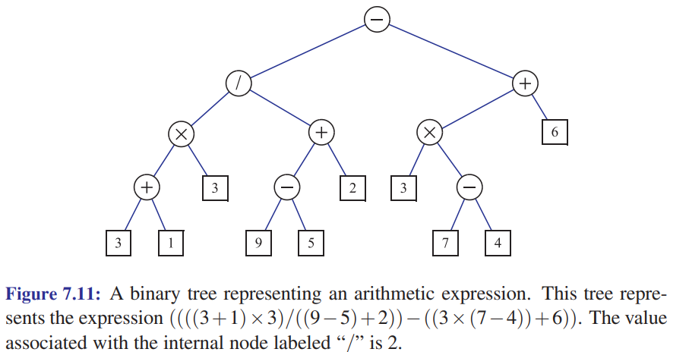
Is this a binary tree? Is it proper or improper?
Binary Trees
A binary tree is a tree where each node has at most 2 children.
Each child of a node labeled as the left child or right child.
The left child comes before the right child in child ordering.

Slide 47
Binary Trees
root
Recursive Definition
A tree T is a binary tree if:
T is empty
Or it consists of a root node whose left child is the root of binary tree, and whose right child is the root of a binary tree
left subtree is a binary tree
right subtree is a binary tree

Slide 48
Node Depth
Write the depth of each node.
The depth of a node p in a tree is the number of ancestors of p, excluding p itself.
If p is a node in a tree, then:
the ancestors of p are p itself, plus the ancestors of p’s parent
the descendants of p are p itself, plus all the nodes that have p as an ancestor

Slide 49
Node Depth
Write the depth of each node.
0
The depth of a node p in a tree is the number of ancestors of p, excluding p itself.
1
1
1
2
2
2
If p is a node in a tree, then:
the ancestors of p are p itself, plus the ancestors of p’s parent
the descendants of p are p itself, plus all the nodes that have p as an ancestor
3

Slide 50
Node Depth
Recursive Definition
The depth of a node p in a tree is:
0 if p is the root
1 plus the depth of its parent if p is not the root
0
1
1
1
2
2
2
3

Slide 51
Node Depth
Recursive Definition
The depth of a node p in a tree is:
0 if p is the root
1 plus the depth of its parent if p is not the root
0
1
1
1
2
2
2
depth(T, p) if p.isRoot() then return 0 else return 1 + depth(T, p.parent())
pseudocode for depth of a node T is a tree p is a node in T
3
In the worst case, how much work does this do?

Slide 52
0
Node Depth
Recursive Definition
The depth of a node p in a tree is:
0 if p is the root
1 plus the depth of its parent if p is not the root
1
1
1
2
2
2
3
depth(T, p) if p.isRoot() then return 0 else return 1 + depth(T, p.parent())
pseudocode for depth of a node T is a tree p is a node in T
It runs in O(depth of node p).
What’s the deepest a node could be in a tree with n nodes?

Slide 53
A tree with n nodes could have a node of depth n.
That means the depth(T, p) algorithm does O(n) recursive calls in the worst case.

Slide 54
0
Node Depth
Recursive Definition
The depth of a node p in a tree is:
0 if p is the root
1 plus the depth of its parent if p is not the root
1
1
1
2
2
2
3
depth(T, p) if p.isRoot() then return 0 else return 1 + depth(T, p.parent())
pseudocode for depth of a node T is a tree p is a node in T
Does O(n) recursive calls in the worst case. Depends on how tall the tree is.

Slide 55
Node Height
Write the height of each node.
Recursive Definition
The height of a node p in a tree is:
0 if p is external (a leaf)
1 plus the max height of a child of p if p is internal (not a leaf)

Slide 56
Node Height
Write the height of each node.
Recursive Definition
The height of a node p in a tree is:
0 if p is external (a leaf)
1 plus the max height of a child of p if p is internal (not a leaf)
3
1
0
2
0
0
1
0

Slide 57
Node Height
3
Recursive Definition
The height of a node p in a tree is:
0 if p is external (a leaf)
1 plus the max height of a child of p if p is internal (not a leaf)
1
0
2
0
0
1
0
node_height(T, p) if p.isLeaf() then return 0 else return max {node_height(c) : c is a child of p}
pseudocode for height of a node T is a tree p is a node in T
If there are n nodes in the tree, now many times is node_height called?

Slide 58
Node Height
3
Recursive Definition
The height of a node p in a tree is:
0 if p is external (a leaf)
1 plus the max height of a child of p if p is internal (not a leaf)
1
0
2
0
0
1
0
node_height(T, p) if p.isLeaf() then return 0 else return max {node_height(c) : c is a child of p}
pseudocode for height of a node T is a tree p is a node in T
node_height is called on almost all nodes.
So O(n) calls to node_height

Slide 59
Tree Height
What’s the height of this tree?
The height of a tree is the height of its root.
3
1
0
2
0
0
1
0

Slide 60
Tree Height
h
The height of a tree is the height of its root.
height2(T, p) if p.isLeaf() then return 0 else h = 0 for each child c of p do h = max(h, height2(T, c))
return 1 + h
pseudocode for height of a tree T is a tree p is a node in T

Slide 61
Tree Height
h = 3
The height of a tree is the height of its root.
3
1
0
2
height2(T, p) if p.isLeaf() then return 0 else h = 0 for each child c of p do h = max(h, height2(T, c))
return 1 + h
pseudocode for height of a tree T is a tree p is a node in T
0
0
1
0
If tree has n nodes and p is the root, how much work does this do?

Slide 62
Tree Height
height2(T, T.root) is called on each node of the tree
The total work is thus the sum of the work done at each node
The amount of work at each node p is O(1) for the max plus O(# children of p)
Adding O(1) + O(# children of p) for all p gives O(n)
There are n-1 child nodes in a tree
The root is the only non-child node
The height of a tree is the height of its root.
height2(T, p) if p.isLeaf() then return 0 else h = 0 for each child c of p do h = max(h, height2(T, c))
return 1 + h
pseudocode for height of a tree T is a tree p is a node in T

Slide 63
Tree Height
h = 3
The height of a tree is the height of its root.
3
1
0
2
height2(T, p) if p.isLeaf() then return 0 else h = 0 for each child c of p do h = max(h, height2(T, c))
return 1 + h
pseudocode for height of a tree T is a tree p is a node in T
0
0
1
0
O(n) work in the worst case.

Slide 64
Print the nodes in pre-order traversal order, starting at the root.
Tree Traversals
A
One order in which to visit all the nodes in a tree is pre-order traversal.
B
C
D
E
F
G
preorder_traversal(T, p) print p for each child c of p preorder_traversal(c)
H

Slide 65
Print the nodes in pre-order traversal order, starting at the root.
Tree Traversals
A
One order in which to visit all the nodes in a tree is pre-order traversal.
B
C
D
E
F
G
preorder_traversal(T, p) print p for each child c of p preorder_traversal(c)
H
Pre-order: A, B, E, F, C, D, G, H

Slide 66
A
Tree Traversals
B
C
D
One order in which to visit all the nodes in a tree is pre-order traversal.
E
F
G
H
preorder_traversal(T, p) print p for each child c of p preorder_traversal(c)
Pre-order: A, B, E, F, C, D, G, H
If there are n nodes in the tree, how much work does preorder_traversal(T, root) do?

Slide 67
A
Tree Traversals
B
C
D
One order in which to visit all the nodes in a tree is pre-order traversal.
E
F
G
H
preorder_traversal(T, p) print p for each child c of p preorder_traversal(c)
Pre-order: A, B, E, F, C, D, G, H
Assuming print p is O(1), all n nodes are visited once, so O(n) work.

Slide 68
Print the nodes in post-order traversal order, starting at the root.
Tree Traversals
A
One order in which to visit all the nodes in a tree is pre-order traversal.
B
C
D
E
F
G
postorder_traversal(T, p) for each child c of p postorder_traversal(c) print p
H

Slide 69
A
Tree Traversals
B
C
D
One order in which to visit all the nodes in a tree is pre-order traversal.
G
E
F
H
postorder_traversal(T, p) for each child c of p preorder_traversal(c) print p
Post-order: E, F, B, C, H, G, D, A
Assuming print p is O(1), all n nodes are visited once, so O(n) work.

Slide 70
Binary Trees Properties
A
Suppose T is a binary tree with n nodes.
What is the max height of T?
What is the min height of T?
B
C
D
E
F
The height of a node p in a tree is:
0 if p is external (a leaf)
1 plus the max height of a child of p if p is internal (not a leaf)
G
The height of a tree is the height of its root.

Slide 71
Binary Trees Properties
What is the max height of T?
How can you construct a binary tree that is as tall as possible? What does it look like?
The height of a node p in a tree is:
0 if p is external (a leaf)
1 plus the max height of a child of p if p is internal (not a leaf)
The height of a tree is the height of its root.

Slide 72
Binary Trees Properties
4
3
What is the max height of T?
How can you construct a binary tree that is as tall as possible? What does it look like?
2
1
The height of a node p in a tree is:
0 if p is external (a leaf)
1 plus the max height of a child of p if p is internal (not a leaf)
0
The height of a tree is the height of its root.

Slide 73
Binary Trees Properties
n-1
n-2
What is the max height of T?
If T has n nodes, then the height of a tree like this is n-1.
2
1
n nodes in the tree leaf starts at 0 each node is 1 higher
so root is height n-1 so tree is height n-1
The height of a node p in a tree is:
0 if p is external (a leaf)
1 plus the max height of a child of p if p is internal (not a leaf)
0
The height of a tree is the height of its root.

Slide 74
Binary Trees Properties
A
Suppose T is a binary tree with n nodes.
What is the max height of T? n-1
What is the min height of T?
B
C
D
E
F
The height of a node p in a tree is:
0 if p is external (a leaf)
1 plus the max height of a child of p if p is internal (not a leaf)
G
The height of a tree is the height of its root.

Slide 75
Binary Trees Properties
What is the min height of T?
How can you construct a binary tree that is as short as possible? What does it look like?
The height of a node p in a tree is:
0 if p is external (a leaf)
1 plus the max height of a child of p if p is internal (not a leaf)
The height of a tree is the height of its root.

Slide 76
Binary Trees Properties
What’s the height of this tree?
A
What is the min height of T?
How can you construct a binary tree that is as short as possible? What does it look like?
B
C
D
E
F
G
The height of a node p in a tree is:
0 if p is external (a leaf)
1 plus the max height of a child of p if p is internal (not a leaf)
The height of a tree is the height of its root.

Slide 77
Binary Trees Properties
A
Level 0
What is the min height of T?
How can you construct a binary tree that is as short as possible? What does it look like?
B
C
Level 1
D
E
F
G
Level 2
If you continue this pattern, how many nodes are in each level of a binary tree?
The height of a node p in a tree is:
0 if p is external (a leaf)
1 plus the max height of a child of p if p is internal (not a leaf)
The height of a tree is the height of its root.

Slide 78


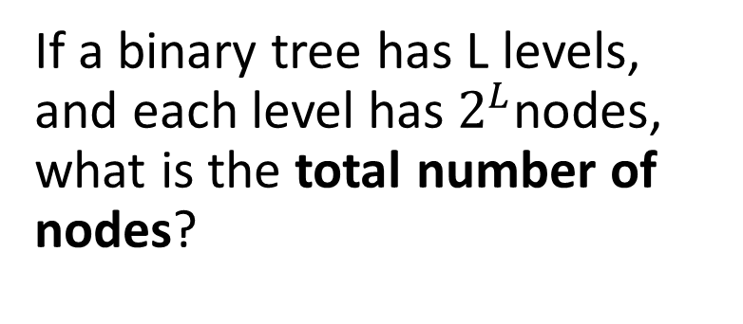


Binary Trees Properties
$$2^{0}=1$$
A
Level 0
If a binary tree has L levels, and each level has${ 2}^{L}$nodes, what is the total number of nodes?
$$2^{1}=2$$
B
C
Level 1
$$2^{2}=4$$
D
E
F
G
Level 2
Level L: ${ 2}^{L}$ nodes

Slide 79

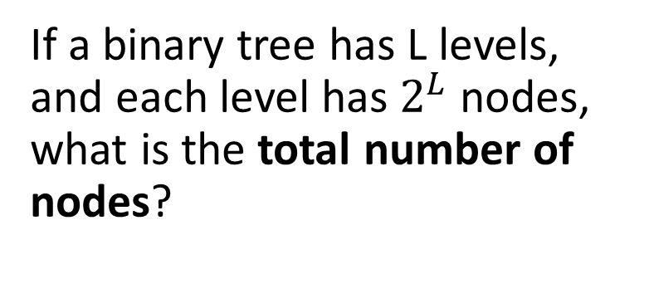
Binary Trees Properties
$$2^{0}=1$$
A
Level 0
If a binary tree has L levels, and each level has${ 2}^{L}$ nodes, what is the total number of nodes?
$$2^{1}=2$$
B
C
Level 1
$$2^{2}=4$$
D
E
F
G
Level 2
$${ 2}^{0} + 2^{1}+2^{2}+ … +2^{L−1}$$
Level L: ${ 2}^{L}$ nodes

Slide 80
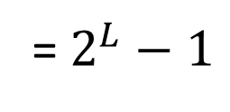
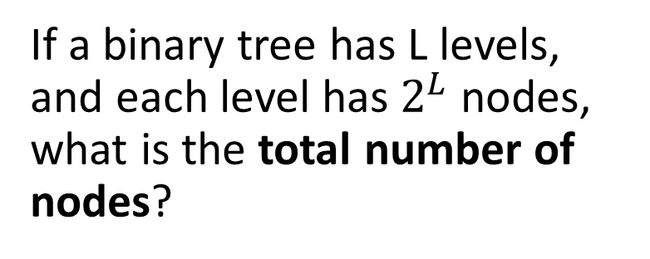
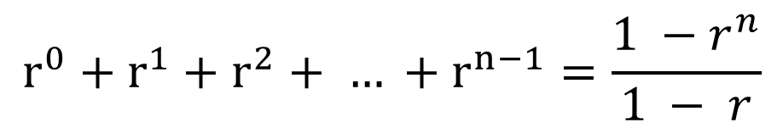
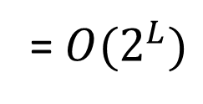
Binary Trees Properties
$$2^{0}=1$$
A
Level 0
If a binary tree has L levels, and each level has${ 2}^{L}$ nodes, what is the total number of nodes?
$$2^{1}=2$$
B
C
Level 1
$$2^{2}=4$$
D
E
F
G
Level 2
$${ 2}^{0} + 2^{1}+2^{2}+ … +2^{L−1}$$
= $2^{L}−1$
You can figure this out by inspection, or using the formula for the sum of a geometric series.
Level L: ${ 2}^{L}$ nodes
= ${O(2}^{L})$
$$r^{0}+r^{1}+r^{2}+ … +r^{n−1}=\frac{1 −{ r}^{n}}{1 − r}$$

Slide 81
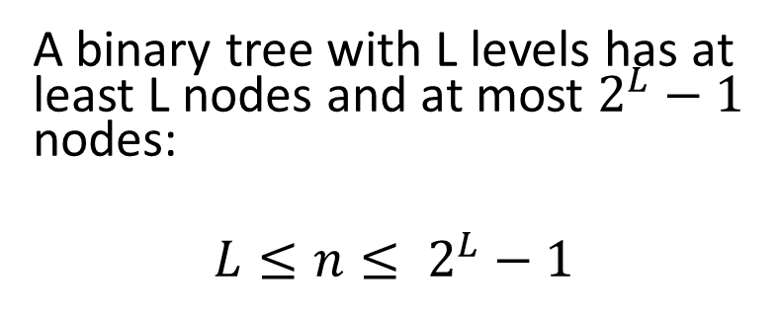
Binary Trees Properties
$$2^{0}=1$$
A
Level 0
A binary tree with L levels has at least L nodes and at most $2^{L}−1$ nodes:
$$L≤n≤ 2^{L}−1$$
$$2^{1}=2$$
B
C
Level 1
$$2^{2}=4$$
D
E
F
G
Level 2

Slide 82
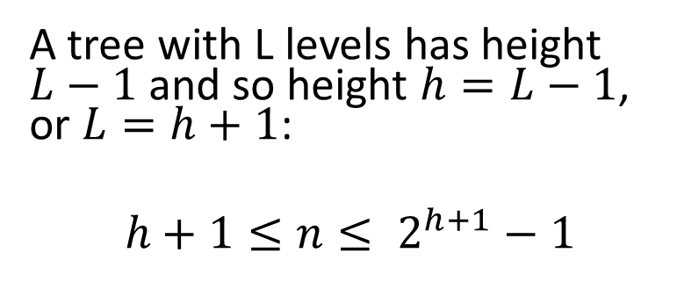
Binary Trees Properties
$$2^{0}=1$$
A
Level 0
A binary tree with L levels has at least L nodes and at most $2^{L}−1$ nodes:
$$L≤n≤ 2^{L}−1$$
$$2^{1}=2$$
B
C
Level 1
$$2^{2}=4$$
D
E
F
G
Level 2
A tree with L levels has height $L−1$ and so height $h=L−1$, or $L=h+1$:
$$h+1≤n≤ 2^{h+1}−1$$

Slide 83

Binary Trees Properties
$$2^{0}=1$$
A
Level 0
If a binary tree has n nodes and height h, then:
$$2^{1}=2$$
B
C
Level 1
$$h+1≤n≤ 2^{h+1}−1$$
$$2^{2}=4$$
D
E
F
G
Level 2

Slide 84

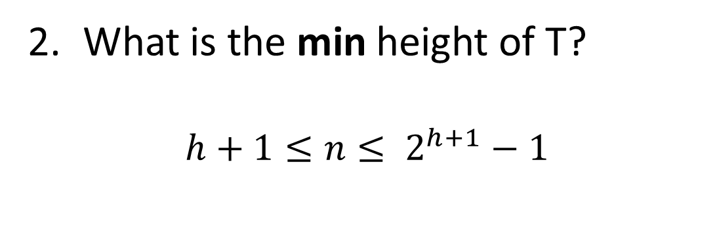


Binary Trees Properties
$$h+1≤n≤ 2^{h+1}−1≤2^{h+1}$$
$$n≤2^{h+1}$$
What is the min height of T?
$$h+1≤n≤ 2^{h+1}−1$$
$$\log{n}≤h+1$$
$$\log{n}−1≤h$$
This shows that a binary tree with n nodes must have a height of at least O(log n)
The height of a node p in a tree is:
0 if p is external (a leaf)
1 plus the max height of a child of p if p is internal (not a leaf)
The height of a tree is the height of its root.

Slide 85
Binary Trees Properties
A
Suppose T is a binary tree with n nodes.
What is the max height of T? n-1
What is the min height of T? O(log n)
B
C
D
E
F
The height of a node p in a tree is:
0 if p is external (a leaf)
1 plus the max height of a child of p if p is internal (not a leaf)
G
The height of a tree is the height of its root.

Slide 86
Binary Trees Properties
A
Suppose T is a binary tree with n nodes.
What is the max height of T? n-1
What is the min height of T? O(log n)
See Proposition 7.10 (pages 288-289) in the textbook for some more facts like this.
B
C
D
E
F
G

