Slide 1
Handling Missing Values

Slide 2
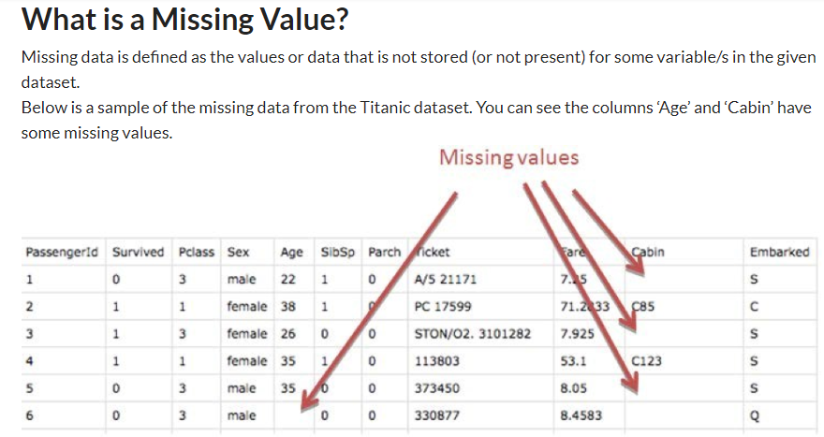

Slide 3
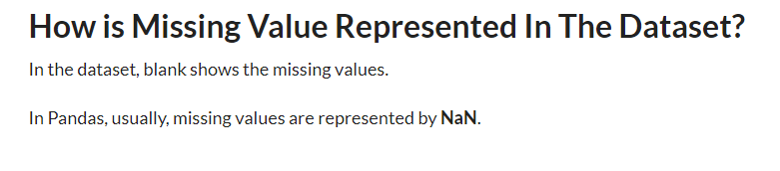

Slide 4
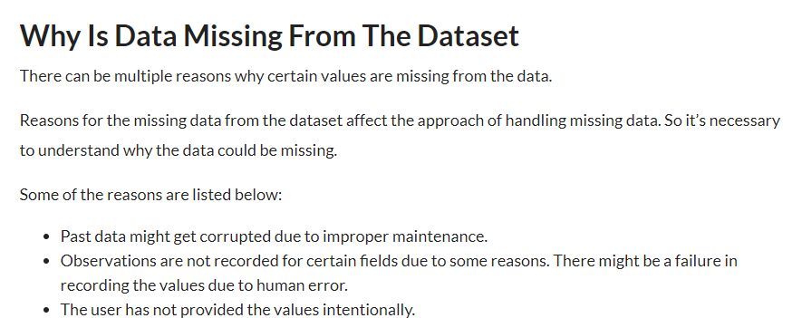

Slide 5
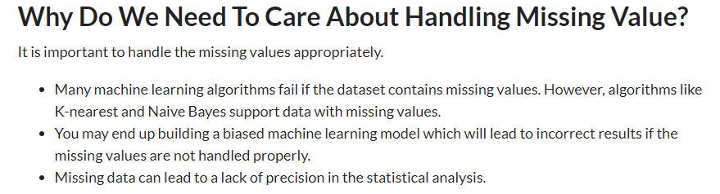

Slide 6
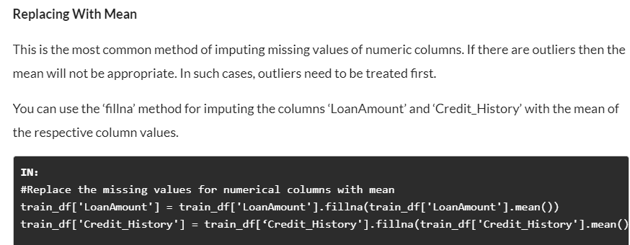

Slide 7
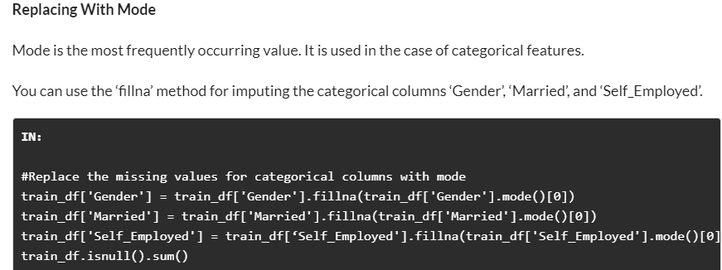

Slide 8
Imputing Missing Values For Categorical Features
There are two ways to impute missing values for categorical features as follows:
Impute the Most Frequent Value
We will make use of ‘SimpleImputer’ in this case and as this is a non-numeric column we can’t use mean or median but we can use most frequent value and constant.
Impute the Value “missing”, which treats it as a Separate Category

Slide 9
Thank You

