Slide 1

Introduction to Operating Systems CS/COE 1550
Fall 2020
Sherif Khattab
ksm73@pitt.edu
(Some slides are from Silberschatz, Galvin and Gagne ©2013)

Slide 2
Course Goal and Objectives
Demystify a good portion of the magic about how computers work
The specific objectives are:
Modify and compile the Linux kernel to add system calls
Write multi-process programs free from race conditions and deadlocks
Implement page-replacement algorithms for virtual memory management
Implement a user-land file system

Slide 3
Contact Info
Course website: http://www.cs.pitt.edu/~skhattab/cs1550/
Instructor: Sherif Khattab ksm73@pitt.edu
OH: TuTh 1-5pm (http://khattab.youcanbook.me)
6307 Sennott Square
Virtual Office: https://pitt.zoom.us/my/khattab
TA: TBD
No recitations this week!
Communication preference
Piazza
Canvas Messages
Email
Please expect a response within 72 hours.

Slide 4
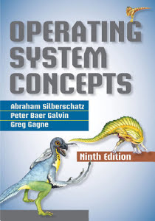
Textbook
Operating System Concepts (9th Edition)
Silberschatz, Galvin, and Gagne

Slide 5
Grading
40% on 4 projects
System programming using C
Posted on Canvas and submitted on Gradescope (auto-graded)
20% on two exams: 12% on higher and 8% on lower
18% on weekly homework assignments
14% recitation: 5 labs using MIT’s Xv6 operating system and 4 quizzes on the projects
8% in-class Tophat questions

Slide 6
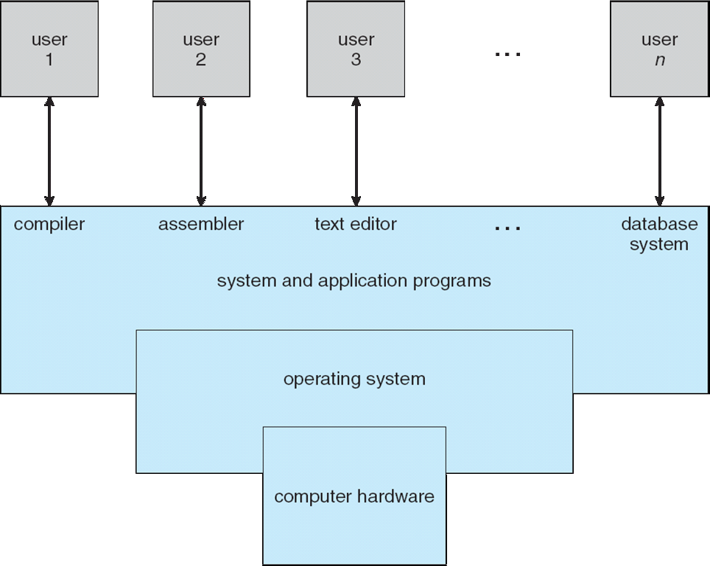
What is an Operating System?
A program that acts as an intermediary between a user of a computer and the computer hardware

Slide 7
What does an OS do?
Manages (controls and arbitrates) resources
Processors, Memory, Input/output devices, Communication devices, Storage, Software applications
Conflicting goals:
Performance vs. utilization
Provides abstractions to application programs
Ease of use
Virtualization
Protects resources

Slide 8
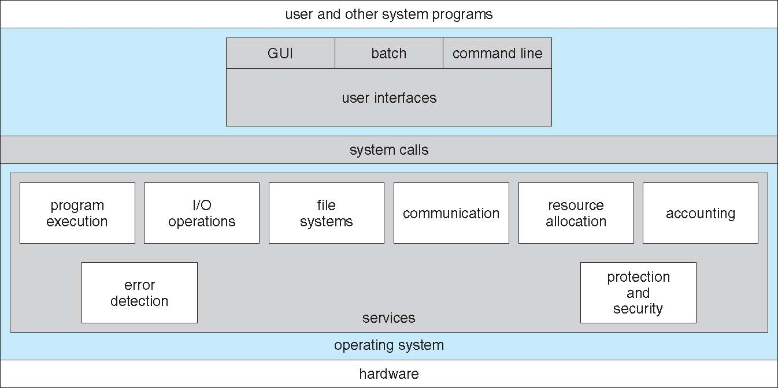
A View of Operating System Services

Slide 9
How does an OS work?
Two main concepts:
Interrupt-driven
Dual-mode

Slide 10
Interrupts
Interrupt transfers control to the interrupt service routine (ISR)
ISRs are segments of code that determine what action should be taken for each type of interrupt
The interrupt vector contains the addresses of all the service routines
Hardware or software:
Hardware interrupt by one of the devices
Software interrupt (exception or trap):
Request for operating system service
Software error (e.g., division by zero)
Other process problems include infinite loop, processes trying to modify each other or the operating system

Slide 11
Dual-mode Operation
Dual-mode operation allows OS to protect itself and other system components
User mode and kernel mode
Mode bit provided by hardware
Provides ability to distinguish when system is running user code or kernel code
Some instructions designated as privileged, only executable in kernel mode
System call changes mode to kernel, return from call resets it to user
Increasingly CPUs support multi-mode operations
virtual machine manager (VMM) mode for guest VMs

Slide 12
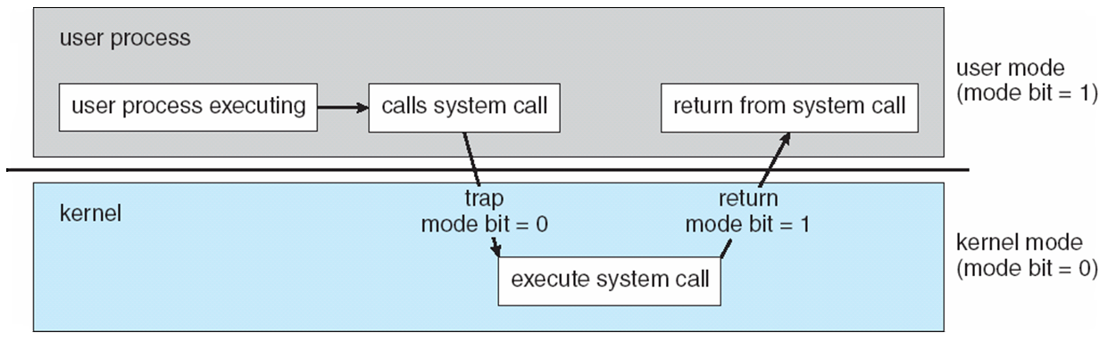
Transition from User to Kernel Mode

Slide 13
System Calls
Programming interface to the services provided by the OS
Typically written in a high-level language (C or C++)
Mostly accessed by programs via a high-level Application Programming Interface (API) rather than direct system call use
Three most common APIs are Win32 API for Windows, POSIX API for POSIX-based systems (including virtually all versions of UNIX, Linux, and Mac OS X), and Java API for the Java virtual machine (JVM)

Slide 14
System Call Implementation
Typically, a number associated with each system call
System-call interface maintains a table indexed according to these numbers
The system call interface invokes the intended system call in OS kernel and returns status of the system call and any return values
The caller need know nothing about how the system call is implemented

Slide 15
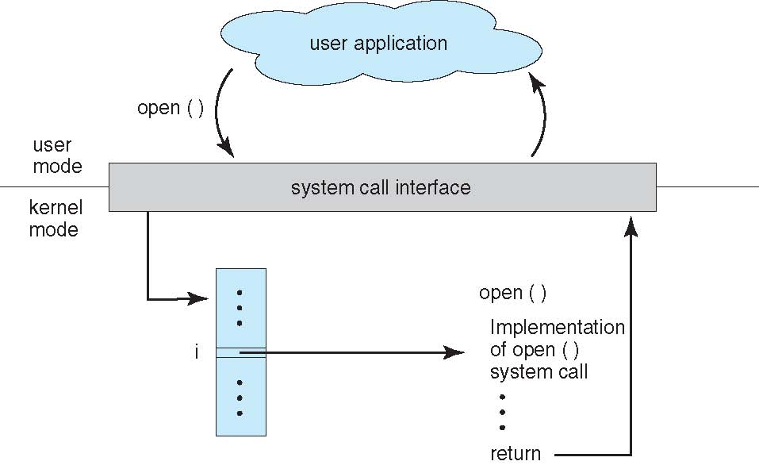
API – System Call – OS Relationship

Slide 16
System Call Parameter Passing
Three general methods used to pass parameters to the OS
Simplest: pass the parameters in registers
In some cases, may be more parameters than registers
Parameters stored in a block, or table, in memory, and address of block passed as a parameter in a register
This approach taken by Linux and Solaris
Parameters placed, or pushed, onto the stack by the program and popped off the stack by the operating system
Block and stack methods do not limit the number or length of parameters being passed

Slide 17
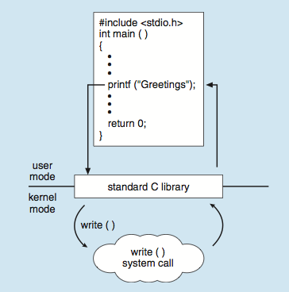
Standard C Library Example
C program invoking printf() library call, which calls write() system call

Slide 18
Operating System Structure
General-purpose OS is very large program
Various ways to structure an OS:
Simple structure – MS-DOS
More complex – UNIX
Layered – an abstraction
Microkernel – Mach

Slide 19
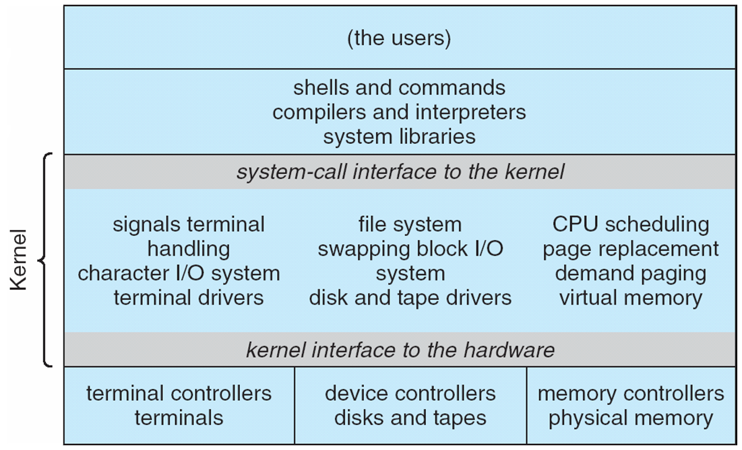
Traditional UNIX System Structure
Beyond simple but not fully layered

Slide 20
Microkernel System Structure

