Slide 1

Introduction to Operating Systems CS/COE 1550
Fall 2020
Sherif Khattab
ksm73@pitt.edu
(Some slides are from Silberschatz, Galvin and Gagne ©2013)

Slide 2
Process Concept
An operating system executes a variety of programs:
Batch system – jobs
Time-shared systems – user programs or tasks
Process – a program in execution; process execution must progress in sequential fashion
Multiple parts
The program code, also called text section
Current activity including program counter, processor registers
Stack containing temporary data
Function parameters, return addresses, local variables
Data section containing global variables
Heap containing memory dynamically allocated during run time

Slide 3
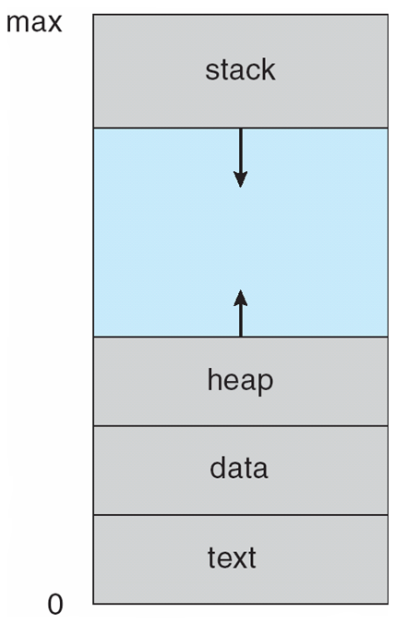
Process in Memory

Slide 4
Process State
As a process executes, it changes state
new: The process is being created
running: Instructions are being executed
waiting: The process is waiting for some event to occur
ready: The process is waiting to be assigned to a processor
terminated: The process has finished execution

Slide 5
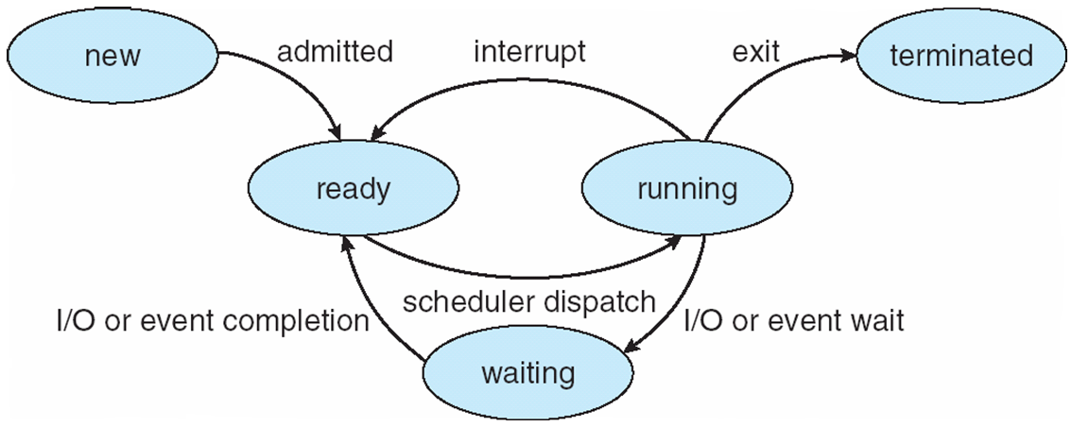
Diagram of Process State

Slide 6
Process Control Block (PCB)
Information associated with each process
(also called task control block)
Process state – running, waiting, etc
Program counter – location of instruction to execute next
CPU registers – contents of all process-centric registers
CPU scheduling information- priorities, scheduling queue pointers
Memory-management information – memory allocated to the process
Accounting information – CPU used, clock time elapsed since start, time limits
I/O status information – I/O devices allocated to process, list of open files

Slide 7
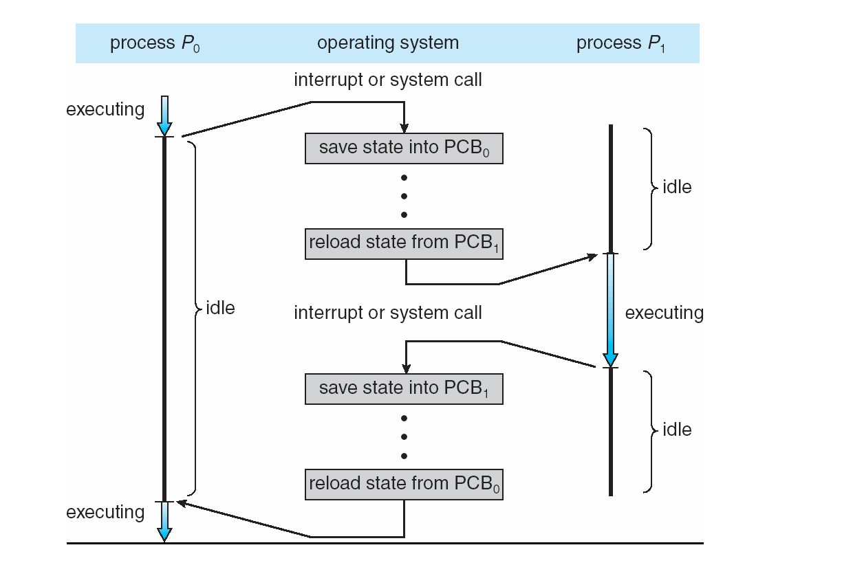
Context Switching

Slide 8
Context Switch
When CPU switches to another process, the system must save the state of the old process and load the saved state for the new process via a context switch
Context of a process represented in the PCB
Context-switch time is overhead; the system does no useful work while switching
The more complex the OS and the PCB ➔ the longer the context switch
Time dependent on hardware support
Some hardware provides multiple sets of registers per CPU ➔ multiple contexts loaded at once

Slide 9
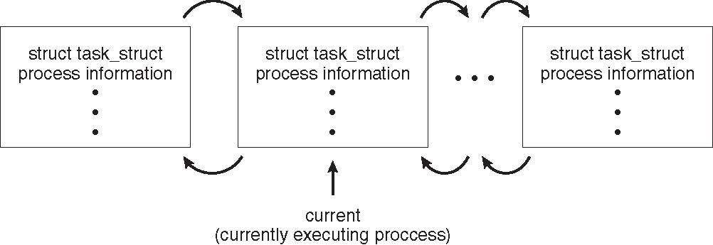
Process Representation in Linux
Represented by the C structure task_struct
pid t_pid; /* process identifier */ long state; /* state of the process */ unsigned int time_slice /* scheduling information */ struct task_struct *parent; /* this process’s parent */ struct list_head children; /* this process’s children */ struct files_struct *files; /* list of open files */ struct mm_struct *mm; /* address space of this process */

Slide 10
Process Scheduling
Maximize CPU use, quickly switch processes onto CPU for time sharing
Process scheduler selects among available processes for next execution on CPU
Maintains scheduling queues of processes
Job queue – set of all processes in the system
Ready queue – set of all processes residing in main memory, ready and waiting to execute
Device queues – set of processes waiting for an I/O device
Processes migrate among the various queues

Slide 11
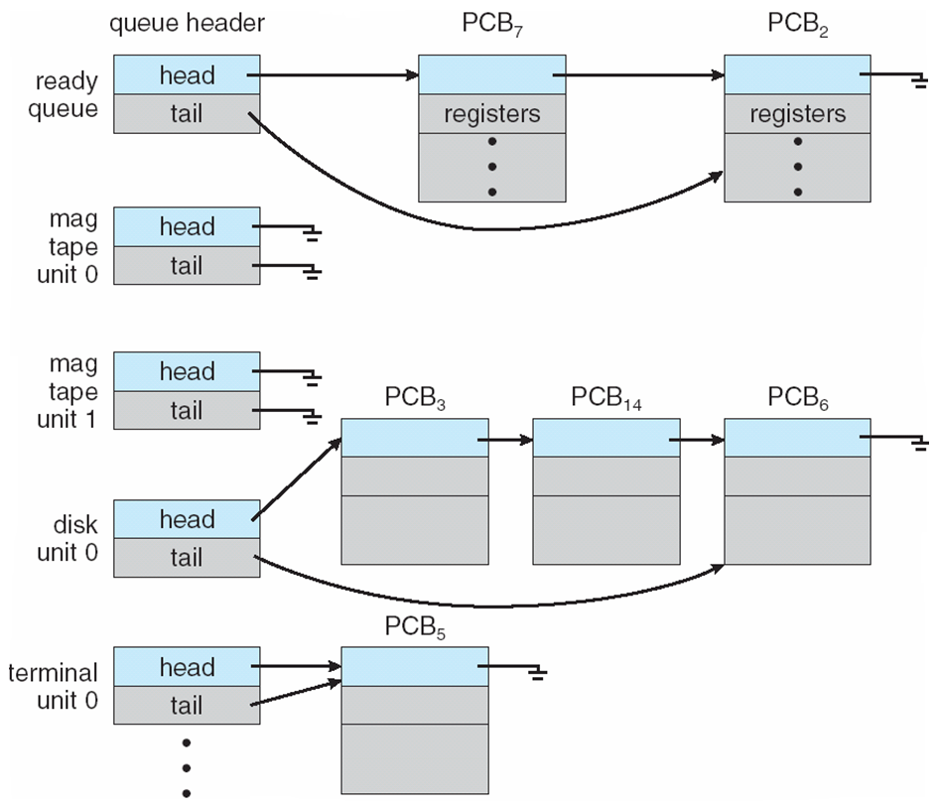
Ready Queue And Various I/O Device Queues

Slide 12
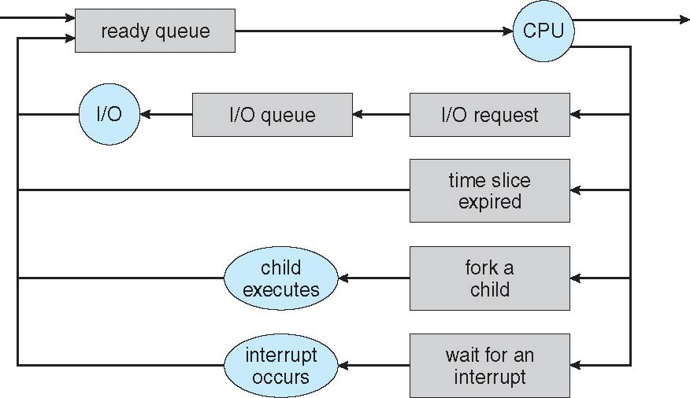
Representation of Process Scheduling
Queueing diagram represents queues, resources, flows

Slide 13
Schedulers
Short-term scheduler (or CPU scheduler) – selects which process should be executed next and allocates CPU
invoked frequently (milliseconds) ⇒ (must be fast)
Long-term scheduler (or job scheduler) – selects which processes should be brought into the ready queue
invoked infrequently (seconds, minutes) ⇒ (may be slow)
controls the degree of multiprogramming
Processes can be described as either:
I/O-bound process – spends more time doing I/O than computations, many short CPU bursts
CPU-bound process – spends more time doing computations; few very long CPU bursts
Long-term scheduler strives for good process mix

Slide 14
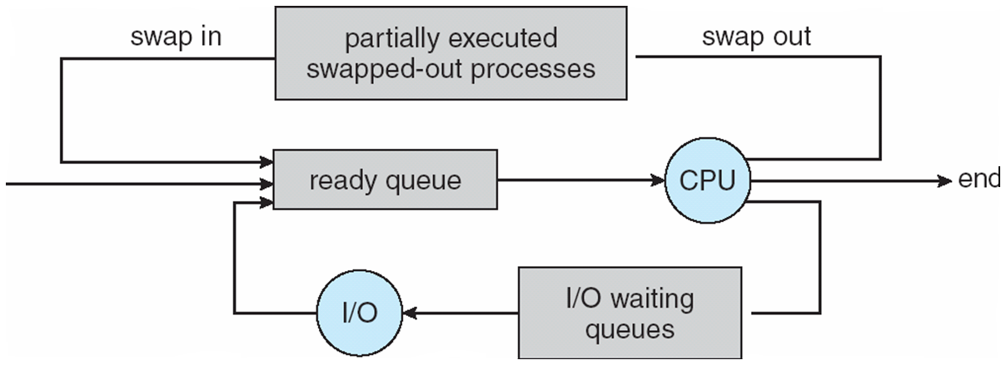
Addition of Medium Term Scheduling
Medium-term scheduler can be added if degree of multiple programming needs to decrease
Remove process from memory, store on disk, bring back in from disk to continue execution: swapping

Slide 15
Process Creation
Parent process creates children processes, which, in turn create other processes, forming a tree of processes
Generally, process identified and managed via a process identifier (pid)
Resource sharing options
Parent and children share all resources
Children share subset of parent’s resources
Parent and child share no resources
Execution options
Parent and children execute concurrently
Parent waits until children terminate

Slide 16
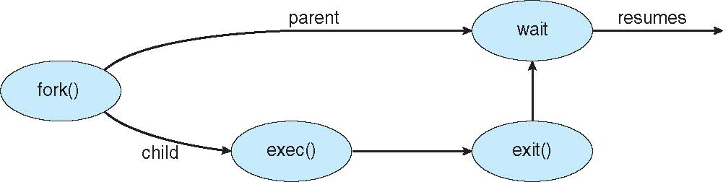
Process Creation (Cont.)
Address space
Child duplicate of parent
Child has a program loaded into it
UNIX examples
fork() system call creates new process
exec() system call used after a fork() to replace the process’ memory space with a new program

Slide 17
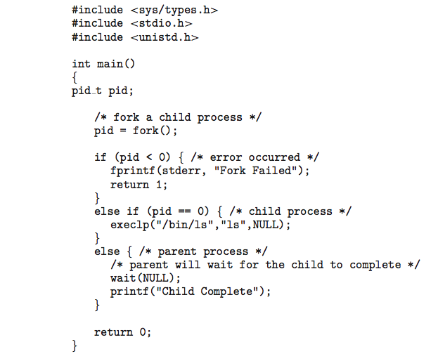
C Program Forking Separate Process

Slide 18
Process Termination
Process executes last statement and then asks the operating system to delete it using the exit() system call.
Returns status data from child to parent (via wait())
Process’ resources are deallocated by operating system
Parent may terminate the execution of children processes using the abort() system call. Some reasons for doing so:
Child has exceeded allocated resources
Task assigned to child is no longer required
The parent is exiting and the operating systems does not allow a child to continue if its parent terminates

Slide 19
Process Termination
Some operating systems do not allow a child to exist if its parent has terminated. If a process terminates, then all its children must also be terminated.
cascading termination. All children, grandchildren, etc. are terminated.
The termination is initiated by the operating system.
The parent process may wait for termination of a child process by using the wait()system call. The call returns status information and the pid of the terminated process
pid = wait(&status);
If no parent waiting (did not invoke wait()) process is a zombie
If parent terminated without invoking wait , process is an orphan

Slide 20
Why do we need Synchronization?
Each process operates sequentially
All is fine until processes want to share data
Exchange data between multiple processes
Allow processes to navigate critical regions
Maintain proper sequencing of actions in multiple processes
These issues apply to threads as well
Threads can share data easily (same address space)
Other two issues apply to threads

Slide 21
Example: bounded buffer problem
Shared variables const int n; typedef … Item; Item buffer[n]; int in = 0, out = 0, counter = 0;
Atomic statements:
Counter += 1;
Counter -= 1;
Producer
Item pitm; while (1) { … produce an item into pitm … while (counter == n) ; buffer[in] = pitm; in = (in+1) % n;
counter += 1; }
Consumer
Item citm; while (1) { while (counter == 0) ; citm = buffer[out]; out = (out+1) % n;
counter -= 1;
… consume the item in citm … }

Slide 22
Problem: race conditions
Cooperating processes share storage (memory)
Both may read and write the shared memory
Problem: can’t guarantee that read followed by write is atomic
Ordering matters!
This can result in erroneous results!
We need to eliminate race conditions…
P1
P2
x=3
R1 <= x
R1 = R1+1
R1 => x
R3 <= x
R3 = R3+1
R3 => x
x=5
R1 <= x
R3 <= x
R3 = R3+1
R1 = R1+1
R1 => x
R3 => x
x=6!

Slide 23
Critical regions
Use critical regions to provide mutual exclusion and help fix race conditions
Four conditions to provide mutual exclusion
No two processes simultaneously in critical region
No assumptions made about speeds or numbers of CPUs
No process running outside its critical region may block another process
No process must wait forever to enter its critical region
A enters critical region
A leaves critical region
Process A
B enters critical region
B leaves critical region
B tries to enter critical region
Process B
B blocked
Time

Slide 24
Busy waiting: strict alternation
Use a shared variable (turn) to keep track of whose turn it is
Waiting process continually reads the variable to see if it can proceed
This is called a spin lock because the waiting process “spins” in a tight loop reading the variable
Avoids race conditions, but doesn’t satisfy criterion 3 for critical regions
Process 0
Process 1
while (TRUE) { while (turn != 0) ; /* loop */ critical_region (); turn = 1; noncritical_region (); }
while (TRUE) { while (turn != 1) ; /* loop */ critical_region (); turn = 0; noncritical_region (); }

Slide 25
Busy waiting: working solution
#define FALSE 0 #define TRUE 1 #define N 2 // # of processes int turn; // Whose turn is it? int interested[N]; // Set to 1 if process j is interested
void enter_region(int process) { int other = 1-process; // # of the other process interested[process] = TRUE; // show interest turn = other; // Set it to my turn while (turn==other && interested[other]==TRUE) ; // Wait while the other process runs }
void leave_region (int process) { interested[process] = FALSE; // I’m no longer interested }

Slide 26
Hardware for synchronization
Prior method works, but…
May be somewhat complex
Require busy waiting: process spins in a loop waiting for something to happen, wasting CPU time
Solution: use hardware
Several hardware methods
Test & set: test a variable and set it in one instruction
Atomic swap: switch register & memory in one instruction
Turn off interrupts: process won’t be switched out unless it asks to be suspended

Slide 27
Mutual exclusion using hardware
Single shared variable lock
Still requires busy waiting, but code is much simpler
Two versions
Test and set
Swap
Works for any number of processes
Possible problem with requirements
can lead to unbounded waiting
int lock = 0;
Code for process P_{i}
while (1) {
while (TestAndSet(lock))
;
// critical section
lock = 0;
// remainder of code
}
Code for process P_{i}
while (1) {
while (Swap(lock,1) == 1)
;
// critical section
lock = 0;
// remainder of code
}

Slide 28
Eliminating busy waiting
Problem: previous solutions waste CPU time
Both hardware and software solutions require spin locks
Allow processes to sleep while they wait to execute their critical sections
Problem: priority inversion (higher priority process waits for lower priority process)
Solution: use semaphores
Synchronization mechanism that doesn’t require busy waiting
Implementation
Semaphore S accessed by two atomic operations
Down(S): while (S<=0) {}; S-= 1;
Up(S): S+=1;
Down() is another name for P()
Up() is another name for V()
Modify implementation to eliminate busy wait from Down()

Slide 29
Critical sections using semaphores
Define a “class” called Semaphore
Class allows more complex implementations for semaphores
Details hidden from processes
Code for individual process is simple
Shared variables
Semaphore mutex;
Code for process P_{i}
while (1) {
down(mutex);
// critical section
up(mutex);
// remainder of code
}

Slide 30
Implementing semaphores with blocking
Assume two operations:
Sleep(): suspends current process
Wakeup(P): allows process P to resume execution
Semaphore is a “class”
Track value of semaphore
Keep a list of processes waiting for the semaphore
Operations still atomic
Semaphore code
Semaphore::down ()
{
value -= 1;
if (value < 0) {
// add this process to pl
Sleep ();
}
}
Semaphore::up () {
Process P;
value += 1;
if (value <= 0) {
// remove a process P
// from pl
Wakeup (P);
}
}
class Semaphore {
int value;
ProcessList pl;
void down ();
void up ();
};

Slide 31
Semaphores for general synchronization
We want to execute B in P1 only after A executes in P0
Use a semaphore initialized to 0
Use up() to notify P1 at the appropriate time
Shared variables
// flag initialized to 0
Semaphore flag;
Process P₀
.
.
.
// Execute code for A
flag.up ();
Process P₁
.
.
.
flag.down ();
// Execute code for B

Slide 32
Types of semaphores
Two different types of semaphores
Counting semaphores
Binary semaphores
Counting semaphore
Value can range over an unrestricted range
Binary semaphore
Only two values possible
1 means the semaphore is available
0 means a process has acquired the semaphore
May be simpler to implement
Possible to implement one type using the other

Slide 33
Deadlock and starvation
Deadlock: two or more processes are waiting indefinitely for an event that can only be caused by a waiting process
P0 gets A, needs B
P1 gets B, needs A
Each process waiting for the other to signal
Starvation: indefinite blocking
Process is never removed from the semaphore queue in which its suspended
May be caused by ordering in queues (priority)
Shared variables
Semaphore A(1),B(1);
Process P₀
A.down();
B.down();
.
.
.
B.up();
A.up();
Process P₁
B.down();
A.down();
.
.
.
A.up();
B.up();

Slide 34
Monitors
A monitor is another kind of high-level synchronization primitive
One monitor has multiple entry points
Think multiple methods in a Java class
Only one process may be in the monitor at any time
Enforces mutual exclusion - less chance for programming errors
Monitors provided by high-level language
Variables belonging to monitor are protected from simultaneous access
Procedures in monitor are guaranteed to have mutual exclusion
Monitor implementation
Language / compiler handles implementation
Can be implemented using semaphores

Slide 35
Monitor usage
This looks like C++ code, but it’s not supported by C++
Provides the following features:
Variables foo, bar, and arr are accessible only by proc1 & proc2
Only one process can be executing in either proc1 or proc2 at any time
monitor mon {
int foo;
int bar;
double arr[100];
void proc1(…) {
}
void proc2(…) {
}
void mon() { // initialization code
}
};

Slide 36
Condition variables in monitors
Problem: how can a process wait inside a monitor?
Can’t simply sleep: there’s no way for anyone else to enter
Solution: use a condition variable
Condition variables support two operations
Wait(): suspend this process until signaled
Signal(): wake up exactly one process waiting on this condition variable
If no process is waiting, signal has no effect
Signals on condition variables aren’t “saved up”
Condition variables are only usable within monitors
Process must be in monitor to signal on a condition variable
Question: which process gets the monitor after Signal()?

Slide 37
Monitor semantics
Problem: P signals on condition variable X, waking Q
Both can’t be active in the monitor at the same time
Which one continues first?
Mesa semantics
Signaling process (P) continues first
Q resumes when P leaves the monitor
Seems more logical: why suspend P when it signals?
Hoare semantics
Awakened process (Q) continues first
P resumes when Q leaves the monitor
May be better: condition that Q wanted may no longer hold when P leaves the monitor

Slide 38
Locks & condition variables
Monitors require native language support
Provide monitor support using special data types and procedures
Locks (Acquire(), Release())
Condition variables (Wait(), Signal())
Lock usage
Acquiring a lock == entering a monitor
Releasing a lock == leaving a monitor
Condition variable usage
Each condition variable is associated with exactly one lock
Lock must be held to use condition variable
Waiting on a condition variable releases the lock implicitly
Returning from Wait() on a condition variable reacquires the lock

Slide 39
Implementing locks with semaphores
Use mutex to ensure exclusion within the lock bounds
Use next to give lock to processes with a higher priority (why?)
nextCount indicates whether there are any higher priority waiters
class Lock {
Semaphore mutex(1);
Semaphore next(0);
int nextCount = 0;
};
Lock::Acquire()
{
mutex.down();
}
Lock::Release()
{
if (nextCount > 0)
next.up();
else
mutex.up();
}

Slide 40
Implementing condition variables
Are these Hoare or Mesa semantics?
Can there be multiple condition variables for a single Lock?
class Condition {
Lock *lock;
Semaphore condSem(0);
int semCount = 0;
};
Condition::Signal ()
{
if (semCount > 0) {
lock->nextCount += 1;
condSem.up ();
lock->next.down ();
lock->nextCount -= 1;
}
}
Condition::Wait ()
{
semCount += 1;
if (lock->nextCount > 0)
lock->next.up();
else
lock->mutex.up();
condSem.down ();
semCount -= 1;
}

Slide 41
Message passing
Synchronize by exchanging messages
Two primitives:
Send: send a message
Receive: receive a message
Both may specify a “channel” to use
Issue: how does the sender know the receiver got the message?
Issue: authentication

Slide 42
Barriers
Used for synchronizing multiple processes
Processes wait at a “barrier” until all in the group arrive
After all have arrived, all processes can proceed
May be implemented using locks and condition variables
A
A
A
A
B
B
B
B
C
C
C
C
D
D
D
D
Processes approaching
barrier
B and D at
barrier
All at
barrier
Barrier releases all processes

Slide 43
Classical synchronization problems
Bounded Buffer
Multiple producers and consumers
Synchronize access to shared buffer
Readers & Writers
Many processes that may read and/or write
Only one writer allowed at any time
Many readers allowed, but not while a process is writing
Dining Philosophers
Resource allocation problem
N processes and limited resources to perform sequence of tasks
Goal: use semaphores to implement solutions to these problems

Slide 44
Bounded buffer problem
Goal: implement producer-consumer without busy waiting
const int n;
Semaphore empty(n),full(0),mutex(1);
Item buffer[n];
Producer
int in = 0;
Item pitem;
while (1) {
// produce an item
// into pitem
empty.down();
mutex.down();
buffer[in] = pitem;
in = (in+1) % n;
mutex.up();
full.up();
}
Consumer
int out = 0;
Item citem;
while (1) {
full.down();
mutex.down();
citem = buffer[out];
out = (out+1) % n;
mutex.up();
empty.up();
// consume item from
// citem
}

Slide 45
Readers-writers problem
Shared variables
int nreaders;
Semaphore mutex(1), writing(1);
Reader process
…
mutex.down();
nreaders += 1;
if (nreaders == 1) // wait if
writing.down(); // 1st reader
mutex.up();
// Read some stuff
mutex.down();
nreaders -= 1;
if (nreaders == 0) // signal if
writing.up(); // last reader
mutex.up();
…
Writer process
…
writing.down();
// Write some stuff
writing.up();
…

Slide 46


Dining Philosophers
N philosophers around a table
All are hungry
All like to think
N chopsticks available
1 between each pair of philosophers
Philosophers need two chopsticks to eat
Philosophers alternate between eating and thinking
Goal: coordinate use of chopsticks

Slide 47
Dining Philosophers: solution 1
Use a semaphore for each chopstick
A hungry philosopher
Gets the chopstick to his right
Gets the chopstick to his left
Eats
Puts down the chopsticks
Potential problems?
Deadlock
Fairness
Shared variables
const int n;
// initialize to 1
Semaphore chopstick[n];
Code for philosopher i
while(1) {
chopstick[i].down();
chopstick[(i+1)%n].down();
// eat
chopstick[i].up();
chopstick[(i+1)%n].up();
// think
}

Slide 48
Dining Philosophers: solution 2
Use a semaphore for each chopstick
A hungry philosopher
Gets lower, then higher numbered chopstick
Eats
Puts down the chopsticks
Potential problems?
Deadlock
Fairness
Code for philosopher i
int i1,i2;
while(1) {
if (i != (n-1)) {
i1 = i;
i2 = i+1;
} else {
i1 = 0;
i2 = n-1;
}
chopstick[i1].down();
chopstick[i2].down();
// eat
chopstick[i1].up();
chopstick[i2].up();
// think
}
Shared variables
const int n;
// initialize to 1
Semaphore chopstick[n];

Slide 49
Dining philosophers with locks
Shared variables
const int n;
// initialize to THINK
int state[n];
Lock mutex;
// use mutex for self
Condition self[n];
Code for philosopher j
while (1) {
// pickup chopstick
mutex.Acquire();
state[j] = HUNGRY;
test(j);
if (state[j] != EAT)
self[j].Wait();
mutex.Release();
// eat
mutex.Acquire();
state[j] = THINK;
test((j+1)%n); // next
test((j+n-1)%n); // prev
mutex.Release();
// think
}
void test(int k)
{
if ((state[(k+n-1)%n)]!=EAT) &&
(state[k]==HUNGRY) &&
(state[(k+1)%n]!=EAT)) {
state[k] = EAT;
self[k].Signal();
}
}

Slide 50
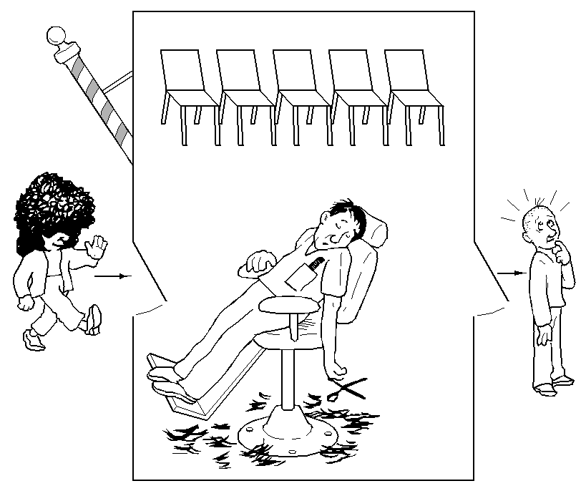
The Sleepy Barber Problem

Slide 51
Code for the Sleepy Barber Problem
#define CHAIRS 5
Semaphore customers=0;
Semaphore barbers=0;
Semaphore mutex=0;
int waiting=0;
void barber(void)
{
while(TRUE) {
// Sleep if no customers
customers.down();
// Decrement # of waiting people
mutex.down();
waiting -= 1;
// Wake up a customer to cut hair
barbers.up();
mutex.up();
// Do the haircut
cut_hair();
}
}
void customer(void)
{
mutex.down();
// If there is space in the chairs
if (waiting<CHAIRS) {
// Another customer is waiting
waiting++;
// Wake up the barber. This is
// saved up, so the barber doesn’t
// sleep if a customer is waiting
customers.up();
mutex.up();
// Sleep until the barber is ready
barbers.down();
get_haircut();
} else {
// Chairs full, leave the critical
// region
mutex.up ();
}
}

Slide 52
Deadlocks
Resources
Why do deadlocks occur?
Dealing with deadlocks
Ignoring them: ostrich algorithm
Detecting & recovering from deadlock
Avoiding deadlock
Preventing deadlock

Slide 53
Resources
Resource: something a process uses
Usually limited (at least somewhat)
Examples of computer resources
Printers
Semaphores / locks
Tables (in a database)
Processes need access to resources in reasonable order
Two types of resources:
Preemptable resources: can be taken away from a process with no ill effects
Nonpreemptable resources: will cause the process to fail if taken away

Slide 54
When do deadlocks happen?
Suppose
Process 1 holds resource A and requests resource B
Process 2 holds B and requests A
Both can be blocked, with neither able to proceed
Deadlocks occur when …
Processes are granted exclusive access to devices or software constructs (resources)
Each deadlocked process needs a resource held by another deadlocked process
Process 1
Process 2
A
B
A
B
DEADLOCK!

Slide 55
Using resources
Sequence of events required to use a resource
Request the resource
Use the resource
Release the resource
Can’t use the resource if request is denied
Requesting process has options
Block and wait for resource
Continue (if possible) without it: may be able to use an alternate resource
Process fails with error code
Some of these may be able to prevent deadlock…

Slide 56
What is a deadlock?
Formal definition: “A set of processes is deadlocked if each process in the set is waiting for an event that only another process in the set can cause.”
Usually, the event is release of a currently held resource
In deadlock, none of the processes can
Run
Release resources
Be awakened

Slide 57
Four conditions for deadlock
Mutual exclusion
Each resource is assigned to at most one process
Hold and wait
A process holding resources can request more resources
No preemption
Previously granted resources cannot be forcibly taken away
Circular wait
There must be a circular chain of 2 or more processes where each is waiting for a resource held by the next member of the chain

Slide 58
Resource allocation graphs
Resource allocation modeled by directed graphs
Example 1:
Resource R assigned to process A
Example 2:
Process B is requesting / waiting for resource S
Example 3:
Process C holds T, waiting for U
Process D holds U, waiting for T
C and D are in deadlock!
A
R
B
S
T
C
D
U

Slide 59
Dealing with deadlock
How can the OS deal with deadlock?
Ignore the problem altogether!
Hopefully, it’ll never happen…
Detect deadlock & recover from it
Dynamically avoid deadlock
Careful resource allocation
Prevent deadlock
Remove at least one of the four necessary conditions
We’ll explore these tradeoffs

Slide 60
Getting into deadlock
A
B
C
Acquire R
Acquire S
Release R
Release S
Acquire S
Acquire T
Release S
Release T
Acquire T
Acquire R
Release T
Release R
A
B
C
A
B
C
A
B
C
R
S
T
R
S
T
R
S
T
Acquire R
Acquire S
Acquire T
A
B
C
A
B
C
A
B
C
R
S
T
R
S
T
R
S
T
Deadlock!
Acquire S
Acquire T
Acquire R

Slide 61
Not getting into deadlock…
Many situations may result in deadlock (but don’t have to)
In previous example, A could release R before C requests R, resulting in no deadlock
Can we always get out of it this way?
Find ways to:
Detect deadlock and reverse it
Stop it from happening in the first place

Slide 62
The Ostrich Algorithm
Pretend there’s no problem
Reasonable if
Deadlocks occur very rarely
Cost of prevention is high
UNIX and Windows take this approach
Resources (memory, CPU, disk space) are plentiful
Deadlocks over such resources rarely occur
Deadlocks typically handled by rebooting
Trade off between convenience and correctness

Slide 63
Detecting deadlocks using graphs
Process holdings and requests in the table and in the graph (they’re equivalent)
Graph contains a cycle => deadlock!
Easy to pick out by looking at it (in this case)
Need to mechanically detect deadlock
Not all processes are deadlocked (A, C, F not in deadlock)
R
A
B
Process | Holds | Wants
A | R | S
B |  | T
C |  | S
D | U | S,T
E | T | V
F | W | S
G | V | U
C
S
D
T
E
F
U
V
W
G

Slide 64
Deadlock detection algorithm
General idea: try to find cycles in the resource allocation graph
Algorithm: depth-first search at each node
Mark arcs as they’re traversed
Build list of visited nodes
If node to be added is already on the list, a cycle exists!
Cycle == deadlock
Assuming one instance of each resource type
For each node N in the graph {
Set L = empty list
unmark all arcs
Traverse (N,L)
}
If no deadlock reported by now, there isn’t any
define Traverse (C,L) {
If C in L, report deadlock!
Add C to L
For each unmarked arc from C {
Mark the arc
Set A = arc destination
/* NOTE: L is a
local variable */
Traverse (A,L)
}
}

Slide 65
Resources with multiple instances
Previous algorithm only works if there’s one instance of each resource
If there are multiple instances of each resource, we need a different method
Track current usage and requests for each process
To detect deadlock, try to find a scenario where all processes can finish
If no such scenario exists, we have deadlock

Slide 66
Deadlock detection algorithm
 | A | B | C | D
Avail | 2 | 3 | 0 | 1
current=avail;
for (j = 0; j < N; j++) {
for (k=0; k<N; k++) {
if (finished[k])
continue;
if (want[k] < current) {
finished[k] = 1;
current += hold[k];
break;
}
}
if (k==N) {
printf “Deadlock!\n”;
// finished[k]==0 means process is in
// the deadlock
break;
}
}
Process | A | B | C | D
1 | 0 | 3 | 0 | 0
2 | 1 | 0 | 1 | 1
3 | 0 | 2 | 1 | 0
4 | 2 | 2 | 3 | 0
Hold
Process | A | B | C | D
1 | 3 | 2 | 1 | 0
2 | 2 | 2 | 0 | 0
3 | 3 | 5 | 3 | 1
4 | 0 | 4 | 1 | 1
Want
Note: want[j], hold[j], current, avail are arrays!

Slide 67
Recovering from deadlock
Recovery through preemption
Take a resource from some other process
Depends on nature of the resource and the process
Recovery through rollback
Checkpoint a process periodically
Use this saved state to restart the process if it is found deadlocked
May present a problem if the process affects lots of “external” things
Recovery through killing processes
Crudest but simplest way to break a deadlock: kill one of the processes in the deadlock cycle
Other processes can get its resources
Preferably, choose a process that can be rerun from the beginning
Pick one that hasn’t run too far already

Slide 68
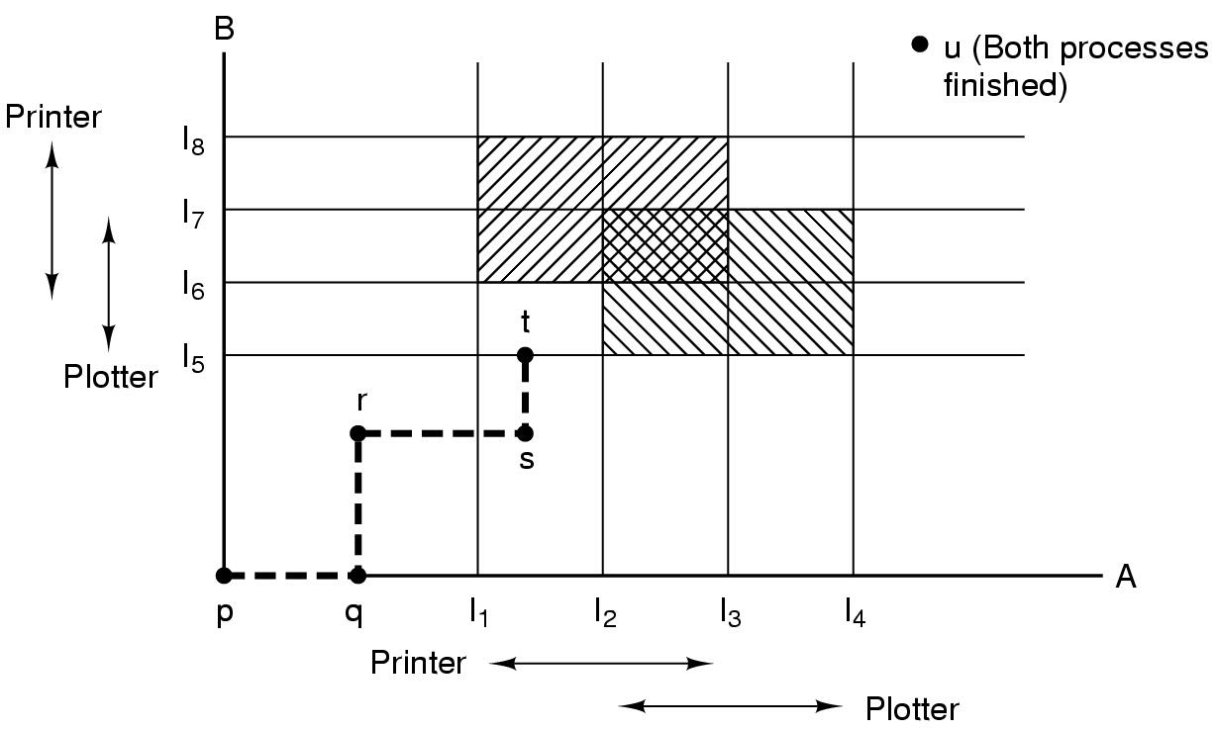
Resource trajectories
Two process resource trajectories

Slide 69
Safe and unsafe states
 | Has | Max
A | 3 | 9
B | 2 | 4
C | 2 | 7
Free: 3
 | Has | Max
A | 3 | 9
B | 4 | 4
C | 2 | 7
Free: 1
 | Has | Max
A | 3 | 9
B | 0 | -
C | 2 | 7
Free: 5
 | Has | Max
A | 3 | 9
B | 0 | -
C | 7 | 7
Free: 0
 | Has | Max
A | 3 | 9
B | 0 | -
C | 0 | -
Free: 7
Demonstration that the first state is safe
 | Has | Max
A | 3 | 9
B | 2 | 4
C | 2 | 7
Free: 3
 | Has | Max
A | 4 | 9
B | 2 | 4
C | 2 | 7
Free: 2
 | Has | Max
A | 4 | 9
B | 4 | 4
C | 2 | 7
Free: 0
 | Has | Max
A | 4 | 9
B | 0 | -
C | 2 | 7
Free: 4
Demonstration that the second state is unsafe

Slide 70
Banker's Algorithm for a single resource
Bankers’ algorithm: before granting a request, ensure that a sequence exists that will allow all processes to complete
Use previous methods to find such a sequence
If a sequence exists, allow the requests
If there’s no such sequence, deny the request
Can be slow: must be done on each request!
 | Has | Max
A | 0 | 6
B | 0 | 5
C | 0 | 4
D | 0 | 7
Free: 10
 | Has | Max
A | 1 | 6
B | 1 | 5
C | 2 | 4
D | 4 | 7
Free: 2
 | Has | Max
A | 1 | 6
B | 2 | 5
C | 2 | 4
D | 4 | 7
Free: 1
Any sequence finishes
C,B,A,D finishes
Deadlock (unsafe state)

Slide 71
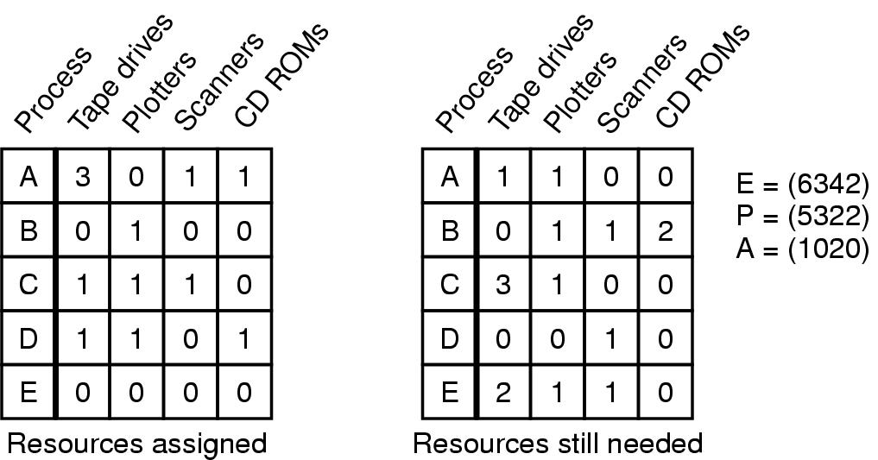
Banker's Algorithm for multiple resources
Example of banker's algorithm with multiple resources

Slide 72
Preventing deadlock
Deadlock can be completely prevented!
Ensure that at least one of the conditions for deadlock never occurs
Mutual exclusion
Circular wait
Hold & wait
No preemption
Not always possible…

Slide 73
Eliminating mutual exclusion
Some devices (such as printer) can be spooled
Only the printer daemon uses printer resource
This eliminates deadlock for printer
Not all devices can be spooled
Principle:
Avoid assigning resource when not absolutely necessary
As few processes as possible actually claim the resource

Slide 74
Attacking “hold and wait”
Require processes to request resources before starting
A process never has to wait for what it needs
This can present problems
A process may not know required resources at start of run
This also ties up resources other processes could be using
Processes will tend to be conservative and request resources they might need
Variation: a process must give up all resources before making a new request
Process is then granted all prior resources as well as the new ones
Problem: what if someone grabs the resources in the meantime—how can the process save its state?

Slide 75
Attacking “no preemption”
This is not usually a viable option
Consider a process given the printer
Halfway through its job, take away the printer
Confusion ensues!
May work for some resources
Forcibly take away memory pages, suspending the process
Process may be able to resume with no ill effects

Slide 76
Attacking “circular wait”
Assign an order to resources
Always acquire resources in numerical order
Need not acquire them all at once!
Circular wait is prevented
A process holding resource n can’t wait for resource m if m < n
No way to complete a cycle
Place processes above the highest resource they hold and below any they’re requesting
All arrows point up!
D
C
3
2
B
1
A

Slide 77
Deadlock prevention: summary
Mutual exclusion
Spool everything
Hold and wait
Request all resources initially
No preemption
Take resources away
Circular wait
Order resources numerically

Slide 78
Example: two-phase locking
Phase One
Process tries to lock all data it needs, one at a time
If needed data found locked, start over
(no real work done in phase one)
Phase Two
Perform updates
Release locks
Note similarity to requesting all resources at once
This is often used in databases
It avoids deadlock by eliminating the “hold-and-wait” deadlock condition

Slide 79
“Non-resource” deadlocks
Possible for two processes to deadlock
Each is waiting for the other to do some task
Can happen with semaphores
Each process required to do a down() on two semaphores (mutex and another)
If done in wrong order, deadlock results
Semaphores could be thought of as resources…

Slide 80
Starvation
Algorithm to allocate a resource
Give the resource to the shortest job first
Works great for multiple short jobs in a system
May cause long jobs to be postponed indefinitely
Even though not blocked
Solution
First-come, first-serve policy
Starvation can lead to deadlock
Process starved for resources can be holding resources
If those resources aren’t used and released in a timely fashion, shortage could lead to deadlock

Slide 81
CPU Scheduling
Scheduling the processor among all ready processes
User-oriented criteria
Response Time: Elapsed time between the submission of a request and the receipt of a response
Turnaround Time: Elapsed time between the submission of a process to its completion
System-oriented criteria
Processor utilization
Throughput: number of process completed per unit time
Fairness

Slide 82
Classification of Scheduling Activity
Long-term: which process to admit?
Medium-term: which process to swap in or out?
Short-term: which ready process to execute next?

Slide 83
Queuing Diagram for Scheduling

Slide 84
Short-Term Scheduler Dispatcher
The dispatcher is the module that gives control of the CPU to the process selected by the short-term scheduler
The functions of the dispatcher include:
Switching context
Switching to user mode
Jumping to the location in the user program to restart execution
The dispatch latency must be minimal

Slide 85
The CPU-I/O Cycle
Processes require alternate use of processor and I/O in a repetitive fashion
Each cycle consist of a CPU burst followed by an I/O burst
A process terminates on a CPU burst
CPU-bound processes have longer CPU bursts than I/O-bound processes

Slide 86
Scheduling Algorithms
First-Come, First-Served Scheduling
Shortest-Job-First Scheduling
Also referred to as Shortest Process Next
Priority Scheduling
Round-Robin Scheduling
Multilevel Queue Scheduling
Multilevel Feedback Queue Scheduling

Slide 87
Characterization of Scheduling Policies
The selection function determines which ready process is selected next for execution
The decision mode specifies the instants in time the selection function is exercised
Nonpreemptive
Once a process is in the running state, it will continue until it terminates or blocks for an I/O
Preemptive
Currently running process may be interrupted and moved to the Ready state by the OS
Prevents one process from monopolizing the processor

Slide 88
Process Mix Example
Process
Arrival Time
Service Time
1
0
3
2
2
6
3
4
4
4
6
5
5
8
2
Service time = total processor time needed in one (CPU-I/O) cycle
Jobs with long service time are CPU-bound jobs and are referred
to as “long jobs”

Slide 89
First Come First Served (FCFS)
Selection function: the process that has been waiting the longest in the ready queue (hence, FCFS)
Decision mode: non-preemptive
a process runs until it blocks for an I/O

Slide 90
FCFS drawbacks
Favours CPU-bound processes
A CPU-bound process monopolizes the processor
I/O-bound processes have to wait until completion of CPU-bound process
I/O-bound processes may have to wait even after their I/Os are completed (poor device utilization)
Better I/O device utilization could be achieved if I/O bound processes had higher priority

Slide 91
Shortest Job First (Shortest Process Next)
Selection function: the process with the shortest expected CPU burst time
I/O-bound processes will be selected first
Decision mode: non-preemptive
The required processing time, i.e., the CPU burst time, must be estimated for each process

Slide 92
SJF / SPN Critique
Possibility of starvation for longer processes
Lack of preemption is not suitable in a time sharing environment
SJF/SPN implicitly incorporates priorities
Shortest jobs are given preference
CPU bound processes have lower priority, but a process doing no I/O could still monopolize the CPU if it is the first to enter the system

Slide 93
Priorities
Implemented by having multiple ready queues to represent each level of priority
Scheduler selects the process of a higher priority over one of lower priority
Lower-priority may suffer starvation
To alleviate starvation allow dynamic priorities
The priority of a process changes based on its age or execution history

Slide 94
Round-Robin
Selection function: same as FCFS
Decision mode: pre-emptive
a process is allowed to run until the time slice period (quantum, typically from 10 to 100 ms) has expired
a clock interrupt occurs and the running process is put on the ready queue

Slide 95
RR Time Quantum
Quantum must be substantially larger than the time required to handle the clock interrupt and dispatching
Quantum should be larger then the typical interaction
but not much larger, to avoid penalizing I/O bound processes

Slide 96
RR Time Quantum

Slide 97
Round Robin: critique
Still favors CPU-bound processes
An I/O bound process uses the CPU for a time less than the time quantum before it is blocked waiting for an I/O
A CPU-bound process runs for all its time slice and is put back into the ready queue
May unfairly get in front of blocked processes

Slide 98
Multilevel Feedback Scheduling
Preemptive scheduling with dynamic priorities
N ready to execute queues with decreasing priorities:
P(RQ₀) > P(RQ₁) > ... > P(RQ_{N-1})
Dispatcher selects a process for execution from RQ_{i} only if RQ_{i-1} to RQ₀ are empty

Slide 99
Multilevel Feedback Scheduling
New process are placed in RQ₀
After the first quantum, they are moved to RQ₁, and to RQ₂ after the second quantum, … and to RQ_{N-1} after the Nth quantum
I/O-bound processes remain in higher priority queues.
CPU-bound jobs drift downward.
Hence, long jobs may starve

Slide 100
Multiple Feedback Queues
Different RQs may have different quantum values

Slide 101
Time Quantum for feedback Scheduling
With a fixed quantum time, the turn-around time of longer processes can be high
To alleviate this problem, the time quantum can be increased based on the depth of the queue
Time quantum of RQ_{i} = 2^{i-1}
May still cause longer processes to suffer starvation.
Possible fix is to promote a process to higher queue after some time

Slide 102
Algorithm Comparison
Which one is the best?
The answer depends on many factors:
the system workload (extremely variable)
hardware support for the dispatcher
relative importance of performance criteria (response time, CPU utilization, throughput...)
The evaluation method used (each has its limitations...)

Slide 103
Back to SJF: CPU Burst Estimation
Let T[i] be the execution time for the ith instance of this process: the actual duration of the ith CPU burst of this process
Let S[i] be the predicted value for the ith CPU burst of this process. The simplest choice is:
S[n+1] =(1/n)(T[1]+…+T[n])=(1/n) Σ{i=1 to n} T[i]
This can be more efficiently calculated as:
S[n+1] = (1/n) T[n] + ((n-1)/n) S[n]
This estimate, however, results in equal weight for each instance

Slide 104
Estimating the required CPU burst
Recent instances are more likely to better reflect future behavior
A common technique to factor the above observation into the estimate is to use exponential averaging :
S[n+1] = α T[n] + (1- α) S[n] ; 0 < α < 1

Slide 105
CPU burst Estimate (Exponential Average)
Recent instances have higher weights, whenever α > 1/n
Expanding the estimated value shows that the weights of past instances decrease exponentially
S[n+1] = α T[n] + (1- α) α T[n-1] + ... (1- α)^{i} α T[n-i] +
... + (1- α)^{n}S[1]
The predicted value of 1st instance, S[1], is usually set to 0 to give priority to new processes

Slide 106
Exponentially Decreasing Coefficients

Slide 107
Exponentially Decreasing Coefficients
S[1] = 0 to give high priority to new processes
Exponential averaging tracks changes in process behavior much faster than simple averaging

