Slide 1

Introduction to Operating Systems CS/COE 1550
Fall 2020
Sherif Khattab
ksm73@pitt.edu
(Some slides are from Silberschatz, Galvin and Gagne ©2013)

Slide 2
Memory management
Basic memory management
Swapping
Virtual memory
Page replacement algorithms
Modeling page replacement algorithms
Design issues for paging systems
Implementation issues
Segmentation

Slide 3
In an ideal world…
The ideal world has memory that is
Very large
Very fast
Non-volatile (doesn’t go away when power is turned off)
The real world has memory that is:
Very large
Very fast
Affordable!
Pick any two…
Memory management goal: make the real world look as much like the ideal world as possible

Slide 4
Memory hierarchy
What is the memory hierarchy?
Different levels of memory
Some are small & fast
Others are large & slow
What levels are usually included?
Cache: small amount of fast, expensive memory
L1 (level 1) cache: usually on the CPU chip
L2 & L3 cache: off-chip, made of SRAM
Main memory: medium-speed, medium price memory (DRAM)
Disk: many gigabytes of slow, cheap, non-volatile storage
Memory manager handles the memory hierarchy

Slide 5
Basic memory management
Components include
Operating system (perhaps with device drivers)
Single process
Goal: lay these out in memory
Memory protection may not be an issue (only one program)
Flexibility may still be useful (allow OS changes, etc.)
No swapping or paging
0xFFFF
0xFFFF
User program (RAM)
Operating system (ROM)
Device drivers (ROM)
User program (RAM)
User program (RAM)
Operating system (RAM)
Operating system (RAM)
0
0

Slide 6
Fixed partitions: multiple programs
Fixed memory partitions
Divide memory into fixed spaces
Assign a process to a space when it’s free
Mechanisms
Separate input queues for each partition
Single input queue: better ability to optimize CPU usage
Partition 4
900K
Partition 4
900K
Partition 3
700K
Partition 3
700K
Partition 2
600K
Partition 2
600K
Partition 1
500K
Partition 1
500K
100K
100K
OS
OS
0
0

Slide 7
How many programs is enough?
Several memory partitions (fixed or variable size)
Lots of processes wanting to use the CPU
Tradeoff
More processes utilize the CPU better
Fewer processes use less memory (cheaper!)
How many processes do we need to keep the CPU fully utilized?
This will help determine how much memory we need
Is this still relevant with memory costing $10/GB?

Slide 8
Modeling multiprogramming
More I/O wait means less processor utilization
At 20% I/O wait, 3–4 processes fully utilize CPU
At 80% I/O wait, even 10 processes aren’t enough
This means that the OS should have more processes if they’re I/O bound
More processes => memory management & protection more important!

Slide 9
Base and limit registers
Special CPU registers: base & limit
Access to the registers limited to kernel (privileged) mode
Registers contain
Base: start of the process’s memory partition
Limit: length of the process’s memory partition
Address generation
Physical address: location in actual memory
Logical address: location from the process’s point of view
Physical address = base + logical address
Logical address larger than limit => error
0xFFFF
0x2000
Limit
Process partition
Base
0x9000
OS
0
Logical address: 0x1204 Physical address: 0x1204+0x9000 = 0xa204

Slide 10
Swapping
C
C
C
C
C
B
B
B
B
A
A
A
A
D
D
D
OS
OS
OS
OS
OS
OS
OS
Memory allocation changes as
Processes come into memory
Processes leave memory
Swapped to disk
Complete execution
Gray regions are unused memory

Slide 11
Swapping: leaving room to grow
Need to allow for programs to grow
Allocate more memory for data
Larger stack
Handled by allocating more space than is necessary at the start
Inefficient: wastes memory that’s not currently in use
What if the process requests too much memory?
Stack
Room for
B to grow
Process B
Data
Code
Stack
Room for
A to grow
Process A
Data
Code
OS

Slide 12
Tracking memory usage: bitmaps
Keep track of free / allocated memory regions with a bitmap
One bit in map corresponds to a fixed-size region of memory
Bitmap is a constant size for a given amount of memory regardless of how much is allocated at a particular time
Chunk size determines efficiency
At 1 bit per 4KB chunk, we need just 256 bits (32 bytes) per MB of memory
For smaller chunks, we need more memory for the bitmap
Can be difficult to find large contiguous free areas in bitmap
A
B
C
D
8
16
24
32
Memory regions
11111100
00111000
01111111
Bitmap
11111000

Slide 13
Tracking memory usage: linked lists
Keep track of free / allocated memory regions with a linked list
Each entry in the list corresponds to a contiguous region of memory
Entry can indicate either allocated or free (and, optionally, owning process)
May have separate lists for free and allocated areas
Efficient if chunks are large
Fixed-size representation for each region
More regions => more space needed for free lists
A
B
C
D
8
16
24
32
Memory regions
A
0
6
-
6
4
B
10
3
-
13
4
C
17
9
D
26
3
-
29
3

Slide 14
Allocating memory
Search through region list to find a large enough space
Suppose there are several choices: which one to use?
First fit: the first suitable hole on the list
Next fit: the first suitable after the previously allocated hole
Best fit: the smallest hole that is larger than the desired region (wastes least space?)
Worst fit: the largest available hole (leaves largest fragment)
Option: maintain separate queues for different-size holes
Allocate 20 blocks first fit
Allocate 13 blocks best fit
Allocate 12 blocks next fit
Allocate 15 blocks worst fit
1
5
18
-
6
5
-
19
14
-
52
25
-
102
30
-
135
16
-
202
10
-
302
20
-
350
30
-
411
19
-
510
3
15

Slide 15
Freeing memory
Allocation structures must be updated when memory is freed
Easy with bitmaps: just set the appropriate bits in the bitmap
Linked lists: modify adjacent elements as needed
Merge adjacent free regions into a single region
May involve merging two regions with the just-freed area
A
X
B
A
B
A
X
A
X
B
B
X

Slide 16
Limitations of swapping
Problems with swapping
Process must fit into physical memory (impossible to run larger processes)
Memory becomes fragmented
External fragmentation: lots of small free areas
Compaction needed to reassemble larger free areas
Processes are either in memory or on disk: half and half doesn’t do any good
Overlays solved the first problem
Bring in pieces of the process over time (typically data)
Still doesn’t solve the problem of fragmentation or partially resident processes

Slide 17
Virtual memory
Basic idea: allow the OS to hand out more memory than exists on the system
Keep recently used stuff in physical memory
Move less recently used stuff to disk
Keep all of this hidden from processes
Processes still see an address space from 0 – max address
Movement of information to and from disk handled by the OS without process help
Virtual memory (VM) especially helpful in multiprogrammed system
CPU schedules process B while process A waits for its memory to be retrieved from disk

Slide 18
Virtual and physical addresses
Program uses virtual addresses
Addresses local to the process
Hardware translates virtual address to physical address
Translation done by the Memory Management Unit
Usually on the same chip as the CPU
Only physical addresses leave the CPU/MMU chip
Physical memory indexed by physical addresses
CPU chip
CPU
MMU
Virtual addresses from CPU to MMU
Memory
Physical addresses on bus, in memory
Disk controller

Slide 19
Paging and page tables
Virtual addresses mapped to physical addresses
Unit of mapping is called a page
All addresses in the same virtual page are in the same physical page
Page table entry (PTE) contains translation for a single page
Table translates virtual page number to physical page number
Not all virtual memory has a physical page
Not every physical page need be used
Example:
64 KB virtual memory
32 KB physical memory
60–64K
-
56–60K
-
52–56K
-
48–52K
6
44–48K
5
40–44K
1
36–40K
-
32–36K
-
28–32K
3
28–32K
24–28K
-
24–28K
20–24K
-
20–24K
16–20K
0
16–20K
12–16K
-
12–16K
8–12K
-
8–12K
4–8K
4
4–8K
0–4K
7
0–4K
Virtual address space
Physical memory

Slide 20
What’s in a page table entry?
Each entry in the page table contains
Valid bit: set if this logical page number has a corresponding physical frame in memory
If not valid, remainder of PTE is irrelevant
Page frame number: page in physical memory
Referenced bit: set if data on the page has been accessed
Dirty (modified) bit :set if data on the page has been modified
Protection information
Protection
D
R
V
Page frame number
Dirty bit
Referenced bit
Valid bit

Slide 21
Mapping logical => physical address
Split address from CPU into two pieces
Page number (p)
Page offset (d)
Page number
Index into page table
Page table contains base address of page in physical memory
Page offset
Added to base address to get actual physical memory address
Page size = 2^{d} bytes
Example:
• 4 KB (=4096 byte) pages
• 32 bit logical addresses
2^{d} = 4096
d = 12
32-12 = 20 bits
12 bits
p
d
32 bit logical address

Slide 22
Address translation architecture
page number
Page frame number
Page frame number
page offset
0
CPU
p
d
f
d
1
. . .
0
f-1
1
f
. . .
f+1
p-1
f+2
p
f
. . .
p+1
physical memory
page table

Slide 23
Memory & paging structures
Physical memory
Page frame number
Page 0
6
Page 1
3
0
Page 1 (P1)
Page 2
4
1
Page 3
9
2
Page 4 (P0)
Page 4
2
3
Page 1 (P0)
Free
pages
4
Page 2 (P0)
Logical memory (P0)
Page table (P0)
5
6
Page 0 (P0)
Page 0
8
7
Page 1
0
8
Page 0 (P1)
9
Page 3 (P0)
Logical memory (P1)
Page table (P1)

Slide 24
Two-level page tables
Problem: page tables can be too large
2³² bytes in 4KB pages need 1 million PTEs
Solution: use multi-level page tables
“Page size” in first page table is large (megabytes)
PTE marked invalid in first page table needs no 2nd level page table
1st level page table has pointers to 2nd level page tables
2nd level page table has actual physical page numbers in it
. . .
220
. . .
657
. . .
. . .
401
. . .
. . .
. . .
125
613
. . .
. . .
. . .
1st level page table
961
. . .
884
960
. . .
2nd level page tables
. . .
main memory
955

Slide 25
More on two-level page tables
Tradeoffs between 1st and 2nd level page table sizes
Total number of bits indexing 1st and 2nd level table is constant for a given page size and logical address length
Tradeoff between number of bits indexing 1st and number indexing 2nd level tables
More bits in 1st level: fine granularity at 2nd level
Fewer bits in 1st level: maybe less wasted space?
All addresses in table are physical addresses
Protection bits kept in 2nd level table

Slide 26
Two-level paging: example
System characteristics
8 KB pages
32-bit logical address divided into 13 bit page offset, 19 bit page number
Page number divided into:
10 bit page number
9 bit page offset
Logical address looks like this:
p₁ is an index into the 1st level page table
p₂ is an index into the 2nd level page table pointed to by p₁
page number
page offset
p₁ = 10 bits
p₂ = 9 bits
offset = 13 bits

Slide 27
2-level address translation example
page number
page offset
p₁ = 10 bits
p₂ = 9 bits
offset = 13 bits
frame number
0
Page table base
physical address
1
0
19
13
. . .
1
. . .
0
1
p₁
. . .
. . .
. . .
p₂
main memory
1st level page table
. . .
2nd level page table

Slide 28
Implementing page tables in hardware
Page table resides in main (physical) memory
CPU uses special registers for paging
Page table base register (PTBR) points to the page table
Page table length register (PTLR) contains length of page table: restricts maximum legal logical address
Translating an address requires two memory accesses
First access reads page table entry (PTE)
Second access reads the data / instruction from memory
Reduce number of memory accesses
Can’t avoid second access (we need the value from memory)
Eliminate first access by keeping a hardware cache (called a translation lookaside buffer or TLB) of recently used page table entries

Slide 29
Translation Lookaside Buffer (TLB)
Search the TLB for the desired logical page number
Search entries in parallel
Use standard cache techniques
If desired logical page number is found, get frame number from TLB
If desired logical page number isn’t found
Get frame number from page table in memory
Replace an entry in the TLB with the logical & physical page numbers from this reference
Logical page #
Physical frame #
8
3
unused
2
1
3
0
12
12
29
6
22
11
7
4
Example TLB

Slide 30
Handling TLB misses
If PTE isn’t found in TLB, OS needs to do the lookup in the page table
Lookup can be done in hardware or software
Hardware TLB replacement
CPU hardware does page table lookup
Can be faster than software
Less flexible than software, and more complex hardware
Software TLB replacement
OS gets TLB exception
Exception handler does page table lookup & places the result into the TLB
Program continues after return from exception
Larger TLB (lower miss rate) can make this feasible

Slide 31
How long do memory accesses take?
Assume the following times:
TLB lookup time = a (often zero - overlapped in CPU)
Memory access time = m
Hit ratio (h) is percentage of time that a logical page number is found in the TLB
Larger TLB usually means higher h
TLB structure can affect h as well
Effective access time (an average) is calculated as:
EAT = (m + a)h + (m + m + a)(1-h)
EAT =a + (2-h)m
Interpretation
Reference always requires TLB lookup, 1 memory access
TLB misses also require an additional memory reference

Slide 32
Inverted page table
Reduce page table size further: keep one entry for each frame in memory
PTE contains
Virtual address pointing to this frame
Information about the process that owns this page
Search page table by
Hashing the virtual page number and process ID
Starting at the entry corresponding to the hash result
Search until either the entry is found or a limit is reached
Page frame number is index of PTE
Improve performance by using more advanced hashing algorithms

Slide 33
Inverted page table architecture
page number
page offset
process ID
p = 19 bits
offset = 13 bits
Page frame number
0
pid
p
physical address
1
19
13
. . .
search
0
pid₀
p₀
1
pid₁
p₁
. . .
. . .
k
k
pid_{k}
p_{k}
main memory
. . .
inverted page table

Slide 34
Page replacement algorithms
Page fault forces a choice
No room for new page (steady state)
Which page must be removed to make room for an incoming page?
How is a page removed from physical memory?
If the page is unmodified, simply overwrite it: a copy already exists on disk
If the page has been modified, it must be written back to disk: prefer unmodified pages?
Better not to choose an often used page
It’ll probably need to be brought back in soon

Slide 35
Optimal page replacement algorithm
What’s the best we can possibly do?
Assume perfect knowledge of the future
Not realizable in practice (usually)
Useful for comparison: if another algorithm is within 5% of optimal, not much more can be done…
Algorithm: replace the page that will be used furthest in the future
Only works if we know the whole sequence!
Can be approximated by running the program twice
Once to generate the reference trace
Once (or more) to apply the optimal algorithm
Nice, but not achievable in real systems!

Slide 36
Not-recently-used (NRU) algorithm
Each page has reference bit and dirty bit
Bits are set when page is referenced and/or modified
Pages are classified into four classes
0: not referenced, not dirty
1: not referenced, dirty
2: referenced, not dirty
3: referenced, dirty
Clear reference bit for all pages periodically
Can’t clear dirty bit: needed to indicate which pages need to be flushed to disk
Class 1 contains dirty pages where reference bit has been cleared
Algorithm: remove a page from the lowest non-empty class
Select a page at random from that class
Easy to understand and implement
Performance adequate (though not optimal)

Slide 37
First-In, First-Out (FIFO) algorithm
Maintain a linked list of all pages
Maintain the order in which they entered memory
Page at front of list replaced
Advantage: (really) easy to implement
Disadvantage: page in memory the longest may be often used
This algorithm forces pages out regardless of usage
Usage may be helpful in determining which pages to keep

Slide 38
Second chance page replacement
Modify FIFO to avoid throwing out heavily used pages
If reference bit is 0, throw the page out
If reference bit is 1
Reset the reference bit to 0
Move page to the tail of the list
Continue search for a free page
Still easy to implement, and better than plain FIFO
referenced
unreferenced
A t=0
B t=4
C t=8
D t=15
E t=21
F t=22
G t=29
H t=30
A t=32

Slide 39
Clock algorithm
Same functionality as second chance
Simpler implementation
“Clock” hand points to next page to replace
If R=0, replace page
If R=1, set R=0 and advance the clock hand
Continue until page with R=0 is found
This may involve going all the way around the clock…
A t=0
A t=32
H t=30
B t=4
B t=32
G t=29
C t=8
C t=32
F t=22
D t=15
J t=32
E t=21
referenced
unreferenced

Slide 40
Least Recently Used (LRU)
Assume pages used recently will be used again soon
Throw out page that has been unused for longest time
Must keep a linked list of pages
Most recently used at front, least at rear
Update this list every memory reference!
This can be somewhat slow: hardware has to update a linked list on every reference!
Alternatively, keep counter in each page table entry
Global counter increments with each CPU cycle
Copy global counter to PTE counter on a reference to the page
For replacement, evict page with lowest counter value

Slide 41
Simulating LRU in software
Few computers have the necessary hardware to implement full LRU
Linked-list method impractical in hardware
Counter-based method could be done, but it’s slow to find the desired page
Approximate LRU with Not Frequently Used (NFU) algorithm
At each clock interrupt, scan through page table
If R=1 for a page, add one to its counter value
On replacement, pick the page with the lowest counter value
Problem: no notion of age—pages with high counter values will tend to keep them!

Slide 42
Aging replacement algorithm
Reduce counter values over time
Divide by two every clock cycle (use right shift)
More weight given to more recent references!
Select page to be evicted by finding the lowest counter value
Algorithm is:
Every clock tick, shift all counters right by 1 bit
On reference, set leftmost bit of a counter (can be done by copying the reference bit to the counter at the clock tick)
Referenced this tick
Tick 0
Tick 1
Tick 2
Tick 3
Tick 4
Page 0
10000000
11000000
11100000
01110000
10111000
Page 1
00000000
10000000
01000000
00100000
00010000
Page 2
10000000
01000000
00100000
10010000
01001000
Page 3
00000000
00000000
00000000
10000000
01000000
Page 4
10000000
01000000
10100000
11010000
01101000
Page 5
10000000
11000000
01100000
10110000
11011000

Slide 43
Working set
Demand paging: bring a page into memory when it’s requested by the process
How many pages are needed?
Could be all of them, but not likely
Instead, processes reference a small set of pages at any given time—locality of reference
Set of pages can be different for different processes or even different times in the running of a single process
Set of pages used by a process in a given interval of time is called the working set
If entire working set is in memory, no page faults!
If insufficient space for working set, thrashing may occur
Goal: keep most of working set in memory to minimize the number of page faults suffered by a process

Slide 44
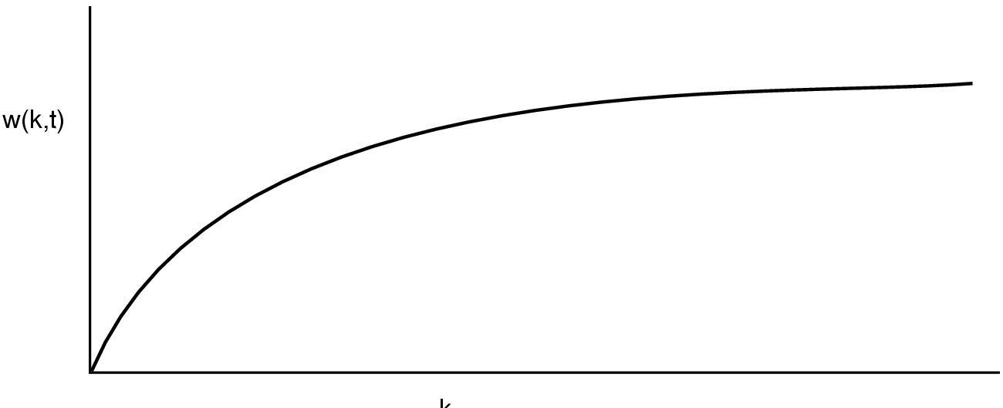
How big is the working set?
w(k,t)
k
Working set is the set of pages used by the k most recent memory references
w(k,t) is the size of the working set at time t
Working set may change over time
Size of working set can change over time as well…

Slide 45
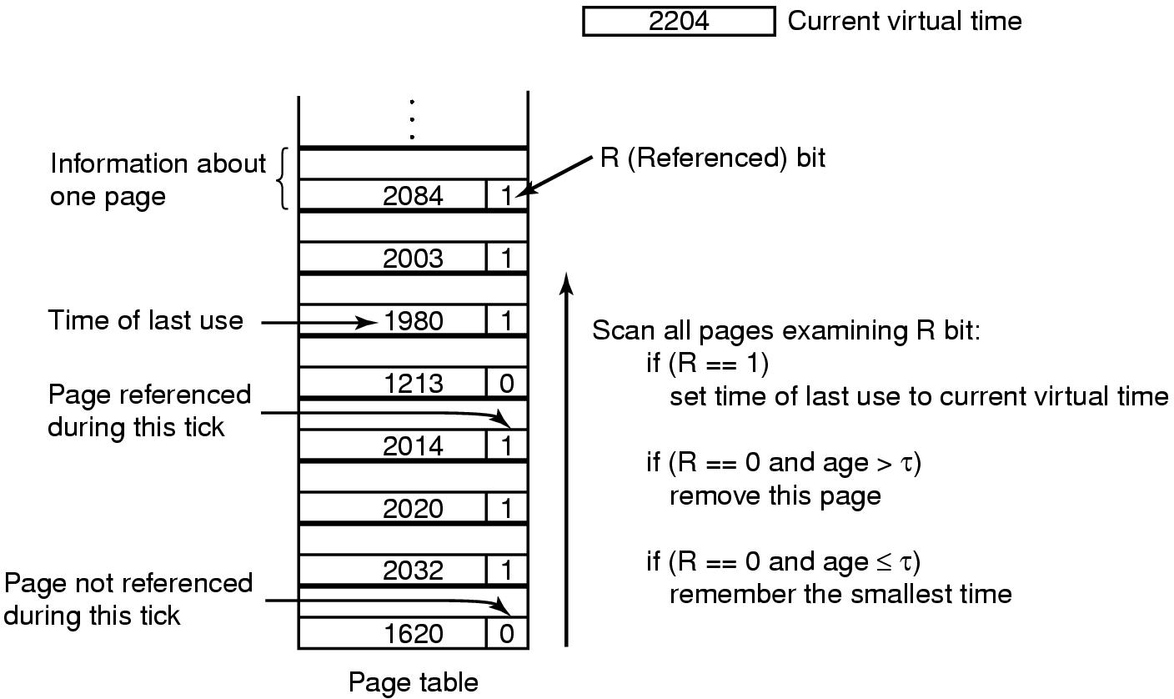
Working set page replacement algorithm

Slide 46
Page replacement algorithms: summary
Algorithm | Comment
OPT (Optimal) | Not implementable, but useful as a benchmark
NRU (Not Recently Used) | Crude
FIFO (First-In, First Out) | Might throw out useful pages
Second chance | Big improvement over FIFO
Clock | Better implementation of second chance
LRU (Least Recently Used) | Excellent, but hard to implement exactly
NFU (Not Frequently Used) | Poor approximation to LRU
Aging | Good approximation to LRU, efficient to implement
Working Set | Somewhat expensive to implement
WSClock | Implementable version of Working Set

Slide 47
Modeling page replacement algorithms
Goal: provide quantitative analysis (or simulation) showing which algorithms do better
Workload (page reference string) is important: different strings may favor different algorithms
Show tradeoffs between algorithms
Compare algorithms to one another
Model parameters within an algorithm
Number of available physical pages
Number of bits for aging

Slide 48
How is modeling done?
Generate a list of references
Artificial (made up)
Trace a real workload (set of processes)
Use an array (or other structure) to track the pages in physical memory at any given time
May keep other information per page to help simulate the algorithm (modification time, time when paged in, etc.)
Run through references, applying the replacement algorithm
Example: FIFO replacement on reference string 0 1 2 3 0 1 4 0 1 2 3 4
Page replacements highlighted in yellow
Page referenced |  | 0 | 1 | 2 | 3 | 0 | 1 | 4 | 0 | 1 | 2 | 3 | 4
Youngest page |  | 0 | 1 | 2 | 3 | 0 | 1 | 4 | 4 | 4 | 2 | 3 | 3
 |  |  | 0 | 1 | 2 | 3 | 0 | 1 | 1 | 1 | 4 | 2 | 2
Oldest page |  |  |  | 0 | 1 | 2 | 3 | 0 | 0 | 0 | 1 | 4 | 4

Slide 49
Belady’s anomaly
Reduce the number of page faults by supplying more memory
Use previous reference string and FIFO algorithm
Add another page to physical memory (total 4 pages)
More page faults (10 vs. 9), not fewer!
This is called Belady’s anomaly
Adding more pages shouldn’t result in worse performance!
Motivated the study of paging algorithms
Page referenced |  | 0 | 1 | 2 | 3 | 0 | 1 | 4 | 0 | 1 | 2 | 3 | 4
Youngest page |  | 0 | 1 | 2 | 3 | 3 | 3 | 4 | 0 | 1 | 2 | 3 | 4
 |  |  | 0 | 1 | 2 | 2 | 2 | 3 | 4 | 0 | 1 | 2 | 3
 |  |  |  | 0 | 1 | 1 | 1 | 2 | 3 | 4 | 0 | 1 | 2
Oldest page |  |  |  |  | 0 | 0 | 0 | 1 | 2 | 3 | 4 | 0 | 1

Slide 50
Modeling more replacement algorithms
Paging system characterized by:
Reference string of executing process
Page replacement algorithm
Number of page frames available in physical memory (m)
Model this by keeping track of all n pages referenced in array M
Top part of M has m pages in memory
Bottom part of M has n-m pages stored on disk
Page replacement occurs when page moves from top to bottom
Top and bottom parts may be rearranged without causing movement between memory and disk

Slide 51
Example: LRU
Model LRU replacement with
8 unique references in the reference string
4 pages of physical memory
Array state over time shown below
LRU treats list of pages like a stack
 | 0 | 2 | 1 | 3 | 5 | 4 | 6 | 3 | 7 | 4 | 7 | 3 | 3 | 5 | 5 | 3 | 1 | 1 | 1 | 7 | 1 | 3 | 4 | 1
 | 0 | 2 | 1 | 3 | 5 | 4 | 6 | 3 | 7 | 4 | 7 | 3 | 3 | 5 | 5 | 3 | 1 | 1 | 1 | 7 | 1 | 3 | 4 | 1
 |  | 0 | 2 | 1 | 3 | 5 | 4 | 6 | 3 | 7 | 4 | 7 | 7 | 3 | 3 | 5 | 3 | 3 | 3 | 1 | 7 | 1 | 3 | 4
 |  |  | 0 | 2 | 1 | 3 | 5 | 4 | 6 | 3 | 3 | 4 | 4 | 7 | 7 | 7 | 5 | 5 | 5 | 3 | 3 | 7 | 1 | 3
 |  |  |  | 0 | 2 | 1 | 3 | 5 | 4 | 6 | 6 | 6 | 6 | 4 | 4 | 4 | 7 | 7 | 7 | 5 | 5 | 5 | 7 | 7
 |  |  |  |  | 0 | 2 | 1 | 1 | 5 | 5 | 5 | 5 | 5 | 6 | 6 | 6 | 4 | 4 | 4 | 4 | 4 | 4 | 5 | 5
 |  |  |  |  |  | 0 | 2 | 2 | 1 | 1 | 1 | 1 | 1 | 1 | 1 | 1 | 6 | 6 | 6 | 6 | 6 | 6 | 6 | 6
 |  |  |  |  |  |  | 0 | 0 | 2 | 2 | 2 | 2 | 2 | 2 | 2 | 2 | 2 | 2 | 2 | 2 | 2 | 2 | 2 | 2
 |  |  |  |  |  |  |  |  | 0 | 0 | 0 | 0 | 0 | 0 | 0 | 0 | 0 | 0 | 0 | 0 | 0 | 0 | 0 | 0

Slide 52
Stack algorithms
LRU is an example of a stack algorithm
For stack algorithms
Any page in memory with m physical pages is also in memory with m+1 physical pages
Increasing memory size is guaranteed to reduce (or at least not increase) the number of page faults
Stack algorithms do not suffer from Belady’s anomaly
Distance of a reference == position of the page in the stack before the reference was made
Distance is ∞ if no reference had been made before
Distance depends on reference string and paging algorithm: might be different for LRU and optimal (both stack algorithms)

Slide 53
Predicting page fault rates using distance
Distance can be used to predict page fault rates
Make a single pass over the reference string to generate the distance string on-the-fly
Keep an array of counts
Entry j counts the number of times distance j occurs in the distance string
The number of page faults for a memory of size m is the sum of the counts for j>m
This can be done in a single pass!
Makes for fast simulations of page replacement algorithms
This is why virtual memory theorists like stack algorithms!

Slide 54
Local vs. global allocation policies
What is the pool of pages eligible to be replaced?
Pages belonging to the process needing a new page
All pages in the system
Local allocation: replace a page from this process
May be more “fair”: penalize processes that replace many pages
Can lead to poor performance: some processes need more pages than others
Global allocation: replace a page from any process
Last access time
Page
A0
14
A1
12
Local allocation
A2
8
A3
A4
5
A4
B0
10
B1
9
Global allocation
B2
A4
3
C0
16
C1
12
C2
8
C3
5
C4
4

Slide 55
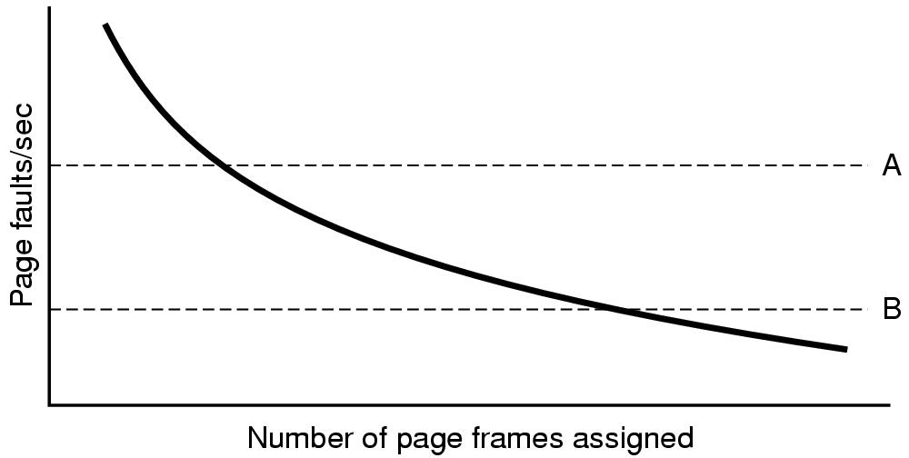
Page fault rate vs. allocated frames
Local allocation may be more “fair”
Don’t penalize other processes for high page fault rate
Global allocation is better for overall system performance
Take page frames from processes that don’t need them as much
Reduce the overall page fault rate (even though rate for a single process may go up)

Slide 56
Control overall page fault rate
Despite good designs, system may still thrash
Most (or all) processes have high page fault rate
Some processes need more memory, …
but no processes need less memory (and could give some up)
Problem: no way to reduce page fault rate
Solution : Reduce number of processes competing for memory
Swap one or more to disk, divide up pages they held
Reconsider degree of multiprogramming

Slide 57
How big should a page be?
Smaller pages have advantages
Less internal fragmentation
Better fit for various data structures, code sections
Less unused physical memory (some pages have 20 useful bytes and the rest isn’t needed currently)
Larger pages are better because
Less overhead to keep track of them
Smaller page tables
TLB can point to more memory (same number of pages, but more memory per page)
Faster paging algorithms (fewer table entries to look through)
More efficient to transfer larger pages to and from disk

Slide 58
Separate I & D address spaces
One user address space for both data & code
Simpler
Code/data separation harder to enforce
More address space?
One address space for data, another for code
Code & data separated
More complex in hardware
Less flexible
CPU must handle instructions & data differently
Instructions
Data
2³²-1
Data
Data
Code
Code
0

Slide 59
Sharing pages
Processes can share pages
Entries in page tables point to the same physical page frame
Easier to do with code: no problems with modification
Virtual addresses in different processes can be…
The same: easier to exchange pointers, keep data structures consistent
Different: may be easier to actually implement
Not a problem if there are only a few shared regions
Can be very difficult if many processes share regions with each other

Slide 60
When are dirty pages written to disk?
On demand (when they’re replaced)
Fewest writes to disk
Slower: replacement takes twice as long (must wait for disk write and disk read)
Periodically (in the background)
Background process scans through page tables, writes out dirty pages that are pretty old
Background process also keeps a list of pages ready for replacement
Page faults handled faster: no need to find space on demand
Cleaner may use the same structures discussed earlier (clock, etc.)

Slide 61
Implementation issues
Four times when OS involved with paging
Process creation
Determine program size
Create page table
During process execution
Reset the MMU for new process
Flush the TLB (or reload it from saved state)
Page fault time
Determine virtual address causing fault
Swap target page out, needed page in
Process termination time
Release page table
Return pages to the free pool

Slide 62
How is a page fault handled?
Hardware causes a page fault
General registers saved (as on every exception)
OS determines which virtual page needed
Actual fault address in a special register
Address of faulting instruction in register
Page fault was in fetching instruction, or
Page fault was in fetching operands for instruction
OS must figure out which…
OS checks validity of address
Process killed if address was illegal
OS finds a place to put new page frame
If frame selected for replacement is dirty, write it out to disk
OS requests the new page from disk
Page tables updated
Faulting instruction backed up so it can be restarted
Faulting process scheduled
Registers restored
Program continues

Slide 63
Backing up an instruction
Problem: page fault happens in the middle of instruction execution
Some changes may have already happened
Others may be waiting for VM to be fixed
Solution: undo all of the changes made by the instruction
Restart instruction from the beginning
This is easier on some architectures than others
Example: LW R1, 12(R2)
Page fault in fetching instruction: nothing to undo
Page fault in getting value at 12(R2): restart instruction
Example: ADD (Rd)+,(Rs1)+,(Rs2)+
Page fault in writing to (Rd): may have to undo an awful lot…

Slide 64
Locking pages in memory
Virtual memory and I/O occasionally interact
P1 issues call for read from device into buffer
While it’s waiting for I/O, P2 runs
P2 has a page fault
P1’s I/O buffer might be chosen to be paged out
This can create a problem because an I/O device is going to write to the buffer on P1’s behalf
Solution: allow some pages to be locked into memory
Locked pages are immune from being replaced
Pages only stay locked for (relatively) short periods

Slide 65
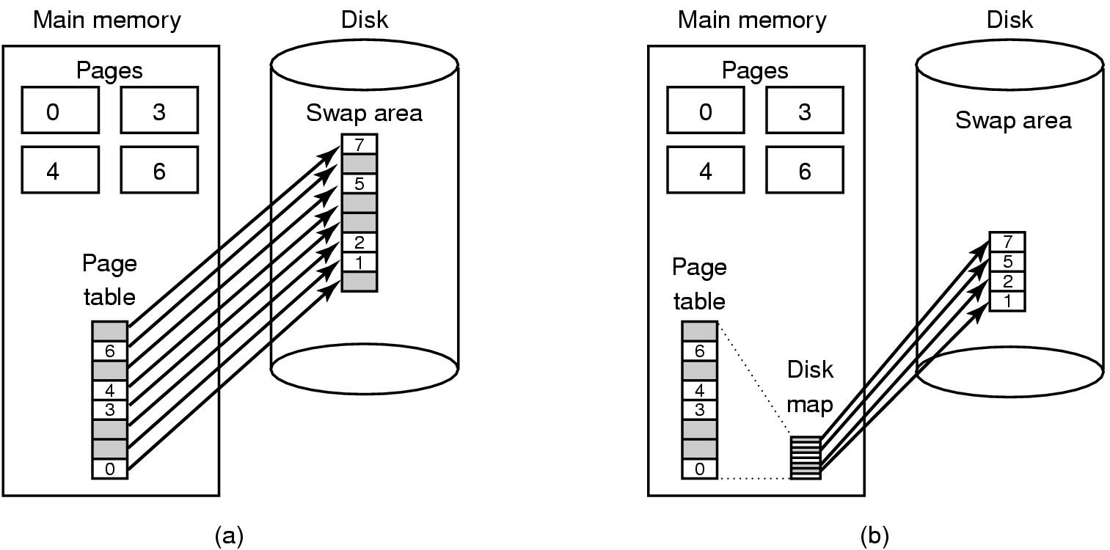
Storing pages on disk
Pages removed from memory are stored on disk
Where are they placed?
Static swap area: easier to code, less flexible
Dynamically allocated space: more flexible, harder to locate a page
Dynamic placement often uses a special file (managed by the file system) to hold pages
Need to keep track of which pages are where within the on-disk storage

Slide 66
Separating policy and mechanism
Mechanism for page replacement has to be in kernel
Modifying page tables
Reading and writing page table entries
Policy for deciding which pages to replace could be in user space
More flexibility
3. Request page
User process
External pager
4. Page arrives
User space
2. Page needed
5. Here is page!
Kernel space
Fault handler
MMU handler
1. Page fault
6. Map in page

