Slide 1

Title: Efficient Load Balancing Mechanism in Software Defined Networks
Subtitle: Implementing a response time-based load balancing strategy using an OpenFlow switch. TEAM NAMES: CHALLA VISHWESHWAR--→ ES22BTECH11007 CHALLA SRIKRISHNA----→ ES22BTECH11006 BADAVATH SRIKANTH---→ ES22BTECH11004 DAVID AASHISH ---→ ES22BTECH11008 HIMANSHU -----→ ES22BTECH11016

Slide 2
Introduction to Software Defined Networks (SDN) :- Definition: Software Defined Networking (SDN) is an innovative network architecture that decouples the control plane (decision-making) from the data plane (traffic forwarding). This separation allows for centralized network control and programmability, enabling dynamic and efficient management of network resources.
Why Load Balancing in SDN?
Ensures Optimal Resource Utilization: Distributes traffic evenly across resources, maximizing throughput and energy efficiency while preventing bottlenecks.
Minimizes Response Time: Reduces queuing delays, adapts to traffic dynamically, and enhances user experience with faster processing.
Improves System Performance: Enhances scalability, fault tolerance, and ensures predictable and efficient network behavior.

Slide 3
Problem Statement
The Challenge:
Traditional load balancing techniques, like static or Round Robin approaches, may result in uneven traffic distribution across servers or network paths.
This can lead to overloaded servers, longer response times, and degraded performance for users.
Such mechanisms often fail to adapt to real-time network conditions, making them less effective in dynamic environments.
The Goal:
Develop an efficient load balancing mechanism that dynamically allocates traffic based on the response time of servers or paths.
Leverage OpenFlow-enabled SDN to achieve centralized control and real-time monitoring for effective traffic management.
Ensure optimal resource utilization, reduced latency, and improved overall system performance.

Slide 4
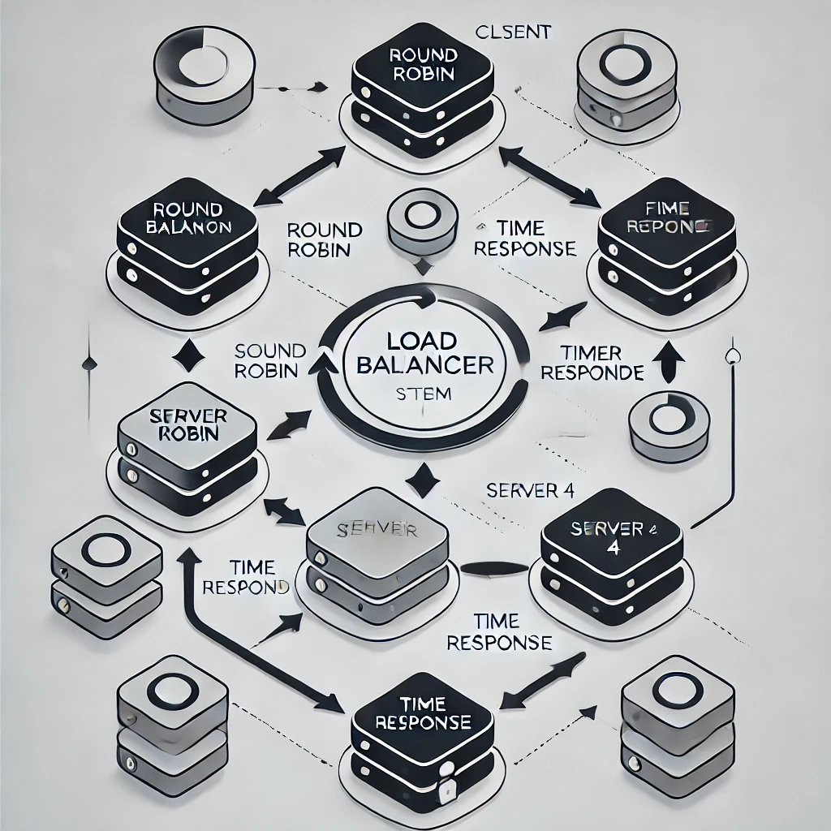
System Block Diagram:
The image shows a system architecture diagram divided into multiple layers:
Server Layer: Contains multiple servers (Server 1 to Server 4) connected to a shared Database/Cache.
SDN Layer: Includes an SDN Controller connected to two SDN Switches.
Authentication Layer: Features an Authentication Service interacting with client devices.
Client Layer: Represents Client Devices that interact with the system.
Load Balancer Layer: Includes two Load Balancers (LB1 and LB2) managing traffic distribution.
Monitoring & Logging Layer: Tracks and logs system performance and issues.
Error Handling: Connects the Load Balancer and Client Layer for retries.

Slide 5

Pseudocode:
CLASS MemoryEntry:
- Stores flow details (IP, ports, server, timestamp)
- Has a method to check expiration based on timeout
- Allows refreshing the flow's timestamp when it's accessed
CLASS ResponseTimeLoadBalancer:
- Initialize with a service IP and list of servers
- Maintain server states (alive, response time)
- Store a mapping of flows to their respective servers
- Periodically probe servers for their response time and availability
FUNCTION _do_probe():
- For each server:
- Send probe packet (e.g., ARP or ping) to check if the server is alive
- Measure the server's response time (time between sending probe and receiving response)
- Store response time and mark server as alive or down based on response

Slide 6
pseudocode
FUNCTION _pick_server():
- Sort the list of servers by response time (lowest first)
- If multiple servers are available, select the one with the best (lowest) response time
- If response times are similar, use round-robin to distribute load
FUNCTION _handle_PacketIn(event):
- If the incoming packet is for the service IP:
- Check if the flow (client, destination, ports) is already in memory:
- If yes, direct the packet to the previously assigned server
- Refresh the flow entry timestamp
- If no, pick the best server based on response time:
- Use `_pick_server` to select the server with the lowest response time
FUNCTION _do_expire():
- Check for expired flow entries:
- If the timestamp is older than the timeout period, remove the flow from memory
- Ensure the flow is reinstalled when needed
MAIN FUNCTION (launch):
- Initialize list of servers and set their initial status (alive or down)
- Continuously probe servers for response time updates
- Register with the OpenFlow controller to handle packet-in events

Slide 7
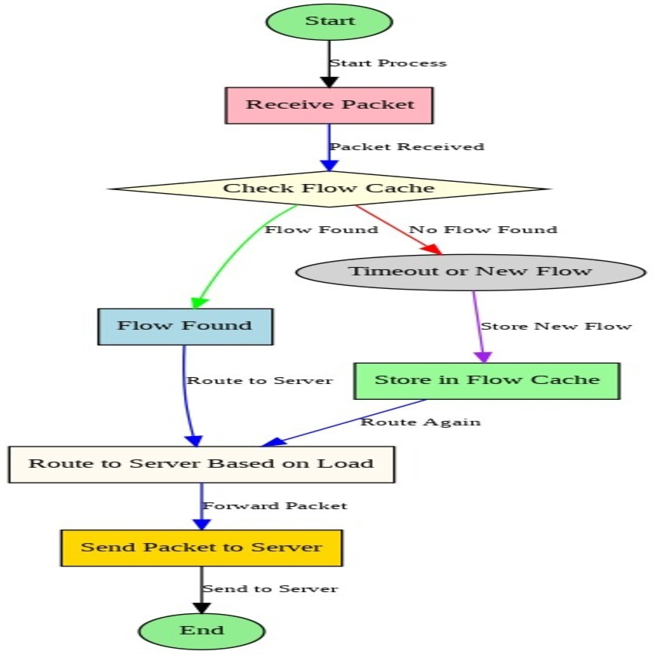
Flow Chart
Start: The process begins.
Receive Packet: A packet is received for processing.
Check Flow Cache: Determines if the packet belongs to an existing flow.
Flow Found: Packet is routed to a server based on load.
Timeout/New Flow: If no flow is found or it times out:
Store in Flow Cache: Saves the new flow in the cache.
Route Again: Routes the packet based on load.
Route to Server Based on Load: Selects a server dynamically.
Send Packet to Server: The packet is forwarded to the selected server.
End: The process completes.

Slide 8
Implementation Details
Environment Setup :
Required Libraries and Packages:
Python 3.10+
Mininet
Xterm
Requests (Python library) in virtual environment
Setup Steps:
Change to the project directory.
Open Mininet with the command for a single switch and 6 hosts.
Open three nodes (h1, h2, h3) using Xterm.
In nodes h1 and h2, activate Python virtual environment.
In h1 and h2, start server simulations with the respective scripts.
Servers run on 10.0.0.1 (h1) and 10.0.0.2 (h2).
Start the load balancer with sudo access and the load balancer's name.
For response time load balancer, provide average response time when prompted.
Send requests to the load balancer from nodes h3, h4, h5 using tools like curl.

Slide 9

Algorithms Implementation
Default Load Balancer Code:
Found in {R}/project/pox/pox/misc as ip_loadbalancer.py.
Default algorithm is random load balancing.
For other algorithms, modify the _pick_server method and adjust class variables in the iplb class.
Load Balancer Variants:
load_balancer_resp_time
load_balancer_round_robin
load_balancer_random
Response Time Load Balancer Algorithm:
Uses a weighted round-robin method based on response times.
Servers with lower response times get more weight.
For two servers with response times
Weight for server 1
Requests are distributed in a round-robin manner using the calculated weights

Slide 10
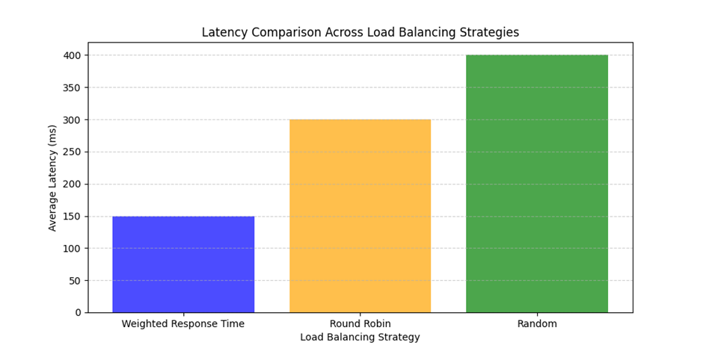
Evaluation
Metrics:
Average response time.
Server utilization.
Throughput.
Results Comparison:
Round-Robin vs. Response-Time-Based
Strategy Average Latency (in ms)
Response time 150
Round Robin 300
Random 400
Strategy Throughput (requests/second)
Response time 60
Round Robin 40
Random 35

