Slide 1
Sensor-Based Human Activity Classification using PIRvision Dataset
Team members Challa Vishweshwar Reddy ES22BTECH11007 Sreehith Sanam ES22BTECH11033 Lakkimsetti Ramanuja ES22BTECH11022

Slide 2
Problem Statement
Goal:
Develop a classification model to predict human activity based on PIR sensor data.
Dataset:
PIRvision FoG Presence Detection dataset (4 seconds of PIR sensor readings per sample).
Objective:
Build a robust model using 5-fold cross-validation and report mean accuracy and standard deviation.

Slide 3
Dataset Overview
Data collected using:
Low-Energy Electronically-chopped Passive Infra-Red (PIR) sensors.
Environments:
Residential and Office.
No of samples :
15302
Each sample:
Date (1st element): Date of observation
Time (2nd element): Time of observation
Label (3rd element): Activity label
Temperature (4th element): Ambient temperature in Fahrenheit
PIR Values (elements 5-59): 55 raw analog sensor readings collected over 4 seconds
Class Labels
0: Vacancy
1: Stationary human presence
3: Other activity/motion No missing values in the dataset

Slide 4
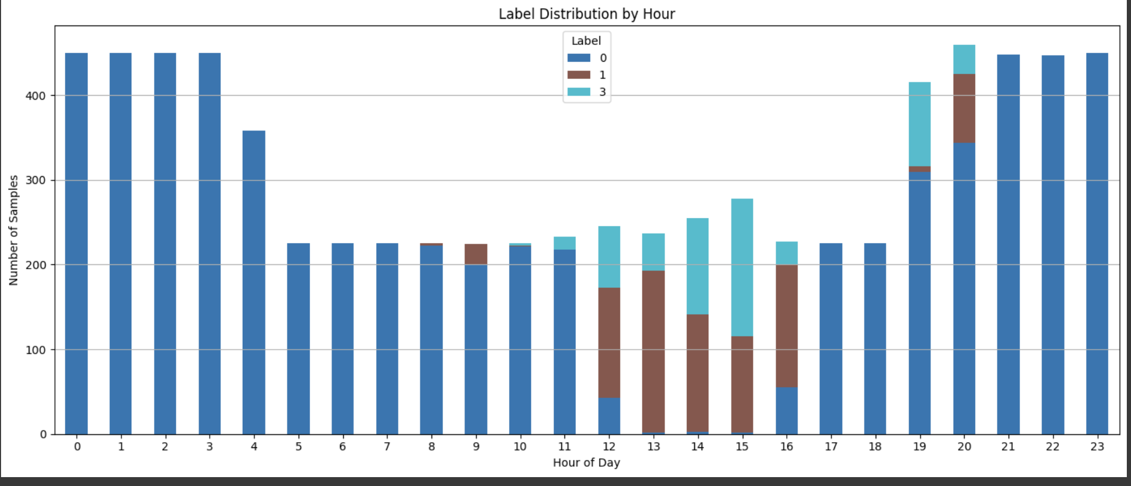

Slide 5
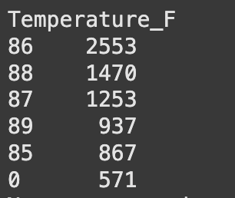
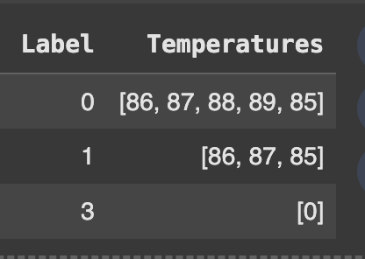
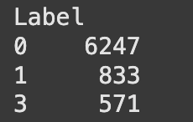
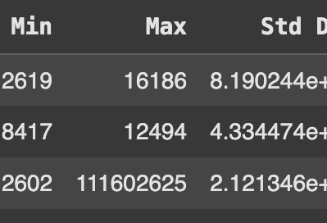
Some observations

Slide 6
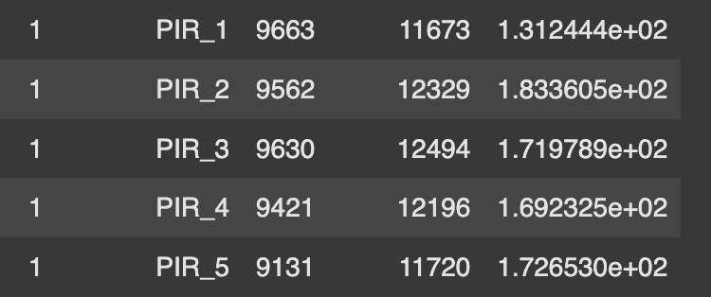
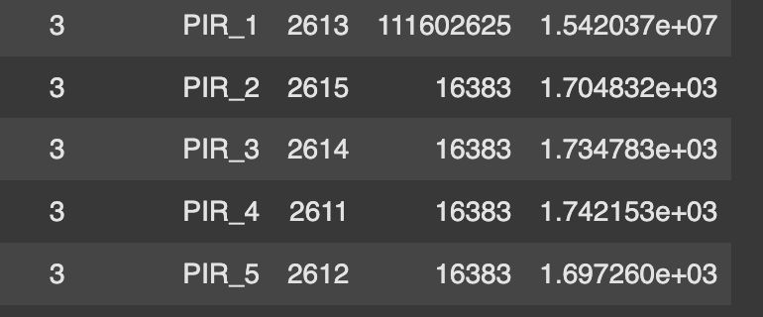
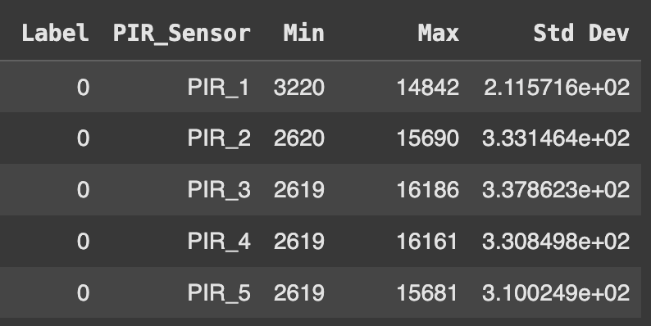
[label,PIR_Sensor,Min,Max,standard deviation]

Slide 7
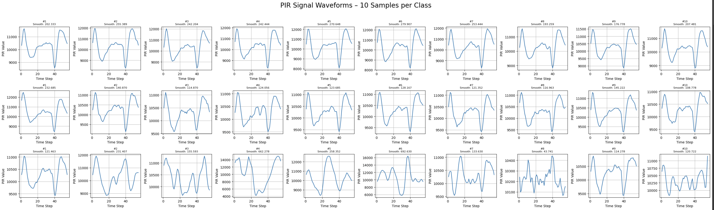
PIR Signal Waveforms

Slide 8
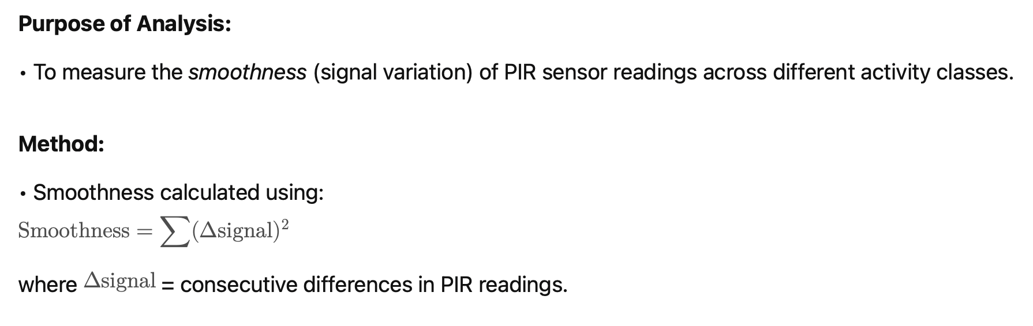
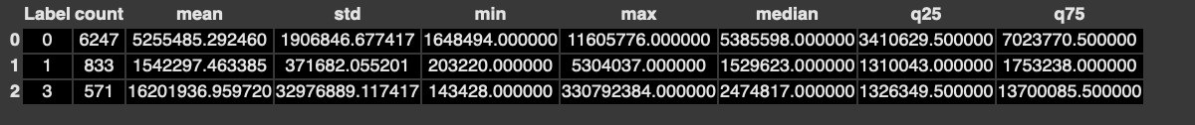
Smoothness Analysis of PIR Signals (Excluding PIR_1)
Key Observations:
Class 0 (probably “No activity / Presence”) has a moderate mean smoothness (~5.25 million) with low variance.
Class 1 (probably “Activity detected”) shows much lower smoothness (~1.54 million), suggesting more stable PIR signals during occupancy.
Class 3 shows extremely high mean smoothness (~16.2 million) and very high variance, indicating erratic signal changes — possibly noisy or complex activity patterns.

Slide 9
Data Preprocessing
Label Correction:
The dataset originally had activity labels: 0, 1, and 3.
To maintain a logical numerical sequence for classification, we reassigned label 3 to 2.
This relabeling ensures better handling during model training and reduces the risk of confusion when interpreting results.
Treatment of Date and Time:
Although ‘Date’ and ‘Time’ were available in the dataset, they were excluded from model training.
Rationale:
➔ Using timestamps could lead the model to memorize patterns related to specific times instead of genuinely learning activity behavior.
By removing them, we aimed to improve the generalization ability of the model during testing.

Slide 10
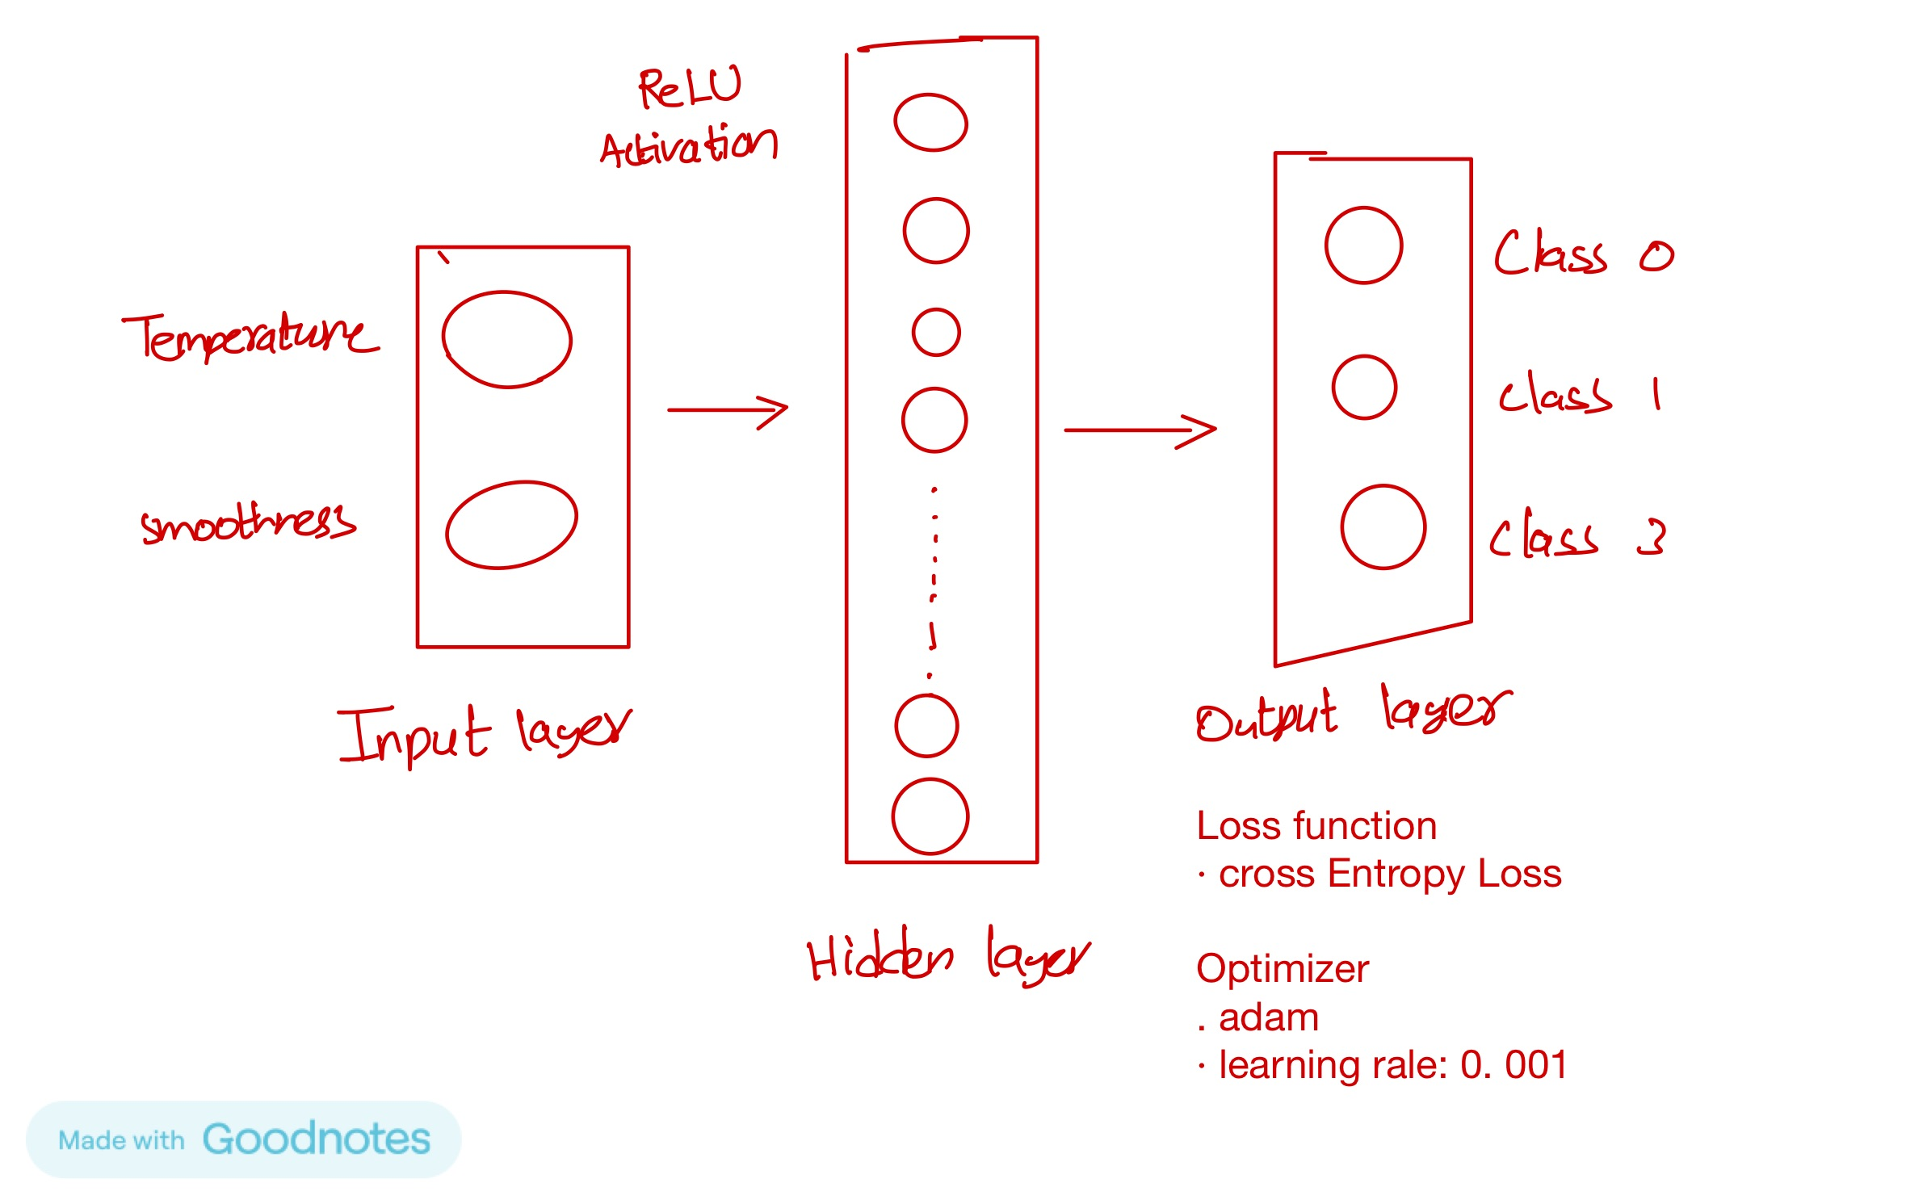
Designing Simple model

Slide 11
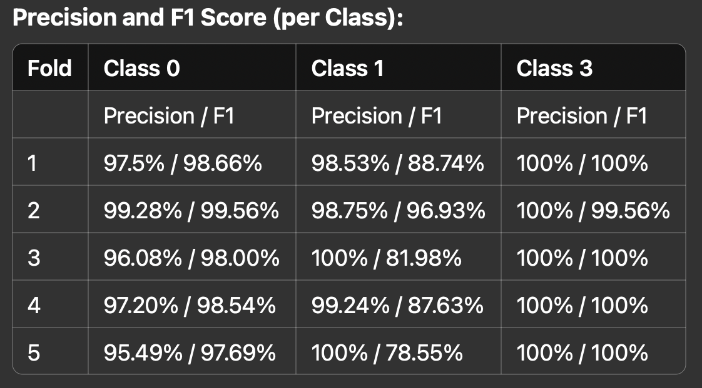
Results from simple NN
5-Fold Cross-Validation Results
Accuracy (per fold):
Fold 1: 97.78%
Fold 2: 99.28%
Fold 3: 96.67%
Fold 4: 97.58%
Fold 5: 96.14%

Slide 12
Feature Scaling:
Standardized both the PIR sensor readings and the ambient temperature feature using StandardScaler.
Scaling helps in giving equal importance to all features by bringing them to a common range (zero mean, unit variance).
This step is especially important for models sensitive to feature magnitudes, such as neural networks.

Slide 13
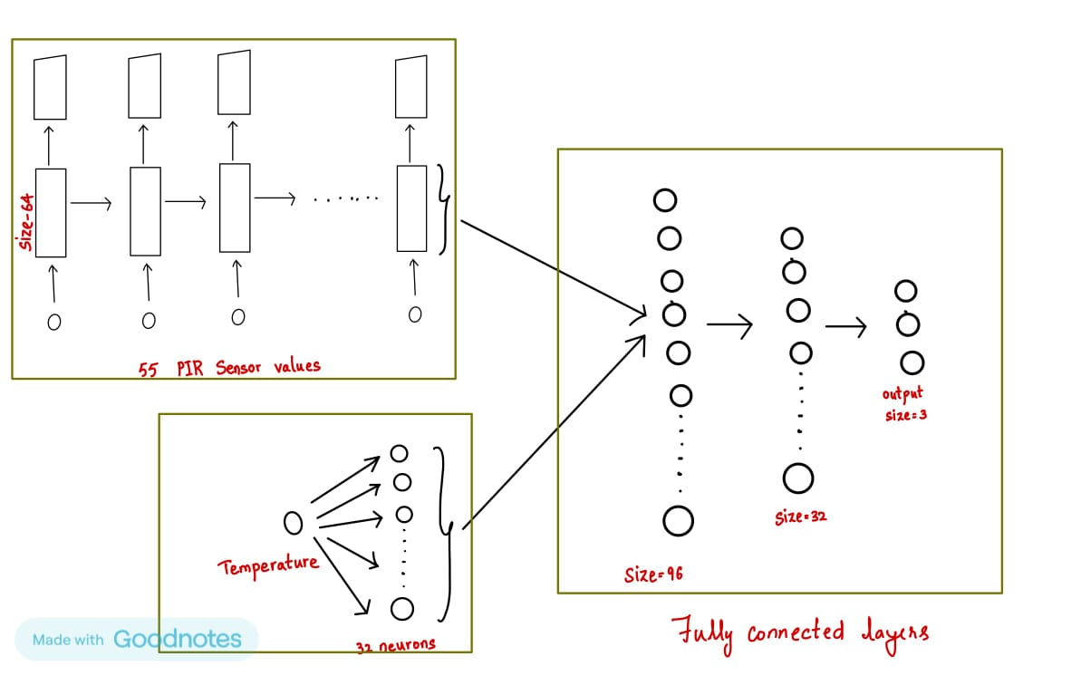
Model Architecture
Used LSTM to process a 55-step PIR sensor sequence where the hidden dimension is 64.
The LSTM’s final hidden state (64-dimensional) captures the full 4-second activity waveform.
A fully connected layer (Linear(1→32) + ReLU) transforms the scalar temperature into a 32-dimensional feature vector.
Concatenates the 64-dim LSTM output with the 32-dim temperature embedding into a unified 96-dim vector.

Slide 14
Imbalanced Dataset
SMOTE: Despite synthetically oversampling the minority class using SMOTE the model's overall performance remained largely unchanged.
Experimented with weighting each class inversely to its frequency in the cross-entropy loss to penalize misclassification of underrepresented classes more heavily.
The performance in both the cases remained largely unchanged.

Slide 15

Weights Initialization and Hyperparameters
To keep the scale of activations and gradients roughly the same across layers at the start of training.
Xavier init draws each weight w uniformly from
This helps avoid vanishing/exploding gradients early on.
Best possible Hyperparameters are chosen using GridsearchCV

Slide 16
Training and Validation
Using 5-fold stratified sampling to ensure each fold maintains the same class distribution.
The code first splits the combined PIR‐and‐temperature feature matrix and corresponding labels into a training set and a validation set, then reshapes the PIR readings into (batch, 55, 1) sequences and isolates the temperature into (batch, 1) vectors.
An instance of the PIRvisionLSTM model is created and initialized with Xavier weights, and an Adam optimizer plus cross‐entropy loss are set up.

Slide 17

Continued...
For a fixed number of epochs, the model alternates between
Training mode: where it shuffles the training examples, processes them in mini‐batches (forward pass → loss → backward pass → optimizer step), accumulates batch losses and correct predictions to compute the epoch’s training loss and accuracy.
Evaluation mode: where dropout and batch‐norm are disabled and gradients are turned off to compute the validation loss and accuracy on the entire held‐out fold.
After each epoch these metrics are stored and printed, and once all epochs finish, the final validation predictions are extracted to compute and record the fold’s confusion matrix and detailed classification scores.

Slide 18
Future Improvements
Architectural Refinements:
Bidirectional LSTMs: To capture dependencies from both past and future contexts, potentially crucial for understanding the flow of an activity. This would involve modifying the PIRvisionLSTM class and adapting the feature fusion.
Attention Mechanism: To weigh the importance of different PIR readings dynamically. This could help the model focus on the most salient parts of the 4-second window.
Investigate hybrid models (e.g., CNN-LSTM-Attention).

Slide 19

Future Improvements Continued...
Explore Data Augmentation by adding noise to the data or by shifting the data slightly which makes the model more generalized.
1
Use automated hyperparameter tuning tools like Optuna.
2
Introduce more informative temporal encodings (such as cyclic features like sine and cosine transformations of time variables) to better capture repeating patterns and seasonal trends.
3

Slide 20
Challenges Faced
Model Selection Complexity:
We experimented with various models including Logistic Regression, RNN, LSTM. However, some models either took too long to train or resulted in low accuracy. After evaluating performance and efficiency, we finally selected LSTM as the most suitable model.
Temporal Feature Representation:
Time-sensitive data required careful feature engineering and sequence preparation for deep models.
Overfitting Risks: Deep models were prone to overfitting

Slide 21
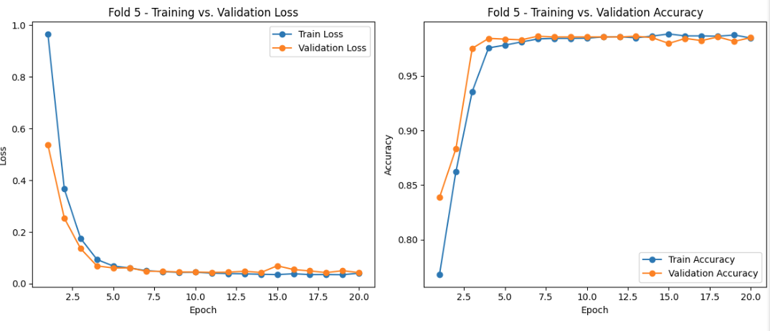
Training Performance

Slide 22
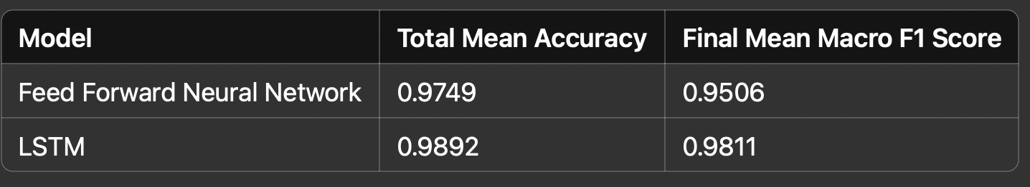
Final Model Performance
Classification Results Summary​

