Slide 1
Слайд 1 с информацией о кадрах
♫MemeSound♫

Slide 2
Слайд 1 с информацией о кадрах
♫MemeSound♫

Slide 3

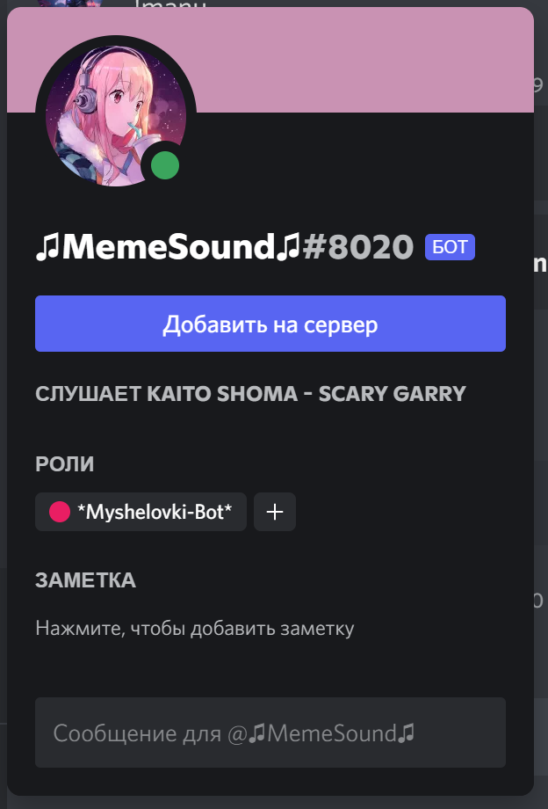
Discord bot
Воспроизведение музыки и другие функции плеера
Получение текста песен
Возможность создание и воспроизведения плейлистов

Slide 4
@commands.command(name='play', aliases=['p', 'sing', '100-7']) async def play(self, ctx, *, query): player = self.bot.music.player_manager.get(ctx.guild.id) query = query.strip('<>') if not query.startswith('http'): query = f'ytsearch:{query}' await self.add_song_to_player(query, ctx) await self.menu(ctx, add_song=True, pause=player.paused, repeat=player.repeat)

Slide 5
@commands.command(name="pl") async def user_playlist(self, ctx, *, playlist_name=None): user_id = ctx.message.author.id player = self.bot.music.player_manager.get(ctx.guild.id) if playlist_name: responce = requests.get(f"https://memesoundwebsitenew.herokuapp.com/api/{user_id}") r_json = responce.json() try: for song in r_json[playlist_name]: if song.startswith("http"): query = song else: query = f'ytsearch:{song}' await self.add_song_to_player(query, ctx, playlist_flag=True) await ctx.send("Альбом добавлен") await self.menu(ctx, add_song=True, pause=player.paused, repeat=player.repeat) except KeyError: await ctx.send("Плейлист не найден") await self.menu(ctx, add_song=True, pause=player.paused, repeat=player.repeat)

Slide 6
@commands.command(name='text', help='lyric') async def text(self, ctx): player = self.bot.music.player_manager.get(ctx.guild.id) album_flag = False album_link = "" query_result = "" def check(m): return m.author.id == ctx.author.id async with ctx.typing(): for msg in get_lyric(player.current.title): if msg.startswith("https"): album_flag = True album_link = msg else: await ctx.send(msg) if album_flag: links, titles = get_album(album_link) for n in range(len(titles)): query_result = query_result + f'{n + 1} {titles[n]}\n' embed = Embed(colour=discord.Colour(0xFF69B4), title="Выберите песню") embed.description = query_result await ctx.send(embed=embed) response = await self.bot.wait_for('message', check=check) async with ctx.typing(): for new_msg in parser_lyric(links[int(response.content) - 1]): await ctx.send(new_msg)

Slide 7
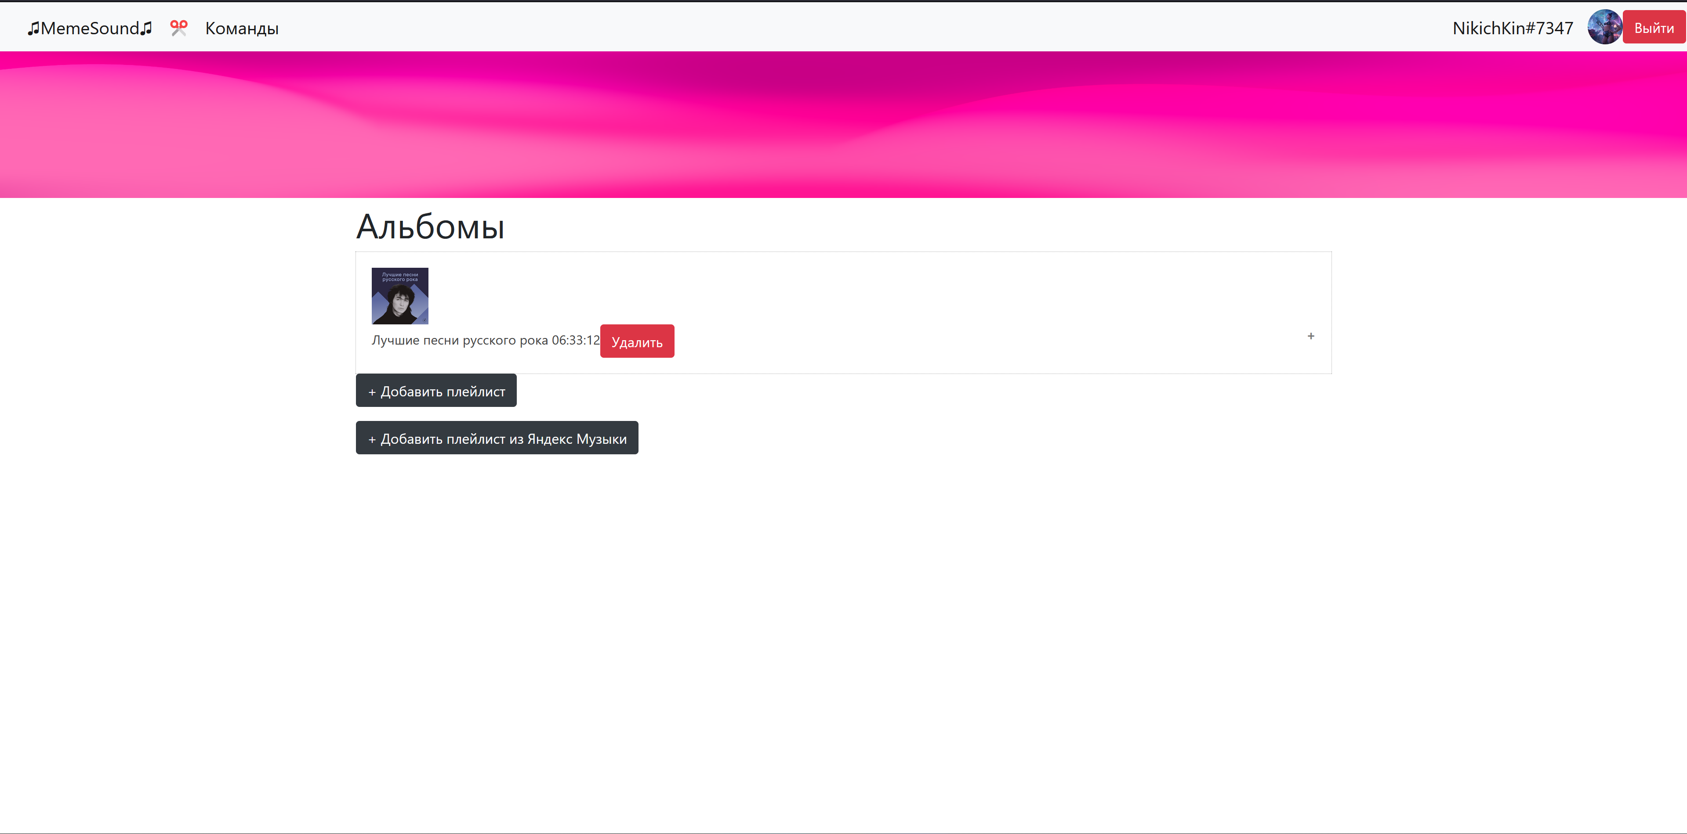
WebSite MemeSound
Создание плейлистов
Импорт плейлистов из YandexMusic
Аунтификация с дискорд аккаунтом

Slide 8
@app.route('/login') def login(): code = request.args['code'] access_token = client.oauth.get_access_token(code, REDIRECT_URL).access_token session['token'] = access_token db_sess = db_session.create_session() bearer_client = APIClient(session.get('token'), bearer=True) current_user = bearer_client.users.get_current_user() try: user = User(name=current_user.username, user_id=current_user.id) db_sess.add(user) db_sess.commit() except IntegrityError: pass return redirect('/')

Slide 9
@app.route('/add_songs/<playlist>', methods=['GET', 'POST']) def add_songs(playlist): form = AddSongForm() bearer_client = APIClient(session.get('token'), bearer=True) current_user = bearer_client.users.get_current_user() if form.validate_on_submit(): db_sess = db_session.create_session() playlist = db_sess.query(PlayList).filter(PlayList.name == playlist).first() video_length = YouTube(form.url.data).length time_ = datetime.strptime(playlist.playlist_length, "%H:%M:%S").time() playlist.playlist_length = str((datetime.combine(date.today(), time_) + timedelta(seconds=video_length)).time()) if video_length >= 3600: song = Songs(name=form.url.data, name_video=get_title(form.url.data), video_length=str(timedelta(seconds=video_length)), playlist_id=playlist.id, video_preview=get_preview(form.url.data)) db_sess.add(song) db_sess.commit() else: song = Songs(name=form.url.data, name_video=get_title(form.url.data), video_length=time.strftime("%M:%S", time.gmtime(video_length)), playlist_id=playlist.id, video_preview=get_preview(form.url.data)) db_sess.add(song) db_sess.commit() return redirect("/") return render_template('add_song.html', form=form, current_user=current_user, playlist=playlist, command=False)

Slide 10
@app.route('/api/<user_id>', methods=['GET', 'POST']) def get_playlists(user_id): db_sess = db_session.create_session() diction = {} playlists = db_sess.query(PlayList).filter(PlayList.user_id == User.id, User.user_id == user_id) for playlist in playlists: songs_lst = [] songs = db_sess.query(Songs).filter(Songs.playlist_id == playlist.id, PlayList.user_id == User.id, User.user_id == user_id) for song in songs: songs_lst.append(song.name) diction[playlist.name] = songs_lst print(diction) return jsonify(diction)

Slide 11
Слайд 1 с информацией о кадрах
♫MemeSound♫

