Slide 1


Consulting Intelligence Platform
Database Systems Engineering &
Distributed Backend Development Project
TEAM MEMBERS
2510080003
2510080018
2510080021
2510080038
2510080044
UNIVERSITY
KLH UNIVERSITY
FACULTY
Laiphangbam melinda
October 2026

Slide 2
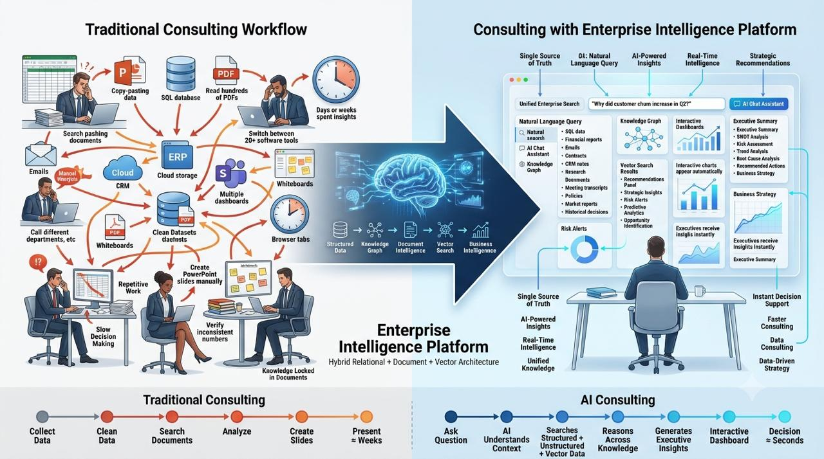

Slide 3











Introduction
CLIENTS
A unified platform for smarter consulting and evaluation
Consulting Intelligence Platform
A centralized system that connects clients, projects, knowledge, and decision support.
PROJECTS
KNOWLEDGE
Streamlines workflows for faculty and project evaluators
Enhances data-driven consulting
and evaluation
DECISION SUPPORT

Slide 4


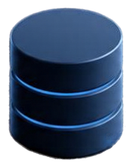
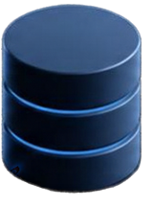




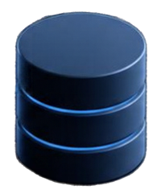

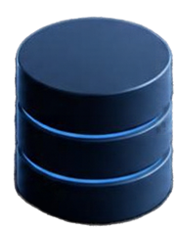
Problem Statement
Current consulting and project evaluation processes face critical challenges
Consulting professionals often need to analyse large amounts of business information stored across multiple sources, including structured databases, unstructured documents, reports, and research files. Because this information exists in different formats and locations, finding relevant information, connecting related evidence, and extracting useful business insights can be time-consuming and difficult.
The proposed Consulting Intelligence Platform aims to provide a unified interface for searching, organizing, and exploring information from these different sources. By combining keyword-based search, document discovery, structured business information, and semantic search concepts, the platform aims to reduce information discovery time and support faster, evidence-based business decision-making.

Slide 5
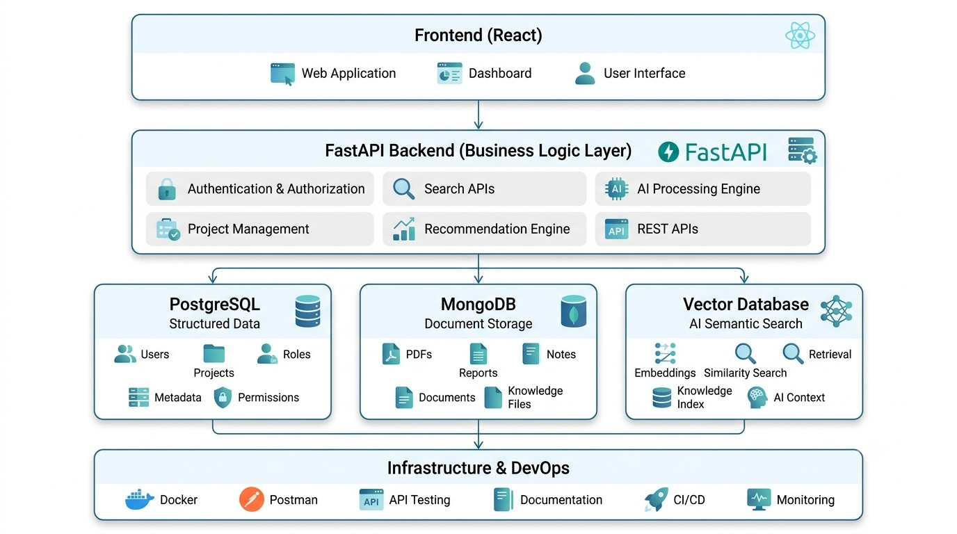

Slide 6







Objectives
01
Centralize client and project management
Facilitate knowledge sharing
and documentation
02
Provide data-driven decision support
for evaluators
03
Improve collaboration among
faculty and evaluators
04
Scalable and user-friendly
system design
05

Slide 7










Proposed System
DECISION SUPPORT
CLIENTS
PROJECTS
KNOWLEDGE
A unified platform that solves consulting challenges
One integrated interface that brings clients, projects, knowledge, and analytics together
UNIFIED INTERFACE
AUTOMATED TRACKING
Automated tracking and notifications to keep projects on schedule
KNOWLEDGE REPOSITORY
Centralized knowledge repository for instant, enterprise-wide access
ANALYTICS DASHBOARD
Analytics dashboard for data-driven insights and smarter decisions
AI-POWERED INSIGHTS
PLANNED
Planned features like AI-powered insights to unlock future value

Slide 8










System Architecture
Frontend
user interface for
faculty and evaluators
Integrated components working together to deliver intelligent consulting and evaluation
Database
stores clients, projects, knowledge, and tasks data
Knowledge
Repository
document management and search
Backend API
handles business logic and data processing
Analytics Engine
data analysis and
decision support

Slide 9











Database Design
CLIENTS
Core entities and how they connect
PROJECTS
KNOWLEDGE DOCUMENTS
Clients have many Projects
Projects assigned to Employees
Knowledge Documents linked to Projects and Clients
Tasks related to Projects
and Employees
EMPLOYEES
TASKS

Slide 10







Key Features and Technologies
Built for smarter consulting and data-driven decisions
KEY FEATURES
TECHNOLOGY STACK
Centralized client/project dashboards
Frontend: React.js or Angular
Knowledge base with search functionality
Backend: Node.js with Express or Java Spring Boot
Database: PostgreSQL or MongoDB
(depending on relational or document needs)
Task management and notifications
Analytics for project progress and decision support (planned)
Analytics: Python with Pandas/NumPy (planned)
Cloud hosting and containerization (Docker/Kubernetes planned)

Slide 11

Expected Outcomes and Future Scope
WHAT WE ACHIEVE
WHERE WE’RE HEADED
Improved efficiency in client and project handling
AI-powered consulting recommendations
Better collaboration through knowledge sharing
Advanced analytics and reporting dashboards
Mobile app for on-the-go access
Data-driven insights for
faculty and evaluators
Integration with external academic systems

Slide 12


Conclusion and Q&A
A unified platform for smarter management and stronger decision support
Built for today, evolving for tomorrow
Roadmap features will drive future impact
Thank you for your time and attention
Questions and Feedback Welcome
We welcome your questions, ideas, and suggestions.

