Slide 1
PROJECT TITLE Secure Data Hiding in Images Using Steganography
CAPSTONE PROJECT
Presented By: LIKHITHA CHINTHIRALA
Student Name : LIKHITHA
College Name & Department : BOMMA INSTITUTE OF TECHNOLOGY AND SCIENCE , CSE

Slide 2
OUTLINE
Problem Statement
Technology used
Wow factor
End users
Result
Conclusion
Git-hub Link
Future scope

Slide 3
Problem Statement
"With the rise in digital communication, securing sensitive data is crucial. Traditional encryption methods are often detectable, making them vulnerable to attacks. Steganography provides a solution by hiding data within images, ensuring confidentiality without raising suspicion. This project focuses on implementing secure data hiding using image steganography to enhance cybersecurity."

Slide 4
Technology used
, Programming Language: Python
Libraries: OpenCV, NumPy, Pillow (PIL), Stegano
Platform: VS Code
Encryption Methods: Least Significant Bit (LSB) Steganography
Image Formats: PNG, JPEG

Slide 5
Wow factors
High-Level Security – Uses advanced LSB steganography for secure data hiding. Custom Encryption – Allows optional encryption before embedding data. Invisible to Human Eye – No noticeable distortion in the image after hiding data. Multi-Format Support – Works with PNG, JPEG, and BMP images. Fast & Efficient – Optimized algorithm for quick encoding and decoding. User-Friendly Interface – Simple GUI for easy encryption and decryption. Stealth Mode – Provides an additional layer of security by disguising the data.

Slide 6
End users
Government Agencies – For secure communication and intelligence operations. Journalists & Whistleblowers – To protect sensitive information and sources. Cybersecurity Professionals – For secure data transmission and forensic applications. Business Enterprises – To safeguard confidential company data. Individuals & Privacy Enthusiasts – To keep personal data hidden from prying eyes.

Slide 7
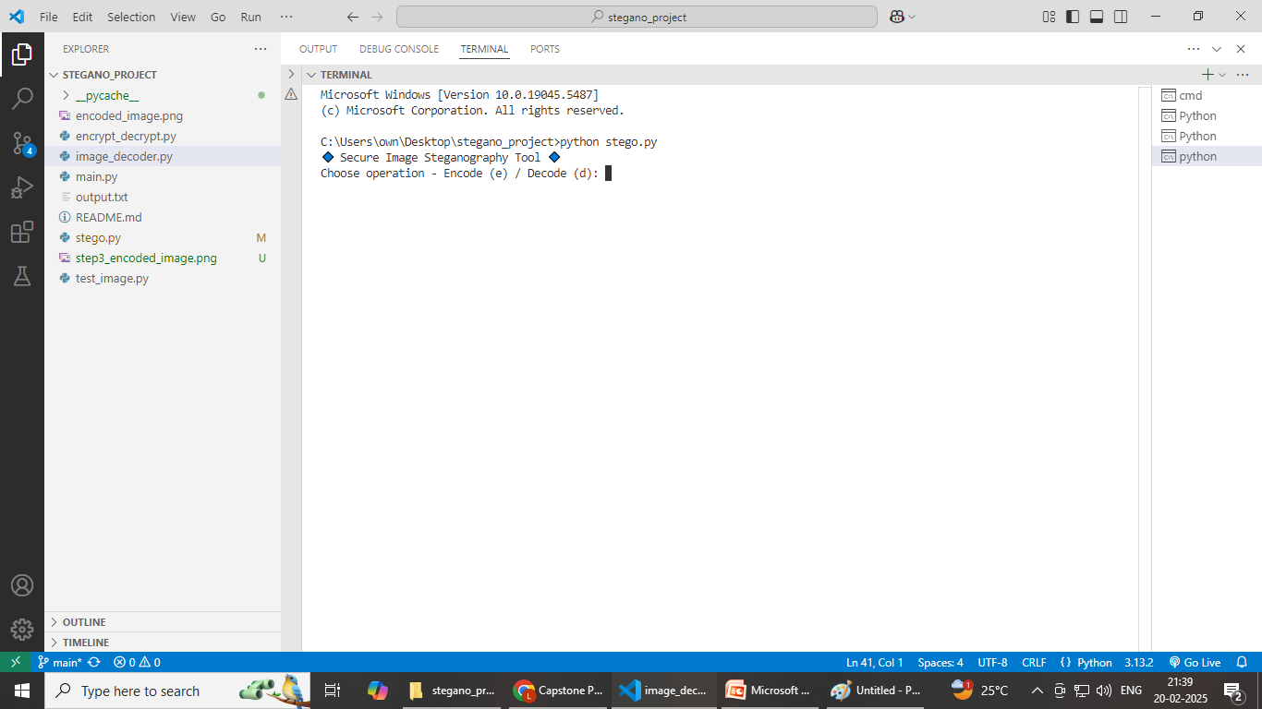
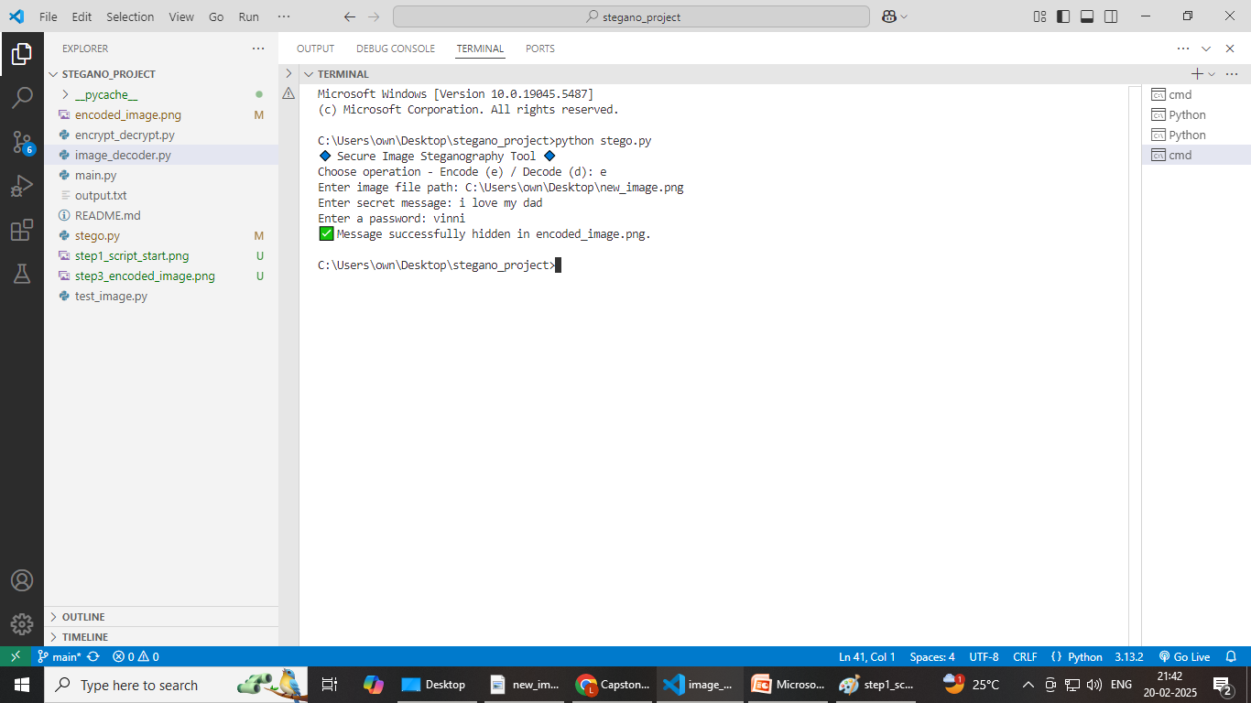
Results

Slide 8
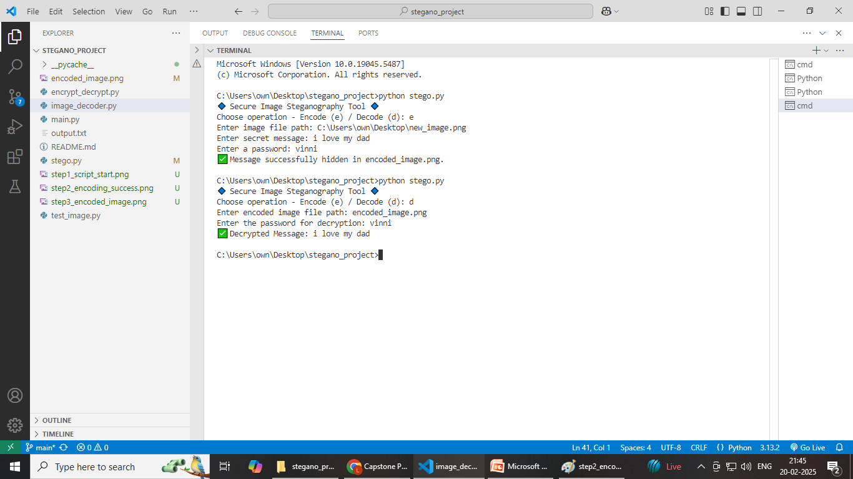

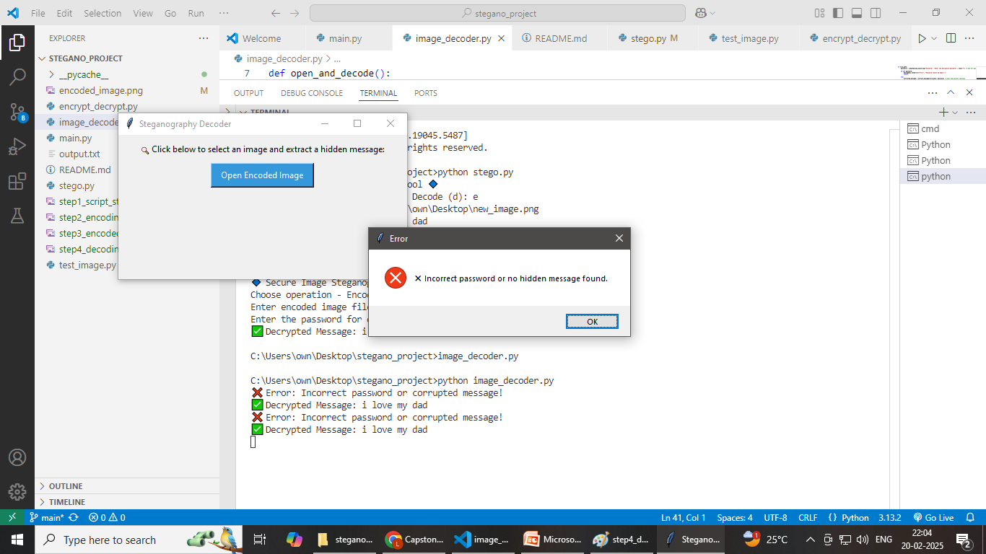

Slide 9
Conclusion
The project successfully implemented image-based steganography using Python.
It allows secure data hiding within images, making it a useful technique for confidential communication.
Future improvements could include stronger encryption for added security and higher image quality retention.

Slide 10
GitHub Link
https://github.com/vinni-905/stegano-project

Slide 11
Future scope(optional)
Improved Security: Integration of advanced encryption algorithms and multi-layer security mechanisms.
Steganography in Videos: Extending the technique to hide data in video files.
Automated Detection: Implementing methods to detect hidden messages within images.
Optimized Algorithms: Enhancing efficiency for larger files and high-resolution images

Slide 12
THANK YOU

