Slide 1



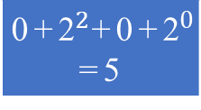



$$\text{q}$$
layer 0
entry
point
$$q−1$$
10₂
1
2
01₂
3
layer 1
4
5
6
7
9
8
00₂
11₂
11
10
nearest
centroid
$$q+1$$
layer 2
13
12
15
14
16
IVF
cells
chosen
scope
9
10
7
2
4
11
5
1
6
Text
$$\text{∨}$$
Images
3
13
14
8
12
15
16
Forward index
img0 | 3
img1 | 0
img2 | 2
img3 | 7
text0 | 6
text1 | 5
text2 | 6
text3 | 0
Neurohashing
Inverted index
0 | {img1, text3}
1 | {}
2 +1 | {img2}
3 +1 | {img0}
4 +0 | {}
5 | {text1}
6 +2 | {text0, text2}
7 | {img3}
0 | 1 | 0 | 1
k-NN
k = 4
$$\text{0}\text{+}{\text{2}}^{2}\text{+}\text{0}\text{+}{\text{2}}^{0}$$ =5

Slide 2
1
1
1
1
1
0
1
0
1
0
1
0
0
0
1
0 | 0 | 1 | 1 | 0 | 0 | 1 | 0 | 0 | 0 | 0 | 0 | 0 | 0 | 1 | 1
0 | 1 | 2 | 3 | 4 | 5 | 6 | 7 | 8 | 9 | 10 | 11 | 12 | 13 | 14 | 15

Slide 3
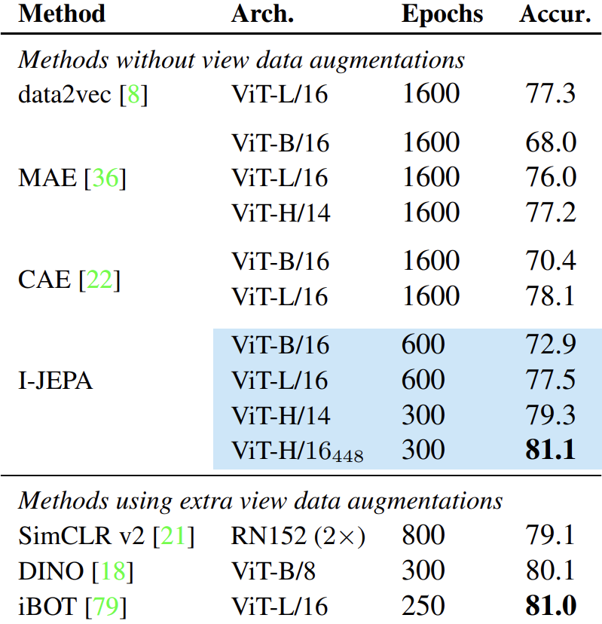
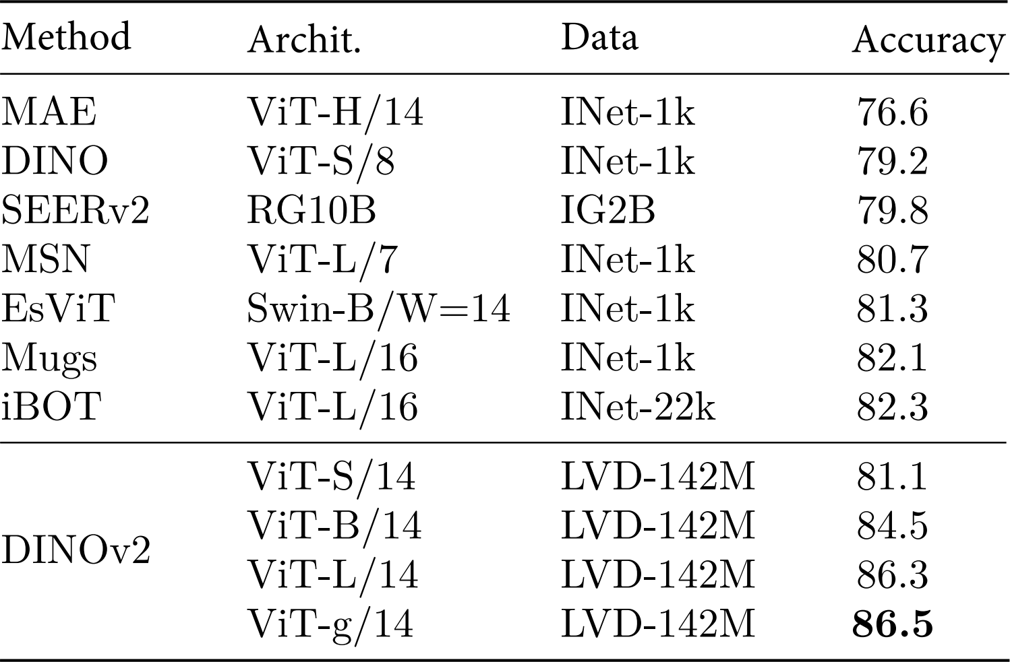
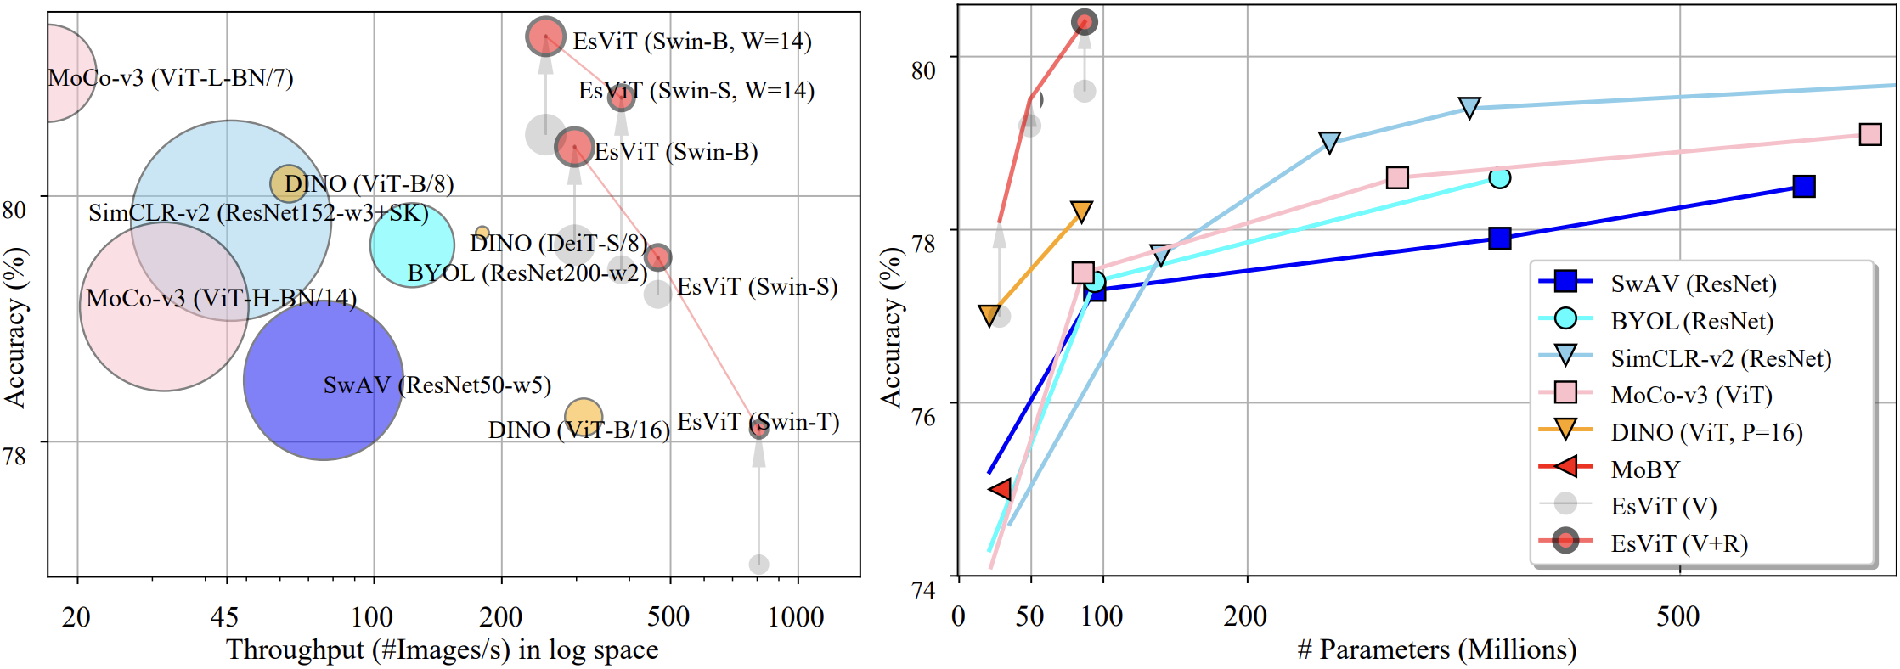

Slide 4
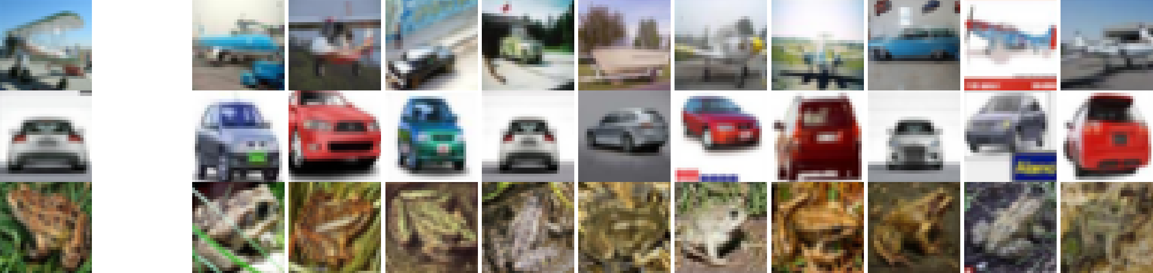
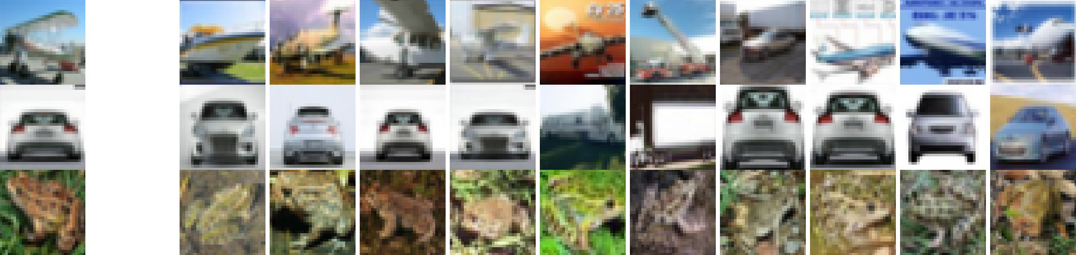
Regular CIBHash (independent bits – O(n) search complexity):
Proposed approach (decimal numbers – O(k) search complexity):

