Slide 1

Your life as you see it o o o !

Slide 2
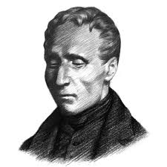

Braille : a revolution by blind
Later became a revolution for blind

Slide 3
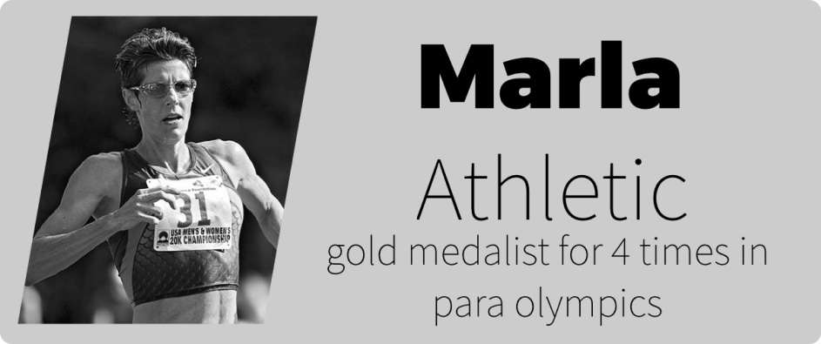
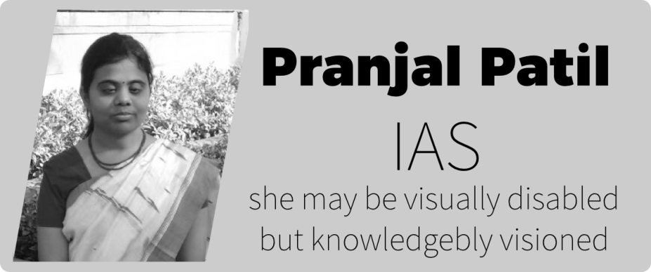
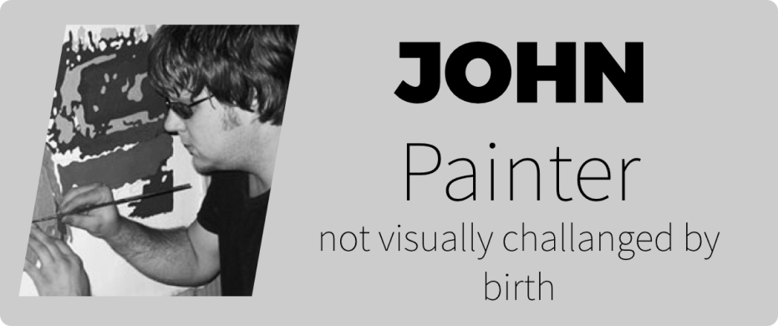
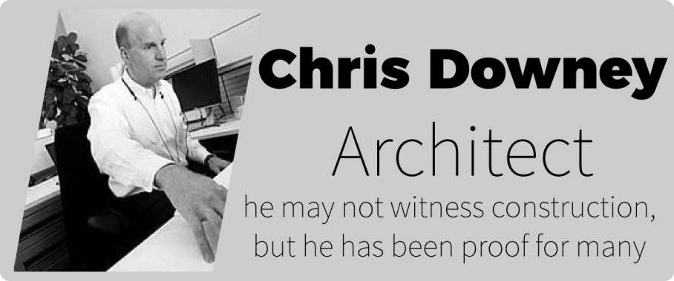
Visually Impaired are Inspired
17.5 Million*
are visually challenged in India
*as per 2007,2010 and 2011 Census data
http://www.who.int/blindness/GLOBALDATAFINALforweb.pdf
http://www.censusindia.gov.in/2011census/Disability_Data/DISAB04-0000.xlsx

Slide 4
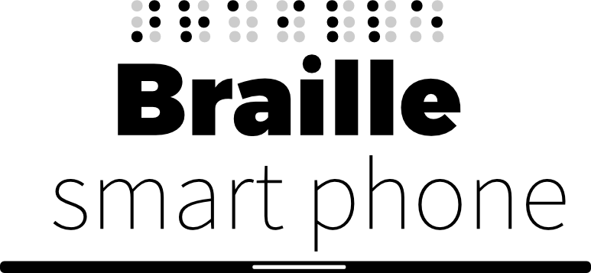
IMPORTANCE
We have been inspired by the efforts put by them in creating braille script which made their life easy. So we have ideated to develop braille scripting to enable them both to send and receive text based messages in a telephony device, a smartphone. Braille smartphone ,naming after the inspiration we have prepared a prototype that illustrates the braille based text communication device. Even if we have voice assistants of smart phones that could solve their problems they provide various un usable services for a visually impaired user. Here our braille smart phone is exclusively designed for visually impaired and all the useful services for them are embedded into this communicating device.

Slide 5
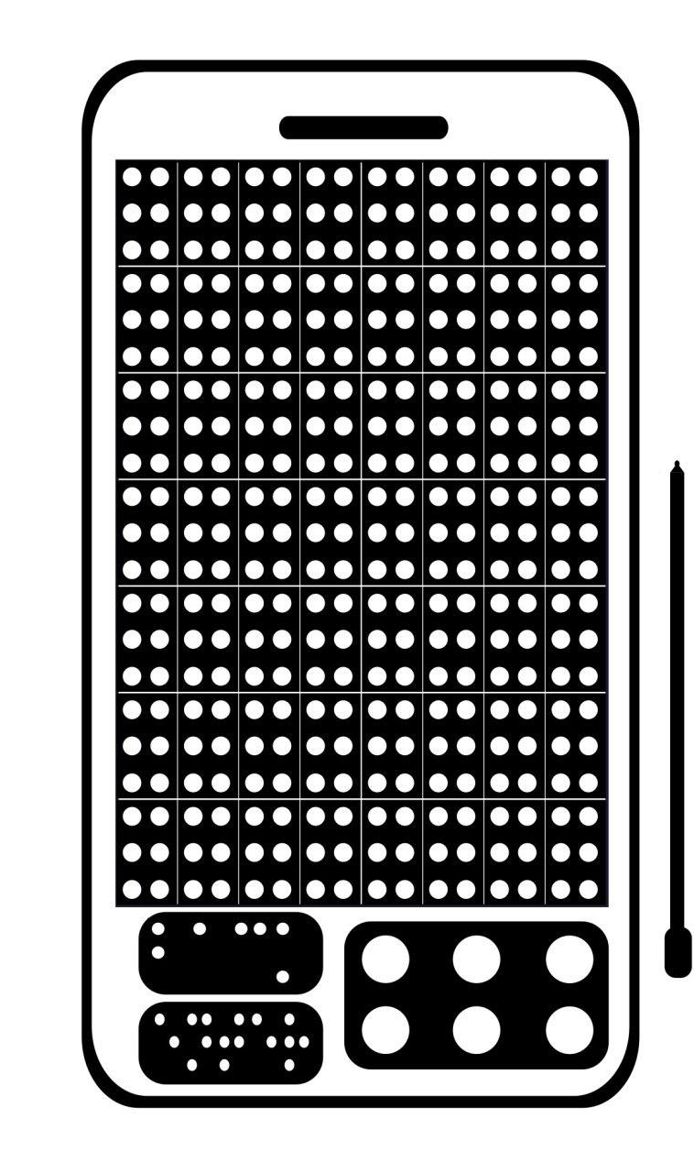
FEATURES
Learn Braille.
Read text based content.
Write text based content.
Control Home Appliances.
Receive Text Messages.
Send Text Messages.
Attending calls and Dialling.

Slide 6

Our Prototype

Slide 7
A simple prototype has been made to demonstrate the texting / messaging service for visually challenged with a telephony device(smart phone).
This prototype consists of the following:
  Keypad : a hardware system for reading and writing text.
  Servo motors : to illustrate the braille button movements
  Arduino Atmega : for circuit connections
  GSM Module : for sending and receiving text messages.
  Speakers and Mic.

Slide 8

Working Principle
1. Text input has to be given using the keypad of the phone. Those messages would be transmitted to a contact by GSM module.

Slide 9


Working Principle
2. Text output would be sensed by the braille buttons embedded on the other part of the screen.

Slide 10
PIXEL MAPPING

Slide 11
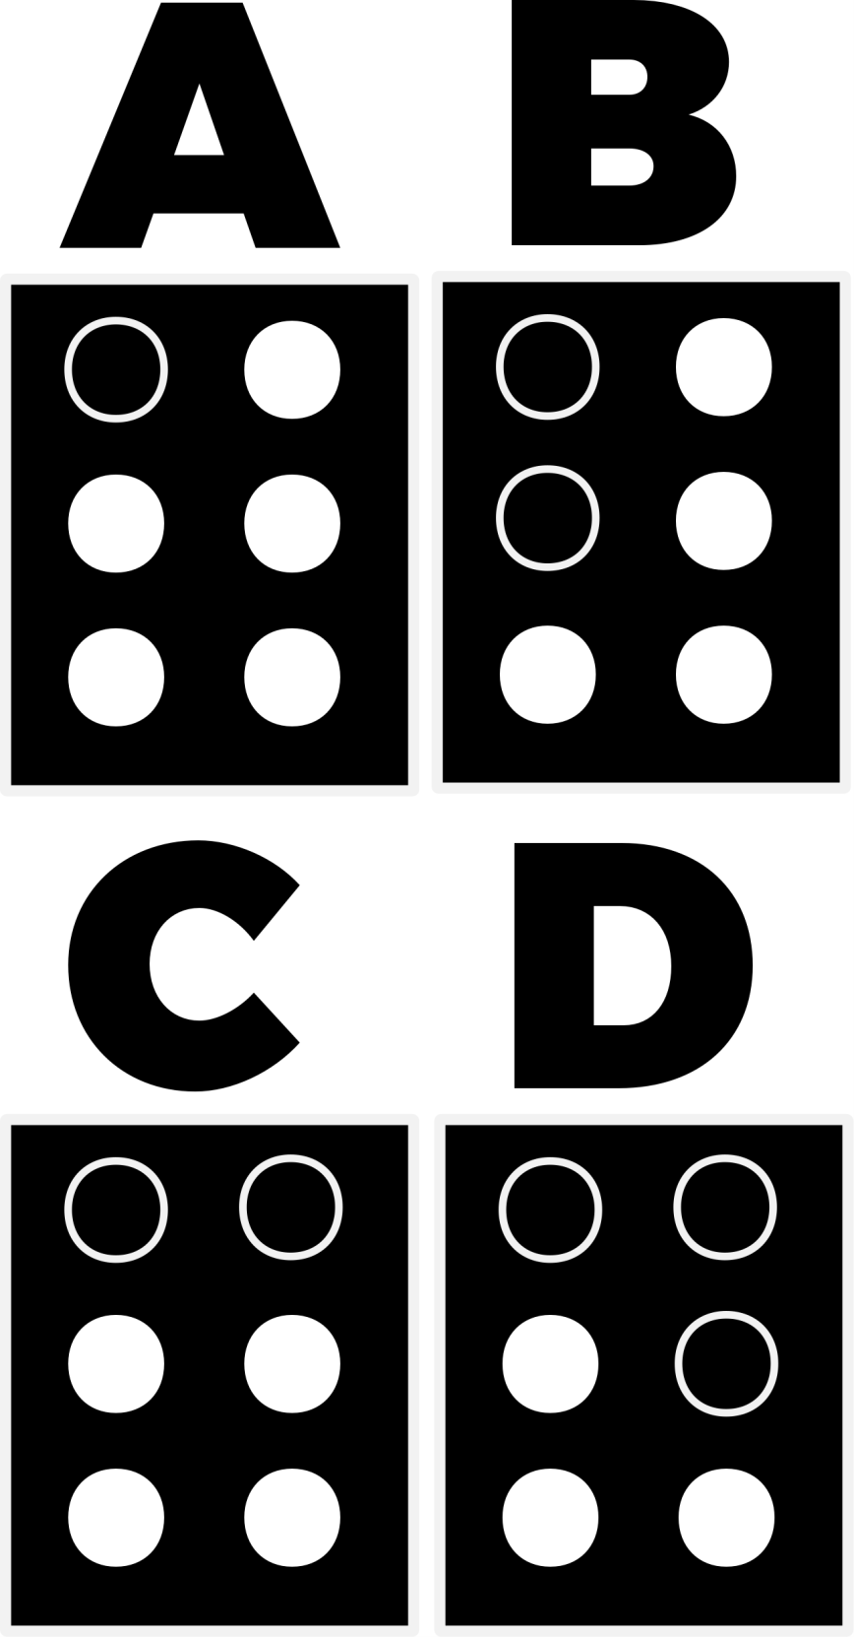
KEY &
PIXEL MAPPING

Slide 12
Use Case
The Use case shall be any visually impaired person can communicate(both receive & send) with others in either a text mode or voice mode.

Slide 13
Test Case & Developments
Usability evaluation of these modules would iteratively be applied to the end-users.
As a result of this integration of various modules, it evolves into a new communication system that helps the visual impaired.
This project is made out of open source technologies, with the support of various communities. Hence this ideation shall grow and make people into its development and maintainance.

Slide 14

Future Goals
  Voice Assistant : to automate typing and searching.
  GPS Tracking : location information & route updates.
  Dictionary: to search for the word and explains their
  meanings.

Slide 15
TEAM
TULASI RAM
MANASA KOMALI
LAKSHMI PRIYA
UMA SHANKAR
MVGRCE(A), VZM – ZONE 1

