Slide 1

ExaGEO Hackathon
Dr Vinny Davies
School of Mathematics & Statistics
University of Glasgow, Scotland

Slide 2
NOAA Hourly Weather Dataset
Global weather observations from monitoring stations
Measurements recorded at hourly or sub-hourly intervals
Includes temperature, wind, humidity, pressure and precipitation
Covers many years, allowing seasonal and longer-term patterns to be explored
Real-world data with missing observations, noise and extreme events
Well suited to time-series forecasting and deep learning

Slide 3
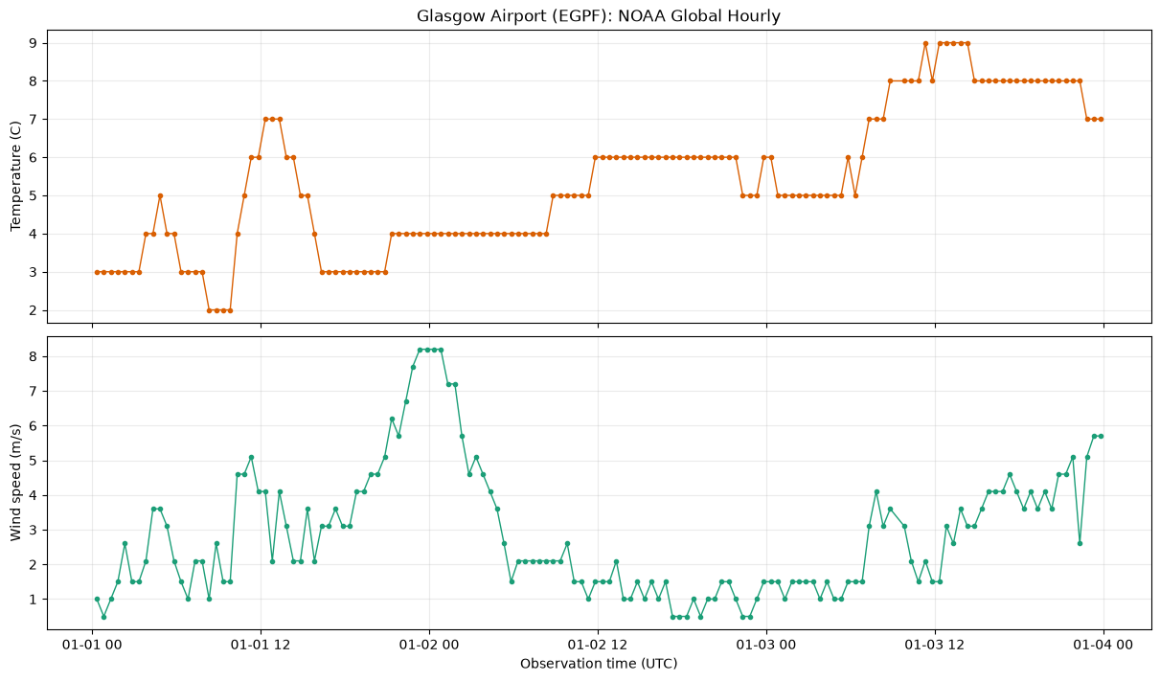
Glasgow Airport (3 days)

Slide 4
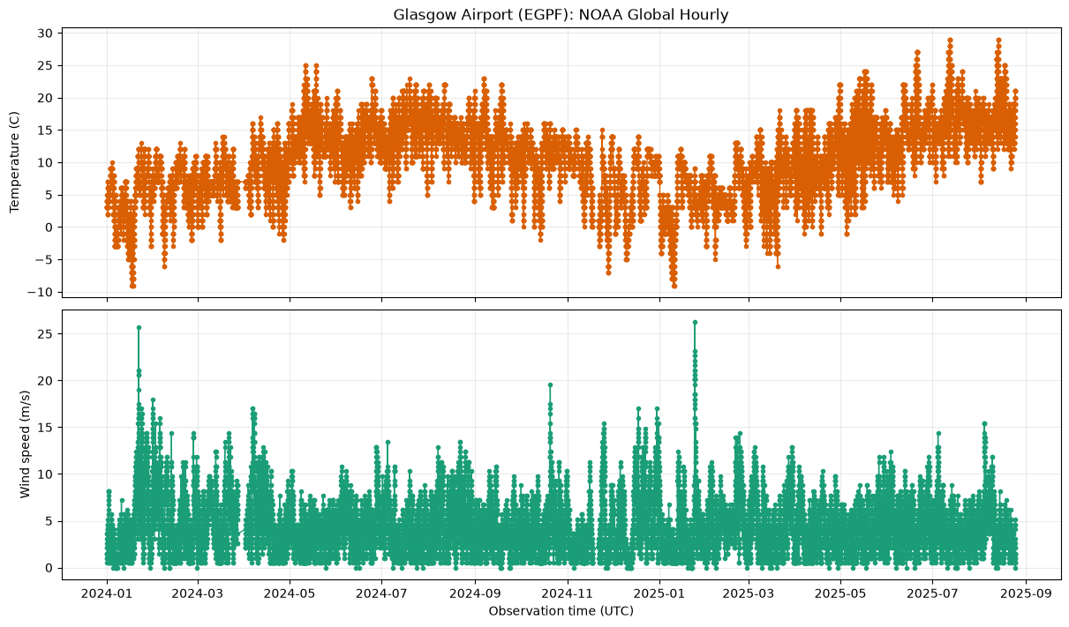
Glasgow Airport (2 years)

Slide 5
Aim of Hackathon
We will use deep learning to predict future weather observations
Weather measurements form a time series — observations ordered through time
Past observations contain information about what is likely to happen next
Neural networks can learn complex temporal patterns directly from historical data
We can use multiple weather variables to help make predictions
The goal is to build and evaluate your own time-series prediction model
We will get to more details in a bit…

Slide 6
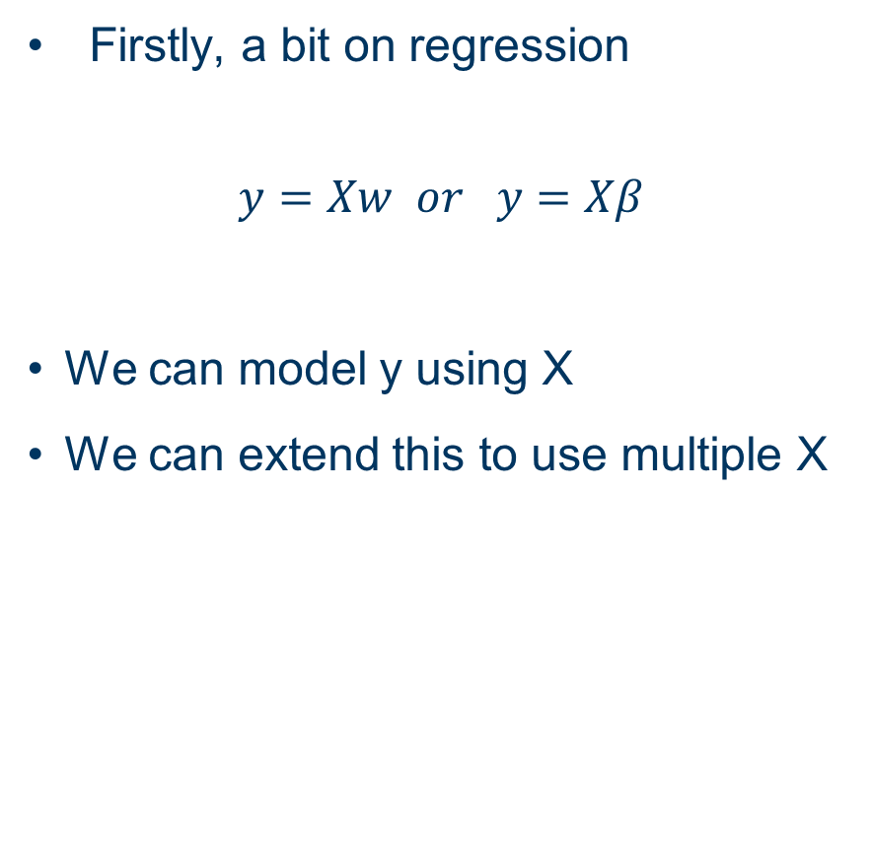
Regression
Firstly, a bit on regression
$$y=Xw or y=Xβ$$
We can model y using X
We can extend this to use multiple X
output data (y)
input data (X)

Slide 7
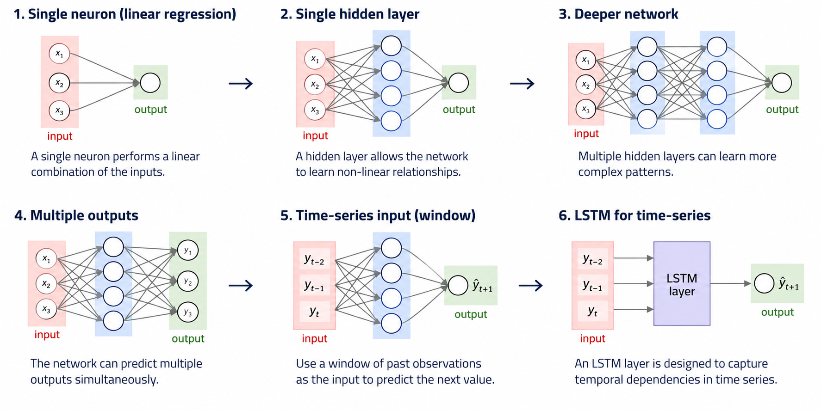
Regression

Slide 8
Neural Networks

Slide 9
“Deep” Neural Networks

Slide 10
A small aside...

Slide 11
A small aside...

Slide 12
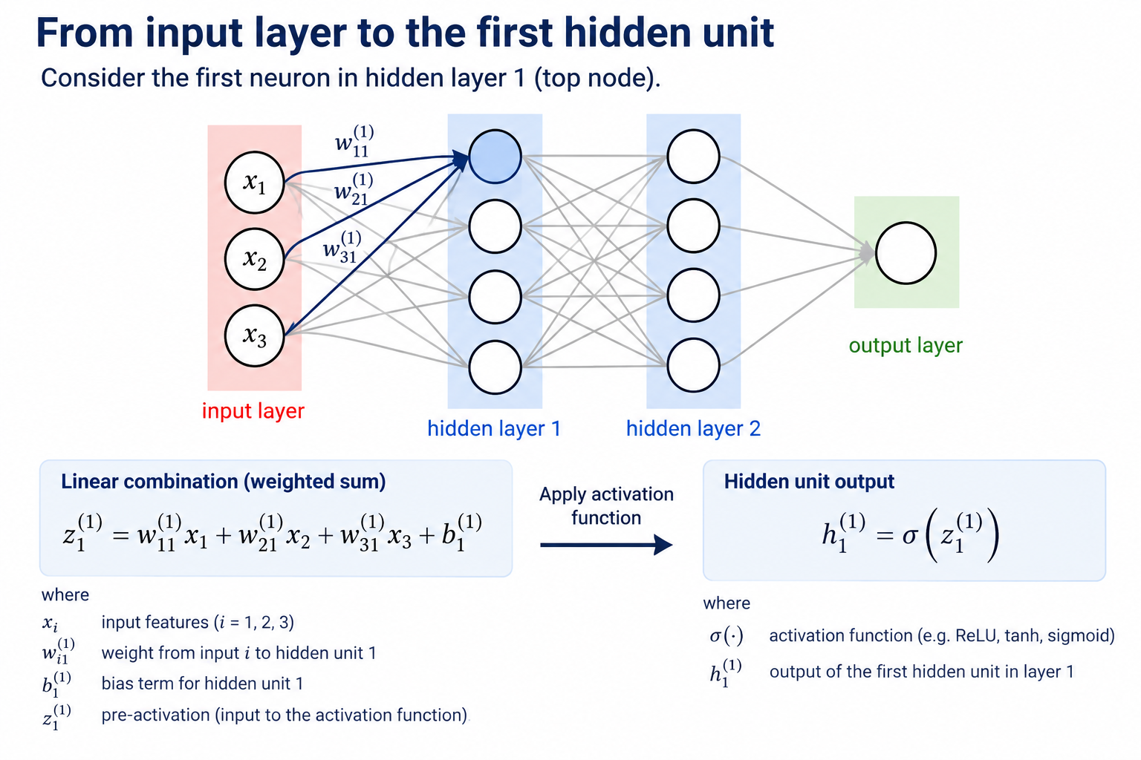
Maths of Neural Networks

Slide 13
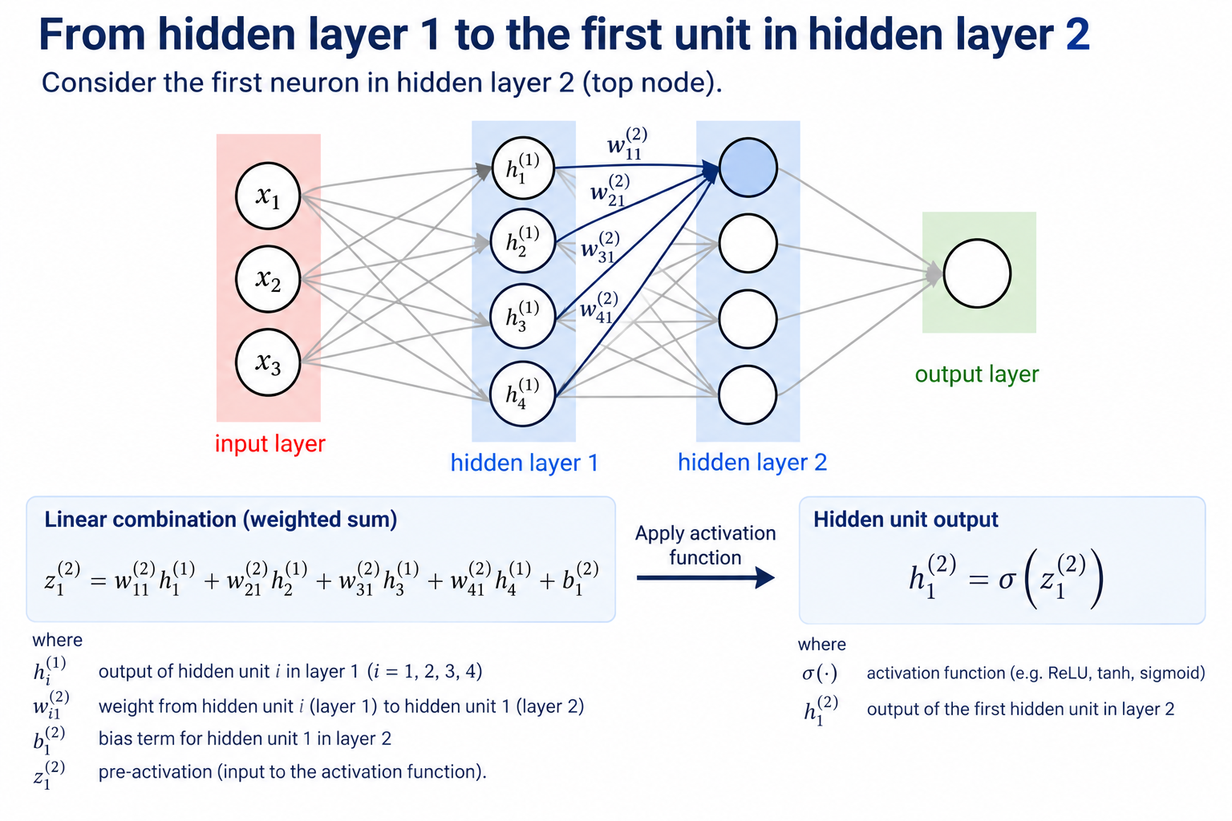
Maths of Neural Networks

Slide 14
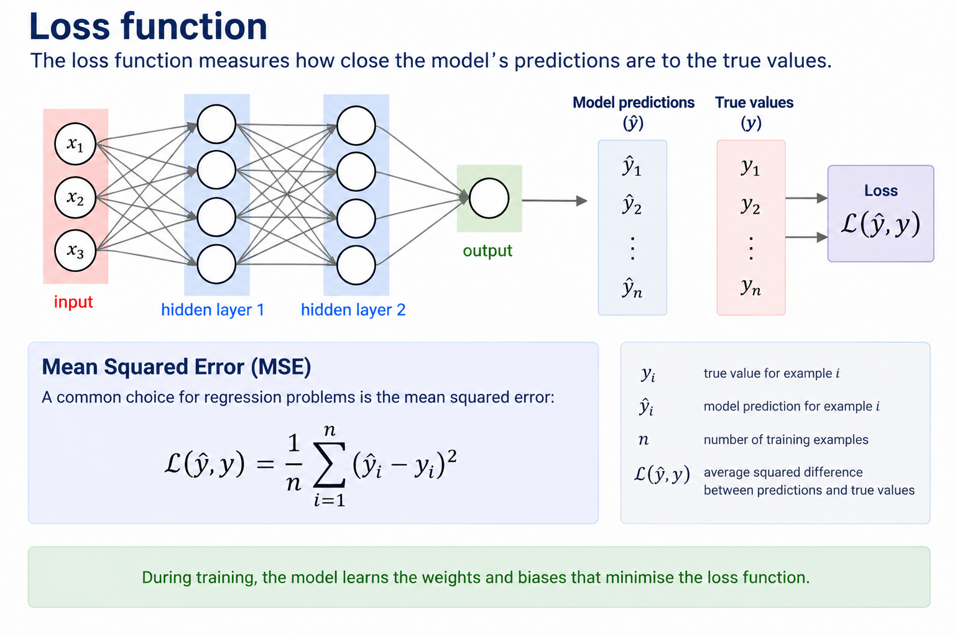
Loss Function

Slide 15
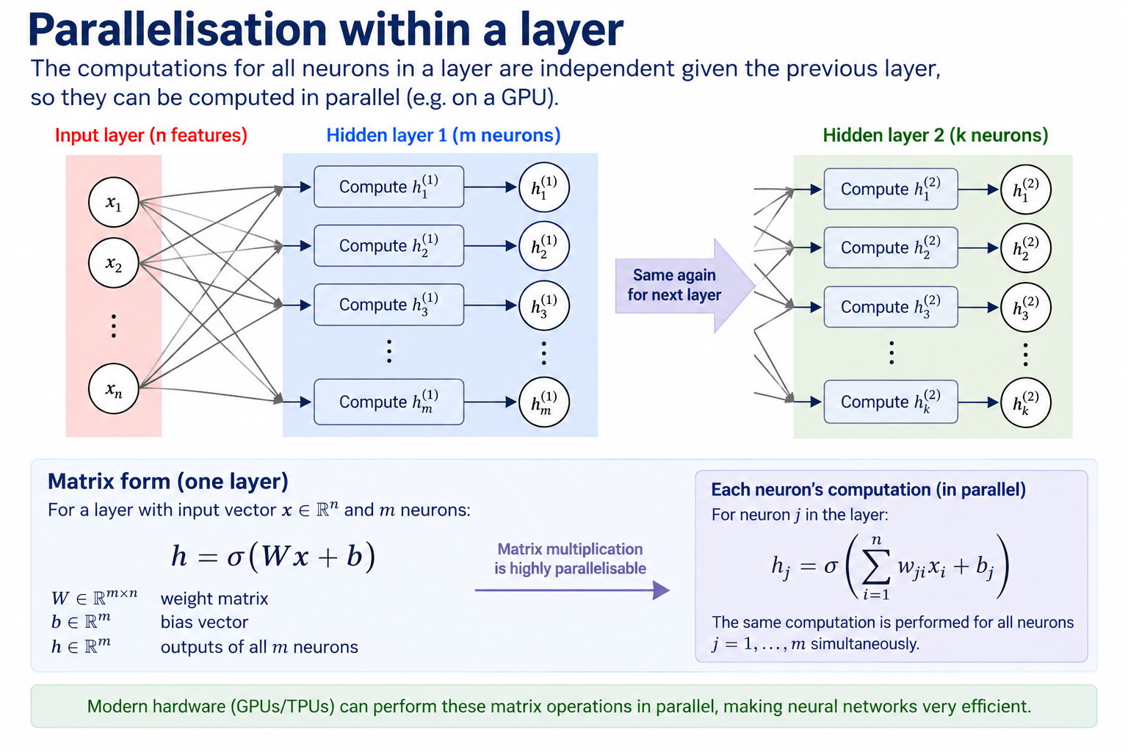
Note on Parallelisation

Slide 16
Time Series Modelling
When you have time series, there are two potential things you are likely to be interested in
Forward prediction – predicting the next time point(s) based on previously observed data
Understanding underlying process – modelling long term trends and relationships
Today I suggest you mainly look at forward prediction

Slide 17
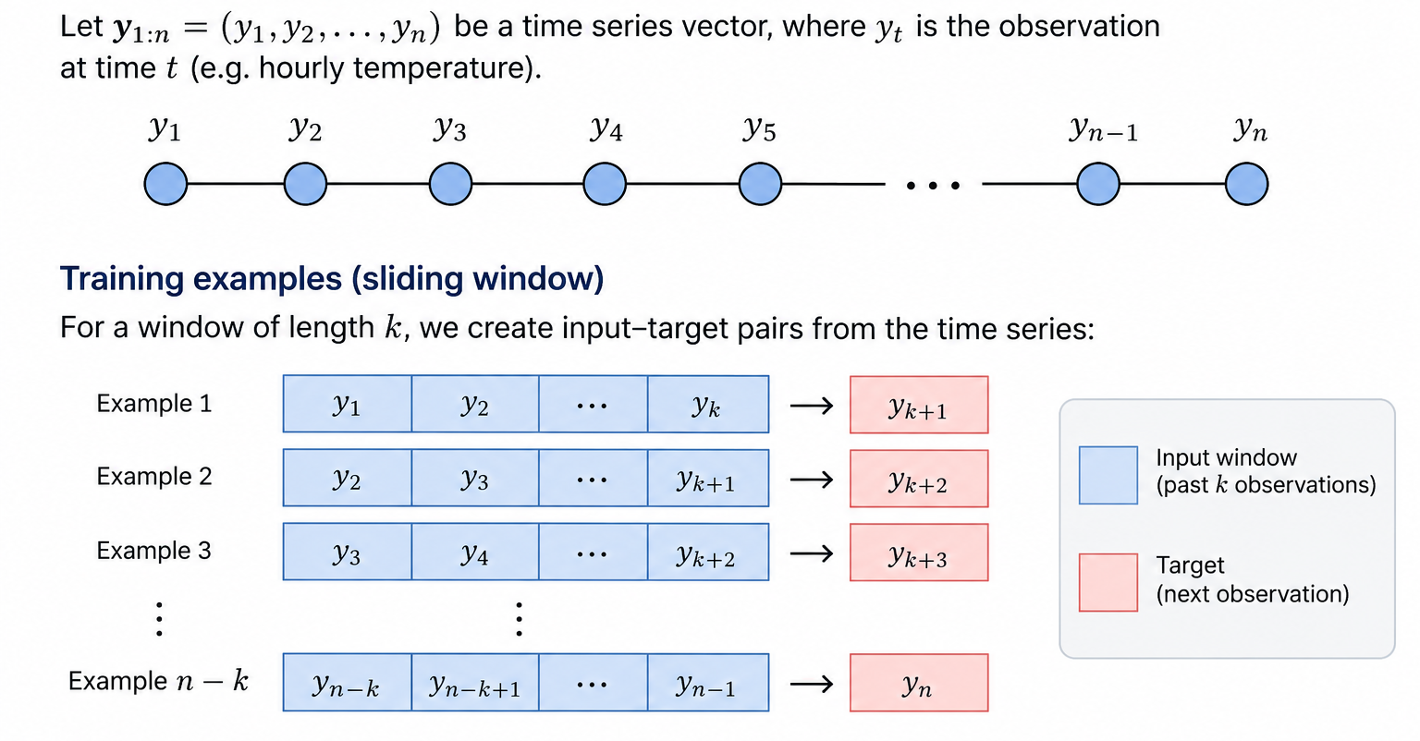
Maths of data processing

Slide 18
Time Series Deep Learning

Slide 19
Time Series Deep Learning

Slide 20
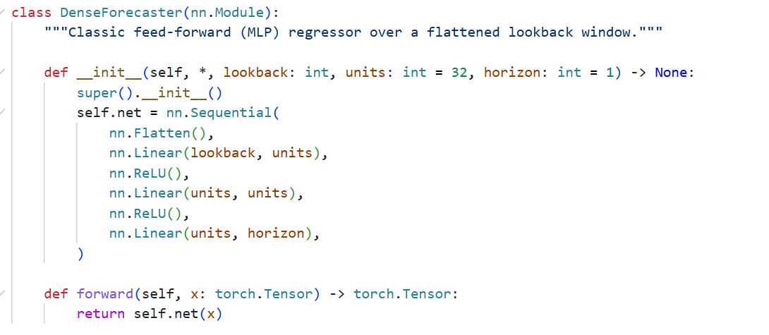
Time Series Deep Learning

Slide 21
LSTMs

Slide 22
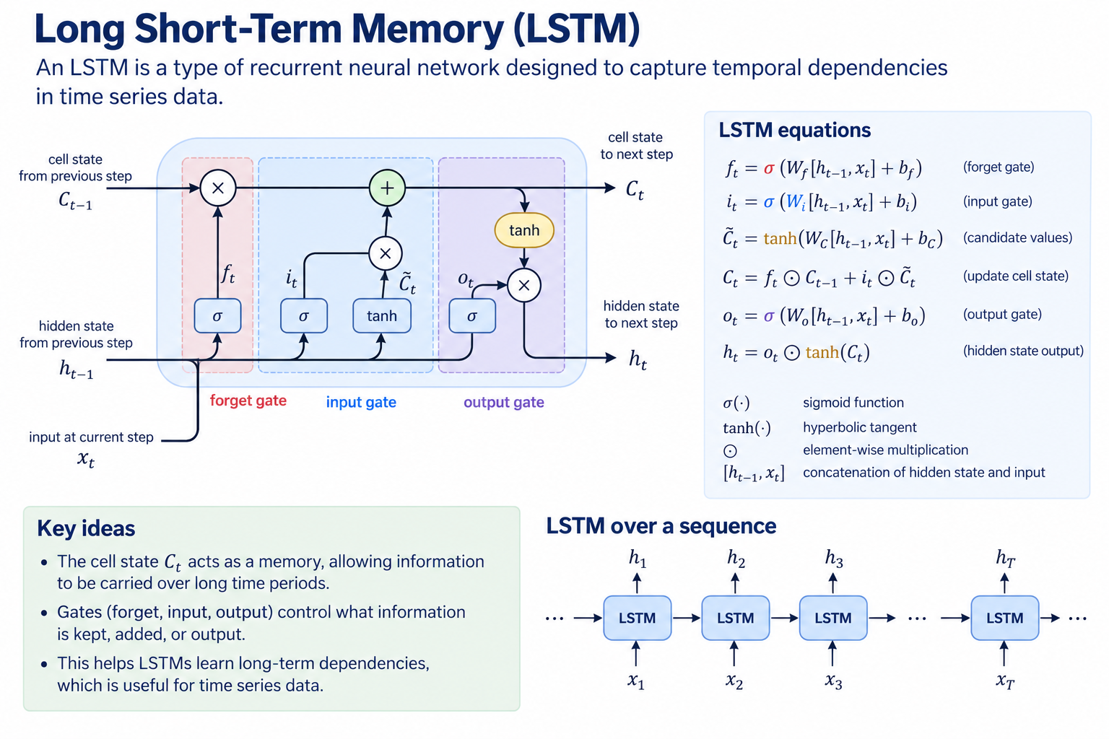
LSTMs (Unchecked maths)

Slide 23
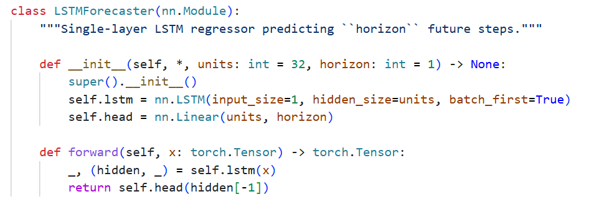
LSTMs (Unchecked maths)

Slide 24
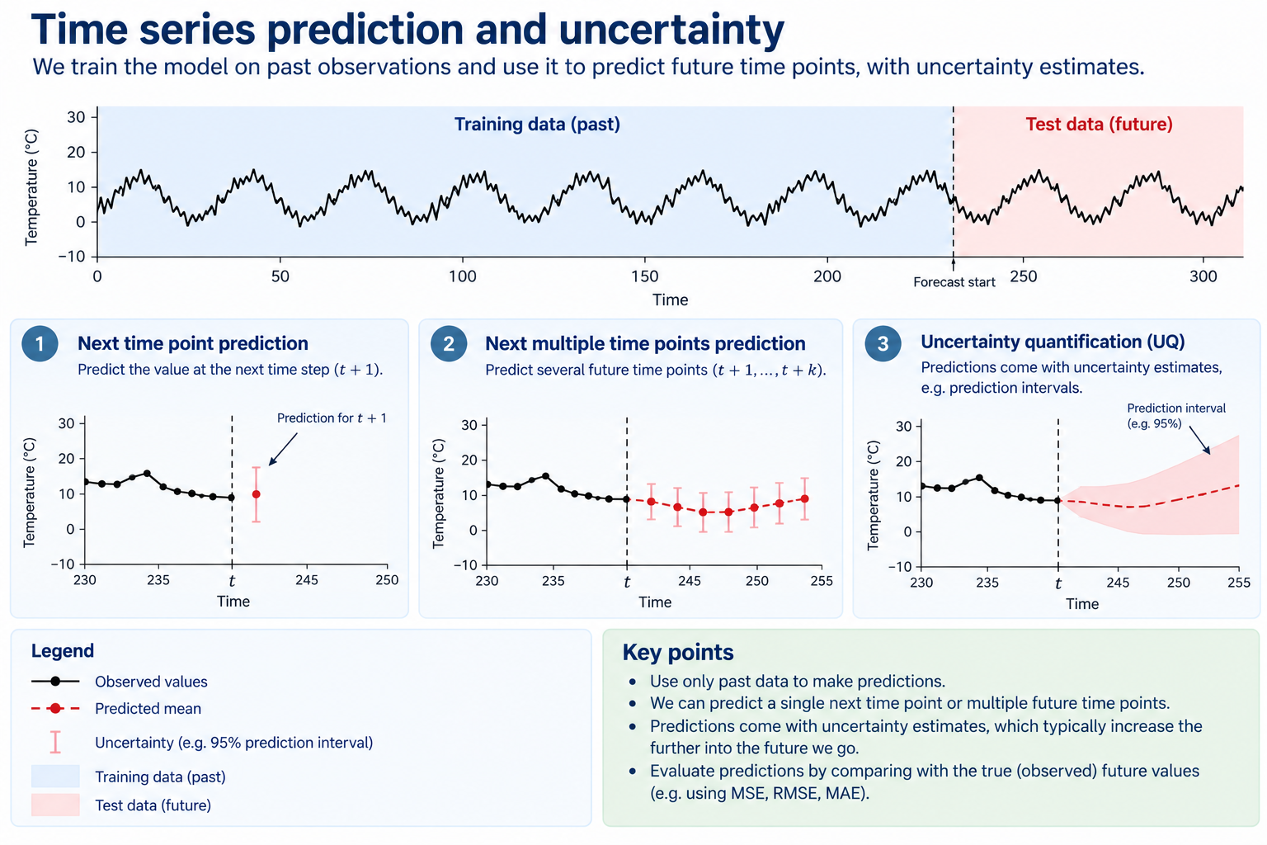
Evaluation

Slide 25
Aim of Hackathon
Explore time series deep learning modelling…
Pick a random location
Or pick multiple…
Very much up to you what you do as a team – suggest starting with something simple and building from there
Try adjusting lengths of inputs and outputs
Try different network architectures
More advanced
Try out transformers etc
Try some pre-trained models, e.g., Meta’s Prophet

Slide 26
Show and Tell
Put together 5min presentation about what you did (12pm)
Some results
Some comparisons
What you learnt?

