Slide 1

A digital twin of a mass spectrometer
Dr Vinny Davies, University of Glasgow

Slide 2

Background & Research
Postdocs in Statistics, Biostatistics, and Computing Science
Senior Lecturer in Statistics
Digital Twin research related to Cardiac Mechanics, 3D Printing, Metabolomics, Biodiversity, and Carbon Emissions
RSS Mardia Prize for workshops in environmental digital twins

Slide 3

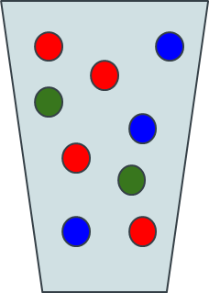
Mass Spectrometry Workflow
Sample + Sample Preparation

Slide 4
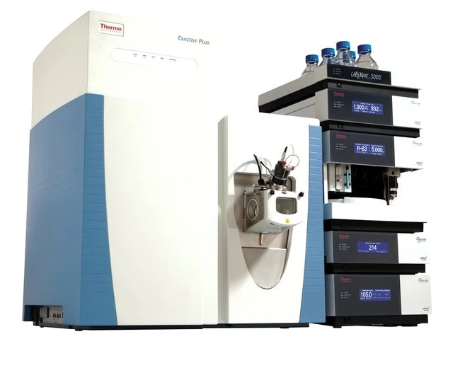
Mass Spectrometry Workflow
Sample + Sample Preparation
Data Collection

Slide 5
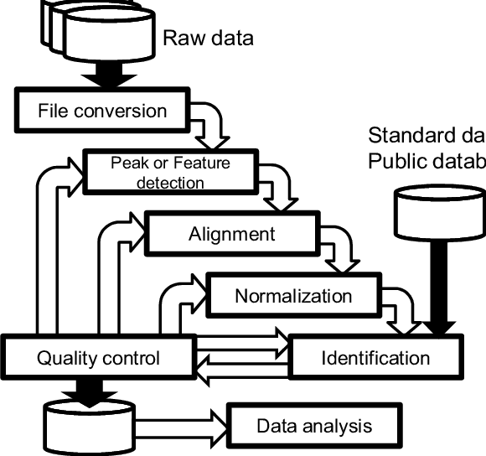
Mass Spectrometry Workflow
Sample + Sample Preparation
Data Collection
Data Processing

Slide 6
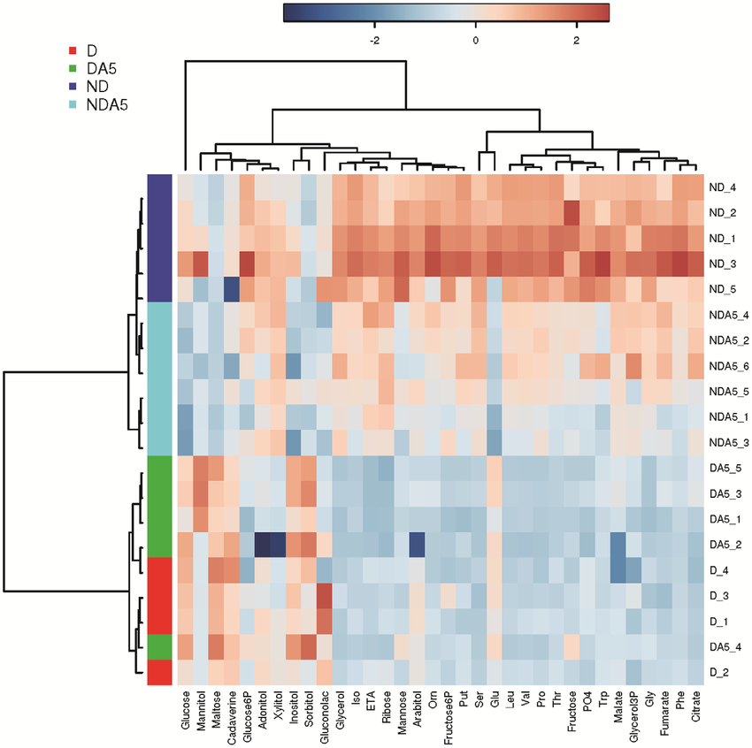
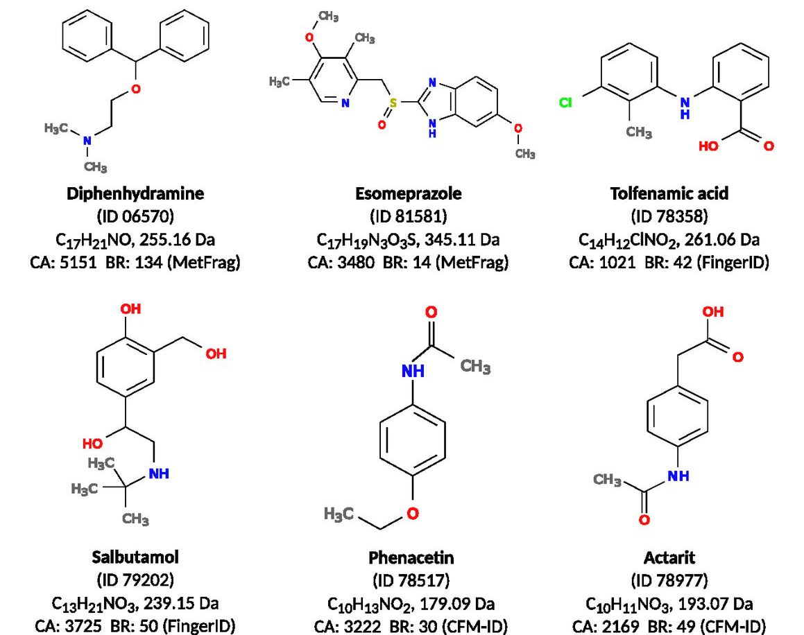
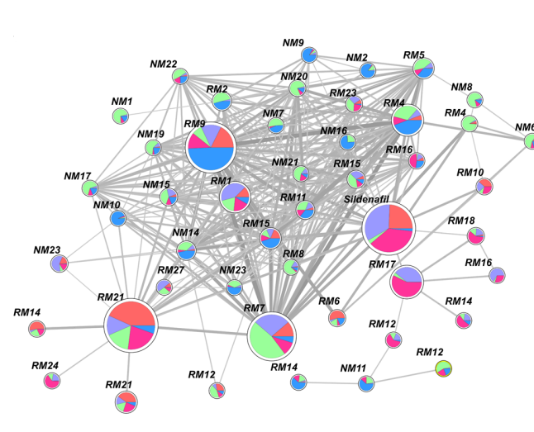
Statistical Analysis
Mass Spectrometry Workflow
Sample + Sample Preparation
Data Collection
Data Processing
Metabolite Identification
Molecular Networking

Slide 7
Statistical Analysis
Mass Spectrometry Workflow
Sample + Sample Preparation
Data Collection
Data Processing
Metabolite Identification
Molecular Networking

Slide 8


ViMMS – A Mass Spectrometer Digital Twin

Slide 9

Mass Spectrometry as a game of Battleships
Mass Spectrometry and Battleships - A weird combination, but bear with me!
 | 1 | 2 | 3 | 4 | 5 | 6 | 7 | 8 | 9 | 10
A
B
C
D
E
F
G
H
I
J

Slide 10
Mass Spectrometry as a game of Battleships
Planes fly from left to right – These are live observations of metabolite quantities
 | 1 | 2 | 3 | 4 | 5 | 6 | 7 | 8 | 9 | 10
A
B
C
D
E
F
G
H
I
J

Slide 11
Mass Spectrometry as a game of Battleships
We can scan to observe metabolite quantities
 | 1 | 2 | 3 | 4 | 5 | 6 | 7 | 8 | 9 | 10
A
B
C
D
E
F
G
H
I
J

Slide 12
Mass Spectrometry as a game of Battleships
And drop bombs (a different type of scan) to observe identifiable patterns
 | 1 | 2 | 3 | 4 | 5 | 6 | 7 | 8 | 9 | 10
A
B
C
D
E
F
G
H
I
J
Intensity (how much)
Mass (per unit charge)

Slide 13
Mass Spectrometry as a game of Battleships
Sometimes drop the bomb in the sea and miss (collect noise)
 | 1 | 2 | 3 | 4 | 5 | 6 | 7 | 8 | 9 | 10
A
B
C
D
E
F
G
H
I
J

Slide 14
Mass Spectrometry as a game of Battleships
The observation process repeats so we know where to drop bombs
 | 1 | 2 | 3 | 4 | 5 | 6 | 7 | 8 | 9 | 10
A
B
C
D
E
F
G
H
I
J

Slide 15
Mass Spectrometry as a game of Battleships
Often, we accidently bomb the same ship (collect information we already have)
 | 1 | 2 | 3 | 4 | 5 | 6 | 7 | 8 | 9 | 10
A
B
C
D
E
F
G
H
I
J
Intensity (how much)
Mass (per unit charge)

Slide 16
Mass Spectrometry as a game of Battleships
Sometimes we get new stuff
 | 1 | 2 | 3 | 4 | 5 | 6 | 7 | 8 | 9 | 10
A
B
C
D
E
F
G
H
I
J
Intensity (how much)
Mass (per unit charge)

Slide 17
Mass Spectrometry as a game of Battleships
Repeat until we run out of fuel (or sample)
 | 1 | 2 | 3 | 4 | 5 | 6 | 7 | 8 | 9 | 10
A
B
C
D
E
F
G
H
I
J

Slide 18
Mass Spectrometry as a game of Battleships
Another success…
 | 1 | 2 | 3 | 4 | 5 | 6 | 7 | 8 | 9 | 10
A
B
C
D
E
F
G
H
I
J
Intensity (how much)
Mass (per unit charge)

Slide 19
Mass Spectrometry as a game of Battleships
Repeating to the end… and DONE!
 | 1 | 2 | 3 | 4 | 5 | 6 | 7 | 8 | 9 | 10
A
B
C
D
E
F
G
H
I
J

Slide 20
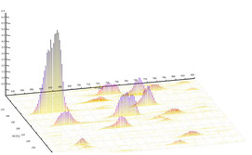
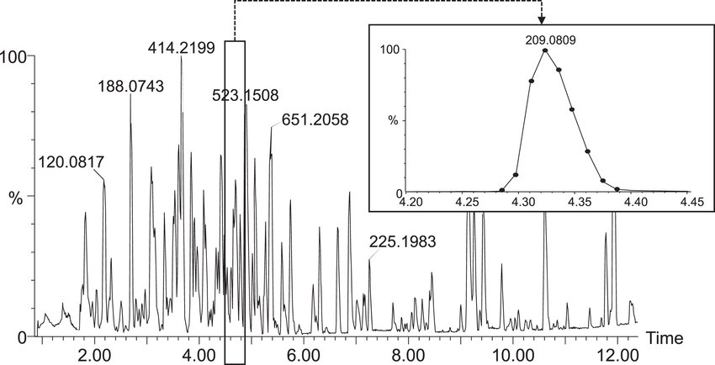
Challenges
Speed & Processing Challenges
Scans take 0.2-0.5 seconds
There are 2000-5000 ships / metabolites
Each scan contains hundreds of data points
Targeting Challenges
Cannot see what is coming in advance
Difficult to determine what is a ship / metabolite
Complex chemical processes

Slide 21
Aims
We can use the Digital Twin (ViMMS) to help us improve this
 | 1 | 2 | 3 | 4 | 5 | 6 | 7 | 8 | 9 | 10
A
B
C
D
E
F
G
H
I
J
 | 1 | 2 | 3 | 4 | 5 | 6 | 7 | 8 | 9 | 10
A
B
C
D
E
F
G
H
I
J

Slide 22
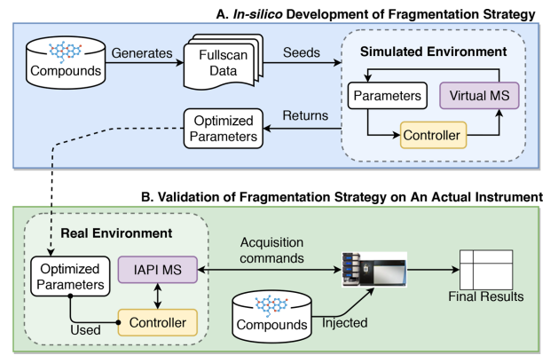
How does ViMMS work?
ViMMS has two environments
Simulated (blue)
Real (green)

Slide 23
How do the simulations work?
Construct peaks from previously observed data

Slide 24
How do the real experiments work?
Real experiments use the observation from the mass spectrometer

Slide 25
Controlling the Scans
Controllers score different scan options in real time
Highest scoring scan is selected
Controllers remains the same in simulated and real experiments

Slide 26
The Mass Spectrometer
The simulator uses the virtual mass spectrometer digital twin

Slide 27
The Mass Spectrometer
The real mass spectrometer is used for the real experiments
The controller code is linked to the real mass spec via C# bridging code

Slide 28
Optimising Acquisition
We can use a strategy that combines simulated and real experiments to design methods giving big development cost benefits
Simulated Results
Prototype
Controller

Slide 29
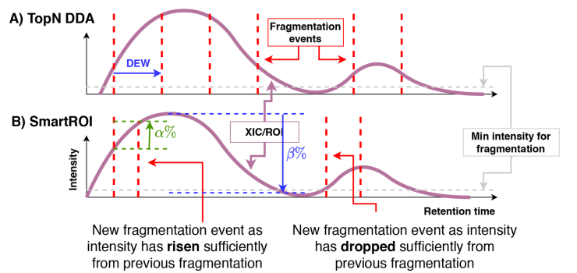
Optimising Acquisition
We can use a strategy that combines simulated and real experiments to design methods giving big development cost benefits
Simulated Results
Prototype
Controller
Controller

Slide 30

Optimising Acquisition
We can use a strategy that combines simulated and real experiments to design methods giving big development cost benefits
Simulated Results
Simulated Results
Unknown $θ$
Prototype
Controller
Controller

Slide 31

Optimising Acquisition
We can use a strategy that combines simulated and real experiments to design methods giving big development cost benefits
Simulated Results
Simulated Results
Unknown $θ$
Optimised $θ$
Prototype
Controller
Controller

Slide 32
Optimising Acquisition
We can use a strategy that combines simulated and real experiments to design methods giving big development cost benefits
Simulated Results
Simulated Results
Unknown $θ$
Optimised $θ$
Prototype
Controller
Controller
Controller

Slide 33
Optimising Acquisition
We can use a strategy that combines simulated and real experiments to design methods giving big development cost benefits
Simulated Results
Simulated Results
Real Results
Unknown $θ$
Optimised $θ$
Prototype
Controller
Controller
Controller

Slide 34
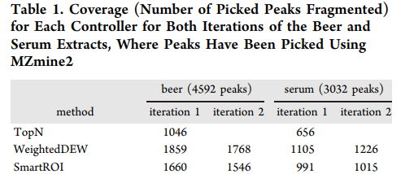
Real Experimental Validation
We see an almost 50% improvement in results
Essentially, we can increase the number of metabolites we are able to identify by 50%

Slide 35
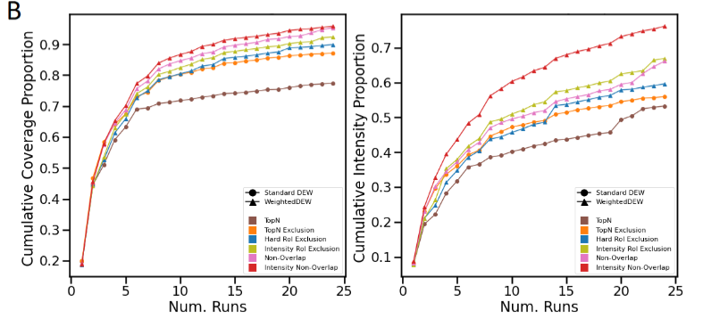
New Methods for Multiple Samples
We can similarly extend the concept to more advanced controllers, although the improvement is less drastic

Slide 36
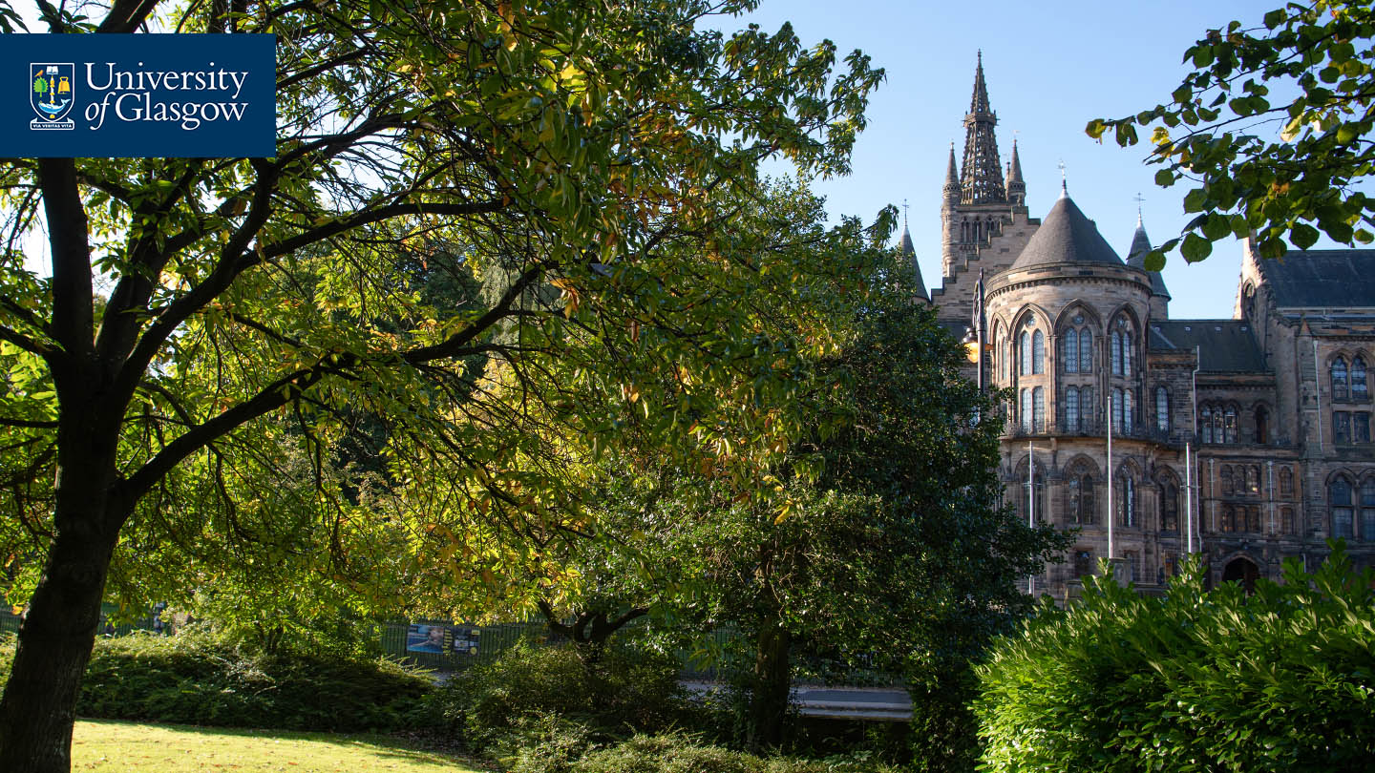
Thanks for Listening
Let me know if you have any questions
Or feel free to reach out at: Vinny.Davies@Glasgow.ac.uk
Slides available at:
https://github.com/vinnydavies/presentations

