Slide 1

Use cases and strategies for a digital twin of a mass spectrometer
Dr Vinny Davies

Slide 2

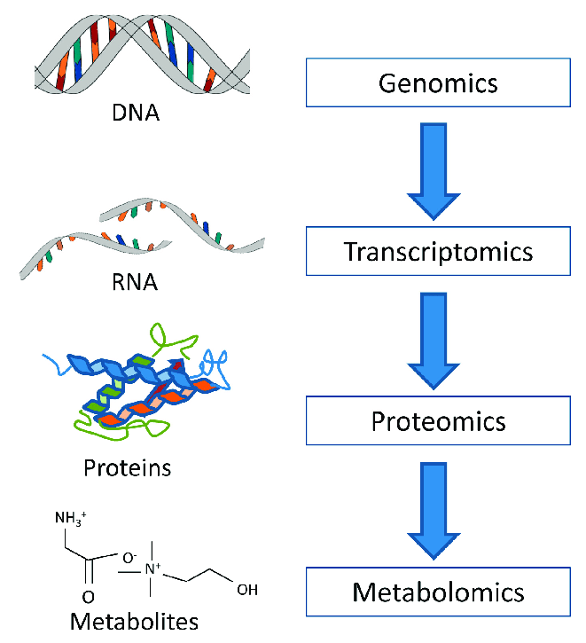
What is Metabolomics?
Metabolomics is the "systematic study of the unique chemical fingerprints that specific cellular processes leave behind", the study of their small-molecule metabolite profiles.
Basically, we are trying to identify all the metabolites in a particular sample

Slide 3
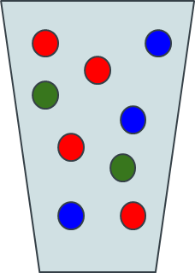
Metabolomics Workflow
Sample + Sample Preparation

Slide 4
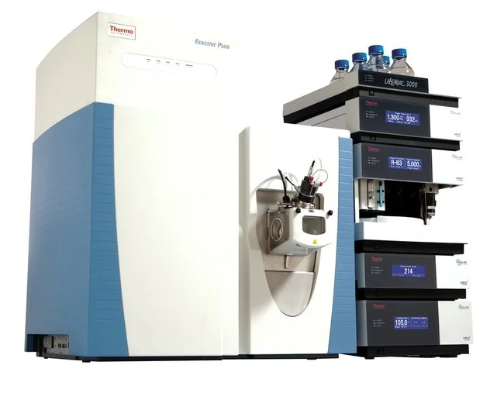
Metabolomics Workflow
Sample + Sample Preparation
Data Collection

Slide 5
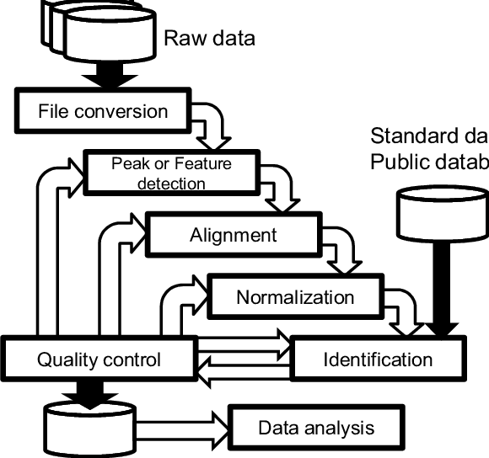
Metabolomics Workflow
Sample + Sample Preparation
Data Collection
Data Processing

Slide 6
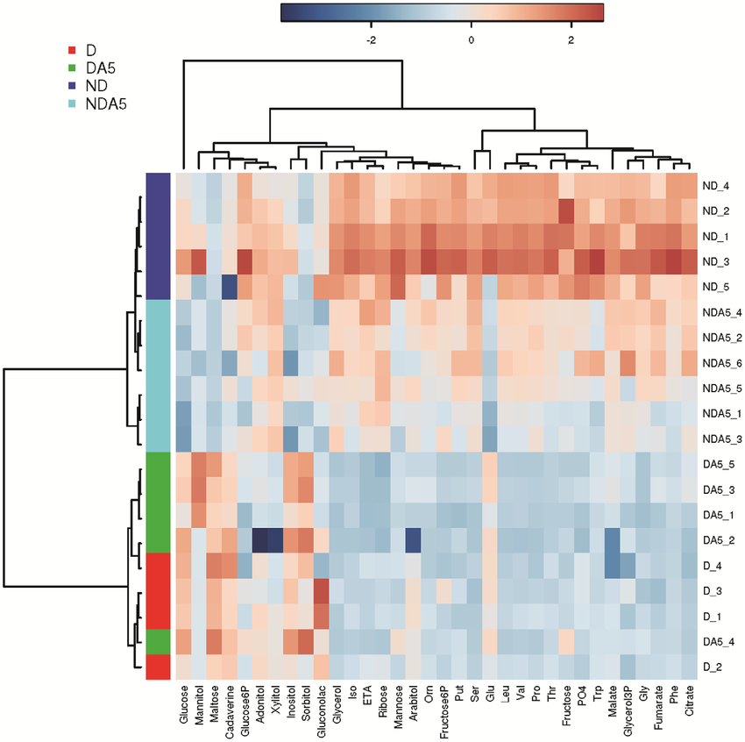
Statistical Analysis
Metabolomics Workflow
Sample + Sample Preparation
Data Collection
Data Processing

Slide 7
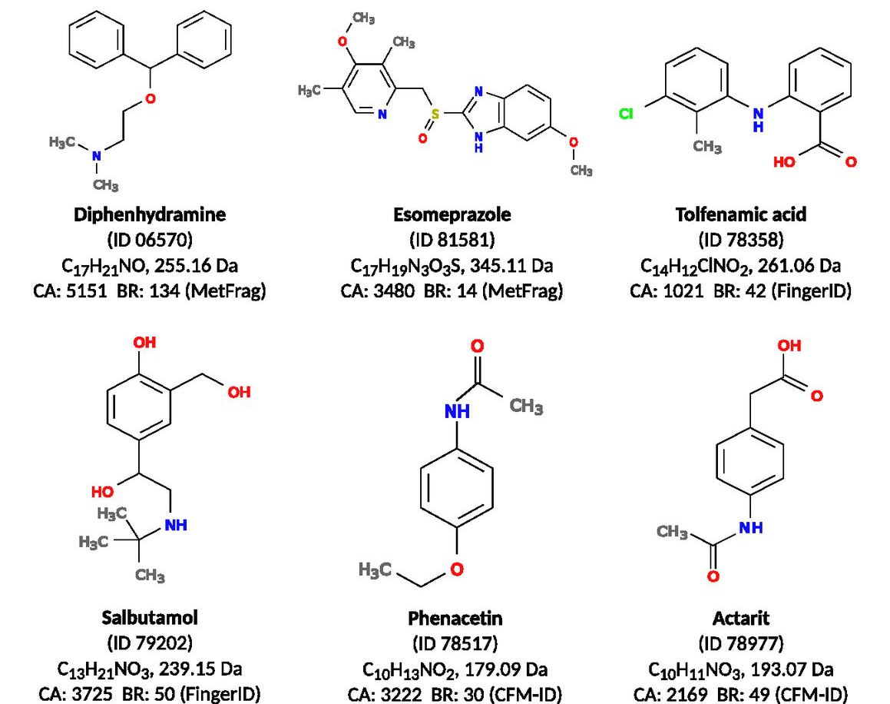
Statistical Analysis
Metabolomics Workflow
Sample + Sample Preparation
Data Collection
Data Processing
Metabolite Identification

Slide 8
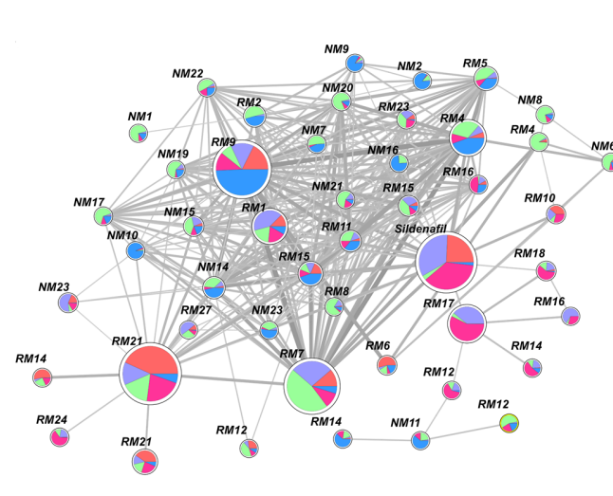
Statistical Analysis
Metabolomics Workflow
Sample + Sample Preparation
Data Collection
Data Processing
Metabolite Identification
Molecular Networking

Slide 9
Statistical Analysis
Metabolomics Workflow
Sample + Sample Preparation
Data Collection
Data Processing
Metabolite Identification
MODELS
Molecular Networking

Slide 10
Statistical Analysis
Metabolomics Workflow
Sample + Sample Preparation
Data Collection
Data Processing
Metabolite Identification
MODELS
MODELS
Molecular Networking

Slide 11
Statistical Analysis
Metabolomics Workflow
MODELS
Sample + Sample Preparation
Data Collection
Data Processing
Metabolite Identification
MODELS
MODELS
Molecular Networking

Slide 12
Statistical Analysis
Metabolomics Workflow
MODELS
Sample + Sample Preparation
Data Collection
Data Processing
Metabolite Identification
MODELS
MODELS
MODELS
Molecular Networking

Slide 13
Statistical Analysis
Metabolomics Workflow
MODELS
Sample + Sample Preparation
Data Collection
Data Processing
Metabolite Identification
MODELS
MODELS
MODELS
Molecular Networking
MODELS

Slide 14
Statistical Analysis
Metabolomics Workflow
MODELS
Sample + Sample Preparation
Data Collection
Data Processing
Metabolite Identification
MODELS
MODELS
MODELS
Molecular Networking
MODELS

Slide 15
Metabolomics Mass Spectrometry Experiments
Samples can be extremely varied, but standard option is blood, urine, etc – We use beer!
No data protection issues
Cheap and easily available
Similar enough for method development

Slide 16
Metabolomics Mass Spectrometry Experiments
Samples can be extremely varied, but standard option is blood, urine, etc – We use beer!
No data protection issues
Cheap and easily available
Similar enough for method development
Ionisation

Slide 17
Metabolomics Mass Spectrometry Experiments
Samples can be extremely varied, but standard option is blood, urine, etc – We use beer!
No data protection issues
Cheap and easily available
Similar enough for method development
Mass Spectrometer
Ionisation

Slide 18
Metabolomics Mass Spectrometry Experiments
Samples can be extremely varied, but standard option is blood, urine, etc – We use beer!
No data protection issues
Cheap and easily available
Similar enough for method development
Mass Spectrometer
Intensity
Ionisation
m/z

Slide 19
LC-MS/MS
MS
scans
Sample
Sample fraction, collected in small time period
Mass (per charge)
Chromatographic peaks
intensity
Chromatographic retention time
retention time

Slide 20
Scan Types – MS1
MS1 scan
Measures mass (per charge), and intensity (how many copies of the molecule)
Scan also has an associated retention time
mass isn’t enough to identify the molecule

Slide 21
Scan Types – MS2
Fragmentation: smashing up a molecule
MS
MS2 spectra can be used as a molecular fingerprint to identify molecules
Spectra are compared against a database of spectra for known molecules

Slide 22
Statistical Analysis
How can Digital Twins help?
MODELS
Sample + Sample Preparation
Data Collection
Data Processing
Metabolite Identification
MODELS
MODELS
MODELS
Molecular Networking
MODELS

Slide 23
How can Digital Twins help?
Data Collection
MODELS

Slide 24
How can Digital Twins help?
Data Collection
MODELS

Slide 25
What stops us building new models?
Costs of Mass Spec: £1-2 million
Cost of yearly servicing: ~£100-200k
Cost to use Mass Spec per day: £2,000-2,500
Limited samples
Limited availability to use Mass Spec

Slide 26


How can Digital Twins help?
What if we make a Digital Twin of a Mass Spectrometer?

Slide 27
What is the point of ViMMS?
ViMMS fully controls scan specifications in real time
Cruicially, experiments can be ran via computer simulations rather than on a real MS
Some Applications of ViMMS
Evaluation of existing methods and settings
Develop, evaluate and test new methods
Control MS in real time via an API
Evaluate current tools

Slide 28
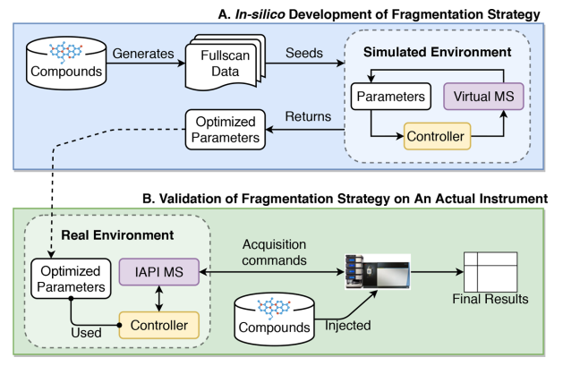
How does ViMMS work?
ViMMS has two environments
Simulated (blue)
Real (green)

Slide 29
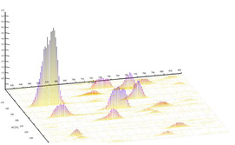
How do the simulations work?
Construct peaks from previously observed data
Take average scan timings from previous data

Slide 30
How do the real experiments work?
The real experiments works in exactly the same way except using a sample rather than simulated ViMMS chemicals

Slide 31
Controlling the Scans
Controllers remain consistent across simulated and real experiments

Slide 32
The Mass Spectrometer
The simulator uses the virtual mass spectrometer digital twin

Slide 33
The Mass Spectrometer
The real mass spectrometer is used for the real experiments
The controller code is linked to the real mass spec via C# bridging code
Crucially:
The controllers remain the same
The bridging code is the same for all methods

Slide 34

Optimising Data Acquisition Parameters
We can use ViMMS to optimise our parameters in simulation before using the same controller on real samples
Simulated Results
Unknown $θ$
Controller

Slide 35

Optimising Data Acquisition Parameters
We can use ViMMS to optimise our parameters in simulation before using the same controller on real samples
Simulated Results
Unknown $θ$
Optimised $θ$
Controller

Slide 36
Optimising Data Acquisition Parameters
We can use ViMMS to optimise our parameters in simulation before using the same controller on real samples
Simulated Results
Unknown $θ$
Optimised $θ$
Controller
Controller

Slide 37
Optimising Data Acquisition Parameters
We can use ViMMS to optimise our parameters in simulation before using the same controller on real samples
Simulated Results
Real Results
Unknown $θ$
Optimised $θ$
Controller
Controller

Slide 38
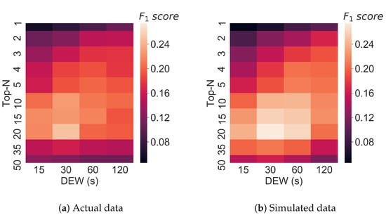
Optimising Data Acquisition Parameters
To prove this strategy actually works, we full tested it across a number of methods

Slide 39
Optimising DDA acquisition
We can use a similar strategy to design new controllers
An additional debugging and design step is added at the start
Simulated Results
Prototype
Controller

Slide 40
Optimising DDA acquisition
We can use a similar strategy to design new controllers
An additional debugging and design step is added at the start
Simulated Results
Prototype
Controller
Controller

Slide 41

Optimising DDA acquisition
We can use a similar strategy to design new controllers
An additional debugging and design step is added at the start
Simulated Results
Simulated Results
Unknown $θ$
Prototype
Controller
Controller

Slide 42

Optimising DDA acquisition
We can use a similar strategy to design new controllers
An additional debugging and design step is added at the start
Simulated Results
Simulated Results
Unknown $θ$
Optimised $θ$
Prototype
Controller
Controller

Slide 43
Optimising DDA acquisition
We can use a similar strategy to design new controllers
An additional debugging and design step is added at the start
Simulated Results
Simulated Results
Unknown $θ$
Optimised $θ$
Prototype
Controller
Controller
Controller

Slide 44
Optimising DDA acquisition
We can use a similar strategy to design new controllers
An additional debugging and design step is added at the start
Simulated Results
Simulated Results
Real Results
Unknown $θ$
Optimised $θ$
Prototype
Controller
Controller
Controller

Slide 45
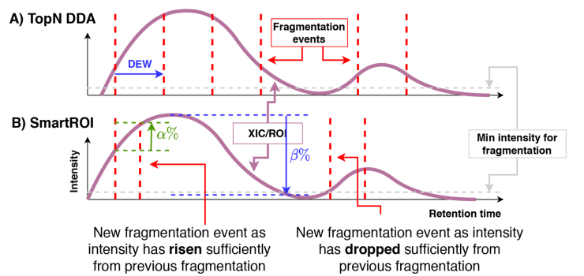
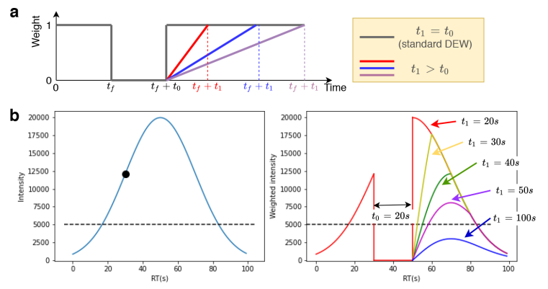
Our New Methods

Slide 46
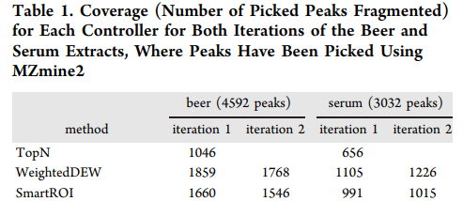
Real Experimental Validation
We see an almost 50% improvement in results

Slide 47
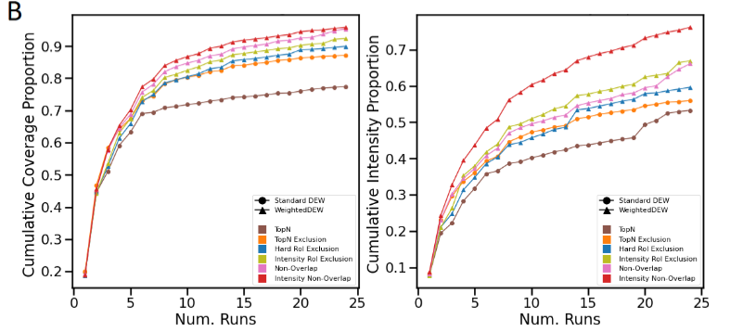
New Methods for Multiple Samples
We can similarly extend the concept to more advanced controllers, although the improvement is less drastic

Slide 48
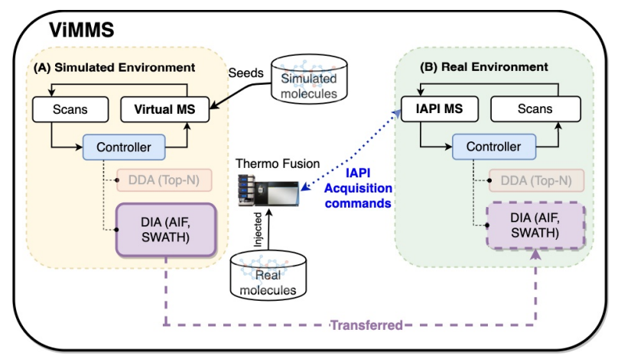
Evaluating Existing Methods
We can similarly implement other methods and test them

Slide 49
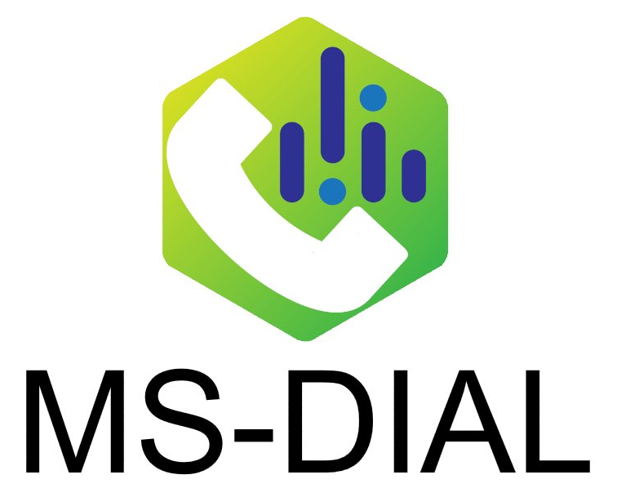
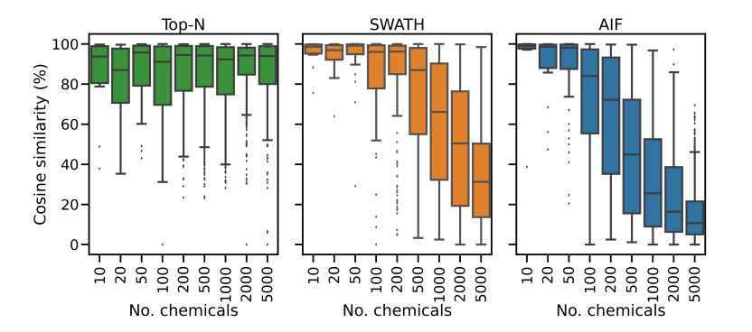
Evaluating a Different Acquisition Method
We test other types of methods, as well as models for evaluating them

Slide 50

Additional Parameter Optimisation
$$θ$$

Slide 51
Any questions?
Big thank you to all my collaborators:
University of Glasgow: Joe Wandy, Rónán Daly, Simon Rogers, Ross McBride, Kevin Bryson, Stefan Weidt, Nikolaos Terzis, Alice Miller
Wageningen University: Justin J.J. van der Hooft
Ideas for ViMMS or any further questions
Email: vinny.davies@glasgow.ac.uk
Twitter: vinny_davies89
Slides available at:
https://github.com/vinnydavies/presentations

