Slide 1

ViMMS 2.0: A framework to develop, test and optimise fragmentation strategies in LC-MS metabolomics
Dr Vinny Davies

Slide 2


ViMMS
ViMMS is a Virtual Metabolomics Mass Spectrometer
It allows you to simulate full metabolomics LC-MS/MS experiments
MS1 and MS2 capabilities, with potential for MSN
ViMMS is implemented within Python and is full open source available at https://github.com/glasgowcompbio/vimms
Wandy, J., Davies, V., et al. (2019). In silico optimization of mass spectrometry fragmentation strategies in metabolomics. Metabolites.
Wandy, J., Davies, V., et al. (2022). ViMMS 2.0: A framework to develop, test and optimise fragmentation strategies in LC-MS metabolomics. JOSS.

Slide 3
What is the point of ViMMS?
ViMMS fully controls scan specifications in real time and allows
Evaluation of existing methods and settings
Develop, evaluate and test new methods
Control MS in real time via an API
Evaluate current tools, e.g. MS-dial
Currently real time control is limited to Thermo Fisher machines with IAPI control

Slide 4
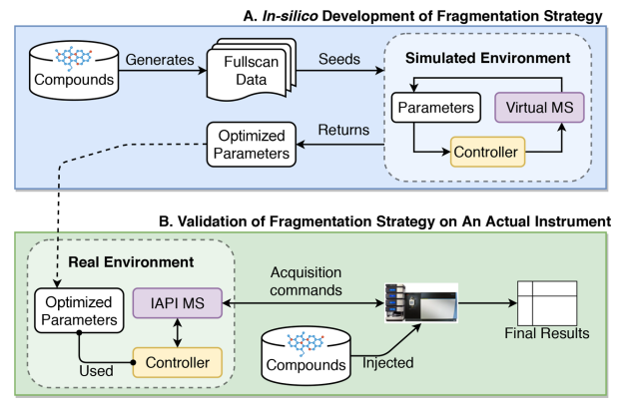
How does ViMMS work?
ViMMS has two environments
Simulated (blue)
Real (green)
The virtual MS (Python code) and real MS (an actual instrument) are interchangeable
Controllers (which schedule scans) are identical in both environments
Samples are either real or virtual

Slide 5
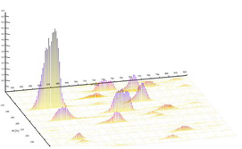
How do the simulations work?
Take an mzml and construct Regions of Interest (ROIs)
ROIs are converted into ViMMS chemicals

Slide 6
How do the simulations work?
Timings for MS1 and MS2 scans are taken directly from the mzml
MS2 spectra are fully synthetic, (e.g. we cannot get new real results)
Standard methods such as Top-N are implemented within ViMMS as controllers (these determine scans)
Results are extracted as mzmls and can analysed in terms of perfomance

Slide 7
How do the real experiments work?
The real experiments works in exactly the same way except using a sample rather than simulated ViMMS chemicals

Slide 8
How do the real experiments work?
Controllers remain consistent across simulated and real experiments
Works through use of Thermo IAPI to control scans in real time (via Python and C# bridging code)
We can use any ViMMS controller on real samples in this manner

Slide 9
What have we used ViMMS to do?
Optimise existing methods
Develop new single-sample DDA methods
Test / develop multi-sample DDA methods
Compare DDA and DIA
Develop new DIA deconvolution methods (ongoing)
Future plans: there are a lots of options. Suggestions very welcome!

Slide 10
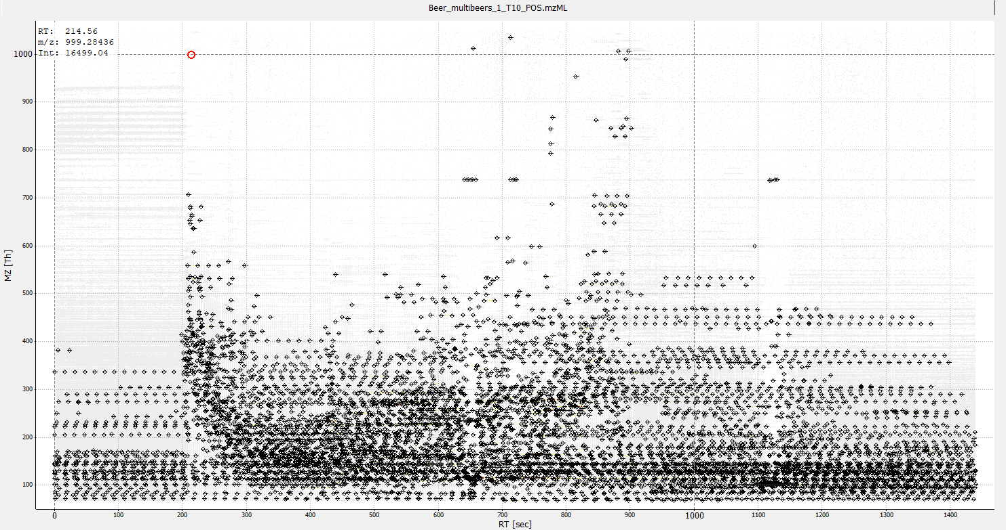
How does Top-N work?
Firstly lets look at how Top-N works…
The way I describe that to statisticians is a game of Battleships!

Slide 11

What are the rules of metabolomics Battleships?!
We can mix radar scans (MS1 scans) with dropping a single bomb (MS2 scan)
 | 1 | 2 | 3 | 4 | 5 | 6 | 7 | 8 | 9 | 10
A
B
C
D
E
F
G
H
I
J

Slide 12
What are the rules of metabolomics Battleships?!
We can mix radar scans (MS1 scans) with dropping a single bomb (MS2 scan)
 | 1 | 2 | 3 | 4 | 5 | 6 | 7 | 8 | 9 | 10
A
B
C
D
E
F
G
H
I
J
Our radar sees nothing, so we do another radar scan next

Slide 13
What are the rules of metabolomics Battleships?!
We can mix radar scans (MS1 scans) with dropping a single bomb (MS2 scan)
 | 1 | 2 | 3 | 4 | 5 | 6 | 7 | 8 | 9 | 10
A
B
C
D
E
F
G
H
I
J

Slide 14
What are the rules of metabolomics Battleships?!
We can mix radar scans (MS1 scans) with dropping a single bomb (MS2 scan)
 | 1 | 2 | 3 | 4 | 5 | 6 | 7 | 8 | 9 | 10
A
B
C
D
E
F
G
H
I
J
Our radar sees 2 ships, so we will schedule 2 bombs for our next times.

Slide 15
What are the rules of metabolomics Battleships?!
We can mix radar scans (MS1 scans) with dropping a single bomb (MS2 scan)
 | 1 | 2 | 3 | 4 | 5 | 6 | 7 | 8 | 9 | 10
A
B
C
D
E
F
G
H
I
J

Slide 16
What are the rules of metabolomics Battleships?!
We can mix radar scans (MS1 scans) with dropping a single bomb (MS2 scan)
 | 1 | 2 | 3 | 4 | 5 | 6 | 7 | 8 | 9 | 10
A
B
C
D
E
F
G
H
I
J
We drop a bomb on our first ship – we do not know (in real time) if it hits (it has and sinks)

Slide 17
What are the rules of metabolomics Battleships?!
We can mix radar scans (MS1 scans) with dropping a single bomb (MS2 scan)
 | 1 | 2 | 3 | 4 | 5 | 6 | 7 | 8 | 9 | 10
A
B
C
D
E
F
G
H
I
J
Bombing a ship is equivalent to getting a fragmentation spectra for a metabolite
This helps us identify the metabolite
Intensity (how much)
Mass (per unit charge)

Slide 18
What are the rules of metabolomics Battleships?!
We can mix radar scans (MS1 scans) with dropping a single bomb (MS2 scan)
 | 1 | 2 | 3 | 4 | 5 | 6 | 7 | 8 | 9 | 10
A
B
C
D
E
F
G
H
I
J

Slide 19
What are the rules of metabolomics Battleships?!
We can mix radar scans (MS1 scans) with dropping a single bomb (MS2 scan)
 | 1 | 2 | 3 | 4 | 5 | 6 | 7 | 8 | 9 | 10
A
B
C
D
E
F
G
H
I
J
We drop a bomb on our second ship – we do not know if it hits (it hasn’t, the ship was too small)

Slide 20
What are the rules of metabolomics Battleships?!
We can mix radar scans (MS1 scans) with dropping a single bomb (MS2 scan)
 | 1 | 2 | 3 | 4 | 5 | 6 | 7 | 8 | 9 | 10
A
B
C
D
E
F
G
H
I
J

Slide 21
What are the rules of metabolomics Battleships?!
We can mix radar scans (MS1 scans) with dropping a single bomb (MS2 scan)
 | 1 | 2 | 3 | 4 | 5 | 6 | 7 | 8 | 9 | 10
A
B
C
D
E
F
G
H
I
J
We completed 2 bomb drops, so we go back to a radar scan.
We see 3 ships and we schedule our next 2 bombs (max 2 bombs dropped per radar scan)

Slide 22
What are the rules of metabolomics Battleships?!
We can mix radar scans (MS1 scans) with dropping a single bomb (MS2 scan)
 | 1 | 2 | 3 | 4 | 5 | 6 | 7 | 8 | 9 | 10
A
B
C
D
E
F
G
H
I
J

Slide 23
What are the rules of metabolomics Battleships?!
We can mix radar scans (MS1 scans) with dropping a single bomb (MS2 scan)
 | 1 | 2 | 3 | 4 | 5 | 6 | 7 | 8 | 9 | 10
A
B
C
D
E
F
G
H
I
J
Generally, hitting a ship twice does not help us

Slide 24
What are the rules of metabolomics Battleships?!
We can mix radar scans (MS1 scans) with dropping a single bomb (MS2 scan)
 | 1 | 2 | 3 | 4 | 5 | 6 | 7 | 8 | 9 | 10
A
B
C
D
E
F
G
H
I
J

Slide 25
What are the rules of metabolomics Battleships?!
We can mix radar scans (MS1 scans) with dropping a single bomb (MS2 scan)
 | 1 | 2 | 3 | 4 | 5 | 6 | 7 | 8 | 9 | 10
A
B
C
D
E
F
G
H
I
J

Slide 26
What are the rules of metabolomics Battleships?!
We can mix radar scans (MS1 scans) with dropping a single bomb (MS2 scan)
 | 1 | 2 | 3 | 4 | 5 | 6 | 7 | 8 | 9 | 10
A
B
C
D
E
F
G
H
I
J

Slide 27
What are the rules of metabolomics Battleships?!
We can mix radar scans (MS1 scans) with dropping a single bomb (MS2 scan)
 | 1 | 2 | 3 | 4 | 5 | 6 | 7 | 8 | 9 | 10
A
B
C
D
E
F
G
H
I
J

Slide 28
What are the rules of metabolomics Battleships?!
We can mix radar scans (MS1 scans) with dropping a single bomb (MS2 scan)
 | 1 | 2 | 3 | 4 | 5 | 6 | 7 | 8 | 9 | 10
A
B
C
D
E
F
G
H
I
J

Slide 29
What are the rules of metabolomics Battleships?!
We can mix radar scans (MS1 scans) with dropping a single bomb (MS2 scan)
 | 1 | 2 | 3 | 4 | 5 | 6 | 7 | 8 | 9 | 10
A
B
C
D
E
F
G
H
I
J

Slide 30
What are the rules of metabolomics Battleships?!
We can mix radar scans (MS1 scans) with dropping a single bomb (MS2 scan)
 | 1 | 2 | 3 | 4 | 5 | 6 | 7 | 8 | 9 | 10
A
B
C
D
E
F
G
H
I
J

Slide 31
What are the rules of metabolomics Battleships?!
We can mix radar scans (MS1 scans) with dropping a single bomb (MS2 scan)
 | 1 | 2 | 3 | 4 | 5 | 6 | 7 | 8 | 9 | 10
A
B
C
D
E
F
G
H
I
J

Slide 32
What are the rules of metabolomics Battleships?!
We can mix radar scans (MS1 scans) with dropping a single bomb (MS2 scan)
 | 1 | 2 | 3 | 4 | 5 | 6 | 7 | 8 | 9 | 10
A
B
C
D
E
F
G
H
I
J

Slide 33
Optimising DDA acquisition
A few different DDA methods are currently implemented within ViMMS
We can use the simulated environment to test different parameter settings on a previously collected sample
Advantage: No machine time or sample costs. Optimised performance for next DDA acquisition

Slide 34
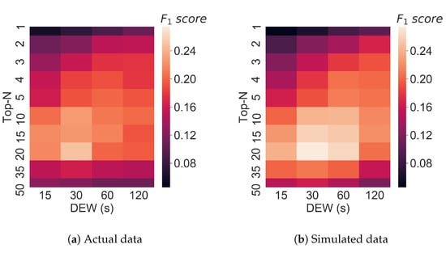
Optimising Top-N
We compared performance of our ViMMS Top-N controller (simulated chemicals) vs machine Top-N (same real sample)
Results show simulations in ViMMS closely match the real performance
Wandy, J., Davies, V., et al. (2019). In silico optimization of mass spectrometry fragmentation strategies in metabolomics. Metabolites.

Slide 35
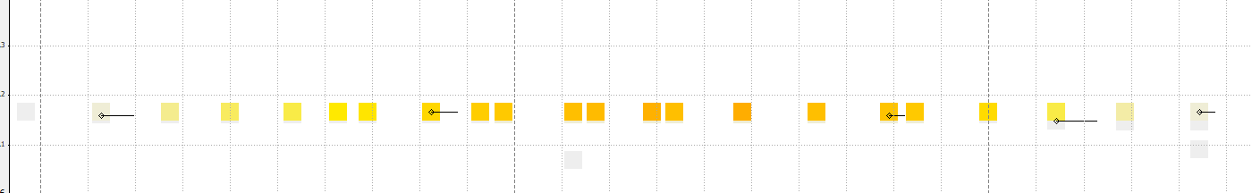
Developing new DDA methods
We can also develop new methods
We motivated our methods to avoid repeated fragmentation events (e.g. below)
We can then compare them against Top-N
Davies, V., et al. (2021). Rapid development of improved data-dependent acquisition strategies. Analytical chemistry.

Slide 36
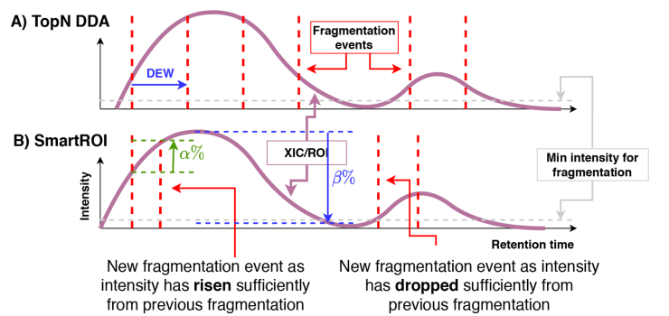
SmartROI
SmartROI constructs ROIs in real time
Uses rises and falls in intensity to determine if an MS2 scan is allowed

Slide 37
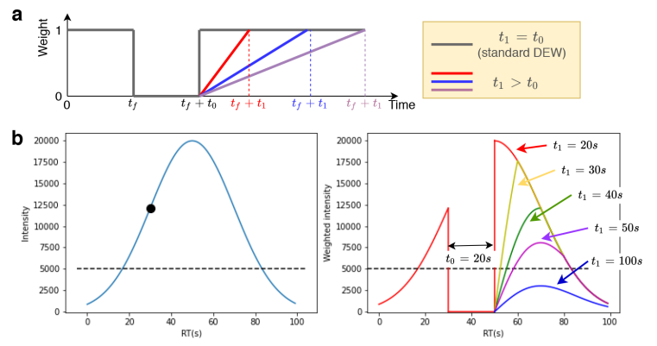
WeightedDEW
WeightedDEW constructs a new type of Dynamic Exclusion Window (DEW)

Slide 38
In-Silico Development in ViMMS
ViMMS allowed us to develop and debug these methods before ever using samples or machine time
We then optimised the parameters of the methods to maximise peak coverage (or any other metric you choose)

Slide 39
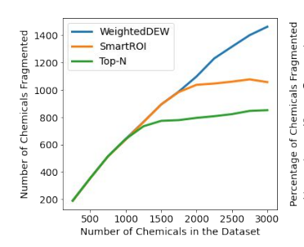
In-Silico Validation in ViMMS
We then tested them out in different simulated scenarios in ViMMS
Big increase in performance when there are a large number of metabolites (peaks)

Slide 40
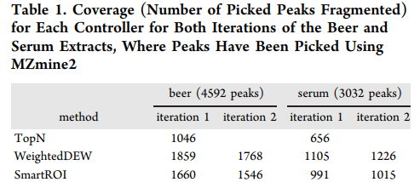
Real Experimental Validation
We then tested the methods on real samples (beer and serum)
Results showed a 50%+ increase in performance

Slide 41
What about multi sample DDA methods?
Under the same principles, we can also develop multi-sample DDA methods and test existing ones, e.g. DsDA, MSplanner

Slide 42
TopNEXt: Automated Exclusion
TopNEXt is a modular framework for multi-sample acquisition
It scores possible MS2 scans based on previously observed scans in the current and previous samples
McBride, R., …, Davies, V., … et al. (2023). TopNEXt: Automatic DDA Exclusion Framework for Multi-Sample Mass Spectrometry Experiments. bioRxiv (submitted to Bioinformatics).

Slide 43
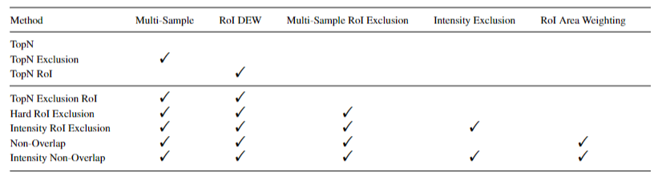
TopNEXt: Automated Exclusion
It contains a number of different options and can easily be extended
McBride, R., …, Davies, V., … et al. (2023). TopNEXt: Automatic DDA Exclusion Framework for Multi-Sample Mass Spectrometry Experiments. bioRxiv (submitted to Bioinformatics).

Slide 44
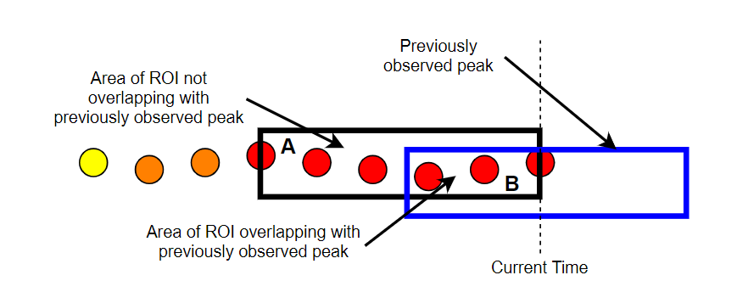
Non-Overlap
Beyond the framework, it also introduces the concept of (non-)overlap
It looks at how much a current ROI (black) overlaps with a previous ROI (blue) and scores it based on how much they overlap
The more it overlaps with a fragmented previous ROI, the lower it will be scored
There is also a version based on the intensity of the previous MS2 scans

Slide 45
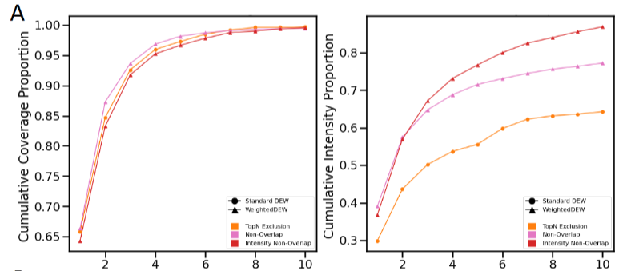
TopNEXt: Automated Exclusion

Slide 46
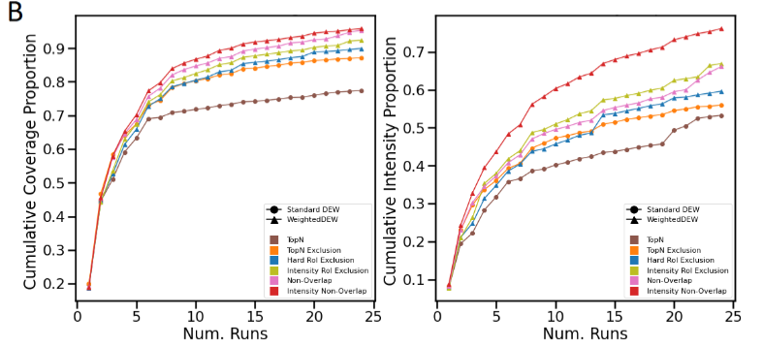
TopNEXt: Automated Exclusion

Slide 47
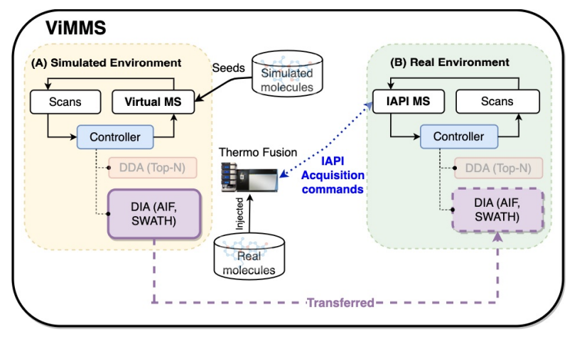
What about DIA?
We can similarly implement DIA in ViMMS (and eventually TopNEXt)

Slide 48
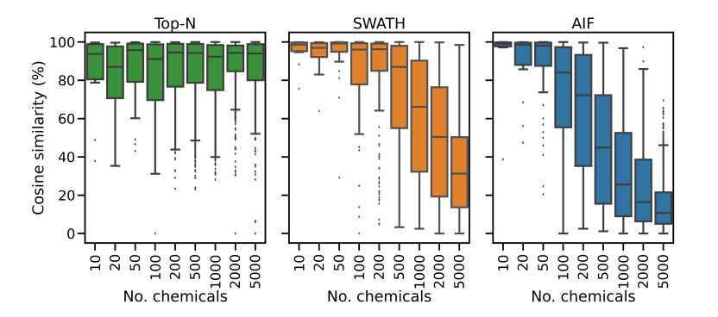
DIA vs DDA
We have implemented SWATH and AIF within ViMMS
Compared them against DDA

Slide 49
Bottleneck of DIA?
We can construct our own DIA methods or even hybrid DDA-DIA methods
Limitation appears to be the deconvolution
Generally inflexible
Low accuracy
Overly correlated predicted spectra
ViMMS allows us to properly evaluate deconvolution and we have began designing our own method
I see this as the immediate application of ViMMS
Wandy, J., ... & Davies, V. (2023). Simulated-to-real Benchmarking of Acquisition Methods in Untargeted Metabolomics. Frontiers in Molecular Biosciences.

Slide 50
Any questions?
Big thank you to all my collaborators:
University of Glasgow: Joe Wandy, Rónán Daly, Simon Rogers, Ross McBride, Kevin Bryson, Stefan Weidt, Nikolaos Terzis, Alice Miller
Wageningen University: Justin J.J. van der Hooft
Ideas for ViMMS or any further questions
Email: vinny.davies@glasgow.ac.uk
Twitter: vinny_davies89
Slides available at:
https://github.com/vinnydavies/presentations

