Slide 1


SPAR-Forest – A spatial autoregressive random forest algorithm for small-area spatial prediction
Dr Vinny Davies, University of Glasgow
Joint work with Prof Duncan Lee and Cara MacBride

Slide 2
Data
Data is Scottish Government data on median property areas in different areas of Scotland
Areas are split into Data Zones (N=6,881) which are nested within Local Authorities
For each area, we have variables that represented
Small area characteristics
Average property features
For all models
The prices are logged
Groups of variables are replaced with low dimensional PCA representations

Slide 3
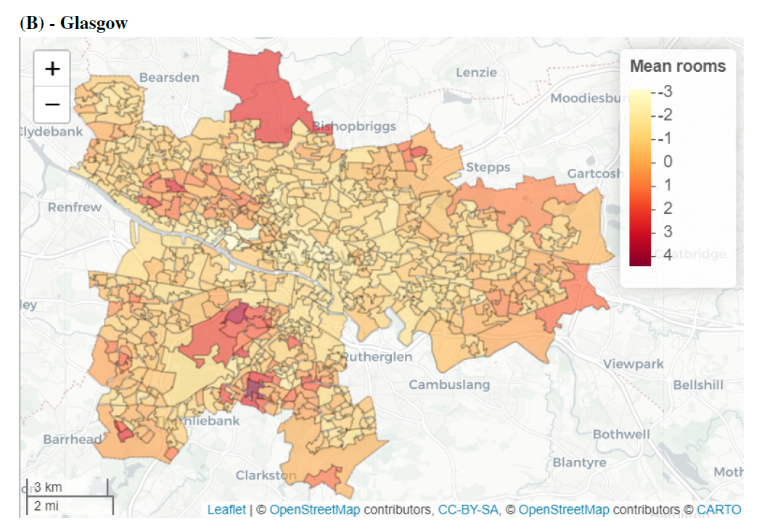
Data – Glasgow

Slide 4
Spatial Smoothing Models
Spatial smoothing models are commonly used to deal with this data
Residual correlation between areas are accounted for through autocorrelated random effects
Models traditionally take the following form:
Features / Covariates
Autocorrelated random effects

Slide 5
CAR and SAR Models
Conditional autoregressive (CAR) and spatial autoregressive (SAR) models are commonly specified for the random effects
We use both CAR and SAR as competitor models and also as part of SPAR-Forest
We use the CAR prior of Leroux, Lei, and Breslow (2000), which has a joint prior of
For the SAR model, we use

Slide 6
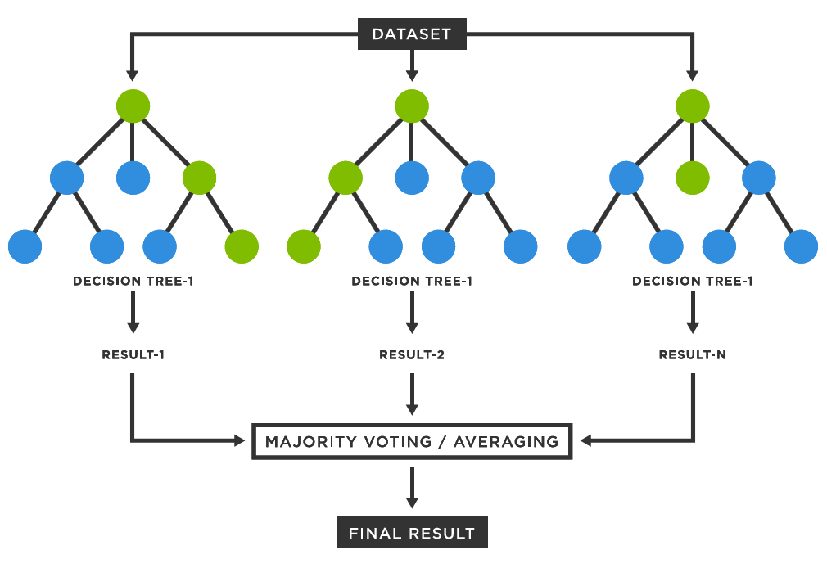
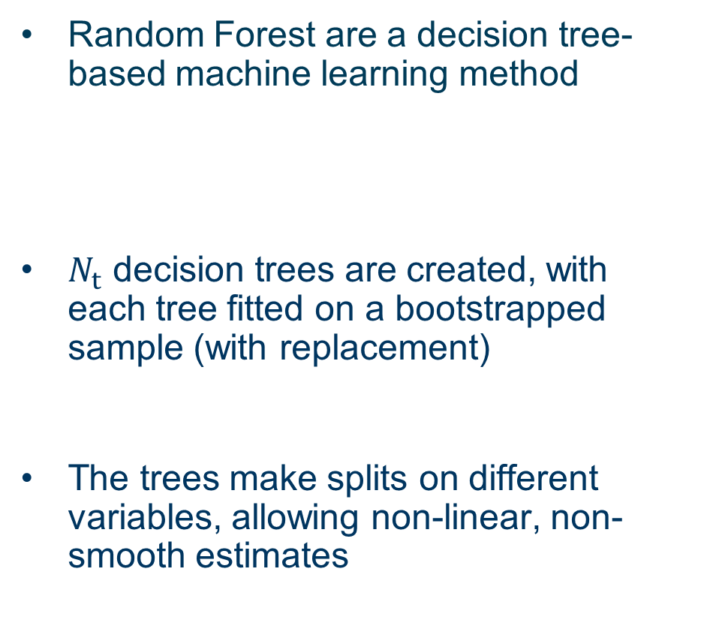
Random Forests
Random Forest are a decision tree-based machine learning method
$N_{t}$ decision trees are created, with each tree fitted on a bootstrapped sample (with replacement)
The trees make splits on different variables, allowing non-linear, non-smooth estimates
Image from Medium

Slide 7
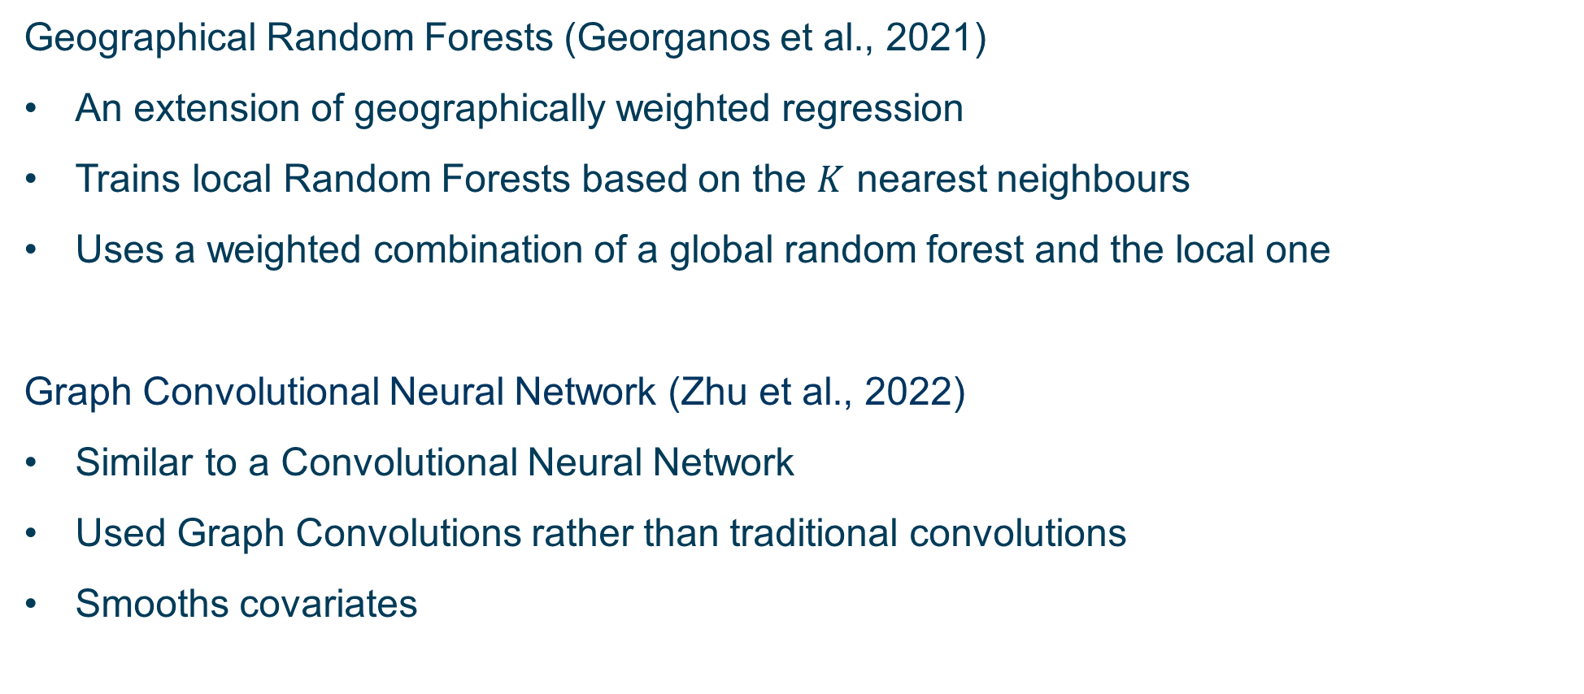
Other Competitor Models
Geographical Random Forests (Georganos et al., 2021)
An extension of geographically weighted regression
Trains local Random Forests based on the $K$ nearest neighbours
Uses a weighted combination of a global random forest and the local one
Graph Convolutional Neural Network (Zhu et al., 2022)
Similar to a Convolutional Neural Network
Used Graph Convolutions rather than traditional convolutions
Smooths covariates
Georganos, S. et al. (2021). Geocarto Iinternational.
Zhu, D. (2022). Geoinformatica.

Slide 8
SPAR-Forest
SPAR-Forest aims to combine random forests with CAR/SAR models
Based on the idea that the observed data is a noisy version of true values
True values

Slide 9
SPAR-Forest
SPAR-Forest aims to combine random forests with CAR/SAR models
Based on the idea that the observed data is a noisy version of true values
The true values can be estimated using a random forest and decomposed to:
Random Forest model estimates
True values

Slide 10
SPAR-Forest
SPAR-Forest aims to combine random forests with CAR/SAR models
Based on the idea that the observed data is a noisy version of true values
The true values can be estimated using a random forest and decomposed to:
The difference between true values and estimate are likely to be autocorrelated, so can be replaced with spatial correlated random effects

Slide 11
SPAR-Forest – Algorithm
Stage 0 –
Stage 1 –
A –
B – Fit the random forest to the decorrelated target variables, producing estimates for out-of-sample predictions
C – Fit the spatial random effects model using INLA, with the spatial random effects represented by either a CAR or SAR model
Stage 2 –

Slide 12
SPAR-Forest – Algorithm
Stage 0 – Initialise the random effects to be 0
Stage 1 –
A –
B – Fit the random forest to the decorrelated target variables, producing estimates for out-of-sample predictions
C – Fit the spatial random effects model using INLA, with the spatial random effects represented by either a CAR or SAR model
Stage 2 –

Slide 13
SPAR-Forest – Algorithm
Stage 0 – Initialise the random effects to be 0
Stage 1 – Iterate the following steps to optimise the algorithm
A –
B – Fit the random forest to the decorrelated target variables, producing estimates for out-of-sample predictions
C – Fit the spatial random effects model using INLA, with the spatial random effects represented by either a CAR or SAR model
Stage 2 –

Slide 14

SPAR-Forest – Algorithm
Stage 0 – Initialise the random effects to be 0
Stage 1 – Iterate the following steps to optimise the algorithm
A – Compute the decorrelated target variable
B – Fit the random forest to the decorrelated target variables, producing estimates for out-of-sample predictions
C – Fit the spatial random effects model using INLA, with the spatial random effects represented by either a CAR or SAR model
Stage 2 –

Slide 15

SPAR-Forest – Algorithm
Stage 0 – Initialise the random effects to be 0
Stage 1 – Iterate the following steps to optimise the algorithm
A – Compute the decorrelated target variable
B – Fit the random forest to the decorrelated target variables, producing estimates for out-of-sample predictions
C – Fit the spatial random effects model using INLA, with the spatial random effects represented by either a CAR or SAR model
Stage 2 –

Slide 16
SPAR-Forest – Algorithm
Stage 0 – Initialise the random effects to be 0
Stage 1 – Iterate the following steps to optimise the algorithm
A – Compute the decorrelated target variable
B – Fit the random forest to the decorrelated target variables, producing estimates for out-of-sample predictions
C – Fit the spatial random effects model using INLA, with the spatial random effects represented by either a CAR or SAR model
Stage 2 –

Slide 17
SPAR-Forest – Algorithm
Stage 0 – Initialise the random effects to be 0
Stage 1 – Iterate the following steps to optimise the algorithm
A – Compute the decorrelated target variable
B – Fit the random forest to the decorrelated target variables, producing estimates for out-of-sample predictions
C – Fit the spatial random effects model using INLA, with the spatial random effects represented by either a CAR or SAR model
Stage 2 – Produce out-of-sample estimates and 95% prediction intervals

Slide 18
Parameter Optimisation
We split the data into Train, Validation, and Test sets
We do this split 5 times, to avoid unfair comparison from outliers
Parameters for each method are optimised by Grid Search and Cross Validation
Results are not shown for Neural Networks, GCNN, or SPAR-NN, as all methods were comparatively poorer than those proposed and use as comparison

Slide 19
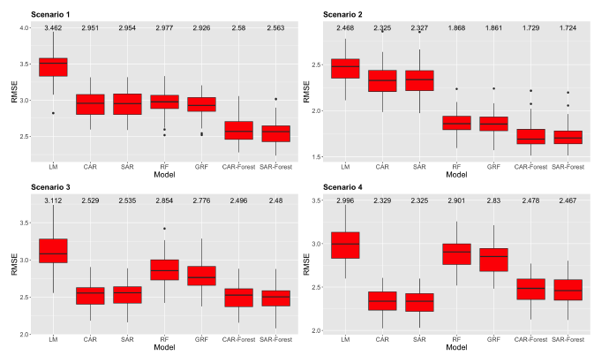
Results – Simulation Study
We showed through simulation studies that the SPAR-Forest models worked consistently multiple alternative scenarios

Slide 20
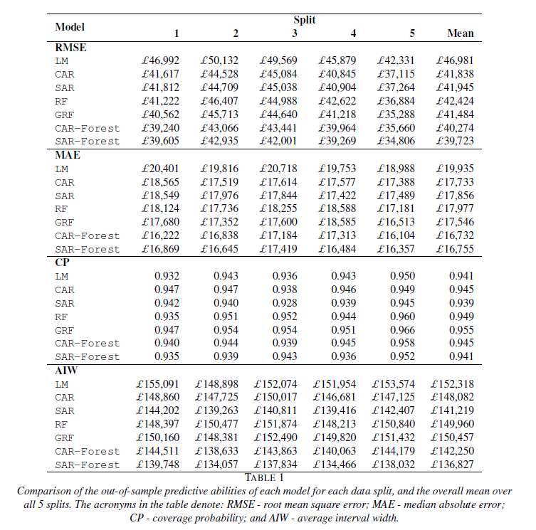
Results – House Price Data
We compared the methods in terms of RMSE and MAE
The SPAR-Forest methods gave the best performance

Slide 21
Results – House Price Data
We also compared their 95% Coverage Probabilities (CP) and their Average Interval Widths (AIW)

Slide 22
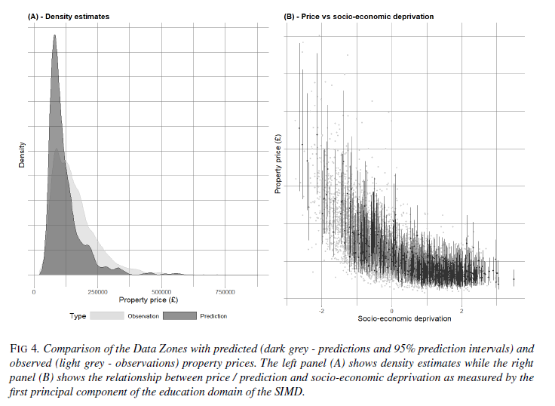
Results – Unobserved Households

Slide 23

SPAR-Forest Paper
The paper is currently under submission, but is available on ArXiv
The code is available on GitHub
Paper
Code

Slide 24




If you have any questions, then please feel free to ask. You can also contact me at Vinny.Davies@Glasgow.ac.uk Slides available at https://github.com/vinnydavies/presentations
#UofGWorldChangers
@UofGlasgow

