Slide 1

What is a Digital Twin?
Dr Vinny Davies
University of Glasgow

Slide 2

What is a Digital Twin?
A digital twin is essentially a digital replica of some real-life process
Generally, the digital twin will be a computerised version of the real-life process that allows us to simulate the process and understand what would happen in different situations

Slide 3


So, what actually is a Digital Twin?
Digital Twin
Real System

Slide 4
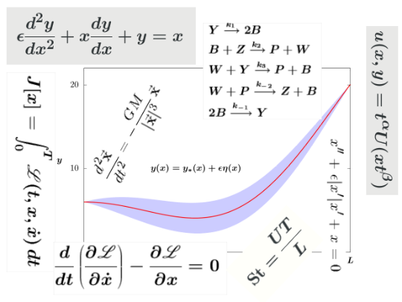
So, what actually is a Digital Twin?
Physical Model
Digital Twin
Real System

Slide 5
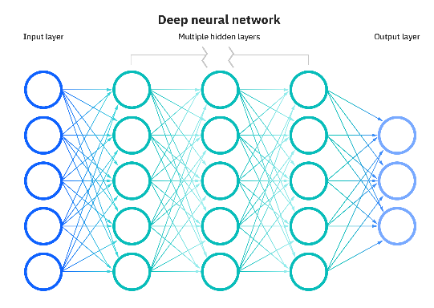
So, what actually is a Digital Twin?
ML / AI Model
Digital Twin
Real System

Slide 6

So, what actually is a Digital Twin?
Digital Twin
Real System
Code

Slide 7
So, what actually is a Digital Twin?
Physical Model
ML / AI Model
Digital Twin
Real System
Code

Slide 8
So, what actually is a Digital Twin?
Digital Twin
Physical Model
ML / AI Model
Digital Twin
Real System
Code

Slide 9
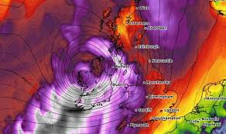
So, what actually is a Digital Twin?
Weather Data
Digital Twin
Physical Model
ML / AI Model
Digital Twin
Code

Slide 10
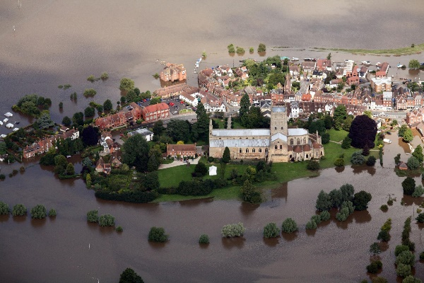
So, what actually is a Digital Twin?
Weather Data
Digital Twin
Physical Model
Flooding Data
ML / AI Model
Digital Twin
Code

Slide 11
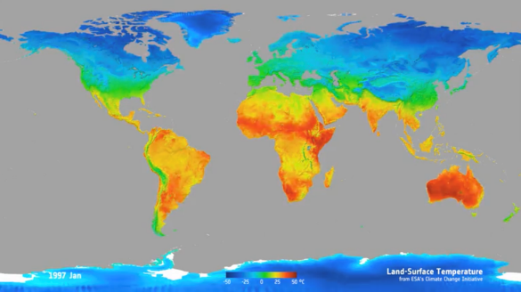
So, what actually is a Digital Twin?
Weather Data
Digital Twin
Physical Model
Flooding Data
ML / AI Model
Temperature Data
Digital Twin
Code

Slide 12
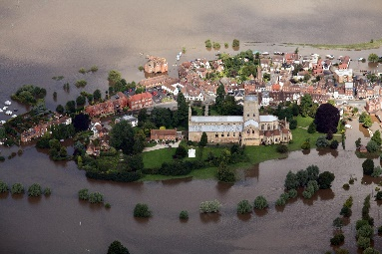

So, what actually is a Digital Twin?
Data
Digital Twin
Physical Model
ML / AI Model
Digital Twin
Code

Slide 13
So, what actually is a Digital Twin?
Training models and parameters
We can use the combination of our digital twin and available data to train the models and parameters of the digital twin
Data
Digital Twin
Physical Model
ML / AI Model
Digital Twin
Code

Slide 14
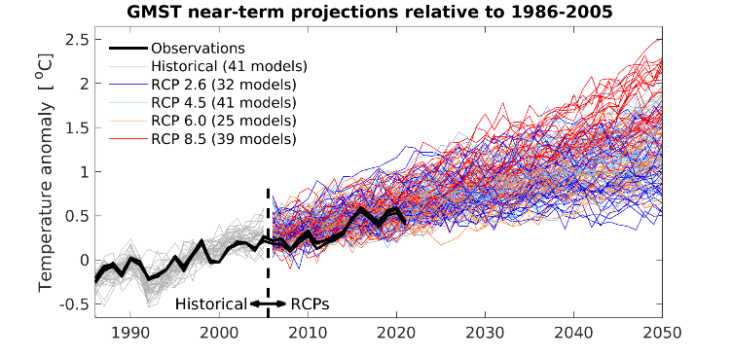
So, what actually is a Digital Twin?
Training models and parameters
We can use the combination of our digital twin and available data to train the models and parameters of the digital twin
Data
Digital Twin
Physical Model
ML / AI Model
Scenario Planning
Digital Twin
Code

Slide 15
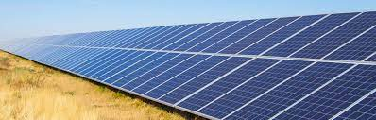
So, what actually is a Digital Twin?
Training models and parameters
We can use the combination of our digital twin and available data to train the models and parameters of the digital twin
Data
Digital Twin
Physical Model
ML / AI Model
Scenario Planning
Digital Twin
Tool / Intervention
Code

