Slide 1

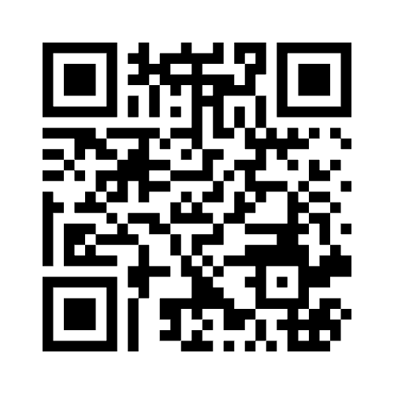
Redesigning Assessments in Times of Generative AI: a Python Example
Dr Vinny Davies presenting for Dr Jenn Gaskell
University of Glasgow

Slide 2
Redesigning Assessments in Times of Generative AI: a Python Example
Dr Vinny Davies presenting for Dr Jenn Gaskell
University of Glasgow
DISCLAIMER
My total contribution was a 5min review. All work done by Dr Jenn Gaskell and Dr Andrew Elliott. Jenn just couldn’t make it today!

Slide 3
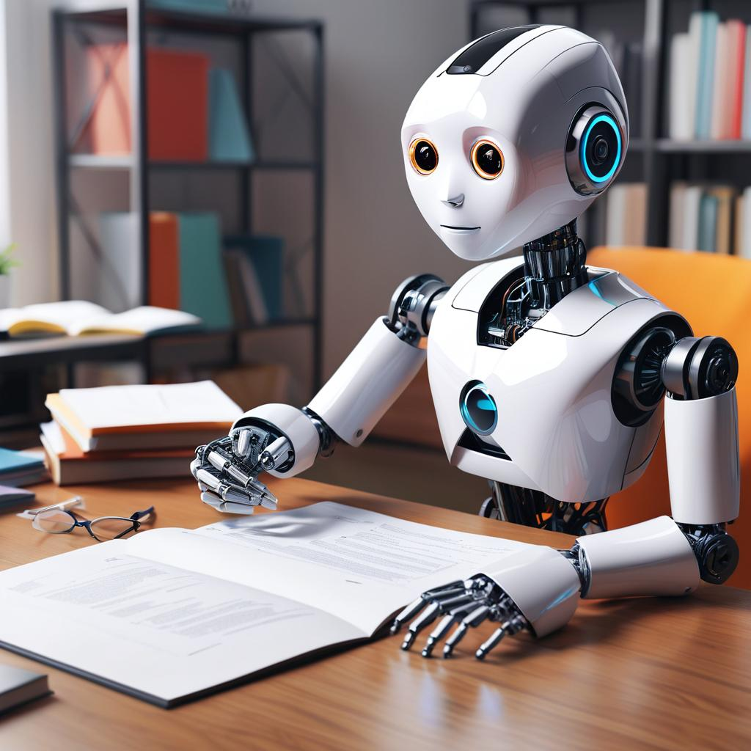

The Rise of Transformers

Slide 4
ODL Python Assessment
Our Online Distance Learning (ODL) course covers Statistics and Data Analytics
Assignments are
Take-Home
Open Book
Generous Time Window
Python Assessment aim to test programming skills and must be suitable for people with mixed levels of programming skill

Slide 5
Performance (ChatGPT 3.5)
Excellent, well-written code
Scored full marks for most questions in a few seconds
Neater than the lecturer
Adds professional comments if asked
For some questions, the lecturers learnt new coding techniques!

Slide 6
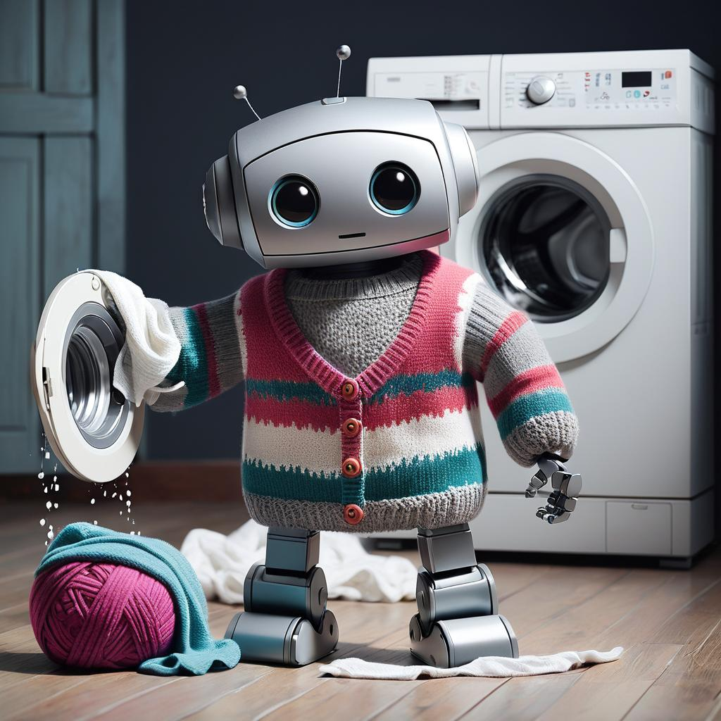
Problems & Opportunites
Can solve the old assignments!
Be aware of errors, bias & limitations
Must have checks
User error or hallucinations
Opportunity to update our assessments and learning outcomes to match the modern working world
Saves time on easier tasks so we can do higher-level thinking

Slide 7
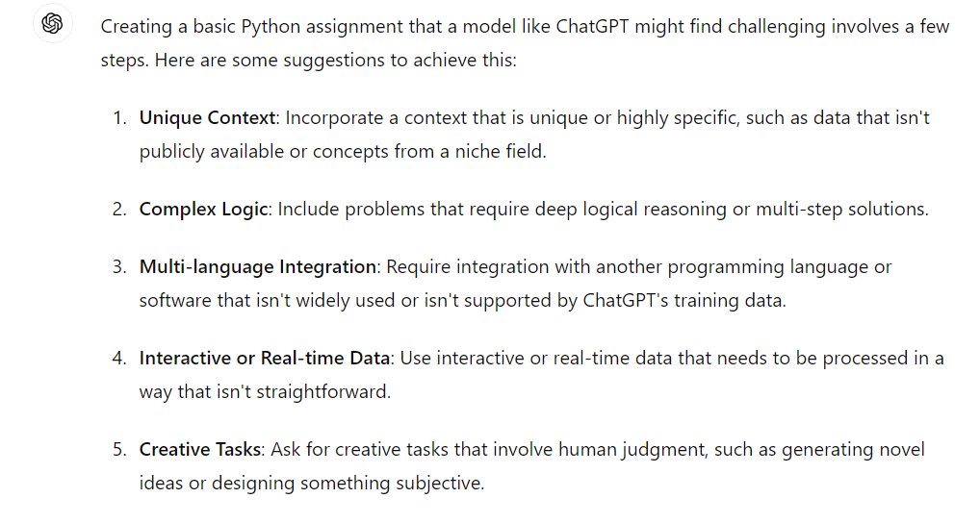
What are the assessment options?
Make question longer – not ideal
Make uncopiable – not good for accessibility
ChatGPT 4.0 is fine with this anyways
Ask ChatGPT:
Integrate GenAI into assessment
Maybe one for future?

Slide 8
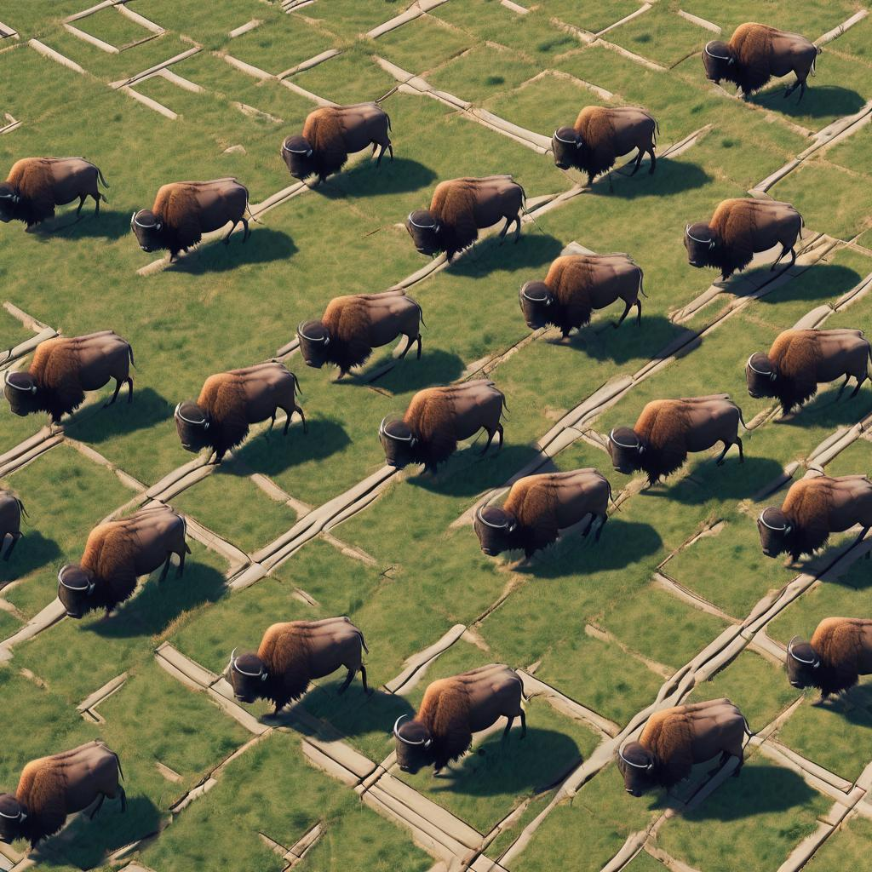
ODL Python Assignment: Buffalo
Created a new Python library, with many functions and files, hosted on GitHub
Hosted documentation on a separate
website
Writing a class, subclass and plotting
GitHub repository is not in ChatGPT database
Can be downloaded and queried manually

Slide 9

Conclusions & Results
Higher start-up cost
Similar grades to previous years
Students learnt new skills: GitHub integration, using external libraries, reading docs
Still tested basic Python
Genuinely written by students

Slide 10
Incorporating Generative AI
Future plans to teach how to use generative AI
Incorporate into skills course as important for future jobs
How to use within assessment is less clear

Slide 11
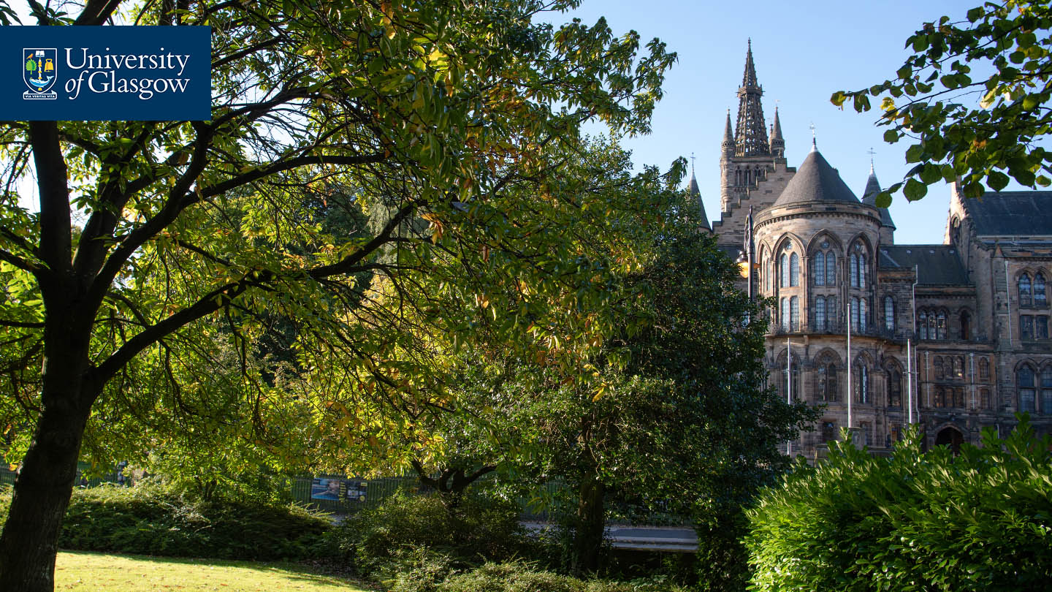
Thanks for Listening
Let me know if you have any questions
Or feel free to reach out to Jenn at: Jennifer.Gaskell@Glasgow.ac.uk

