Slide 1

ViMMS: Improved Real-Time Data Acquisition Methods for Metabolomics LC-MS/MS Experiments
Dr Vinny Davies, University of Glasgow

Slide 2

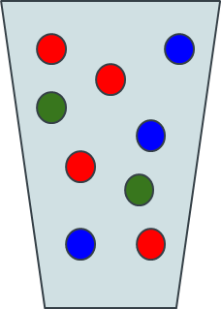
Metabolomics Workflow
Sample + Sample Preparation

Slide 3
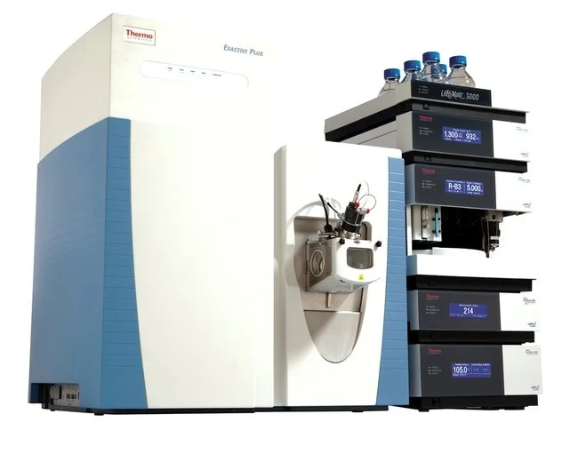
Metabolomics Workflow
Sample + Sample Preparation
Data Collection

Slide 4
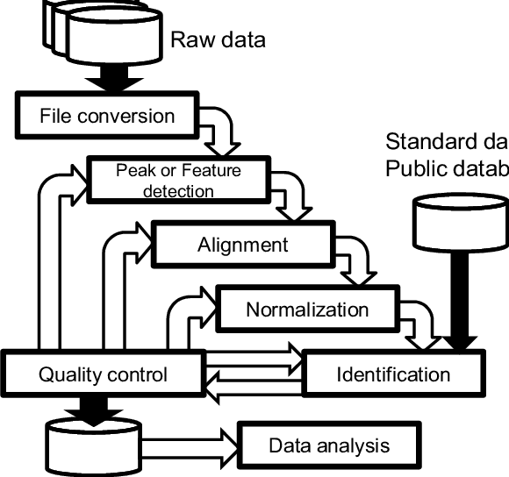
Metabolomics Workflow
Sample + Sample Preparation
Data Collection
Data Processing

Slide 5
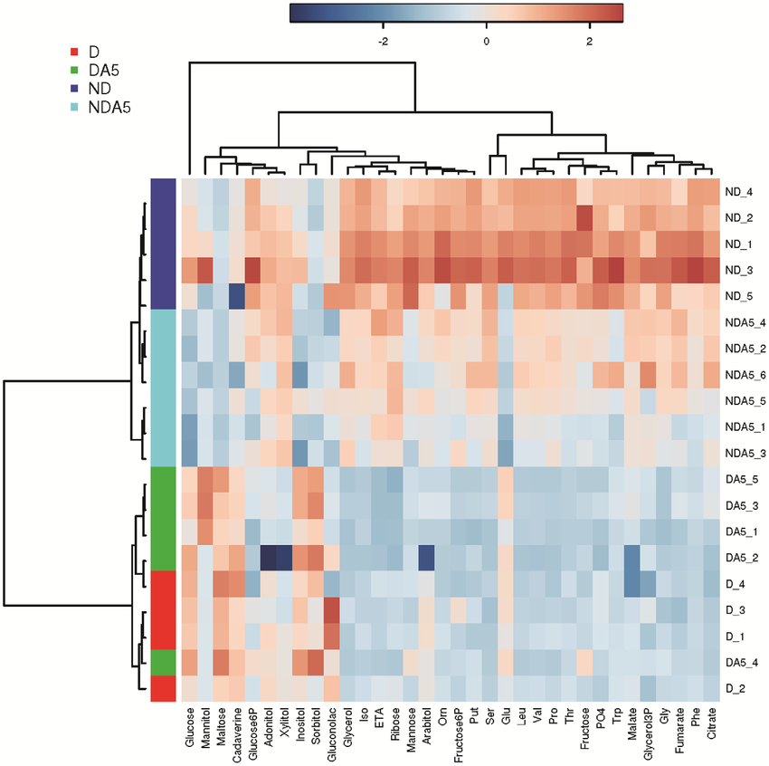
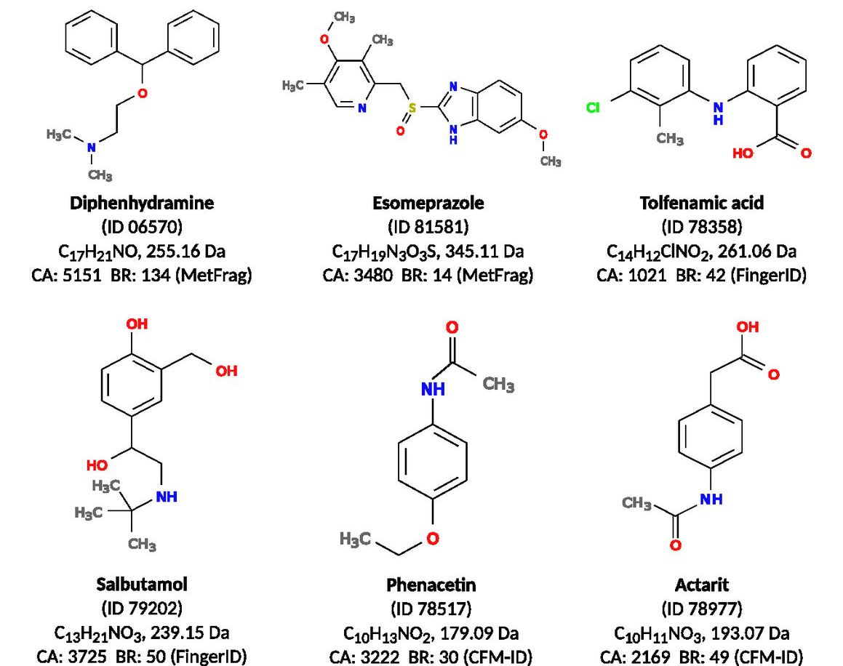
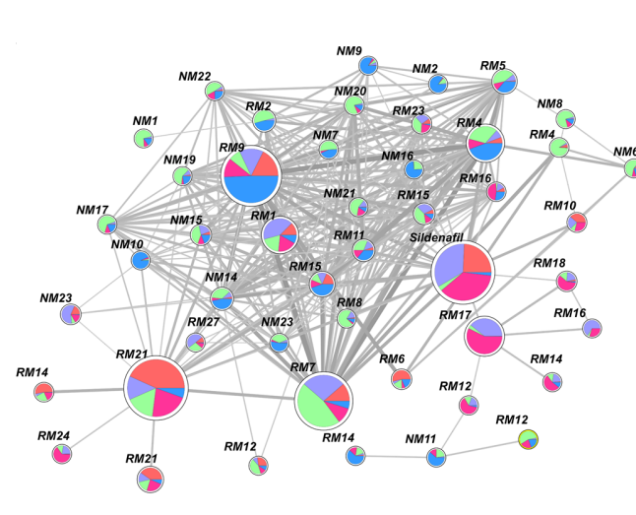
Statistical Analysis
Metabolomics Workflow
Sample + Sample Preparation
Data Collection
Data Processing
Metabolite Identification
Molecular Networking

Slide 6
Statistical Analysis
Metabolomics Workflow
Sample + Sample Preparation
Data Collection
Data Processing
Metabolite Identification
Molecular Networking

Slide 7
Metabolomics Mass Spectrometry Experiments
Samples can be extremely varied, but standard option is blood, urine, etc – We use beer!
No data protection issues
Cheap and easily available
Similar enough for method development
Aim to optimise how we identify metabolites
Often we do not collect all the information needed for downstream analyses
Metabolite Identification

Slide 8
Scan Types
There are two main types of scan in LC-MS/MS (DDA)
We switch between these scans to collect data
MS1 Scans
Identify the presence of metabolite
Quantify the about of metabolite in the sample
MS2 scans
Collect individual metabolite spectra
Allows metabolite identification
I like to treat it like a game of Battleships…
Intensity
m/z

Slide 9

What are the rules of metabolomics Battleships?!
We can mix radar scans (MS1 scans) with dropping a single bomb (MS2 scan)
 | 1 | 2 | 3 | 4 | 5 | 6 | 7 | 8 | 9 | 10
A
B
C
D
E
F
G
H
I
J

Slide 10
What are the rules of metabolomics Battleships?!
We can mix radar scans (MS1 scans) with dropping a single bomb (MS2 scan)
 | 1 | 2 | 3 | 4 | 5 | 6 | 7 | 8 | 9 | 10
A
B
C
D
E
F
G
H
I
J
Our radar sees nothing, so we do another radar scan next

Slide 11
What are the rules of metabolomics Battleships?!
We can mix radar scans (MS1 scans) with dropping a single bomb (MS2 scan)
 | 1 | 2 | 3 | 4 | 5 | 6 | 7 | 8 | 9 | 10
A
B
C
D
E
F
G
H
I
J

Slide 12
What are the rules of metabolomics Battleships?!
We can mix radar scans (MS1 scans) with dropping a single bomb (MS2 scan)
 | 1 | 2 | 3 | 4 | 5 | 6 | 7 | 8 | 9 | 10
A
B
C
D
E
F
G
H
I
J
Our radar sees 2 ships, so we will schedule 2 bombs for our next times.

Slide 13
What are the rules of metabolomics Battleships?!
We can mix radar scans (MS1 scans) with dropping a single bomb (MS2 scan)
 | 1 | 2 | 3 | 4 | 5 | 6 | 7 | 8 | 9 | 10
A
B
C
D
E
F
G
H
I
J

Slide 14
What are the rules of metabolomics Battleships?!
We can mix radar scans (MS1 scans) with dropping a single bomb (MS2 scan)
 | 1 | 2 | 3 | 4 | 5 | 6 | 7 | 8 | 9 | 10
A
B
C
D
E
F
G
H
I
J
We drop a bomb on our first ship – we do not know (in real time) if it hits (it has and sinks)

Slide 15
What are the rules of metabolomics Battleships?!
We can mix radar scans (MS1 scans) with dropping a single bomb (MS2 scan)
 | 1 | 2 | 3 | 4 | 5 | 6 | 7 | 8 | 9 | 10
A
B
C
D
E
F
G
H
I
J
Bombing a ship is equivalent to getting a fragmentation spectra for a metabolite
This helps us identify the metabolite
Intensity (how much)
Mass (per unit charge)

Slide 16
What are the rules of metabolomics Battleships?!
We can mix radar scans (MS1 scans) with dropping a single bomb (MS2 scan)
 | 1 | 2 | 3 | 4 | 5 | 6 | 7 | 8 | 9 | 10
A
B
C
D
E
F
G
H
I
J

Slide 17
What are the rules of metabolomics Battleships?!
We can mix radar scans (MS1 scans) with dropping a single bomb (MS2 scan)
 | 1 | 2 | 3 | 4 | 5 | 6 | 7 | 8 | 9 | 10
A
B
C
D
E
F
G
H
I
J
We drop a bomb on our second ship – we do not know if it hits (it hasn’t, the ship was too small)

Slide 18
What are the rules of metabolomics Battleships?!
We can mix radar scans (MS1 scans) with dropping a single bomb (MS2 scan)
 | 1 | 2 | 3 | 4 | 5 | 6 | 7 | 8 | 9 | 10
A
B
C
D
E
F
G
H
I
J

Slide 19
What are the rules of metabolomics Battleships?!
We can mix radar scans (MS1 scans) with dropping a single bomb (MS2 scan)
 | 1 | 2 | 3 | 4 | 5 | 6 | 7 | 8 | 9 | 10
A
B
C
D
E
F
G
H
I
J
We completed 2 bomb drops, so we go back to a radar scan.
We see 3 ships and we schedule our next 2 bombs (max 2 bombs dropped per radar scan)

Slide 20
What are the rules of metabolomics Battleships?!
We can mix radar scans (MS1 scans) with dropping a single bomb (MS2 scan)
 | 1 | 2 | 3 | 4 | 5 | 6 | 7 | 8 | 9 | 10
A
B
C
D
E
F
G
H
I
J

Slide 21
What are the rules of metabolomics Battleships?!
We can mix radar scans (MS1 scans) with dropping a single bomb (MS2 scan)
 | 1 | 2 | 3 | 4 | 5 | 6 | 7 | 8 | 9 | 10
A
B
C
D
E
F
G
H
I
J
Generally, hitting a ship twice does not help us

Slide 22
What are the rules of metabolomics Battleships?!
We can mix radar scans (MS1 scans) with dropping a single bomb (MS2 scan)
 | 1 | 2 | 3 | 4 | 5 | 6 | 7 | 8 | 9 | 10
A
B
C
D
E
F
G
H
I
J

Slide 23
What are the rules of metabolomics Battleships?!
We can mix radar scans (MS1 scans) with dropping a single bomb (MS2 scan)
 | 1 | 2 | 3 | 4 | 5 | 6 | 7 | 8 | 9 | 10
A
B
C
D
E
F
G
H
I
J

Slide 24
What are the rules of metabolomics Battleships?!
We can mix radar scans (MS1 scans) with dropping a single bomb (MS2 scan)
 | 1 | 2 | 3 | 4 | 5 | 6 | 7 | 8 | 9 | 10
A
B
C
D
E
F
G
H
I
J

Slide 25
What are the rules of metabolomics Battleships?!
We can mix radar scans (MS1 scans) with dropping a single bomb (MS2 scan)
 | 1 | 2 | 3 | 4 | 5 | 6 | 7 | 8 | 9 | 10
A
B
C
D
E
F
G
H
I
J

Slide 26
What are the rules of metabolomics Battleships?!
We can mix radar scans (MS1 scans) with dropping a single bomb (MS2 scan)
 | 1 | 2 | 3 | 4 | 5 | 6 | 7 | 8 | 9 | 10
A
B
C
D
E
F
G
H
I
J

Slide 27
What are the rules of metabolomics Battleships?!
We can mix radar scans (MS1 scans) with dropping a single bomb (MS2 scan)
 | 1 | 2 | 3 | 4 | 5 | 6 | 7 | 8 | 9 | 10
A
B
C
D
E
F
G
H
I
J

Slide 28
What are the rules of metabolomics Battleships?!
We can mix radar scans (MS1 scans) with dropping a single bomb (MS2 scan)
 | 1 | 2 | 3 | 4 | 5 | 6 | 7 | 8 | 9 | 10
A
B
C
D
E
F
G
H
I
J

Slide 29
What are the rules of metabolomics Battleships?!
We can mix radar scans (MS1 scans) with dropping a single bomb (MS2 scan)
 | 1 | 2 | 3 | 4 | 5 | 6 | 7 | 8 | 9 | 10
A
B
C
D
E
F
G
H
I
J

Slide 30
What are the rules of metabolomics Battleships?!
We can mix radar scans (MS1 scans) with dropping a single bomb (MS2 scan)
 | 1 | 2 | 3 | 4 | 5 | 6 | 7 | 8 | 9 | 10
A
B
C
D
E
F
G
H
I
J

Slide 31
Optimising Scans
Traditional methods struggle to optimally place the MS2 Scans ( )
 | 1 | 2 | 3 | 4 | 5 | 6 | 7 | 8 | 9 | 10
A
B
C
D
E
F
G
H
I
J

Slide 32
The Aims of ViMMS
ViMMS provides a way of designing methods to intelligently schedule scans
 | 1 | 2 | 3 | 4 | 5 | 6 | 7 | 8 | 9 | 10
A
B
C
D
E
F
G
H
I
J
 | 1 | 2 | 3 | 4 | 5 | 6 | 7 | 8 | 9 | 10
A
B
C
D
E
F
G
H
I
J

Slide 33


ViMMS – A Mass Spectrometer Digital Twin
ViMMS is essentially a mass spectrometer simulator

Slide 34
What is the point of ViMMS?
ViMMS fully controls scan specifications in real time
Crucially, experiments can be run via computer simulations rather than on a real MS
Some Applications of ViMMS
Evaluation of existing methods and settings
Develop, evaluate and test new methods
Control MS in real time via an API
Evaluate current tools

Slide 35
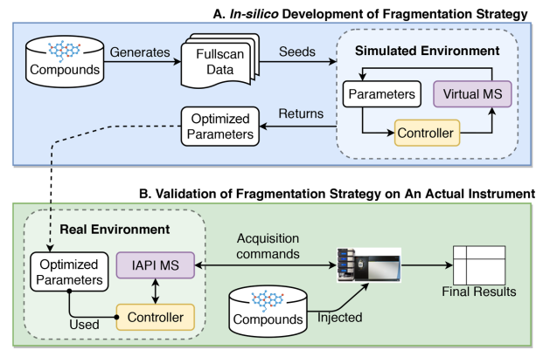
How does ViMMS work?
ViMMS has two environments
Simulated (blue)
Real (green)

Slide 36
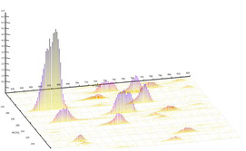
How do the simulations work?
Construct peaks from previously observed data
Take average scan timings from previous data

Slide 37
How do the real experiments work?
The real experiments works in exactly the same way except using a sample rather than simulated ViMMS chemicals

Slide 38
Controlling the Scans
Controllers score different scan options
Advanced controllers can be developed and tested using the ViMMS framework
Controllers remain consistent across simulated and real experiments

Slide 39
The Mass Spectrometer
The simulator uses the virtual mass spectrometer digital twin

Slide 40
The Mass Spectrometer
The real mass spectrometer is used for the real experiments
The controller code is linked to the real mass spec via C# bridging code
Crucially:
The controllers remain the same
The bridging code is the same for all methods

Slide 41
Optimising DDA acquisition
We can use a strategy that combines simulated and real experiments to design methods giving big development cost benefits
Simulated Results
Prototype
Controller

Slide 42
Optimising DDA acquisition
We can use a strategy that combines simulated and real experiments to design methods giving big development cost benefits
Simulated Results
Prototype
Controller
Controller

Slide 43

Optimising DDA acquisition
We can use a strategy that combines simulated and real experiments to design methods giving big development cost benefits
Simulated Results
Simulated Results
Unknown $θ$
Prototype
Controller
Controller

Slide 44

Optimising DDA acquisition
We can use a strategy that combines simulated and real experiments to design methods giving big development cost benefits
Simulated Results
Simulated Results
Unknown $θ$
Optimised $θ$
Prototype
Controller
Controller

Slide 45
Optimising DDA acquisition
We can use a strategy that combines simulated and real experiments to design methods giving big development cost benefits
Simulated Results
Simulated Results
Unknown $θ$
Optimised $θ$
Prototype
Controller
Controller
Controller

Slide 46
Optimising DDA acquisition
We can use a strategy that combines simulated and real experiments to design methods giving big development cost benefits
Simulated Results
Simulated Results
Real Results
Unknown $θ$
Optimised $θ$
Prototype
Controller
Controller
Controller

Slide 47
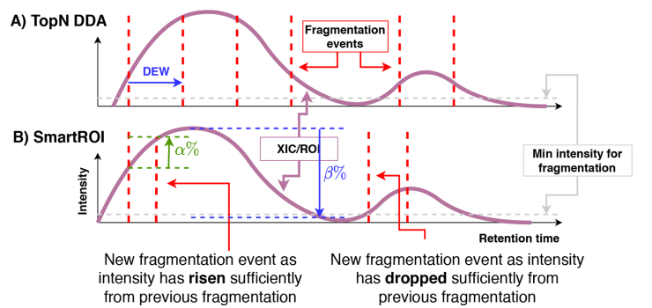
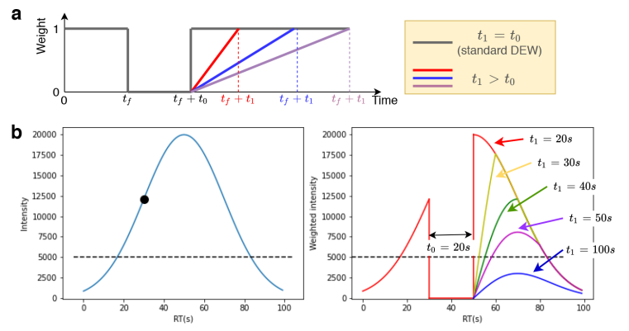
Our New Methods (Controllers)

Slide 48
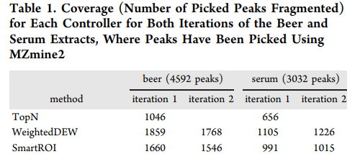
Real Experimental Validation
We see an almost 50% improvement in results

Slide 49
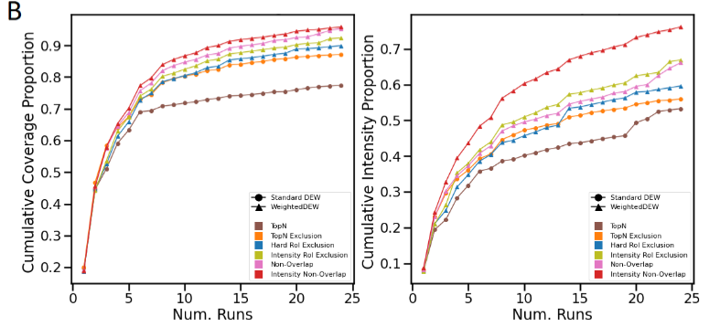
New Methods for Multiple Samples
We can similarly extend the concept to more advanced controllers, although the improvement is less drastic

Slide 50

Thanks for Listening
Let me know if you have any questions
Or feel free to reach out at: Vinny.Davies@Glasgow.ac.uk
Slides available at:
https://github.com/vinnydavies/presentations

