Slide 1

ViMMS 2.0: A framework to develop, test and optimise fragmentation strategies in LC-MS metabolomics
Dr Vinny Davies

Slide 2
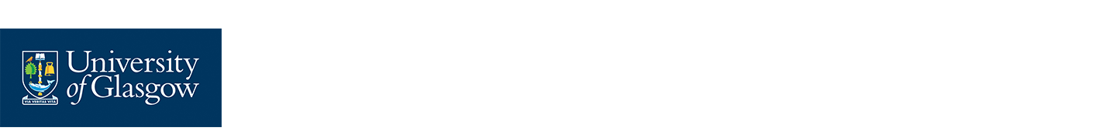
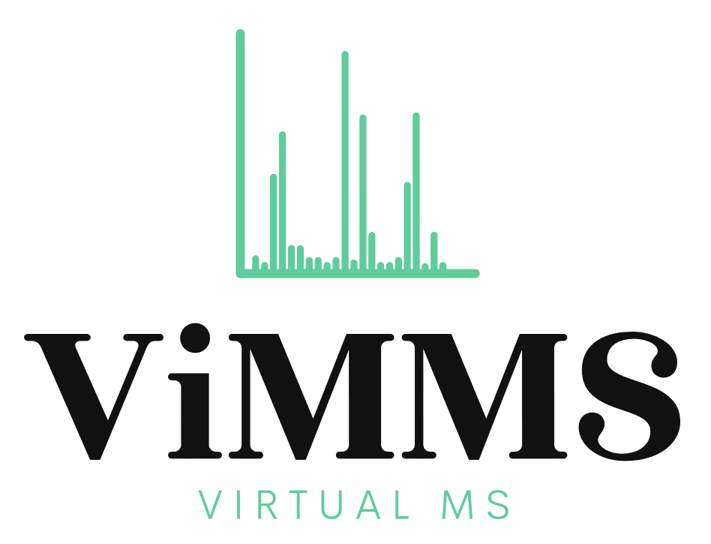
ViMMS
ViMMS is a Virtual Metabolomics Mass Spectrometer
It allows you to simulate full metabolomics LC-MS/MS experiments
MS1 and MS2 capabilities, with potential for MSN
ViMMS is implemented within Python and is full open source available at https://github.com/glasgowcompbio/vimms
Wandy, J., Davies, V., et al. (2019). In silico optimization of mass spectrometry fragmentation strategies in metabolomics. Metabolites.
Wandy, J., Davies, V., et al. (2022). ViMMS 2.0: A framework to develop, test and optimise fragmentation strategies in LC-MS metabolomics. JOSS.

Slide 3
What is the point of ViMMS?
ViMMS fully controls scan specifications in real time and allows
Evaluation of existing methods and settings
Develop, evaluate and test new methods
Control MS in real time via an API
Evaluate current tools, e.g. MS-dial
Currently real time control is limited to Thermo Fisher machines with IAPI control

Slide 4
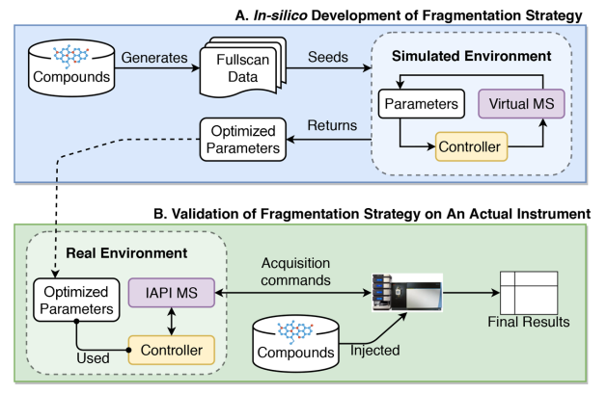
How does ViMMS work?
ViMMS has two environments
Simulated (blue)
Real (green)
The virtual MS (Python code) and real MS (an actual instrument) are interchangeable
Controllers (which schedule scans) are identical in both environments
Samples are either real or virtual

Slide 5
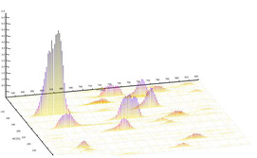
How do the simulations work?
Take an mzml and construct Regions of Interest (ROIs)
ROIs are converted into ViMMS chemicals

Slide 6
How do the simulations work?
Timings for MS1 and MS2 scans are taken directly from the mzml
MS2 spectra are fully synthetic, (e.g. we cannot get new real results)
Standard methods such as Top-N are implemented within ViMMS as controllers (these determine scans)
Results are extracted as mzmls and can analysed in terms of perfomance

Slide 7
How do the real experiments work?
The real experiments works in exactly the same way except using a sample rather than simulated ViMMS chemicals

Slide 8
How do the real experiments work?
Controllers remain consistent across simulated and real experiments
Works through use of Thermo IAPI to control scans in real time (via Python and C++ bridging code)
We can use any ViMMS controller on real samples in this manner

Slide 9
What have we used ViMMS to do?
Optimise existing methods
Develop new single-sample DDA methods
Test / develop multi-sample DDA methods
Compare DDA and DIA
Develop new DIA deconvolution methods (ongoing)
Future plans: there are a lots of options. Suggestions very welcome!

Slide 10
Optimising DDA acquisition
A few different DDA methods are currently implemented within ViMMS
We can use the simulated environment to test different parameter settings on a previously collected sample
Advantage: No machine time or sample costs. Optimised performance for next DDA acquisition

Slide 11
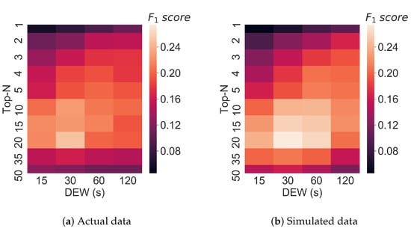
Optimising Top-N
We compared performance of our ViMMS Top-N controller (simulated chemicals) vs machine Top-N (same real sample)
Results show simulations in ViMMS closely match the real performance
Wandy, J., Davies, V., et al. (2019). In silico optimization of mass spectrometry fragmentation strategies in metabolomics. Metabolites.

Slide 12
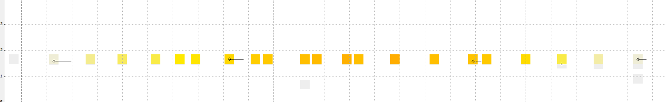
Developing new DDA methods
We can also develop new methods
We motivated our methods to avoid repeated fragmentation events (e.g. below)
We can then compare them against Top-N
Davies, V., et al. (2021). Rapid development of improved data-dependent acquisition strategies. Analytical chemistry.

Slide 13
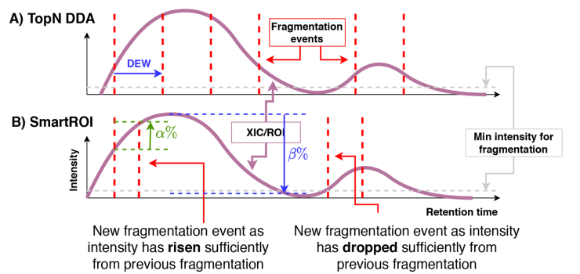
SmartROI
SmartROI constructs ROIs in real time
Uses rises and falls in intensity to determine if an MS2 scan is allowed

Slide 14
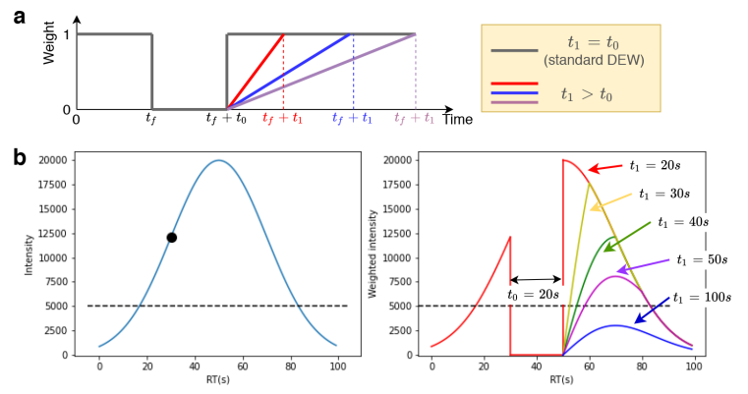
WeightedDEW
WeightedDEW constructs a new type of Dynamic Exclusion Window (DEW)

Slide 15
In-Silico Development in ViMMS
ViMMS allowed us to develop and debug these methods before ever using samples or machine time
We then optimised the parameters of the methods to maximise peak coverage (or any other metric you choose)

Slide 16
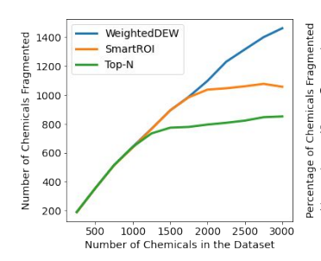
In-Silico Validation in ViMMS
We then tested them out in different simulated scenarios in ViMMS
Big increase in performance when there are a large number of metabolites (peaks)

Slide 17
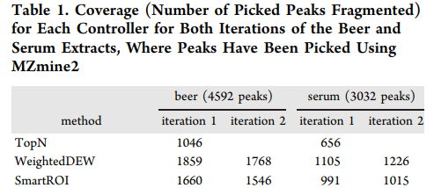
Real Experimental Validation
We then tested the methods on real samples (beer and serum)
Results showed a 50%+ increase in performance

Slide 18
What about multi sample DDA methods?
Under the same principles, we can also develop multi-sample DDA methods and test existing ones, e.g. DsDA, MSplanner

Slide 19
TopNEXt: Automated Exclusion
TopNEXt is a modular framework for multi-sample acquisition
It scores possible MS2 scans based on previously observed scans in the current and previous samples
McBride, R., …, Davies, V., … et al. (2023). TopNEXt: Automatic DDA Exclusion Framework for Multi-Sample Mass Spectrometry Experiments.

Slide 20
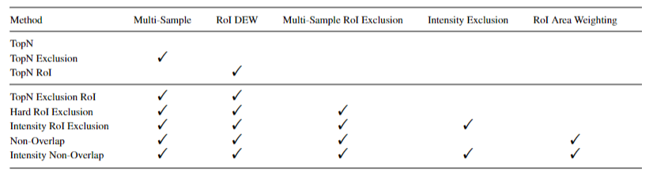
TopNEXt: Automated Exclusion
It contains a number of different options and can easily be extended
McBride, R., …, Davies, V., … et al. (2023). TopNEXt: Automatic DDA Exclusion Framework for Multi-Sample Mass Spectrometry Experiments.

Slide 21
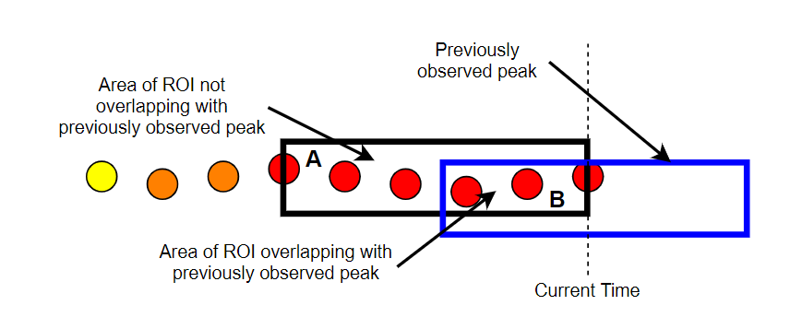
Non-Overlap
Beyond the framework, it also introduces the concept of (non-)overlap
It looks at how much a current ROI (black) overlaps with a previous ROI (blue) and scores it based on how much they overlap
The more it overlaps with a fragmented previous ROI, the lower it will be scored
There is also a version based on the intensity of the previous MS2 scans

Slide 22
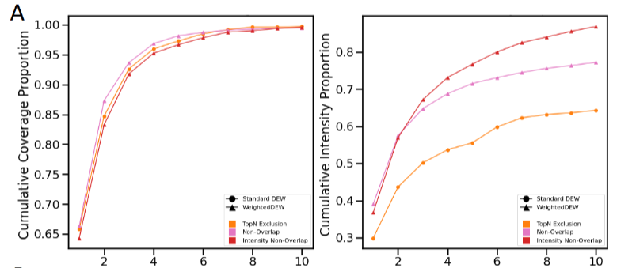
TopNEXt: Automated Exclusion

Slide 23
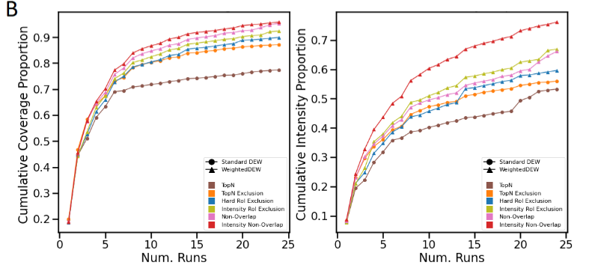
TopNEXt: Automated Exclusion

Slide 24
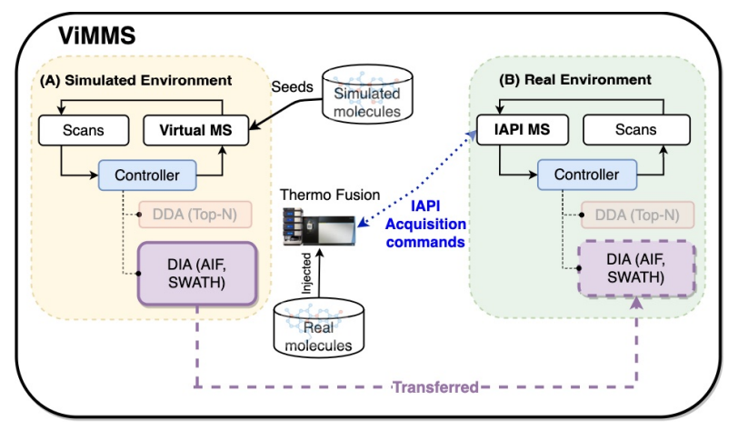
What about DIA?
We can similarly implement DIA in ViMMS (and eventually TopNEXt)

Slide 25
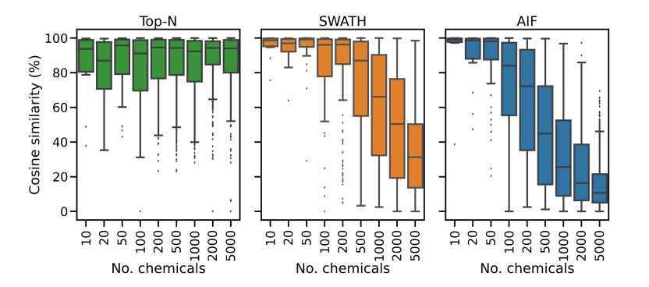
DIA vs DDA
We have implemented SWATH and AIF within ViMMS
Compared them against DDA

Slide 26
Bottleneck of DIA?
We can construct our own DIA methods or even hybrid DDA-DIA methods
Limitation appears to be the deconvolution
Generally inflexible
Low accuracy
Overly correlated predicted spectra
ViMMS allows us to properly evaluate deconvolution and we have began designing our own method
I see this as the immediate application of ViMMS
Wandy, J., ... & Davies, V. (2023). Simulated-to-real Benchmarking of Acquisition Methods in Metabolomics. bioRxiv.

Slide 27
Any questions?
Big thank you to all my collaborators:
University of Glasgow: Joe Wandy, Rónán Daly, Simon Rogers, Ross McBride, Kevin Bryson, Stefan Weidt, Nikolaos Terzis, Alice Miller
Wageningen University: Justin J.J. van der Hooft
Ideas for ViMMS or any further questions
Email: vinny.davies@glasgow.ac.uk
Twitter: vinny_davies89
Slides available at:
https://github.com/vinnydavies/presentations

