Slide 1

Training the Trainers: How do we educate staff in modern technologies?
Dr Vinny Davies, University of Glasgow

Slide 2
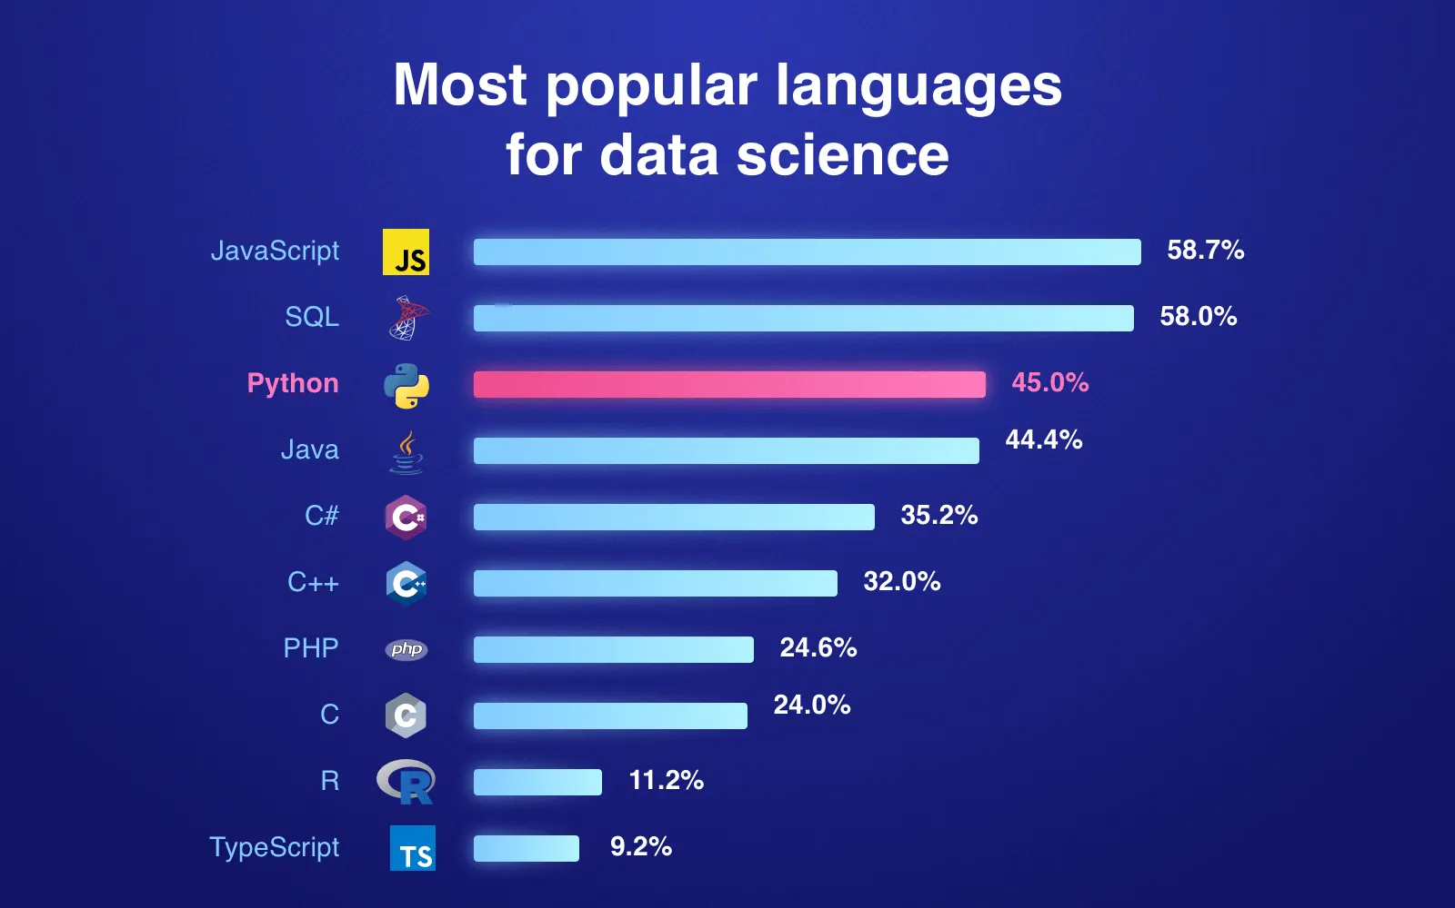
Why do we need new technologies?
Should statistics adapt to new technologies?
Should we educate students around new technologies?
What about less trusted technologies, e.g., ChatGPT?
It depends if they are used in practice
Industry?
Academia?
Government?

Slide 3


Past technologies
We have adapted in the past
What happened to Minitab?
Glasgow switched from Minitab to R around 2010
Most universities, presumably, now teach R as the core programming language
When I did my undergraduate (Lancaster) RStudio was just being introduced
What abut tidyverse?
What about Machine Learning?

Slide 4
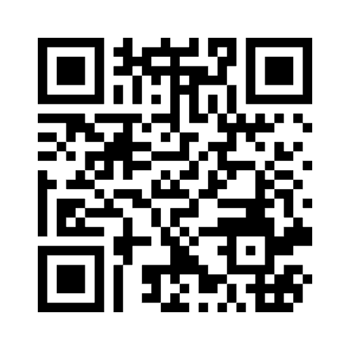
Current & Future technologies
What are technologies you adding / do you want to add?
At the University of Glasgow, we are now adding:
Python
Version Control
AI – essentially Deep Learning
ChatGPT
Mentimeter Code: 6646 6100

Slide 5
Upskilling Staff
Upskilling staff is an interesting problem
Do we have the time?
Will staff prioritise it even if they do?
My best guess at what our staff know?
Machine Learning – around 50-60%
Python – around 20-25% (only 10% prepared to teach it)
Version Control – 15% well, 40% at all
AI – 7-12%
ChatGPT – 3% (Jenn) well, 7-10% basic
This is my personal best guess… no uncertainty quantification… a bad attempt at an ordinal scale…

Slide 6
Why upskill Staff?
Teaching
Teaching will change, so staff need to know about new technologies
Can’t just rely on a small number of staff
For students to learn effectively the technologies must appear in more courses
Student projects will also change, staff will struggle to help
Research
Research is changing like teaching
Upskilling our staff helps with research
Train better future staff (PGRs) and leaders

Slide 7
Skills Courses
What are we doing to upskill staff? One approach is skills courses
Staff don’t have time to take long courses, e.g. existing modules
They will engage is shorter training sessions / seminars
They will learn if their PGRs begin using it

Slide 8
Skills Courses
Version Control, ChatGPT (in development)
Detailed information in course materials, combined with regular (6 monthly) training sessions / seminars
We aim to teach staff, PGRs, PGTs and UGs
Aiming the course at multiple level makes the time investments worthwhile
A contagious approach – you will learn it if others around you use it
I’m sure there is a proper pedagogical term for this, but I couldn’t quite find the right thing… ChatGPT just lied to me…

Slide 9

A contagious approach
This was the best Microsoft Designer could manage…

Slide 10

A contagious approach
Staff educates PGR, or PGR educates Staff.
OR

Slide 11


A contagious approach
Staff educates PGR, or PGR educates Staff. A network where everyone learns
OR

Slide 12

Multi Code Integration
For students to properly learn new technologies, they must be integrated into multiple courses

Slide 13
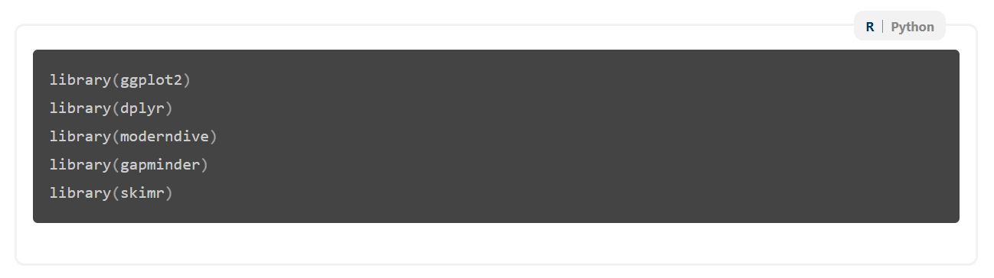
R-Python Integration
Jack, E., Alexander, C., McArthur, D., & Mair, C. (2023). Reflections on designing and delivering an online distance learning programme in the mathematical sciences. MSOR Connections, 21(2), 25-33.
Our accessible notes now allow switching between languages or descriptions
We first used this in our Version Control course for GitHub Desktop vs command-line
We can also use it for R vs Python

Slide 14
R-Python Integration
Jack, E., Alexander, C., McArthur, D., & Mair, C. (2023). Reflections on designing and delivering an online distance learning programme in the mathematical sciences. MSOR Connections, 21(2), 25-33.
Our accessible notes now allow switching between languages or descriptions
We first used this in our Version Control course for GitHub Desktop vs command-line
We can also use it for R vs Python

Slide 15
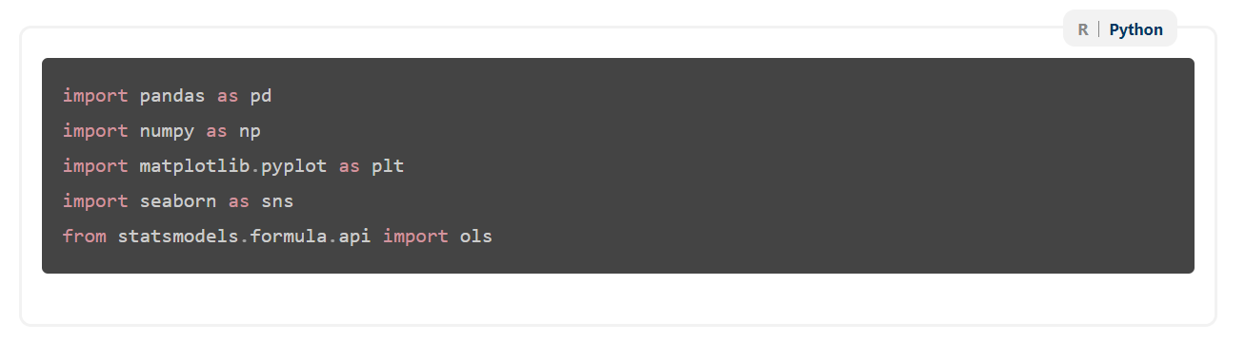
R-Python Integration
Jack, E., Alexander, C., McArthur, D., & Mair, C. (2023). Reflections on designing and delivering an online distance learning programme in the mathematical sciences. MSOR Connections, 21(2), 25-33.
Our accessible notes now allow switching between languages or descriptions
We first used this in our Version Control course for GitHub Desktop vs command-line
We can also use it for R vs Python

Slide 16
Benefits and Problems of Multi Code Integration
Benefits – Students see the programming languages throughout the programme
Problem – not many of our staff know Python
What are the impacts of multi code integration?
Does it force staff to learn basic Python?
Do we need to teach them?
Not in my opinion, but we need to provide them support
Drop-in sessions? PGR support?

Slide 17
Do staff need to know both options?
What do you think about the concept of teaching a course in multiple languages?
Do you think that staff need to know both options?
Is it fine that code is available in 2 languages, but only taught in 1?
Mentimeter Code: 6646 6100

Slide 18
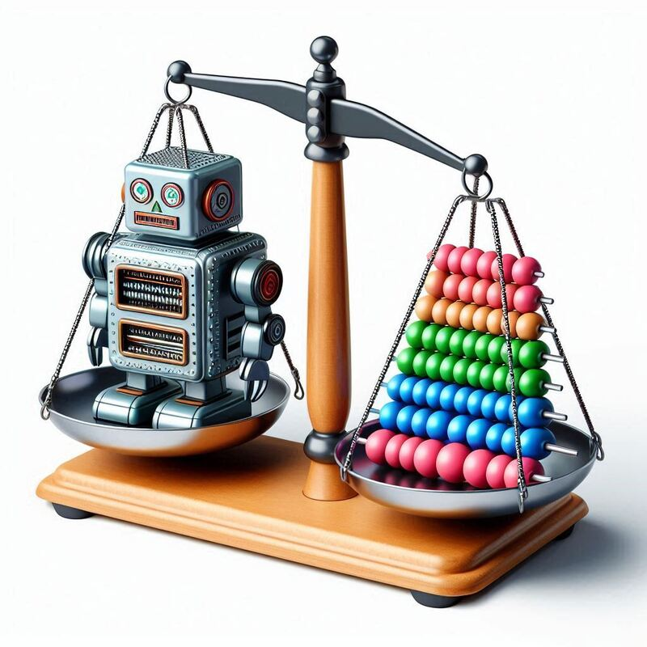
Should we teach AI?
How much to teach AI in Statistics courses is a big question for universities currently?
Whether you integrate it depends on your course and your available staff?
How do we teach enough staff about AI to not be reliant on a small number of staff?
How do we ensure the course is up-to-date if we don’t have an in-depth knowledge of AI?

Slide 19

Teaching staff AI
How do we ensure we have enough trained staff to not get caught short?
Encourage research collaboration between staff with different skills?
Invite speakers that teach within AI disciplines?
Internal staff seminars?
Doesn’t seem possible with current workloads
Require specialist Computing Science teaching staff
Even harder to find than statisticians!

Slide 20
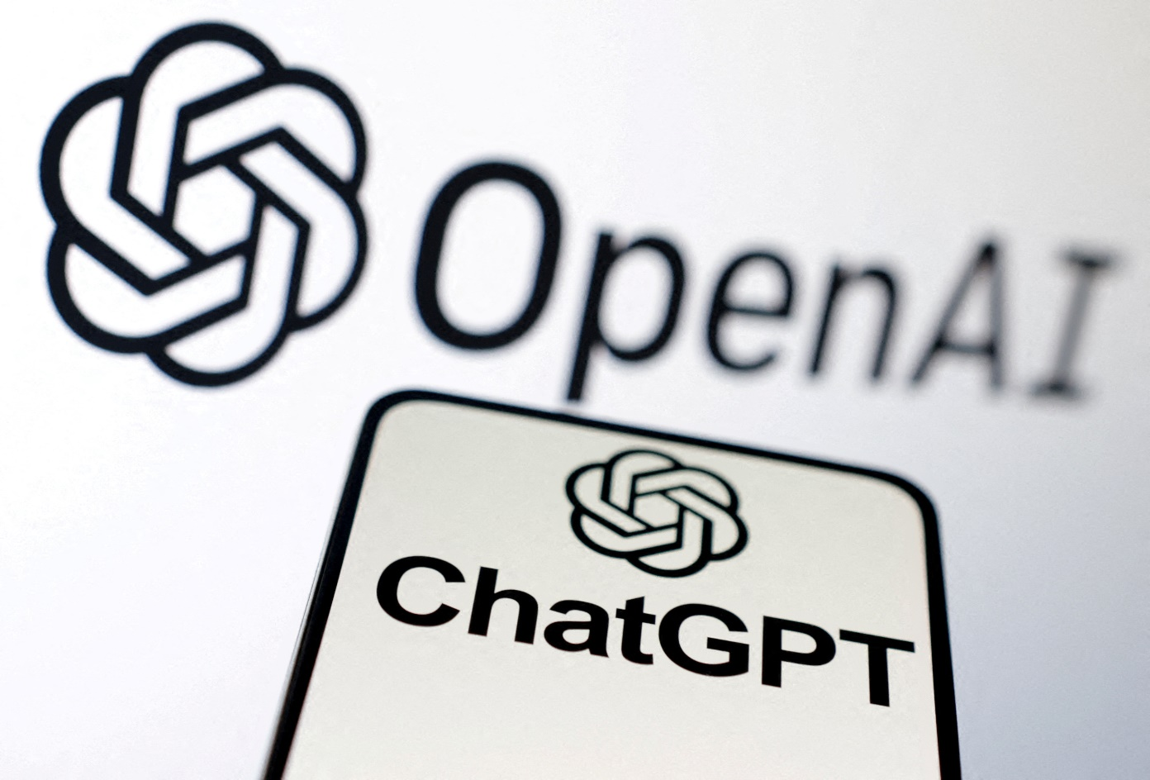
Integrating Generative AI (ChatGPT)
Should we integrate ChatGPT?
How do we teach it when we don’t know how to use it?
Mentimeter Code: 6646 6100

Slide 21
Taking generative AI seriously
How do we convince our school / department of its importance?
I demonstrated how quickly ChatGPT could get 95-100% on my Python assignment. Most people appeared completely surprised
Everything will change, people are starting to understand it, but they don’t understand quite how much things will need to change
It will also evolve as students learn more quickly than us

Slide 22
How do we teach generative AI?
It seems difficult to integrate into every course, but multi-course integration will almost certainly be necessary in the long run
We are addressing this with another skills course
No idea where we are finding this time…
Does every school have the skills to put this together?
Is there a need for training materials that are more applicable to statistics?
Yes, at least in my opinion

Slide 23

Thanks for Listening
Let me know if you have any questions
Or feel free to reach out at: Vinny.Davies@Glasgow.ac.uk
Slides available at:
https://github.com/vinnydavies/presentations/blob/master/UKCOTS2024_VinnyDavies.pdf

